Slide 1
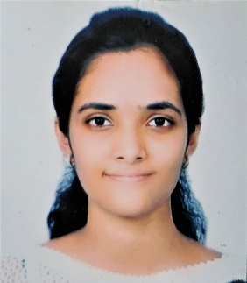
Aditi Dumbre
Blockchain Developer
Personal Statement
Software development Skills
Ms. Aditi is a Blockchain, AWS and Java Developer as a part of Capgemini’s ADM – Java Practice in Financial Services. She is a blockchain and cloud enthusiast and has been developing PoC’s on R3 Corda, a blockchain platform built for business. She is also exploring and has a brief knowledge of Hyperledger Fabric. She has also worked on the cloud deployment of blockchain PoC’s on AWS platform.
Ms. Aditi has a good hands on over Core and Advanced Java (Spring Framework, Hibernate, JSP and Servlets), front end web designing (XML, HTML5, CSS) and Database Operations (Oracle).
Java/JEE
Corda
Hyperledger Fabric
Web Services
Mongo DB
AngularJS
Spring
Servlets and JSP
Node JS
Build Automation Tools
AWS
Work Experience
Education
Professional Certifications
AWS Certified DevOps Engineer – Professional
AWS Certified Developer – Associate
Oracle Certified Associate Java SE 7 Programmer
R3 Corda Certified Developer
Blockchain Developer
Capgemini Technology Services India Ltd,
Client PoC Corda (January 2019 – October 2019)
Blockchain Developer
Capgemini Technology Services India Ltd,
Client PoC Corda (October 2018 – January 2019)
Bachelor in Engineering (Electronics)
2017
Mumbai University
Blockchain Developer
Capgemini Technology Services India Ltd,
Client PoC Corda (July 2018 – September 2018)
Software/Tools Skills
Blockchain Developer
Capgemini Technology Services India Ltd,
Global KYC PoC Upgrade Corda (January 2018 – May 2018)
30%
30%
90%
40%
60%
Java Developer
Capgemini Technology Services India Ltd (Aug 2017 – January 2017)
Requirement Gathering
Design
Development
Testing
Agile Methodology

