Slide 1


MONEY TRANSFER PLATFORM
Architecture Document

Slide 2
OUTLINE
INTRODUCTION
FUNCTIONAL REQUIREMENTS
NON-FUNCTIONAL REQUIREMENTS
TECHNICAL MAPPING
TEST CASES

Slide 3
INTRODUCTION:
This document describes the architecture and design for the Money Transfer Platform.
It is a Banking application that helps in transferring money as an asset from one user to another. It can have multiple organization as its constituents.
In this application all the transactions are being supervised by an Observer.
This is a generic app which is based on Blockchain Technology and uses Corda R3 as its DLT.
It aims to remove the data redundancy and makes the transaction peer to peer thus eliminating the middlemen.
It also aims to provide full fledged security to its users.

Slide 4
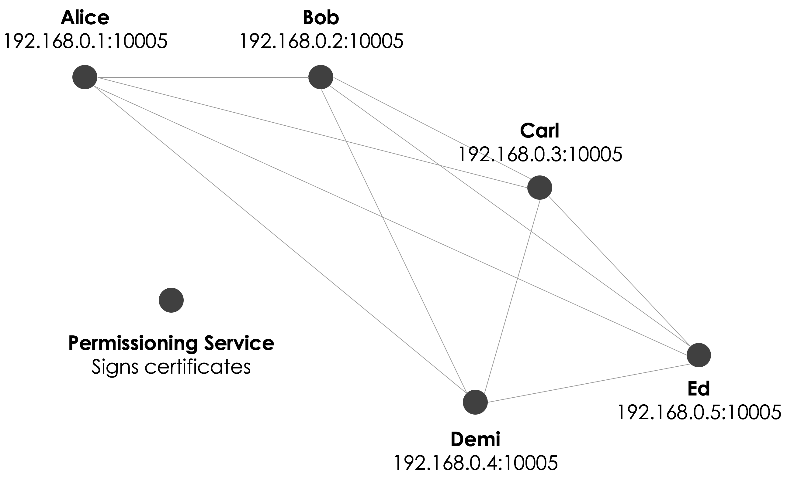
Bank A
Bank B
Bank C
Auditor
Observes Transactions
Notary
Bank D
Bank E

Slide 5
FUNCTIONAL REQUIREMENTS:
There need to be at least 3 banks on the network.
Bank A
Bank B
Bank C.
There should be one Observer Node i.e. the auditor.
Auditor can’t perform any transaction but can view all the transactions between any two users of any two banks.
There should be a Notary which needs to verify transactions and check on Double Spend.
The transaction should be peer to peer.
Only users of Banks can participate in any transaction. Notary node and auditor cannot perform any transaction process, i.e., lend or borrow money.

Slide 6
The transaction between any two users or banks can’t be seen by any other bank or user apart from the two involved in that transaction.
All the transactions should be supervised by the auditor.
Validation of account balance should be done before any transaction.
Each User in a bank should maintain its Wallet.
Personal information of one party (particularly lender) cannot be seen by any other party including the borrower.

Slide 7
NON-FUNCTIONAL REQUIREMENTS:
Session Management
The user account should automatically sign out if there is inactivity for a certain time (say 15 min).
Add a multi-factor authentication feature
Offer real-time text and email alerts
For example sending OTP’s in case of Forgot Password.
Bill Payments
This is another way of initiating transactions.
KYC verification

Slide 8
KYC check in case of fraudulent user.
Failed Transactions Amount Reversal
In case the transaction is rejected, re-initiate it. And if the money is deducted in such scenario, revert back the same.
Currency Conversion for international Banking
Two banks or users of banks who need to perform the transaction may belong to any country. So, in such cases performing currency conversions while sending the money.
Limited Number of Transaction and Amount in a Day

Slide 9
TECHNICAL MAPPING:
Build.gradle : Here we define the nodes
Banks
Notary
Users
Auditor

Slide 10

WELCOME!!
SIGN IN

Slide 11
Account Number *
Password *
FORGOT PASSWORD?

Slide 12
Enter registered email or Mobile Number to reset Password
Reset Password

Slide 13


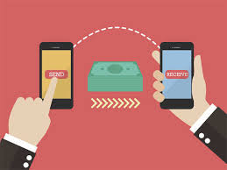
Sign Out
Welcome XYZ
Sign Out
Change Password
Change Password
Wallet
Transaction History
Make a transaction
Home

Slide 14
Back
Initiate Transaction
Borrower *
Value *
Send

Slide 15
CONTRACT : Here we define the business logic
• No inputs should be consumed
• Only one output state should be created
• The lender and the borrower cannot be the same entity.
Lender cannot send money to himself.
• All of the participants must be signers.
• The Transaction's value must be a positive value.
Validating the transaction value is done in this part. Value to be transferred cannot be 0,
negative, alphabet or symbol.

Slide 16
State : Here we store the transactions
It stores the value transferred
It also stores the info of the Lender and the Borrower
It has the unique transaction ID

Slide 17
Sign Out
Back
XYZ’s Transaction History
Change Password
Lender
Borrower
Value
Trx ID
Date/Time

Slide 18
Flow: Here we define the Stages of the Transaction
This flow allows two parties (the [Lender] and the [Borrower]) to come to an agreement about the transaction encapsulated within a State.
Stage - 1 Generate an unsigned transaction.
Stage – 2 Verify that the transaction is valid.
Stage – 3 Sign the transaction.
Stage - 4 Send the state to the counterparty, and receive it back with their signature.
Stage – 5 Notarize and record the transaction in both parties' vaults.

Slide 19


Sign Out
Back
XYZ’s WALLET
Change Password
Add Money to Wallet
View Balance

Slide 20
TEST CASES:
Money transfer value is a negative number or 0 or any alphabet or symbol.
Value should be a positive number and this has to be validated in contract.
Money to be transferred is greater than the amount present in the wallet. Validation is not done.
User is sending money to himself, i.e., lender and borrower are same.
User does not exist. For example, the account number entered is wrong.
Transaction is unsuccessful (in this case, the money should not be deducted from lender’s wallet and if deducted should revert back). Error message is to be displayed. Rejected transaction should be re-initiated.
Wallet is not getting updated after every transaction.
Auditor is taking part in transaction, i.e., trying to send or borrow money from any other user of any bank. Auditor can only see the transactions but cannot take part in any transaction.
Transaction is not visible to auditor.

Slide 21
Personal information of lender is being seen by the borrower.
Double spending case.
Fraud user trying to borrow money (steal) from the bank user. KYC verification is not done.
Number of transactions in a given time frame exceed the limit.
After Session Timeout account should automatically logout.
Text and email alerts should be sent for every transaction
KYC verifies the fraud users
Failed Transactions should lead to Amount Reversal and rejected transactions should re-initiate.
Currency Conversion in case of international Banking.

Slide 22
THANK YOU

