Slide 1


Mobile Transfer Platform MTP
Architecture Document

Slide 2
Table of Contents:
INTRODUCTION
FUNCTIONAL REQUIREMENTS
NON-FUNCTIONAL REQUIREMENTS
TECHNICAL MAPPING
TEST CASES

Slide 3
INTRODUCTION:
This document describes the architecture and design for the Mobile Transfer Platform.
It is a Banking application that helps in transferring money as an asset from one user to another. It can have multiple organization as its constituents.
In this application all the transactions are being supervised by an Observer.
This is a generic app which is based on Blockchain Technology and uses Corda R3 as its DLT.
It aims to remove the data redundancy and makes the transaction peer to peer thus eliminating the middlemen.
It also aims to provide full fledged security to its users.

Slide 4
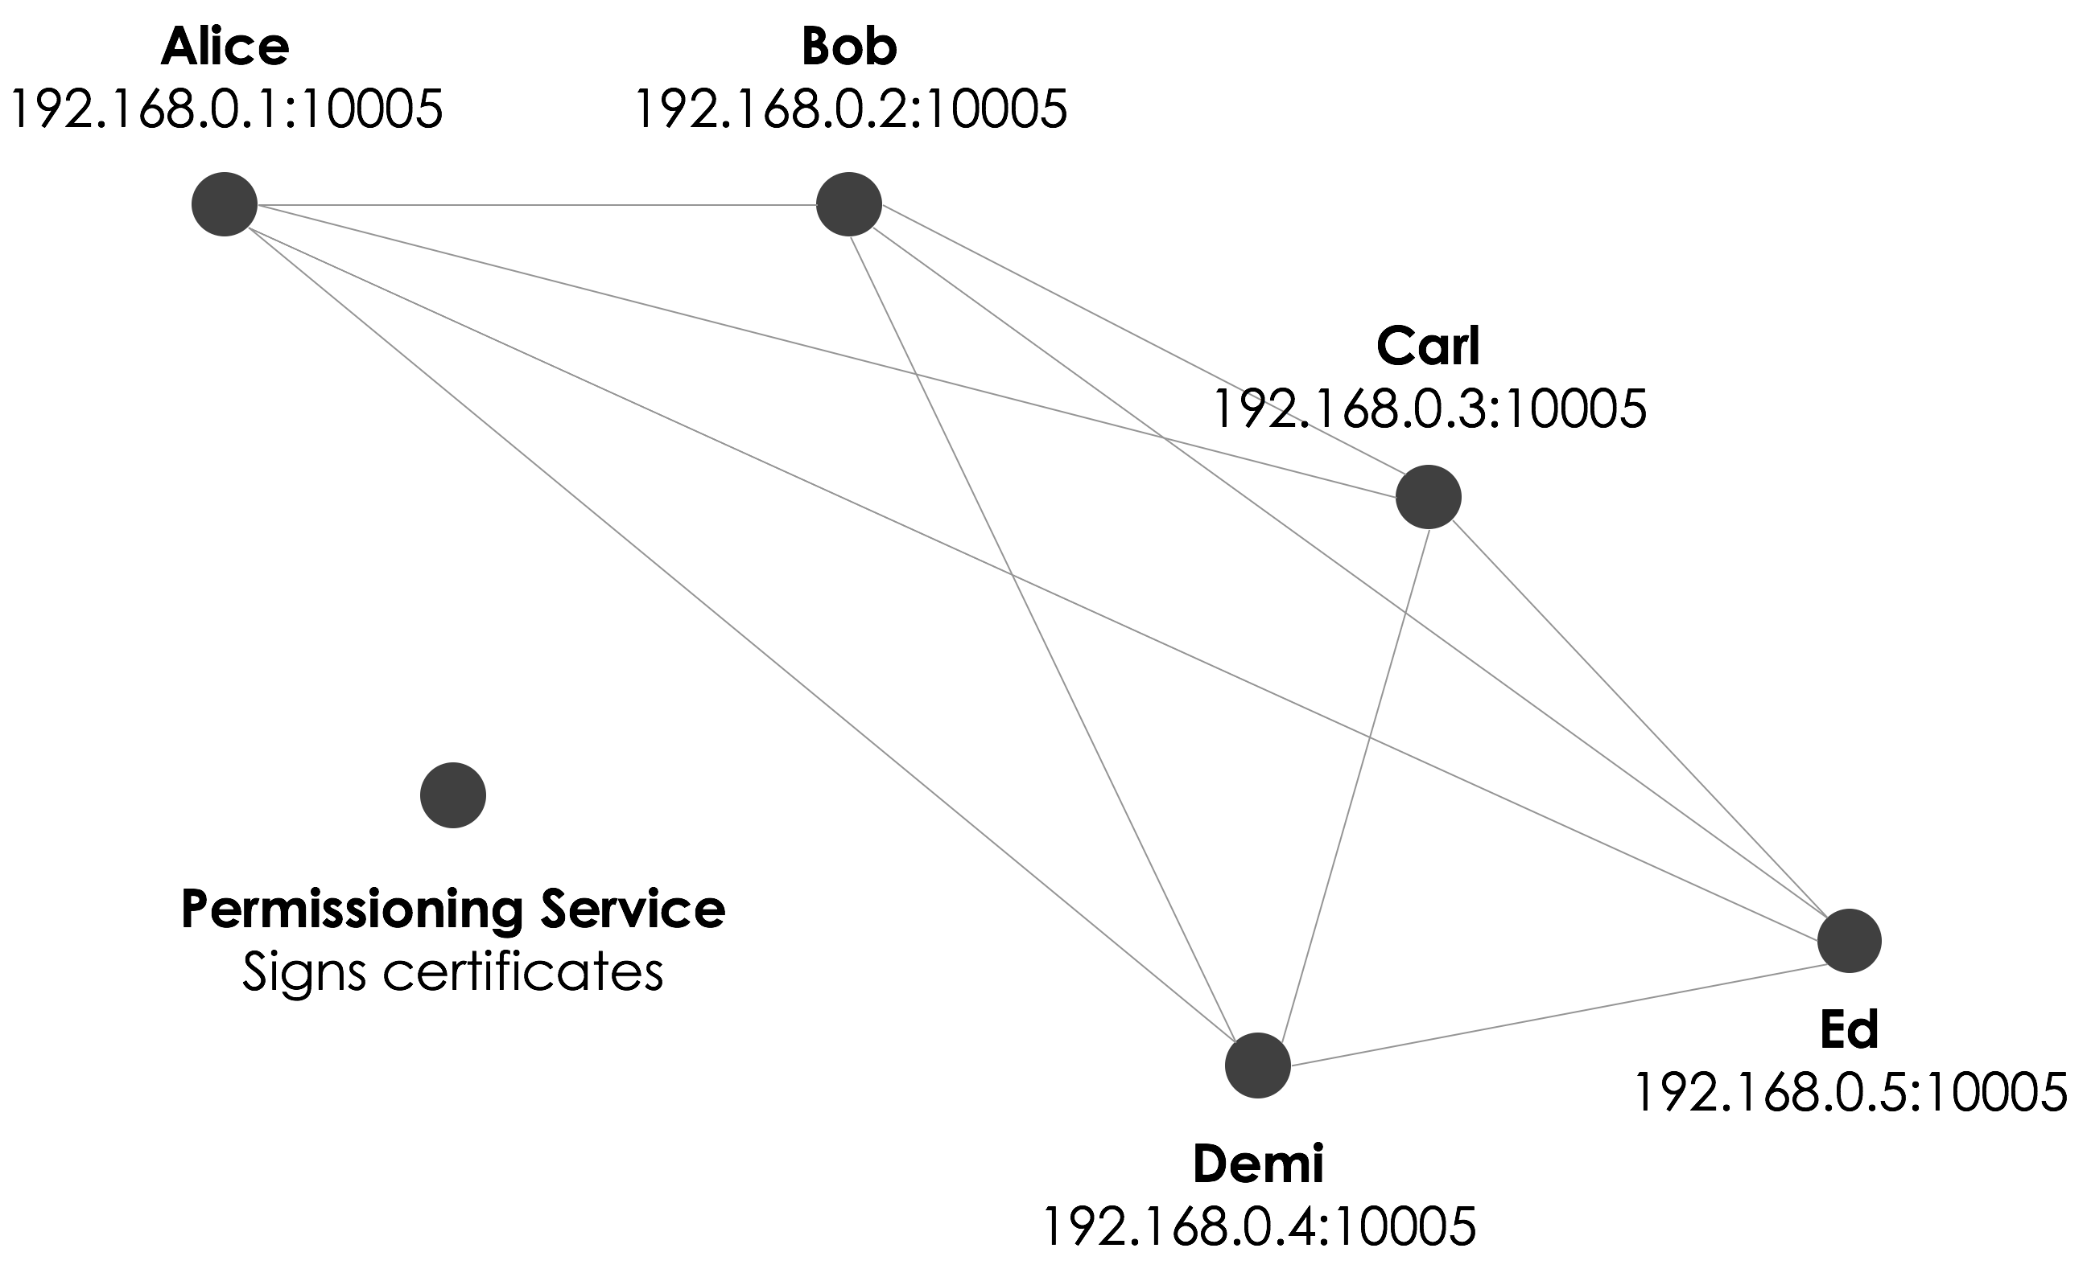
Bank A
Bank B
Bank C
Auditor
Observes Transactions
Notary
Bank D
Bank E

Slide 5
FUNCTIONAL REQUIREMENTS:
There need to be at least 3 banks on the network.
There should be one Observer Node i.e. the auditor.
There should be a Notary which needs to verify transactions and check on Double Spend.
The transaction should be peer to peer.
All the transactions should be supervised by the auditor.
Validation of account balance should be done before any transaction.
Each User in a bank should maintain its Wallet.

Slide 6
NON-FUNCTIONAL REQUIREMENTS:
Session Management
Personal information should not be visible to the borrower
Add a multi-factor authentication feature
Offer real-time text and email alerts
Bill Payments
KYC verification
Failed Transactions Amount Reversal
Currency Conversion for international Banking
Limited Number of Transaction and Amount in a Day

Slide 7
TECHNICAL MAPPING:
To meet the business requirements, following steps need to be taken:
CONTRACT : Here we define the business logic
• No inputs should be consumed
• Only one output state should be created
• The lender and the borrower cannot be the same entity.
• All of the participants must be signers.
• The Transaction's value must be a positive value.

Slide 8
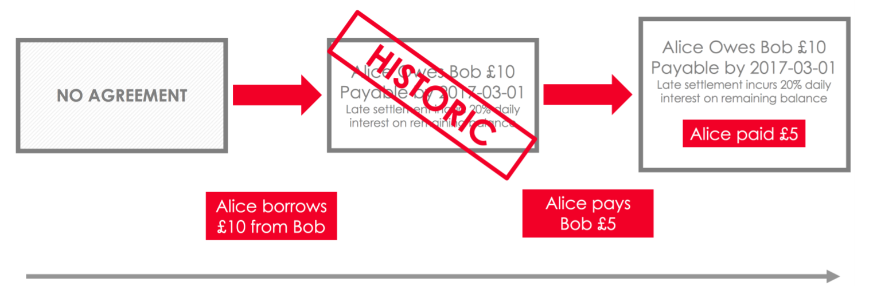
TECHNICAL MAPPING:
Build.gradle : Here we define the nodes
Banks
Notary
Users
Auditor
State : Here we store the transactions
It stores the value transferred
It also stores the info of the Lender and the Borrower
It has the unique transaction ID

Slide 9
TECHNICAL MAPPING:
Flow: Here we define the Stages of the Transaction
This flow allows two parties (the [Lender] and the [Borrower]) to come to an agreement about the transaction encapsulated within a State.
Stage - 1 Generate an unsigned transaction.
Stage – 2 Verify that the transaction is valid.
Stage – 3 Sign the transaction.
Stage - 4 Send the state to the counterparty, and receive it back with their signature.
Stage – 5 Notarize and record the transaction in both parties' vaults.

Slide 10
TEST CASES:
Money transfer value should not be a negative number or 0 or any alphabet or symbol.
Money to be transferred should be greater than or equal to the wallet balance of the Lender.
User is sending money to himself, i.e., lender and borrower should not be the same.
User (lender or borrower) does not exist.
If transaction is unsuccessful, Error message is to be displayed i.e., the money should not be deducted from lender’s wallet and if deducted it should revert back.
Auditor can’t transact.
Wallet Amount should be updated.
Personal information of lender should not be visible to the borrower.

Slide 11
TEST CASES:
Double spending should not happen i.e. only one output of the transaction.
Number of transactions in a given time frame should not exceed the given limit.
Transaction is unsuccessful but the money is deducted and error message is not displayed.
Transaction is not visible to auditor.
After Session Timeout account should automatically logout.
Multi-factor authentication should let user login into his account
Text and email alerts should be sent for every transaction
KYC verifies the fraud users
Failed Transactions should lead to Amount Reversal
Currency Conversion in case of international Banking

Slide 12
Doubt:
NEFT
Personal Info to the Auditor

