Slide 1
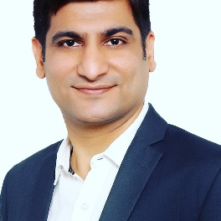
Rinkesh Chhetia
AWS & Blockchain FS India Head
Personal Statement
Education
Over 17 years of progressive experience in IT with extensive experience in area of application design, development, implementation, maintenance, project lead and management in multiple environments. Professional whose career has focused on the Development of Enterprise Level Software Systems using Cloud technologies.
He has taken many hands-on roles involving analysis & design, development, deployment operations. Highly skilled in creating and maintaining collaborative working relationships, providing concise communication to upper management, and mentoring peers.
Professional Certifications
aws Certified Solution Architect
r3 corda Certified Blockchain Developer
EM (Engagement Manager) Certification from Capgemini
Honours Diploma in Network-Centered Computing Certificate from NIIT Indore Center with 90%
Pt. Ravi Shankar Shukla University, MCA, 2001, with 84.8%
DAVV, Indore, MBA (Distance Education Finance), 2004
Software development Skills
AWS
Hyperledger Fabric
Work Experience
Corda
Ethereum
BigchainDB
AWS & Blockchain FS India Head
Capgemini India ( May 2016 – Present )
Web Services
JAVA/ / JEE
Java Script
Spring
Pune Java Center Head
Capgemini India ( Sep 2014 - Apr 2016 )
Hibernate
EJB
UML
Enterprise Architect
Capgemini India ( Aug 2010 - Sep 2014 )
DevOps
Sr. Developer / Project Lead
Capgemini India ( May 2005 - Aug 2010 )
Software/Tools Skills
Developer
Impetus Infotech (India) Pvt. Ltd., ( Feb 2001 – May 2005 )
75%
85%
95%
95%
75%
Agile Methodology
Program Management
Design
Architecture
Alliance/Supplier Relationships

