Slide 1
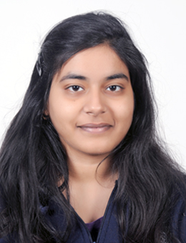
Shraddha Singh
Blockchain/Java Developer
Personal Statement
Software development Skills
I am a Java and Blockchain Developer as a part of Capgemini’s ADM – Java Practice in Financial Services. I am also certified as an AWS Developer – Associate. I have developed PoCs on R3 Corda, a blockchain platform built for business. I am currently working as a backend Java developer in iCompass, an evaluation tool which is used by recruitment, staffing and HR.
I have a strong hold on Core as well as Advanced Java (Spring Framework, Hibernate, JSP and Servlets), also have hands-on on Angular and Database Operations (MySQL).
Java/JEE
Corda
Web Services
AngularJS
Spring
Servlets and JSP
AWS
Education
Professional Certifications
AWS Certified Developer – Associate
Mulesoft Developer Associate
Work Experience
Bachelor in Engineering
Instrumentation & Control 2018
Thapar Institute of Engineering And Technology, Patiala
Java Backend Developer
Capgemini Technology Services India Ltd,
iCompass Tool (August’ 19 – Present)
Software/Tools Skills
Blockchain Developer
Capgemini Technology Services India Ltd,
Corda Money Transfer Platform PoC (March’ 19 – July’ 19)
40%
30%
90%
40%
50%
Blockchain Developer
Capgemini Technology Services India Ltd,
Global KYC PoC Corda (January’ 19 – March’ 19)
Requirement Gathering
Design
Development
Testing
Agile
Methodology

