Slide 1
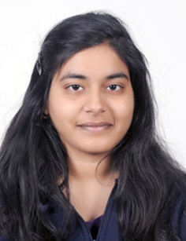
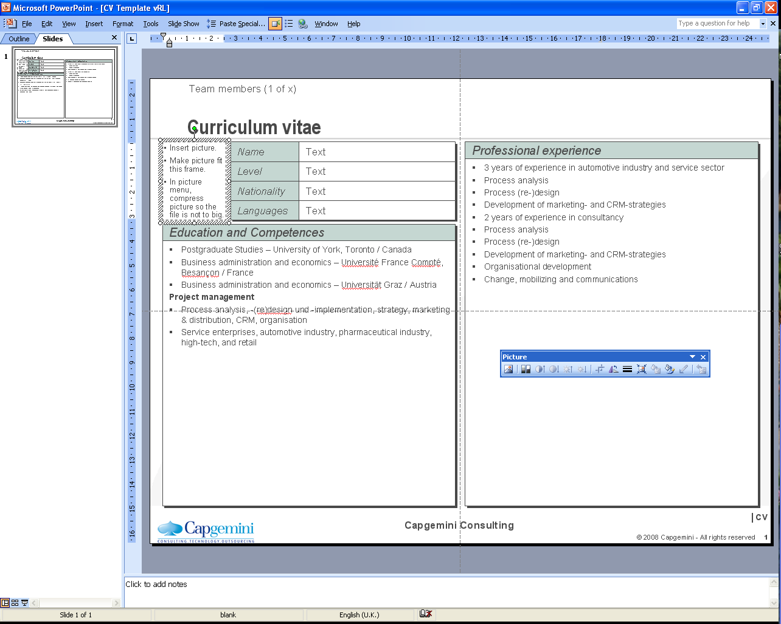
Shraddha Singh
Insert picture.
Make picture fit this frame.
In picture menu, compress picture so the file is not too big.
Name
Shraddha Singh
Professional Experience
Grade
Associate Consultant
Blockchain PoC, Money Transfer Platform:
Worked as Blockchain developer to develop R3 Corda based banking application. It is a Blockchain Node Network and REST API Application, that helps in transferring money as an asset from one user to another. It can have multiple organization as its constituents.
Blockchain PoC, hands-on on KYC Application:
Have done hands-on on KYC Application developed in R3 Corda during its migration from version v3.0 to v3.3 and later to v4.1
Backend Java Developer, iCompass:
Working as a Java Backend developer in iCompass , is a product for organization wide talent evaluation, elevation and nurturing needs. It is based on Spring Framework, Hibernate
AWS Cloud:
Studied cloud concepts and cleared AWS Developer Associate Exam.
Java Fullstack PoC, Capbook:
Worked in a team to develop a social networking application CapBook. It is an application based on Java SpringBoot, Hibernate, Javascript and MySQL. It can setup profile along with uploading images & posts and could be used to send friend requests as well as messages.
Nationality
Indian
Residence
Pune
Insert picture.
Make picture fit this frame.
In picture menu, compress picture so the file is not to big.
Role
Blockchain Developer
Profile
I am a Blockchain and Java Developer as a part of Capgemini’s ADM – Java Practice in Financial Services. I am also certified as an AWS Developer – Associate. I have developed PoCs on R3 Corda, a Blockchain platform built for business. I am currently working as a backend Java developer in iCompass, an evaluation tool which is used by recruitment, staffing and HR.
I also have a strong hold on Core as well as Advanced Java (Spring Framework, Hibernate, JSP and Servlets), also have hands-on on Angular and Database Operations (MySQL).
Competences
Blockchain R3 Corda PoC Development
AWS Cloud Development
Certifications:
AWS Certified Developer – Associate
Mulesoft Developer Associate
Education
Bachelor in Engineering
Electronics Instrumentation & Control - 2018
Thapar Institute of Engineering & Technology, Patiala

