Slide 1

Innovate, Build, Transform with Agentic AI

Slide 2
Team Name and Member Details
Team Name: Uchiha Clan
Dept names: Delivery – [ Brands ]
Member Details:
Ajinkya Bhosale - Frontend Web Developer
Tushar Patil - Frontend Developer
Senjuti Halder - Java Full stack Developer
Vitthal Gontalwar - QA
Problem Statement: ( Warehouse Data Quality AI )

Slide 3
Problem Statement- Solution
Your Analysis of the Problem Statement
Warehouse and logistics data is distributed across multiple systems such as ERP, WMS, inventory, planning, and dispatch platforms, making it difficult to detect inconsistencies early.
These data-quality issues can trigger operational problems such as stock mismatches, dispatch delays, misrouting, and replenishment failures.
Our solution uses Agentic AI to continuously detect, correlate, explain, prioritize, and recommend corrective actions for these issues while keeping humans in control of final execution.
How you are utilizing Agentic AI
We use specialized AI agents to monitor warehouse, inventory, master-data, and dispatch data.
The Data Validation Agent detects missing, outdated, and inconsistent records.
The Root Cause Agent connects related anomalies and identifies the likely source of the issue.The Resolution Agent recommends corrective actions and prepares the required update. Operators approve the action, ensuring human oversight and a complete audit trail.
Your Solution Overview:
We built a real-time Warehouse Data Quality & Anomaly Control Center powered by React.js/Next.js, DB, and AI micro-agents. The system continuously ingests inventory, master data, and dispatch streams across ERP and WMS to catch bad records early. It correlates isolated anomalies into single root-cause trees and surfaces them on an intuitive Live Radar dashboard. Operators receive actionable, automated fix recommendations with a one-click database write-back approval workflow and full audit logging.

Slide 4
Problem Statement- Solution
Some useful pointers to aim for
• A well-defined problem statement
• User-journey maps
• User-needs statements
• A product blueprint
• User Personas
• Business Value Propositions
• High-level wireframes
Value Proposition
Detect data issues early before they affect operations.
Reduce stock mismatches and dispatch delays.
Identify the root cause instead of just showing errors.
Give operators clear, AI-powered action recommendations.
Reduce manual investigation and escalation effort.
Keep humans in control with approval and audit tracking.
Improve data accuracy and operational visibility.

Slide 5
Business Opportunity
    Explain the overall Business Opportunity for VW
    Target Users: Warehouse operators, planners, dispatch teams, plant supervisors, and master-data teams.
    Value to VW: Improve data reliability, reduce operational disruptions, and reduce manual investigation effort.
    Scalability: Start with one warehouse or plant and expand across VW operations.
    Start with a low-cost POC using synthetic data, then move to production integration.
    Success Metrics: Data-quality accuracy, detection time, resolution time, inventory accuracy, dispatch delays, misrouting, replenishment failures, and manual effort saved.

Slide 6
Additional Supporting documents
Includes but not limited to
Multi-system warehouse and logistics environments
Increasing need for real-time data quality and anomaly detection
Opportunity to scale from one plant/warehouse to multiple VW operations
6

Slide 7
Dashboard / Wireframe
The landing page should answer three questions in 10 seconds: What is wrong? What matters? What should I do?
23
7
91%
14
Open incidents
Critical
Data health
Actions awaiting approval
Priority incidents
AI incident brief
CRITICAL
D1023
Misrouting risk
Part P-441 master mismatch
12 min
Why critical?
P-441 dimensions differ between master and warehouse records. D1023 is already assigned to a lane that rejects the current package profile.
HIGH
S7751
Inventory mismatch
ERP 120 vs scan 65
26 min
HIGH
R8830
Replenishment
ROP stale + demand spike
41 min
Suggested action
Hold shipment → verify master record → re-plan lane.
MEDIUM
D1028
Dispatch delay
Picking event missing
1h 12m
APPROVE
REJECT
7

Slide 8
User Journey & Personas
From anomaly to approved resolution
PRIMARY PERSONAS
USER JOURNEY
Warehouse Operator
Monitors incidents and takes corrective action
1
Detect
2
Explain
3
Prioritize
Issue appears in a source system
AI connects related anomalies
Impact and urgency are scored
Inventory Planner
Tracks stock accuracy and replenishment risk
4
Recommend
5
Approve
6
Learn
Resolution Agent proposes action
Human reviews and approves
Outcome + audit trail retained
Plant Supervisor
Approves high-impact corrective actions
SELECTION POV
Shows judges that the product is designed around real warehouse roles and a clear human-in-the-loop decision journey—not only around technology.
INTERNAL

Slide 9
Product Blueprint / Architecture
The control layer sits across existing enterprise systems
ERP /
Master Data
WMS
Inventory
Planning
Dispatch
Data Ingestion
/API Layer
Data Validation
Agent
Anomaly &
Correlation
Root Cause
Agent
Impact &
Priority
Resolution
Agent
Human Approval
(Approve / Reject)
Action / Update
Audit Trail
INTERNAL

Slide 10
Data Flow Diagram
How synthetic warehouse data becomes an actionable incident
Source Data
AI Agents
Decision Layer
User / Action
Master
Data
Validate
Incident
Created
Dashboard
Inventory
Correlate
Impact &
Priority
Approve /
Reject
Orders /
Shipments
Explain
Recommendation
Execute +
Audit
Events
Example signal path: stale master-data rule → inventory mismatch → replenishment risk → recommended update → supervisor approval.
INTERNAL

Slide 11
Sequence Diagram
Agentic flow from detection to approved resolution
Data Source
Validation
Agent
Root Cause
Agent
Resolution
Agent
Supervisor
Audit
Record received
Validate + correlate
Likely root cause + impact
Recommendation
Approve
Write action + audit
Related anomalies found
Human approval is the control point: AI recommends and prepares the action; the supervisor decides whether it is executed.
INTERNAL

Slide 12
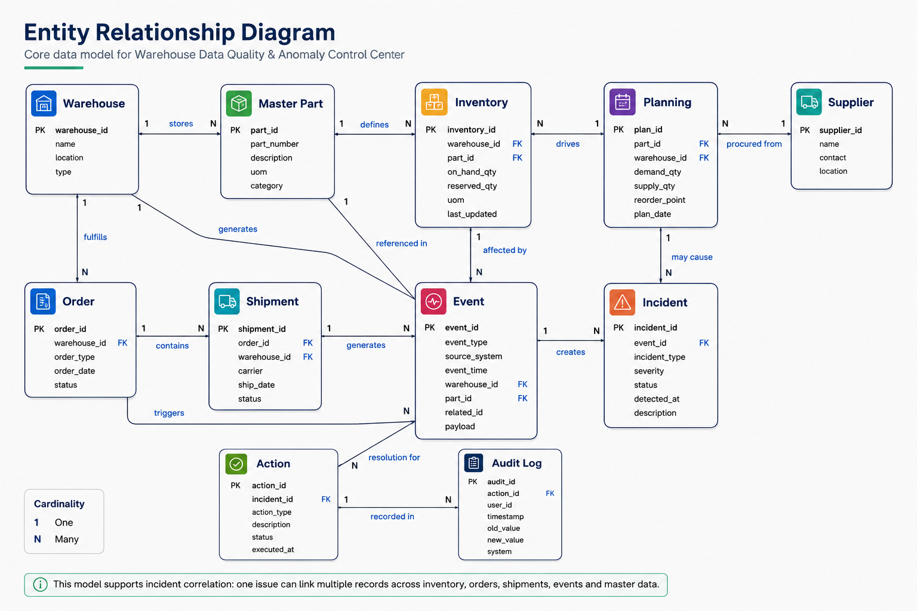

Slide 13
Data We Need –
Warehouse / Workspace Management
Inventory
Orders
Shipments
Warehouse & Logistics Events
Planning & Replenishment
Master Data
Suppliers & Locations

