Slide 1
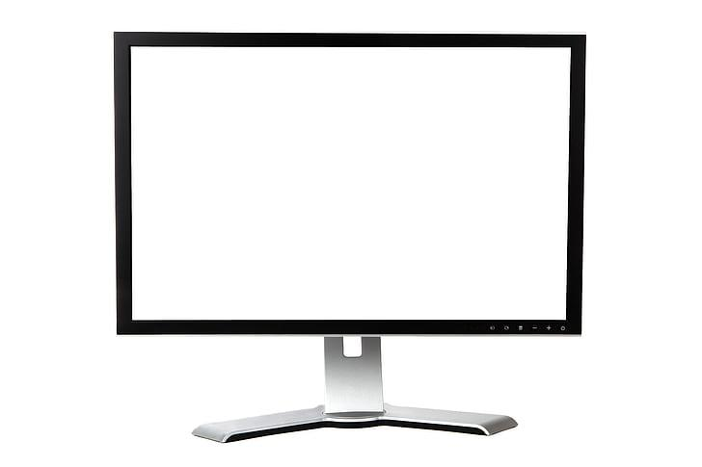
ECE 593 Fundamentals of Pre-Silicon Validation: Design and Verification of Asynchronous FIFO
Team 10: Monesh Kareti - monesh@pdx.edu
Senkathir Mutharasu - senkmuth@pdx.edu

Slide 2

Agenda
Introductions of Team Member
Overview of the Project
Design Implementation
Class-based Verification
UVM-based Verification
Key Challenges and Lessons Learned
Project Demonstration
Q&A Session

Slide 3


Project Overview
An asynchronous FIFO is a buffer that enables safe data transfer between two independently clocked domains. It ensures data integrity by managing read and write pointers across clock domain boundaries using Gray-code synchronization.
Specifications
Write Clock (wclk) = 500 MHz
Read Clock (rclk) = 500 MHz
Burst Size = 450 data items
Write Idle Cycles = 0, Read Idle Cycles = 4
FIFO Depth = 512 (2⁹), Minimum Required = 360
Additional flags: full_3_4 (occupancy >= 384), empty_1_4 (occupancy <= 128)

Slide 4

Design Implementation
An extra bit is used in pointer width to distinguish FULL and EMPTY conditions.
Gray-code encoding is applied to write and read pointers (g_wptr, g_rptr) for safe cross-clock-domain synchronization via two-stage flip-flop synchronizers (sync_wptr, sync_rptr).
On reset (wrst_n / rrst_n active low), both binary and Gray-coded pointers in wptr_handler and rptr_handler are initialized to zero.
wptr_handler increments b_wptr only when w_en=1 and !full. rptr_handler increments b_rptr only when r_en=1 and !empty.
Full & Empty Conditions
EMPTY: g_wptr_sync == g_rptr_next. Asserted in rptr_handler when synchronized write pointer equals the next read pointer.
FULL: MSBs of g_wptr_next and g_rptr_sync differ while remaining bits match. Additional flags: full_3_4 when occupancy >= 384, empty_1_4 when occupancy <= 128.

Slide 5
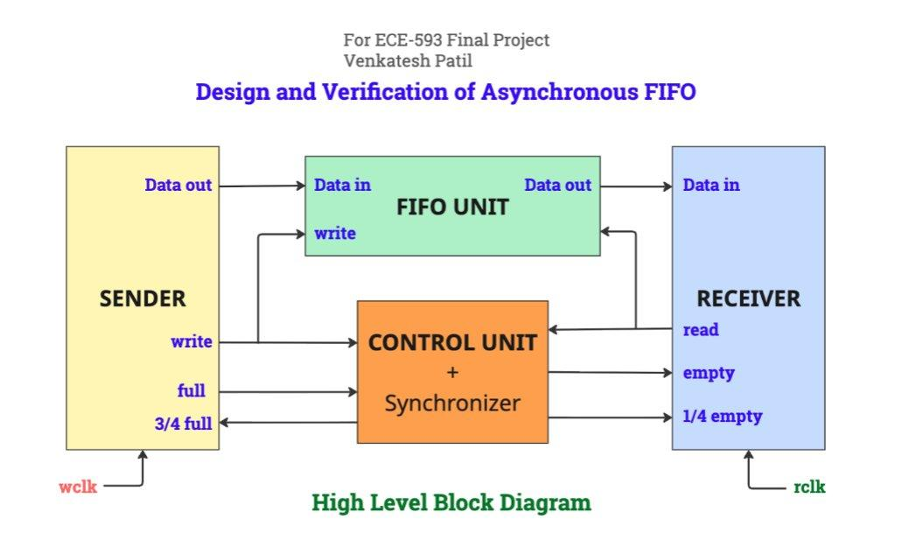
Block Diagram of Asynchronous FIFO

Slide 6
Verfication of Aysnchorous FIFO
Our Verification of Aysnchorous FIFO is done with both:
SystemVerilog Class-Based Verification Environment
UVM-Based Verification Environment

Slide 7
Class Based Verification
Verification includes the development of a testbench using components built with SystemVerilog classes.
The key classes involved are:
Transaction, Generator, Driver, Monitor, Scoreboard
Instances of these classes are created within the "Environment" class.
The overall process flow is shown in the following slide.

Slide 8
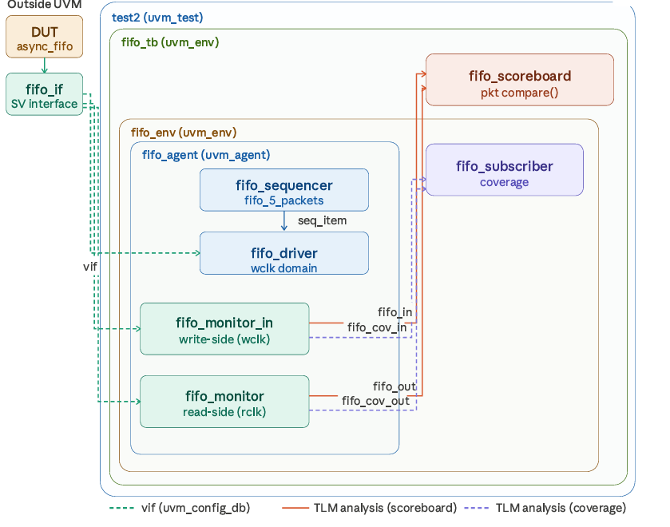
UVM Environment We Built

Slide 9
UVM Based Verification
Verification includes the development of a testbench using components built with UVM.
The key classes involved are:
uvm_seq_item, uvm_sequence, uvm_sequencer, uvm_driver, uvm_monitor, uvm_scoreboard
Instances of these classes are created within the “uvm_env" class.
The overall process flow is shown in the following slide.

Slide 10
UVM Sequences & Simulation
Test Sequences:
fifo_5_packets runs 100 iterations: req.randomize() with {length==450; write_idle_cycles==0; read_idle_cycles==3;}. fifo_base_seq raises/drops objection via starting_phase in pre_body()/post_body().
TLM Port Connections:
monitor_out.fifo_out → scoreboard.fifo_out (read side) | monitor_in.fifo_in → scoreboard.fifo_in (write side) | monitor_out.fifo_cov_out → subscriber.analysis_export (coverage)
Running and Checking:
Runs in ModelSim/QuestaSim. Scoreboard uses packet.compare() (UVM field macros) on full objects. check_phase asserts reference queue is drained , zero unmatched packets.

Slide 11
UVM Environment Structure
Testbench Topology:
fifo_agent: active agent — sequencer + driver + monitor_out + monitor_in, all connected in connect_phase
fifo_env (inner): holds fifo_agent + fifo_subscriber; connects coverage TLM ports
fifo_tb (outer): holds fifo_env + fifo_scoreboard; connects scoreboard analysis ports
Virtual interface distributed via uvm_config_db to all components targeting uvm_test_top.tb.env.agent.*
Stimulus Generation:
fifo_5_packets: runs 100 iterations, each randomized with length==450 (burst spec), write_idle_cycles==0
fifo_base_seq: handles phase objection raise (pre_body) and drop (post_body) to control simulation end
Simulation Flow:
Standard UVM phases: build → connect → start_of_simulation → run → check → report
Results Validation:
Scoreboard check_phase verifies reference queue is empty (all packets matched)
Subscriber reports functional coverage; fifo_subscriber samples flag-state combinations via analysis_export

Slide 12
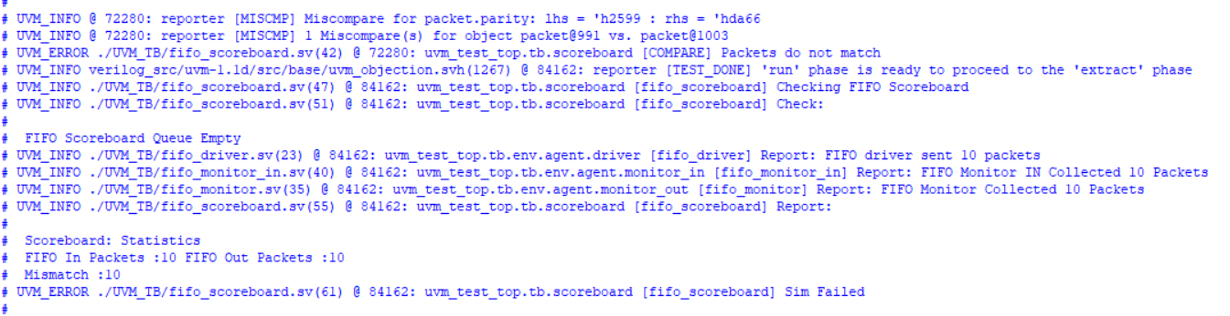
Bug Injection

Slide 13
Task Allocation
Monesh is responsible for the write-side architecture across both RTL and verification. His RTL focus includes wptr_handler.sv, implementing the binary write pointer increment, Gray-code conversion, and the full / full_3_4 flag logic (wfull_3_4: b_wptr − b_rptr_sync ≥ 384), and the fifo_mem.sv synchronous write path with overflow protection. On the verification side, Monesh develops the UVM write-side components: fifo_driver.sv (packet framing and wclk-domain stimulus), fifo_monitor_in.sv (write-side packet reconstruction), fifo_seqs.sv and fifo_sequencer.sv (sequence generation and arbitration), and fifo_packet.sv (transaction class with constraints and parity). He also leads the Design Specification documentation.
Senkathir is responsible for the read-side architecture across both RTL and verification. His RTL tasks include rptr_handler.sv, implementing the binary read pointer increment, Gray-code conversion, and the empty / empty_1_4 flag logic (rempty14: b_wptr_sync − b_rptr ≤ 384), and the integration of synchronizer.sv two-flop modules (sync_wptr and sync_rptr) into hw_top.sv. On the verification side, Senkathir builds the UVM read-side and infrastructure components: fifo_monitor.sv (read-side packet reconstruction and coverage sampling), fifo_scoreboard.sv (packet-level comparison and reference model), fifo_subscriber.sv (functional coverage collection), fifo_env.sv and fifo_tb.sv (environment hierarchy and TLM connections), fifo_test_lib.sv (test classes), and tb_top.sv (static testbench top). He also leads authorship of the Verification Plan.

Slide 14
Key Challenges
Managing the two-level UVM environment hierarchy (fifo_tb wrapping fifo_env) required careful TLM port connection planning across the outer and inner environments.
The `data_out` was not updated correctly after each read transfer in the monitor and driver.
Ensuring the virtual interface path in uvm_config_db matched the two-level hierarchy (uvm_test_top.tb.env.agent.*) required precise path configuration.
Staggered reset (wrst_n before rrst_n) across asynchronous clock domains required careful sequencing in tb_top to prevent metastability in the synchronizer pipeline during initialization.

Slide 15
Lessons Learned
1. Standardization and Reusability:
UVM’s factory and config_db mechanisms allow components like the agent and scoreboard to be reused and reconfigured without modifying source code.
2. Modularity:
Separating the scoreboard into the outer environment (fifo_tb) and coverage into the inner environment (fifo_env) kept concerns isolated and made debugging significantly easier.
3. Advanced Debugging Features:
UVM phase reporting (UVM_HIGH/UVM_LOW verbosity) and topology printing at end_of_elaboration were essential for tracking component instantiation and TLM connection issues.
4. Comprehensive Coverage:
Packet-level scoreboard comparison (comparing full id/length/payload/parity objects) caught data ordering issues that byte-level comparison would have missed.

Slide 16
References
http://www.sunburst-design.com/papers/CummingsSNUG2002SJ_FIFO1.pdf
The UVM Primer
Khandelwal, T. Asynchronous FIFO Reference. github.com/teekamkhandelwal/asynchronous_fifo.
IEEE Std 1800-2017. SystemVerilog Unified Hardware Design, Specification, and Verification Language.
Accellera. Universal Verification Methodology (UVM) 1.2 User’s Guide. Accellera, 2015.

Slide 17

THANK YOU

