Slide 1
ParkPulse
Find the parking that actually chokes traffic, and patrol it first.
Gridlock Hackathon 2.0 (Flipkart), Round 2 | Poor Visibility on Parking-Induced Congestion
Team Spectres · Kavya Mahajan, Aarav Harshvardhan, Souhardyo Dasgupta, Vishesh Gupta
Demo: https://flipkart-gridlock-gamma.vercel.app/

Slide 2
The problem
• Bengaluru logs thousands of parking violations a day, but the feed shows where TICKETS are written, not where parking actually blocks traffic.
• Those are different places: a lane that catches a daily pre-dawn sweep can out-ticket the junction that jams a main road every evening.
• Enforcement is reactive and patrol-based, with no impact heatmap and no way to prioritize.
• Goal: tell an officer where, when, and at what cost to deploy, and how many patrols it takes.
Notes:
Set up the visibility gap in 20 seconds.

Slide 3
The data we have (and don't)
• 298,445 real violation records, 151 days (Nov 2023 to Apr 2024), 54 police stations.
• Per record: location, violation type, vehicle type, timestamps.
• Missing: no traffic speeds, volumes, or travel times, so congestion impact must be DERIVED, not looked up.
• Confound: a violation is logged only when a patrol is present. A daily 4-5am sweep is 15% of all records.
• So recorded violations are roughly parking demand times patrol presence, and the recorded hour reflects shifts, not congestion.
Notes:
Be honest about the data up front.

Slide 4
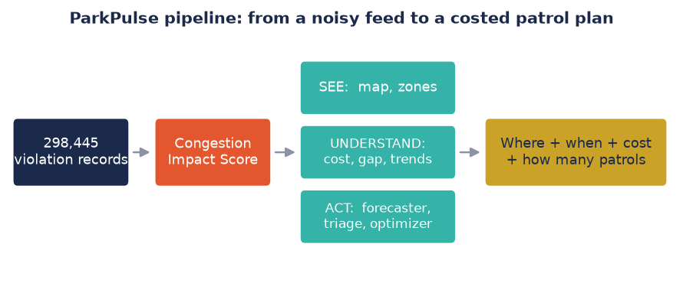
Our approach: see, understand, act
• SEE: an impact-weighted hotspot map and a ranked shortlist of zones.
• UNDERSTAND: what the congestion costs, where effort is misallocated, which spots are worsening.
• ACT: a forecaster, a false-report triage model, and a patrol optimizer that outputs a costed plan.
• Runs on the cleaned data with no live feed, and is built to absorb one when it exists.
Notes:
One pipeline, three layers.

Slide 5
How we build it: data foundation
• Convert timestamps UTC to IST. Without this, rush-hour analysis is 5.5 hours wrong.
• Map each violation type to an obstruction weight (how much it blocks the carriageway).
• Map each vehicle to a PCU footprint: a double-parked bus counts far more than a scooter.
• Weight each record by an EXOGENOUS road-utilization curve by hour. This injects traffic flow without a feed and dodges the confound.
• Aggregate to H3 res-9 cells (about 150 m): 2,534 hotspot cells. Build the core on approved records.
Notes:
The unglamorous work that makes the rest valid.

Slide 6
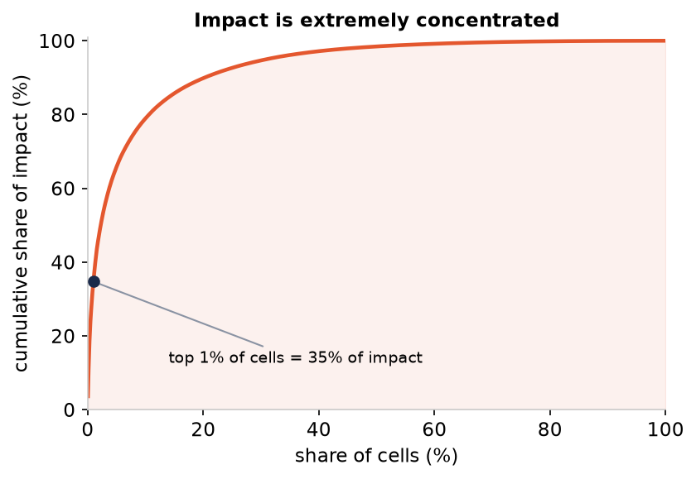
The Congestion Impact Score (0 to 100)
• score = 100 x (Volume x Intensity x Exposure x Persistence) ^ 1/4, a geometric mean of percentile ranks.
• Volume: how many violations, shrunk so a single-event fluke can't top the list.
• Intensity: how obstructive the typical violation is (carriageway, vehicle footprint, junction adjacency).
• Exposure: how busy the road normally is. Persistence: how chronic the spot is.
• Deliberately decoupled from a raw count (rank correlation 0.56). The top 1% of cells carry 35% of impact.
Notes:
The heart of it. A cell must be bad on several axes to rank high.

Slide 7
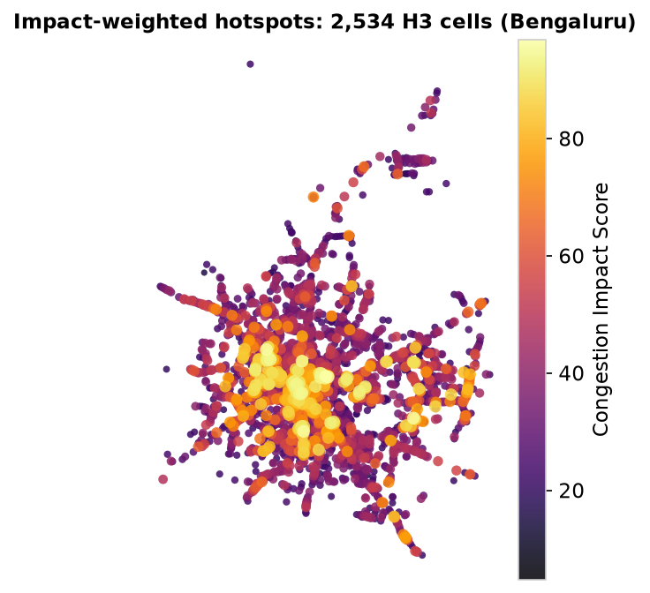
The impact map: watch the city re-rank
• Every cell (about 150 m) is colored by its Congestion Impact Score.
• Toggle raw count to impact: the pre-dawn-sweep clusters fade, the real chokepoints light up.
• Hover any cell for its breakdown: the four axes, its estimated cost, and a rising or cooling tag.
• The bright core is the known commercial belt: Shivajinagar, Majestic, City Market, Malleshwaram.
Notes:
The toggle is the wow moment. Demo it live.

Slide 8
Ranked zones: where AND when
• The top 30 cells, each with its dominant violation, the streets involved, and an exposure-weighted window.
• Validated without ground truth: face validity, where 20 of the top 20 are known chokepoints.
• Stability: the ranking holds month to month (rank correlation about 0.75 to 0.86).
• This is the ops payload: a shortlist an officer can act on tomorrow.
Notes:
A map is nice; an officer needs a list.

Slide 9
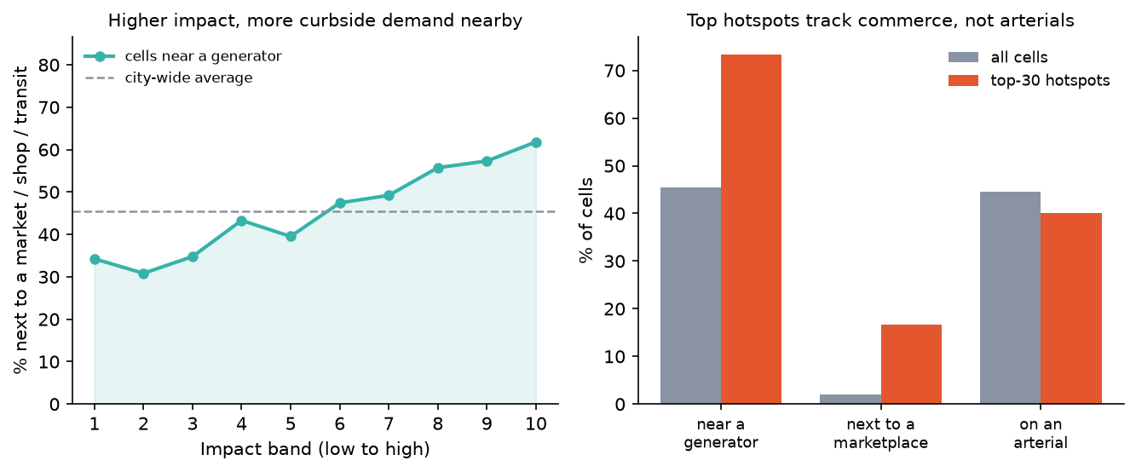
Does it agree with the real city?
• The score uses no road network and no land use, just the violation feed. We cross-check it against real OpenStreetMap geography it never saw.
• Sort all cells into 10 impact bands: the share next to a market, shop, or transit stop climbs steadily from 34% in the lowest to 62% in the highest.
• Top-30 hotspots sit next to a marketplace 17% vs 2% city-wide, an ~8x enrichment; proximity tracks impact about twice as strongly as road class.
• Honest read: it barely correlates with arterial road class (0.12), which is correct. Parking chokes narrow commercial streets, not wide arterials.
Notes:
Built blind to OSM, the score still rediscovers the commercial cores. The strongest validation we have.

Slide 10
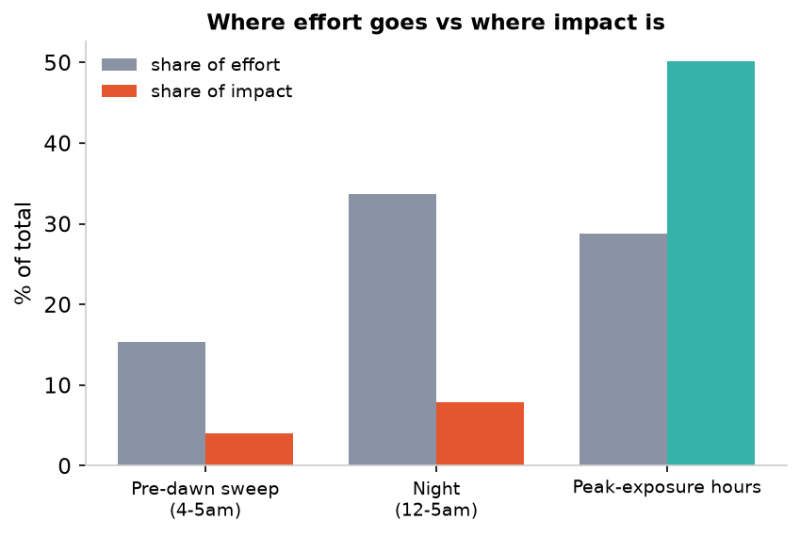
The visibility gap: effort vs impact
• Recorded violations double as a map of enforcement EFFORT.
• Weight each by its impact unit (obstruction x PCU x utilization) to see what that effort actually buys.
• The 4-5am sweep: 15% of effort, 4% of impact. The night window: 34% of effort, 8% of impact.
• Peak hours are the reverse: 29% of effort, 50% of impact. ParkPulse redirects effort to where it matters.
Notes:
The persuasion slide. Lead with the night number.

Slide 11
What it costs
• Calibrate the physical delay-potential into vehicle-hours, then rupees, with a low / base / high band.
• About 574 vehicle-hours of delay per day; roughly Rs 5.2 crore per year (base case).
• The worst 20 cells carry 31% of the cost; just 58 cells carry half.
• A first-order estimate, not a measurement. The relative concentration is robust to the assumptions.
Notes:
The number leadership remembers.

Slide 12
Emerging hotspots: early warning
• The score ranks where things are bad on average; this flags where they are getting WORSE.
• Trend each cell's SHARE of citywide volume over the four full months, which detrends the citywide enforcement ramp.
• 227 cells are rising; 103 are both high-impact and rising, the priority set.
• Honest: a rising trend can reflect shifting enforcement focus, so we call it rising activity.
Notes:
Proactive, not just descriptive.

Slide 13
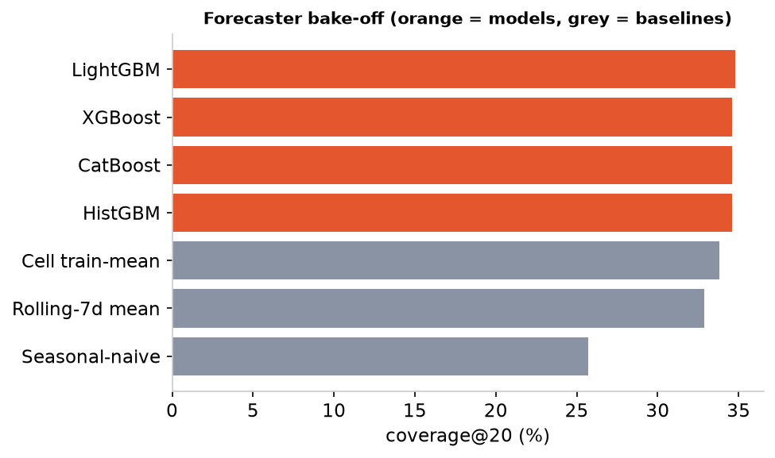
Forecaster: the one model with real labels
• Predict next-day violation intensity per cell on a strict temporal holdout (train Nov-Feb, test Mar-Apr).
• A bake-off across the gradient-boosting family; LightGBM (Tweedie) wins.
• Beats the seasonal-naive baseline by 36% on coverage@20; captures 72% of the oracle ceiling.
• Honest ablation: 29 extra features and tuning did not beat the base set. The ceiling is the data, not the model.
Notes:
This is the genuine ML, and we are honest about its ceiling.

Slide 14
False-report triage: don't chase ghosts
• About a third of reviewed reports are rejected on review.
• A separate supervised model predicts which, from the report's own attributes (location, time, vehicle, type).
• ROC-AUC 0.758 on a stratified holdout: real structure, not a base rate.
• Flag the top 20% most-suspect and you catch 43% of all rejections at 64% precision, so patrols go to real problems.
Notes:
A second, cleaner ML win.

Slide 15
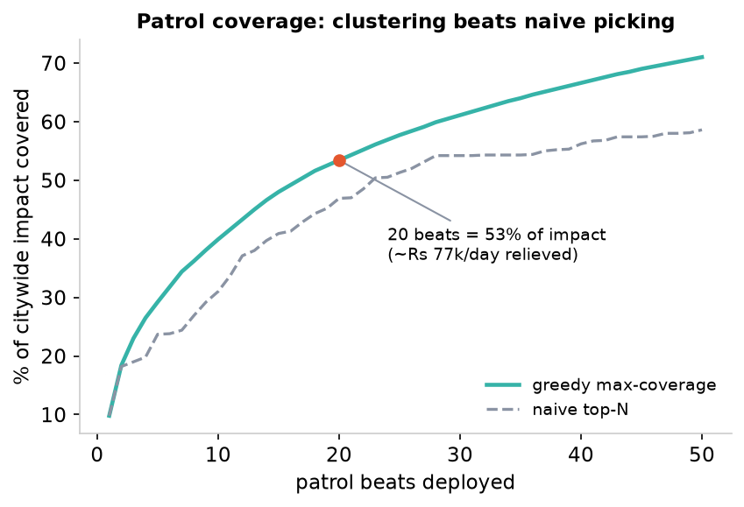
Patrol optimizer + ROI
• A greedy max-coverage optimizer assigns N beats (a cell plus its H3 ring) to maximize impact covered.
• Because the worst cells cluster, 20 beats cover 53% of citywide impact vs 47% for a naive top-N pick.
• The slider also reports the rupee ROI: 20 patrols relieve roughly Rs 77k per day of delay.
• Same fleet, more relief. It turns the analysis into a deployable plan with a number attached.
Notes:
From insight to a deployable, costed plan.

Slide 16
Honest about the gap
• No ground truth for impact: an engineered index, validated four ways (face validity, stability, weight-robustness, and an independent OSM cross-check), never claimed as accuracy.
• Robust to the weights: across 2,000 random axis weightings the top-20 ranking holds (median rank-corr 0.97), so the score isn't a hand-tuned artefact.
• The enforcement confound: we weight by exogenous exposure, never the recorded hour.
• The data can't see the evening (enforcement rarely works evenings), so we don't fake an hour-by-hour schedule.
• Fusion-ready: a live speed feed turns the index into a learning model, with measured slowdown as the label.
Notes:
Judges reward candor; so does anyone deploying this.

Slide 17
Tech, impact, and what's next
• Pipeline: Python (pandas, h3, scikit-learn, lightgbm). App: Next.js + deck.gl, fully static, on a CDN with no backend or API keys.
• Live demo: https://flipkart-gridlock-gamma.vercel.app/
• Impact today: a ranked, costed, where-and-when patrol plan with its ROI.
• Next: plug in live speeds (a true impact label), the OSM road graph (flow-criticality), and patrol rosters (de-bias the confound).
Notes:
Close on deployability and the roadmap.

