Slide 1

Cancel or Retain
Kangaroo Auto Insurance
This Photo by Unknown Author is licensed under CC BY-SA

Slide 2
Agenda
Introduction
Data Visualization and Exploration
Model Results
Conclusion & Recommendations

Slide 3
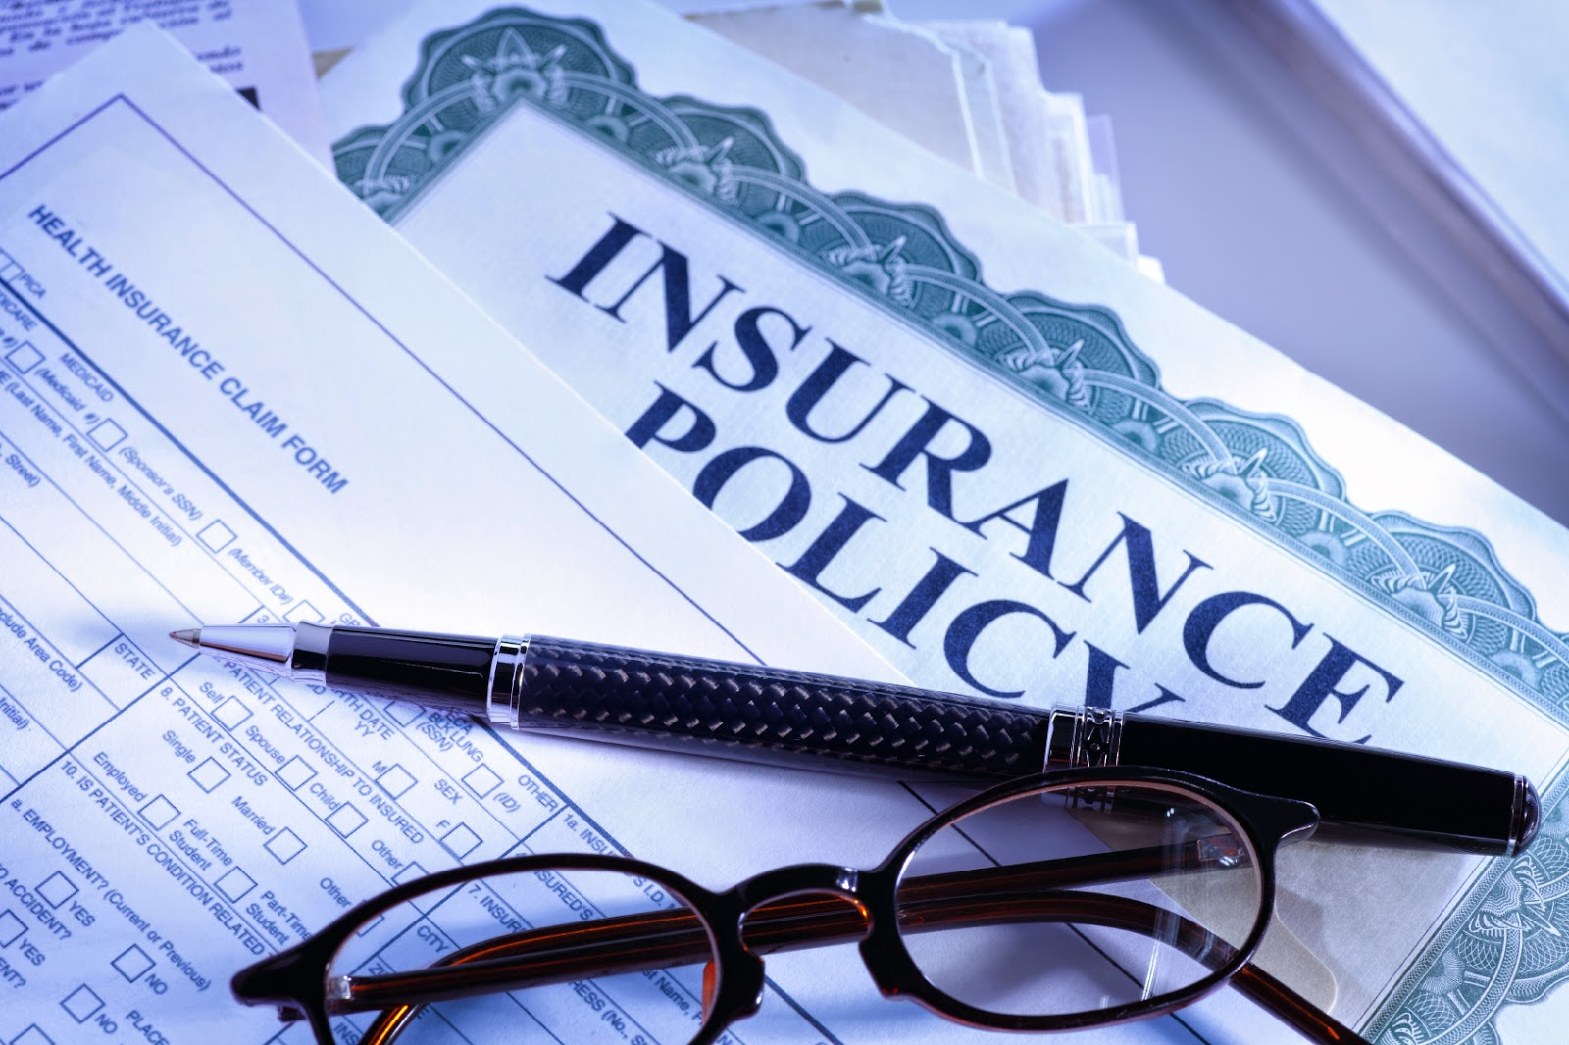
Introduction

Slide 4
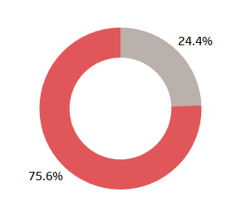

Visualization
Response Outcome Frequency

Slide 5
Model Selection

Slide 6
Results

Slide 7
Conclusion

Slide 8
Recommendations

