Slide 1

HealthifyMe HealthCheck Platform – Consulting-Style Business Requirements Overview
Detailed overview of platform business requirements
Notes:
AI-generated content may be incorrect. ---

Slide 2
Strategic Context and Value Proposition
Notes:
Executive Summary and Platform Vision, Business Problem and Market Opportunity, Strategic Objectives and Success Targets

Slide 3

Executive Summary and Platform Vision
Unified Digital Health Solution
HealthifyMe offers a unified platform for health, fitness, and wellness with real-time, personalized feedback and insights.
Self-Service Health Assessments
Users input key physical and lifestyle data to instantly receive calculated health metrics like BMI and heart rate trends.
Scalable B2C and B2B Value
Platform serves individuals and corporate wellness programs, enabling scalable preventive healthcare solutions.
Actionable Preventive Care
The platform translates complex data into clear signals for early risk identification and behavior change support.
Notes:
The HealthifyMe HealthCheck platform is envisioned as a unified, digital-first health, fitness, and wellness solution that empowers users to proactively understand and improve their health outcomes. The platform enables self-service health assessments by allowing users to input key physical and lifestyle parameters and instantly receive calculated health metrics such as BMI, waist-hip ratio, and heart rate trends. From a strategic perspective, the vision is to move beyond fragmented health data scattered across devices and applications, and instead create a single source of truth for personal wellness. This approach aligns strongly with modern digital health trends, where users expect real-time feedback, personalized insights, and visually intuitive dashboards. The platform is designed to serve both individual consumers and corporate wellness programs, creating scalable value across B2C and B2B segments. By combining automated calculations with evidence-based health standards, HealthifyMe positions itself as a credible, trusted partner in preventive healthcare. The executive vision emphasizes simplicity, accessibility, and actionability, ensuring that complex health information is translated into clear signals and next steps. In a consulting-style framing, the platform directly addresses unmet needs in early risk identification, behavior change support, and longitudinal progress tracking, all of which are critical levers for improving population health outcomes while reducing long-term healthcare costs.

Slide 4

Business Problem and Market Opportunity
Fragmented Health Data Challenges
Health data is scattered across multiple platforms, hindering accurate analysis and meaningful insights.
Lack of Actionable Insights
Most platforms display data but fail to provide personalized, actionable health recommendations to users.
Market Opportunity for Integration
An integrated health dashboard can consolidate inputs, automate calculations, and deliver engaging, insightful visualizations.
Business Potential and Growth Drivers
Rising preventive health awareness, smartphone adoption, and demand for scalable wellness solutions fuel business growth.
Notes:
The current digital health landscape presents several persistent challenges that limit user engagement and impact. Many users lack easy access to accurate health metric calculations, forcing them to rely on manual methods or disconnected tools that provide limited context. Health data is often fragmented across fitness apps, spreadsheets, and wearable dashboards, making it difficult to derive meaningful insights or track trends over time. Additionally, most platforms stop at data display and fail to translate metrics into personalized, actionable recommendations. This creates a clear market opportunity for HealthifyMe to deliver an integrated health dashboard that consolidates inputs, automates calculations, and surfaces insights in a simple, visually compelling manner. From a business standpoint, this opportunity extends to corporate wellness initiatives, insurers, and preventive health programs seeking scalable digital solutions. By positioning the HealthCheck platform as a comprehensive assessment and monitoring tool, HealthifyMe can differentiate itself through depth of insights, user-centric design, and clinical credibility. The opportunity is further amplified by rising consumer awareness around preventive health, increasing smartphone penetration, and growing acceptance of self-service digital health tools. Addressing these gaps enables HealthifyMe to capture unmet demand while creating strong engagement loops through continuous progress tracking and goal alignment.

Slide 5

Strategic Objectives and Success Targets
User-Centered Health Assessments
Enables instant, easy self-service health checks to increase completion rates and reduce friction.
Personalized Health Insights
Delivers tailored recommendations guiding diet, activity, and lifestyle for achievable improvements.
Engagement through Goal Tracking
Supports sustained user engagement with progress dashboards, milestones, and motivational badges.
Growth and Performance Metrics
Targets high user satisfaction and scalable monthly active users with clear success metrics.
Notes:
The strategic objectives of the HealthifyMe HealthCheck platform are designed to balance user value creation with measurable business outcomes. At the core, the platform aims to enable instant, self-service health assessments that reduce friction and increase completion rates. A key objective is to deliver personalized health insights that not only classify risk levels but also guide users toward achievable improvements through diet, activity, and lifestyle adjustments. Supporting sustained engagement is another critical goal, achieved through structured goal tracking, progress dashboards, and motivational indicators such as milestones and badges. From a performance perspective, the platform targets high user satisfaction with recommendations, reflecting relevance and trustworthiness. Growth objectives include scaling to a large monthly active user base within the first year, demonstrating product-market fit and operational scalability. In a consulting framework, these objectives are paired with clear success metrics, such as assessment completion rates, weekly active usage, and goal achievement percentages. Together, these targets ensure that the platform delivers tangible health impact while supporting sustainable growth and monetization opportunities.

Slide 6
Scope Definition and Metric Framework
Notes:
In-Scope Capabilities and Core Features, Out-of-Scope Items and Phase Boundaries, Key Health Metrics and Measurement Logic

Slide 7

In-Scope Capabilities and Core Features
User Registration & Profile
Secure user registration captures baseline demographic and physical data including age, gender, height, and weight.
Health Metrics & Calculations
Platform supports multiple health metrics with automatic BMI, waist-hip ratio, and body fat calculations.
Goal Setting & Tracking
Users can set weight, fitness, or wellness goals and track progress over time with visual indicators.
Risk Assessment & Recommendations
Health risk assessment translates data into personalized health guidance and actionable recommendations.
Notes:
The defined scope of the HealthifyMe HealthCheck platform focuses on delivering high-impact, foundational health assessment capabilities in its initial phase. In scope are user registration and profile management, enabling secure capture of baseline demographic and physical data such as age, gender, height, weight, and activity level. The platform supports input of multiple health metrics with automatic calculations for BMI, waist-hip ratio, and body fat indicators, ensuring accuracy and consistency with recognized standards. Goal setting and progress tracking are central capabilities, allowing users to define weight, fitness, or wellness objectives and monitor changes over time. A visually rich dashboard aggregates these metrics into charts and indicators that highlight trends and deviations. Health risk assessment and personalized recommendations are also included, translating raw data into meaningful guidance. The scope explicitly emphasizes mobile-responsive design, reflecting the usage patterns of modern health consumers. By concentrating on these core features, the platform ensures a focused, high-quality user experience while laying the groundwork for future enhancements.

Slide 8

Out-of-Scope Items and Phase Boundaries
Defined Out-of-Scope Features
Key features like wearable integration and telemedicine are excluded to reduce complexity and regulatory risk in this phase.
Benefits of Clear Boundaries
Clear phase boundaries help prioritize core user experience, improve data accuracy, and enable faster time-to-market.
Extensible Platform Design
The architecture is designed for extensibility, allowing future integration of out-of-scope features without major rework.
Balanced Execution Strategy
A phased approach balances ambitious goals with realistic execution for successful digital health transformation.
Notes:
To maintain clarity and delivery discipline, several features are intentionally defined as out of scope for the current phase of the HealthifyMe HealthCheck platform. These include direct integration with wearable devices, advanced telemedicine or video consultation capabilities, prescription and medication management, and laboratory test result uploads. While these features represent potential future value, excluding them from the initial scope reduces complexity, dependency risk, and regulatory overhead. From a consulting and program management perspective, this clear boundary allows the team to prioritize user experience, data accuracy, and performance for the core assessment journey. It also supports faster time-to-market and more predictable delivery timelines. Importantly, the platform architecture and data model can be designed with extensibility in mind, ensuring that out-of-scope items can be incorporated in later phases without significant rework. This phased approach balances ambition with execution realism, a key principle in successful digital health transformations.

Slide 9

Key Health Metrics and Measurement Logic
Body Composition Metrics
Core metrics like BMI and waist-hip ratio assess weight status and abdominal obesity risk accurately.
Cardiovascular Monitoring
Heart rate and pulse tracking over time helps identify health trends and potential anomalies effectively.
Body Measurements for Fitness
Measurements of chest, waist, hips, and arms offer granular progress tracking beyond weight alone.
Fitness and Calorie Goals
Fitness goals translate weight and activity targets into calorie deficit or surplus recommendations.
Notes:
The HealthifyMe HealthCheck platform is built around a structured framework of key health metrics that provide a holistic view of user wellness. Core metrics include Body Mass Index, calculated using standardized formulas to classify weight status, and waist-hip ratio, which serves as an indicator of abdominal obesity risk. Heart rate and pulse readings are tracked over time to identify trends and potential anomalies. Body measurements such as chest, waist, hips, and arms support fitness and physique-related goals, offering more granular progress signals beyond weight alone. Fitness goals incorporate target weight and activity levels, translating them into calorie deficit or surplus guidance. Each metric is paired with clear health insights that contextualize results, such as risk categorization or progress status. This metric framework ensures consistency, comparability, and clinical relevance, while also supporting visually intuitive dashboards that resonate with users and stakeholders alike.

Slide 10
Functional Capabilities and User Experience
Notes:
User Onboarding and Profile Management, Health Assessment and Real-Time Calculations, Personalized Recommendations and Insights

Slide 11

User Onboarding and Profile Management
Simple and Secure Onboarding
The onboarding process enables users to securely create accounts using email or mobile number verification with a simple flow.
Profile Setup with Essential Data
Users provide key details like age, gender, height, weight, and activity level to establish an accurate health baseline.
Automatic Health Metrics Calculation
The platform computes BMI, basal metabolic rate, and calorie needs automatically, reducing user effort and errors.
User Experience Focus
Onboarding emphasizes clarity and minimal cognitive load to improve completion rates and data quality for personalization.
Notes:
User onboarding is a critical moment that shapes first impressions and long-term engagement with the HealthifyMe HealthCheck platform. The onboarding flow is designed to be simple, secure, and data-efficient, allowing users to create accounts through email or mobile verification. During profile setup, essential information such as age, gender, height, weight, and activity level is captured to establish a reliable baseline for calculations. The platform automatically computes derived metrics like BMI, basal metabolic rate, and daily calorie needs, minimizing user effort and reducing error. Baseline measurements are securely stored to enable longitudinal comparisons. From a user experience standpoint, the onboarding process emphasizes clarity, progressive disclosure, and minimal cognitive load. In a consulting-style evaluation, this capability directly supports higher assessment completion rates and stronger data quality, which are prerequisites for accurate insights and personalization downstream.

Slide 12

Health Assessment and Real-Time Calculations
Streamlined User Interface
A single interface lets users input health metrics efficiently and seamlessly.
Real-Time Calculations
Instant feedback is provided with calculations updating live, enhancing user experience.
Visual Health Indicators
Color-coded status signals intuitively communicate health ranges to reduce interpretation effort.
Data Storage and Trend Analysis
Assessments are timestamped and stored, allowing for tracking health trends over time.
Notes:
The HealthCheck assessment experience is centered on a single, streamlined interface that allows users to input all relevant health metrics efficiently. As users enter data, the platform performs real-time calculations, providing instant feedback without requiring page reloads or additional steps. Visual indicators, such as green, yellow, and red status signals, are used to communicate health ranges intuitively and reduce interpretation effort. Each assessment is timestamped and stored, enabling trend analysis across multiple sessions. This real-time capability enhances user trust and engagement by demonstrating immediate value. From a functional perspective, it also reduces support burden and increases data consistency. In consulting terms, the assessment module represents the operational core of the platform, where accuracy, responsiveness, and usability converge to drive perceived product quality.

Slide 13
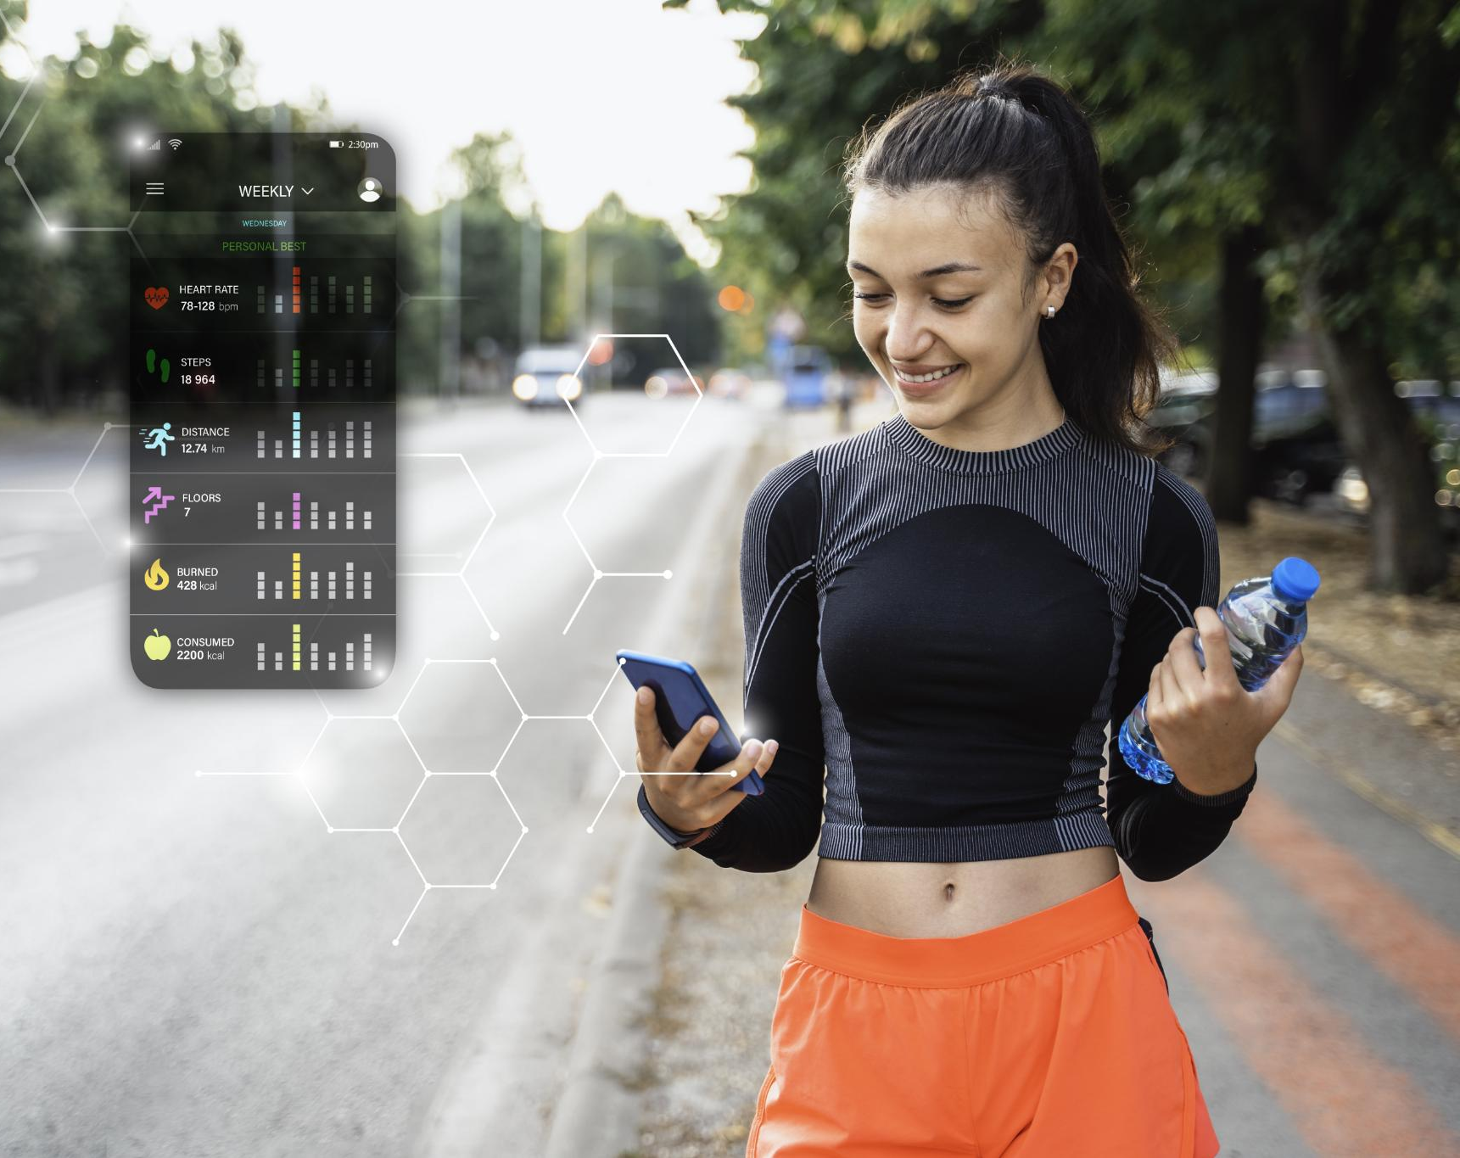
Personalized Recommendations and Insights
Health Risk Profiling
The system categorizes users into low, medium, or high health risk profiles based on personalized metrics and goals.
Tailored Diet Recommendations
Diet advice is customized according to BMI and target health outcomes for effective nutritional guidance.
Personalized Exercise Suggestions
Exercise recommendations align with user fitness levels and preferences to boost adherence and results.
Holistic Lifestyle Advice
Lifestyle tips focus on sleep, hydration, and stress management to support overall wellness.
Notes:
Personalized recommendations transform raw health data into actionable guidance, making them a key differentiator for the HealthifyMe platform. Based on calculated metrics and user goals, the system generates a health risk profile categorized into low, medium, or high risk levels. Diet recommendations are tailored according to BMI status and target outcomes, while exercise suggestions align with fitness level and preferences. Lifestyle advice addresses factors such as sleep, hydration, and stress management, reinforcing a holistic wellness approach. These insights are designed to be practical, achievable, and easy to understand, avoiding clinical jargon where possible. In a consulting lens, personalization increases engagement, improves perceived relevance, and supports measurable behavior change, all of which contribute to higher retention and conversion rates.

Slide 14
Dashboards, Analytics, and Journey
Notes:
Progress Dashboards and Visual Analytics, BMI and Health Metric Dashboards, End-to-End User Journey Flow

Slide 15

Progress Dashboards and Visual Analytics
Health Monitoring Interface
The dashboard displays weekly and monthly trend charts to help users track and understand their health progress over time.
Goal Visualization
Goal achievements are highlighted using progress bars, enhancing user motivation and clarity of progress.
Behavioral Reinforcement
Before-and-after comparisons and milestone indicators provide emotional resonance to reinforce positive behavior change.
Clean Professional Design
The dashboard uses a green and blue healthcare palette, ensuring a clean, professional, and user-friendly consulting aesthetic.
Notes:
The progress dashboard is the primary interface through which users monitor their health journey over time. It presents weekly and monthly trend charts for all tracked metrics, enabling users to quickly identify improvements or areas of concern. Goal achievement is visualized through progress bars, reinforcing motivation and clarity. Before-and-after comparisons and milestone indicators add emotional resonance and reinforce positive behavior. From a design standpoint, the dashboard adopts a clean, green and blue healthcare color palette consistent with professional consulting aesthetics. Analytically, the dashboard supports both short-term feedback and long-term trend analysis. In a consulting context, this capability demonstrates how data visualization can drive engagement, insight, and sustained usage without overwhelming the user.

Slide 16

BMI and Health Metric Dashboards
BMI Visualization
The BMI dashboard categorizes users into health ranges with clear color coding and labels for easy understanding.
Trend Monitoring
BMI trends over time highlight lifestyle impacts and progress toward health goals.
Consistent Metrics Design
Other metrics like heart rate and body measurements follow similar visual styles for consistency.
Executive Presentation Ready
Dashboards are designed for clarity and executive readability, supporting consulting-style presentations.
Notes:
The BMI dashboard serves as a flagship visualization within the HealthifyMe platform, translating a widely recognized health metric into an intuitive, category-based view. Users can see where they fall across underweight, normal, overweight, and obese ranges, supported by color coding and clear labels. Over time, BMI trends illustrate the impact of lifestyle changes and adherence to goals. Similar visual treatments are applied to other metrics such as heart rate and body measurements, creating a consistent analytical language across the platform. These dashboards are designed to be presentation-ready, aligning with consulting-style expectations for clarity and executive readability. By making metrics visually compelling, the platform increases comprehension and encourages regular check-ins.

Slide 17

End-to-End User Journey Flow
User Onboarding
Users start by signing up and creating a basic profile to begin their health journey with the platform.
Health Assessment
Users complete a comprehensive health assessment to receive instant, valuable results that build trust and engagement.
Goal Setting and Progress
Users set specific health goals and track their progress through weekly check-ins and dashboards.
Alerts and Insights
Alerts and insights notify users of improvements or concerns, prompting timely health actions and habit reinforcement.
Notes:
The end-to-end user journey for the HealthifyMe HealthCheck platform is designed as a logical, motivating progression. Users begin with signup and basic profile creation, followed by their first comprehensive health assessment. Instant results provide immediate value, reinforcing trust and curiosity. Users then set specific goals, such as weight loss or fitness improvement, which anchor subsequent interactions. Weekly check-ins allow users to update measurements and observe progress through dashboards. Alerts and insights highlight improvements or potential concerns, prompting timely action. From a consulting viewpoint, this journey is optimized to minimize drop-off, reinforce habit formation, and create recurring engagement loops that support both user outcomes and business objectives.

Slide 18
Delivery, Governance, and Outcomes
Notes:
Non-Functional Requirements and Quality Standards, Success Metrics and Business Impact, Roadmap, Next Steps, and Approvals

Slide 19

Non-Functional Requirements and Quality Standards
Performance and Scalability
The platform must load pages quickly and support many concurrent users without performance drops.
Security Compliance
Ensuring encrypted data storage, role-based access, and compliance with healthcare regulations is essential.
Usability and Design
Mobile-first design with minimal interaction steps and clear visuals improves user experience and adoption.
Operational Risk Reduction
Strong non-functional requirements reduce risks and support sustainable scaling as user base grows.
Notes:
Non-functional requirements define the quality attributes that ensure the HealthifyMe HealthCheck platform is reliable, secure, and scalable. Performance targets include fast page load times and the ability to support high concurrent user volumes without degradation. Security requirements emphasize compliance with healthcare data regulations, encrypted storage, and role-based access control. Usability standards focus on mobile-first design, minimal interaction steps, and clear visual communication. These requirements are critical enablers of trust and adoption, particularly in a health context where data sensitivity is high. In consulting terms, strong non-functional foundations reduce operational risk and support sustainable scaling as user numbers grow.

Slide 20

Success Metrics and Business Impact
User Engagement Metrics
User registrations, weekly active usage, and assessment completion rates indicate platform engagement and usability.
Health Outcome Indicators
Goal achievement rates serve as proxies to measure the real-world health impact of the platform.
Business Performance Metrics
Premium conversion rates and net promoter score reflect commercial success and customer satisfaction.
Corporate Wellness Impact
Reduced healthcare costs and increased employee wellness participation demonstrate corporate client value.
Notes:
Success for the HealthifyMe HealthCheck platform is measured through a combination of quantitative and qualitative indicators. Key metrics include user registrations, weekly active usage, and assessment completion rates, which signal engagement and usability. Health outcome proxies, such as goal achievement rates, provide insight into real-world impact. Business metrics, including premium conversion and net promoter score, reflect commercial viability and brand strength. For corporate clients, reduced healthcare costs and improved employee wellness participation represent additional value levers. This balanced scorecard approach ensures that success is evaluated holistically, aligning user benefit with business performance.

Slide 21
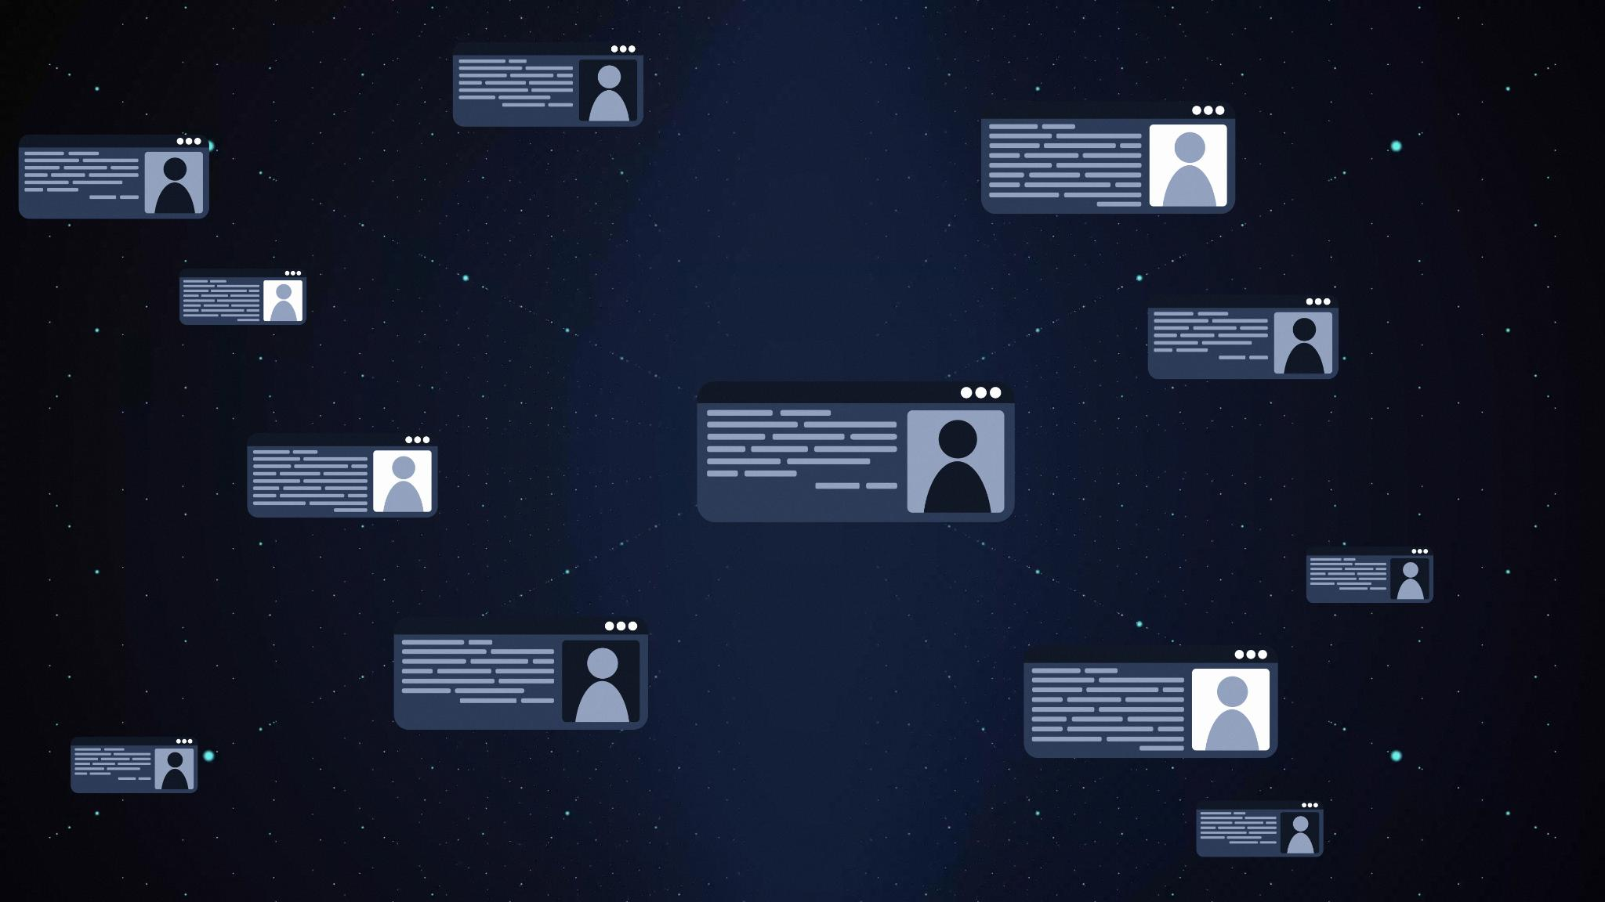
Roadmap, Next Steps, and Approvals
Governance and Approval
Stakeholder review and approval ensure project alignment and accountability before development begins.
Technical and Medical Validation
Finalizing architecture and medical validation mitigates risks prior to platform development.
UI and UX Wireframes
Wireframe creation turns requirements into tangible user experiences to guide development.
Roadmap and Execution
MVP establishes core features; future phases add analytics and integrations with clear ownership.
Notes:
The immediate next steps for the HealthifyMe HealthCheck platform focus on governance, validation, and execution readiness. Stakeholder review and approval of the business requirements ensure alignment and accountability. Technical architecture finalization and medical validation of calculations are critical risk-mitigation activities prior to development. UI and UX wireframe creation translates requirements into tangible user experiences. From a roadmap perspective, the initial MVP phase establishes core capabilities, while subsequent phases can introduce advanced analytics and integrations. In a consulting-style close, clear decision points and ownership are emphasized to maintain momentum and deliver the platform on time and within scope.

