Slide 1

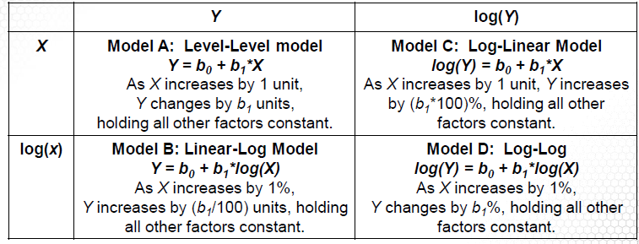





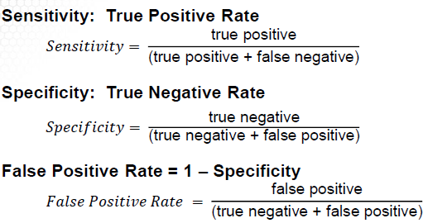
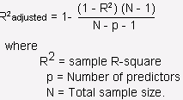





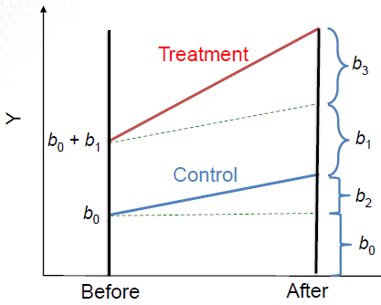










Selection Bias
Self-selection
Voluntary response
nonresponse
Controlling Selection Bias
Randomized controlled
Natural experiment
Control variables (weaker)
Calculating risks
SD
Beta
R²
Drawdown
Investing costs
Commissions
Bid-ask spread
Delay
SMB – Size
HML – Value
MOM – Momentum
QMJ – Quality
BAB – Risk

Slide 2

