Slide 3
Channel: Number of class
Channel: Number of class
Channel:1024
Channel:512
Channel:512
Channel:256
Channel:256
Channel:128
Channel:128
 | Convolutional Layer 3x3 filter, stride: 1+ BatchNormalization Layer+LeakyReLU
 | Convolutional Layer 3x3 filter, stride: 2+ BatchNormalization Layer
 | Dropout Layer (0.5)
 | De-Convolutional Layer 3x3 filter, stride: 2+ BatchNormalization Layer
 | Concatence Layer
 | Convolutional Layer 1x1 filter, stride: 1+ BatchNormalization Layer+LeakyReLU
Channel:64
Channel:64
Input Block
Output Block
Middle Block
Concat Middle Block

Slide 4
Channel: Number of class
Channel: Number of class
Channel:1024
Channel:512
Channel:512
Channel:256
Channel:256
Channel:128
Channel:128
Channel:64
 | Convolutional Layer 3x3 filter, stride: 1+ BatchNormalization Layer+LeakyReLU
 | Convolutional Layer 3x3 filter, stride: 2+ BatchNormalization Layer
 | Dropout Layer (0.5)
 | De-Convolutional Layer 3x3 filter, stride: 2+ BatchNormalization Layer
 | Concatence Layer
 | Convolutional Layer 1x1 filter, stride: 1+ BatchNormalization Layer
 | Channel-Attention Layer
Channel:64
Input Block
Output Block
Middle Block
Channel-Attention Block
Concat Middle Block

Slide 5
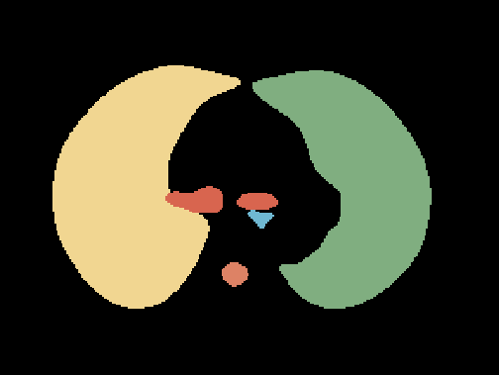
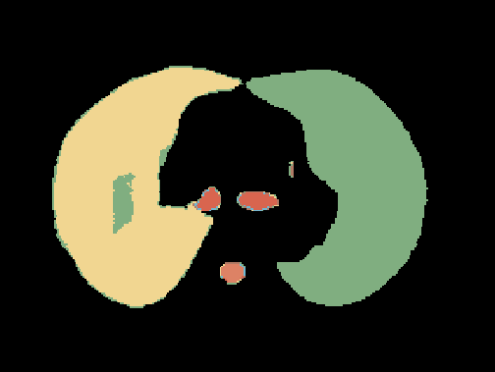
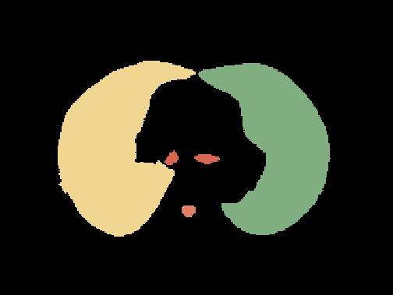
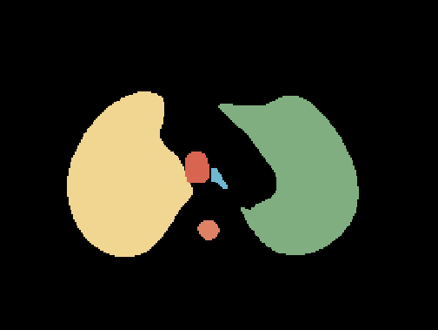

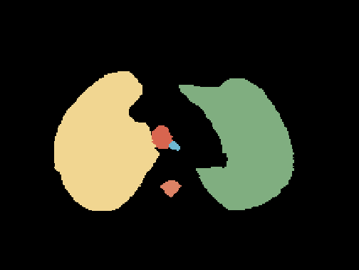
Ground Truth
Predict
Postprocess Predict

Slide 6
Ground Truth
Predict
Postprocess Predict

Slide 7
 | Convolutional Layer 3x3 filter, stride: 1+ BatchNormalization Layer+LeakyReLU
 | Convolutional Layer 3x3 filter, stride: 2+ BatchNormalization Layer
 | Dropout Layer (0.5)
 | De-Convolutional Layer 3x3 filter, stride: 2+ BatchNormalization Layer
 | Concatence Layer
 | Convolutional Layer 1x1 filter, stride: 1+ BatchNormalization Layer+LeakyReLU
Input Block
Input Block
Output Block
Output Block
Middle Block
Middle Block
Channel-Attention Block
Concat Middle Block
Concat Middle Block
 | Convolutional Layer 3x3 filter, stride: 1+ BatchNormalization Layer+LeakyReLU
 | Convolutional Layer 3x3 filter, stride: 2+ BatchNormalization Layer
 | Dropout Layer (0.5)
 | De-Convolutional Layer 3x3 filter, stride: 2+ BatchNormalization Layer
 | Concatence Layer
 | Convolutional Layer 1x1 filter, stride: 1+ BatchNormalization Layer
 | Channel-Attention Layer
1x1xC
WxHxC
WxHxC
WxHxC

Slide 8
Input Block
Output Block
Input Block
Middle Block
Output Block
Middle Block
Concat Middle Block
Channel-Attention Block
Concat Middle Block
1x1xC
WxHxC
WxHxC
WxHxC

Slide 9
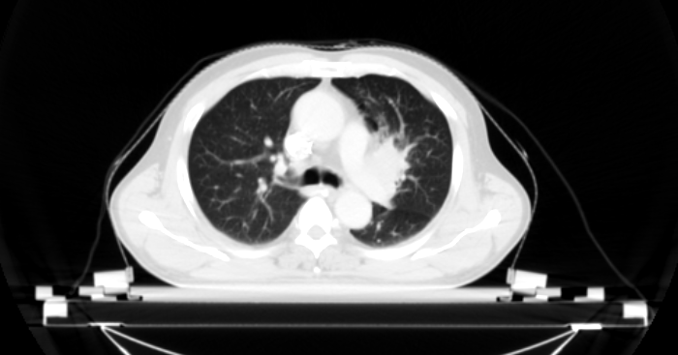
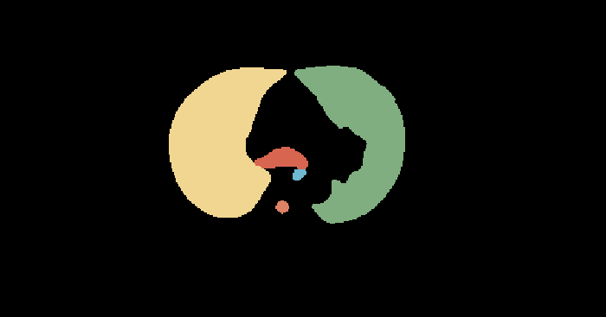

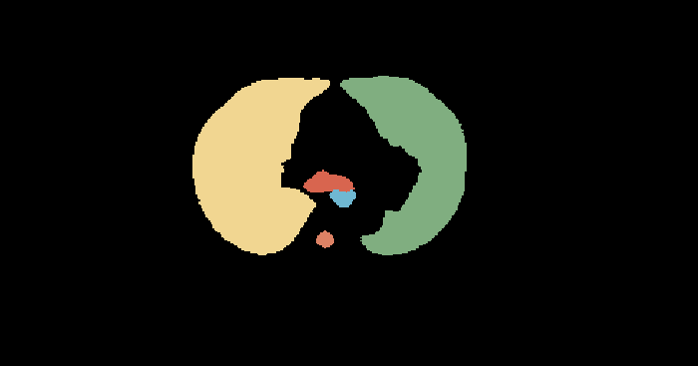
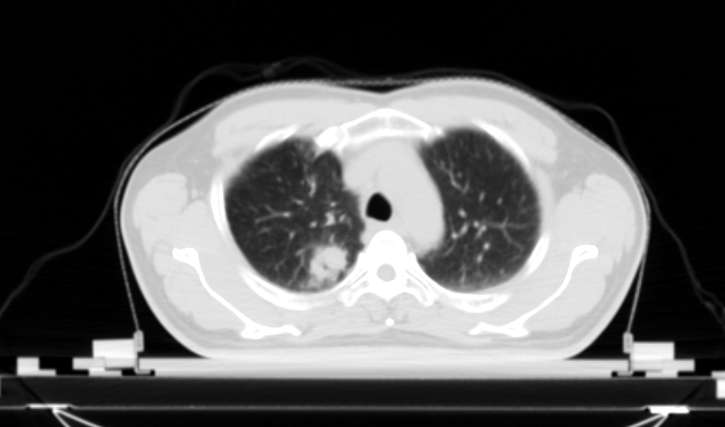
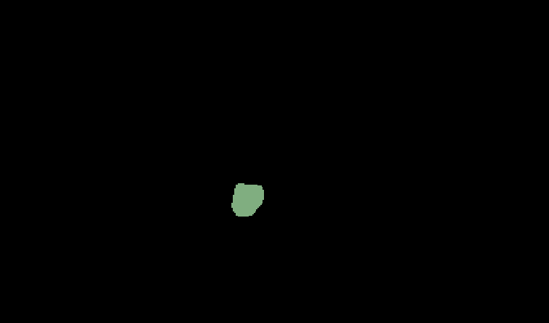


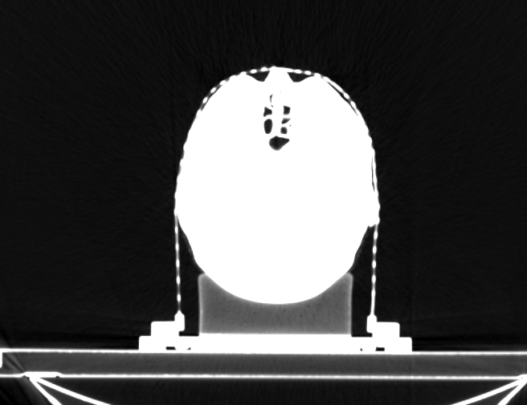
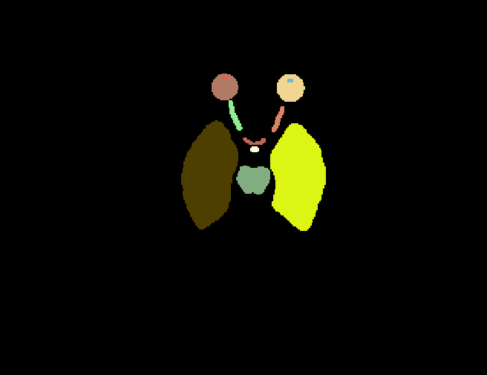
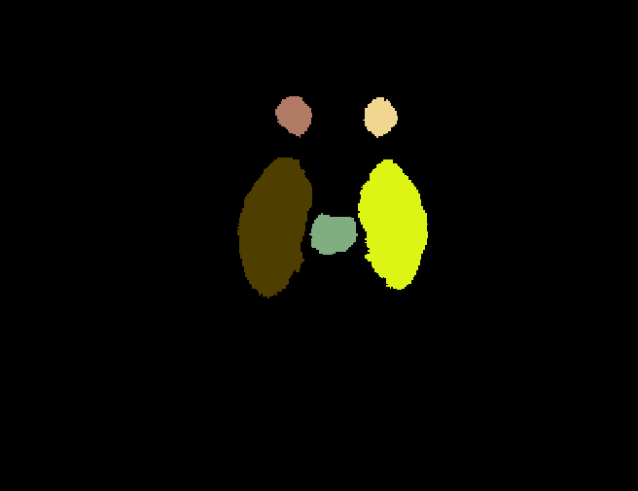

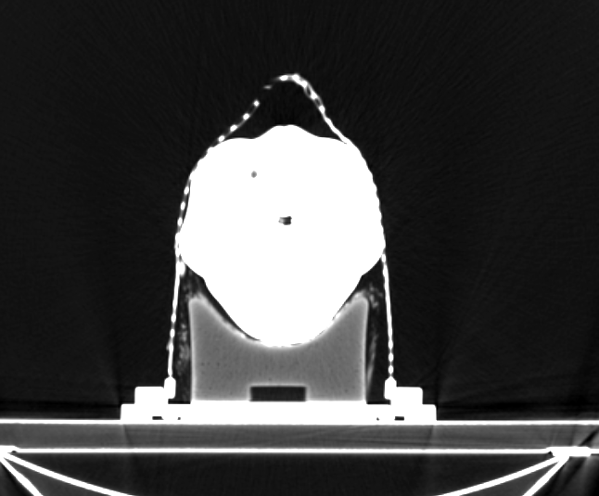
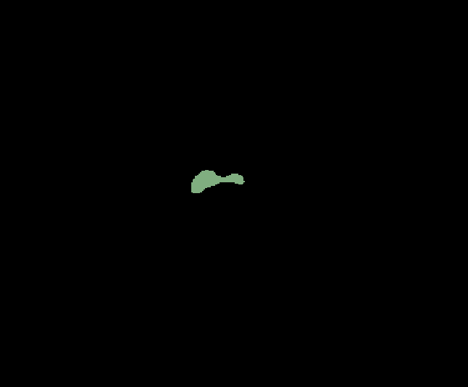
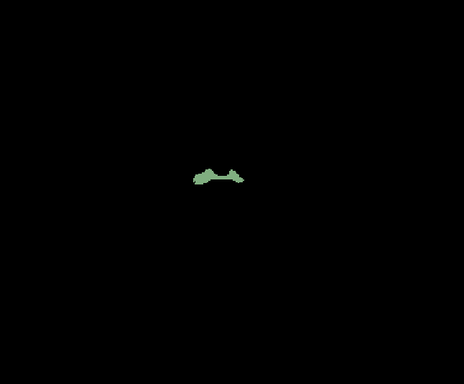


Slide 10
data
label
Unet-predict
Unet+CAB-predict

Slide 11
data
label
Unet-predict
Unet+CAB-predict

