Slide 1
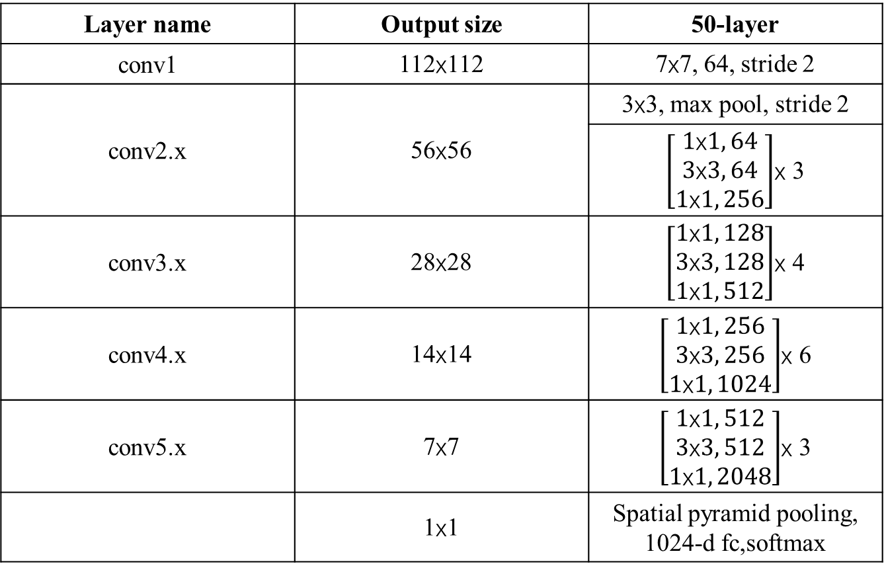
Layer name | Output size | 50-layer
conv1 | 112x112 | 7x7, 64, stride 2
conv2.x | 56x56 | 3x3, max pool, stride 2
 |  | $\left[\begin{aligned}1\text{x}1, 64 \\ 3\text{x}3, 64 \\ 1\text{x}1, 256\end{aligned}\right]$x 3
conv3.x | 28x28 | $\left[\begin{aligned}1\text{x}1, 128 \\ 3\text{x}3, 128 \\ 1\text{x}1, 512\end{aligned}\right]$x 4
conv4.x | 14x14 | $\left[\begin{aligned}1\text{x}1, 256 \\ 3\text{x}3, 256 \\ 1\text{x}1, 1024\end{aligned}\right]$x 6
conv5.x | 7x7 | $\left[\begin{aligned}1\text{x}1, 512 \\ 3\text{x}3, 512 \\ 1\text{x}1, 2048\end{aligned}\right]$x 3
 | 1x1 | Spatial pyramid pooling, 1024-d fc,softmax

Slide 2




1024-dimension
Resnet 50
valence
Encoder
512-dimension
arousal

Slide 3
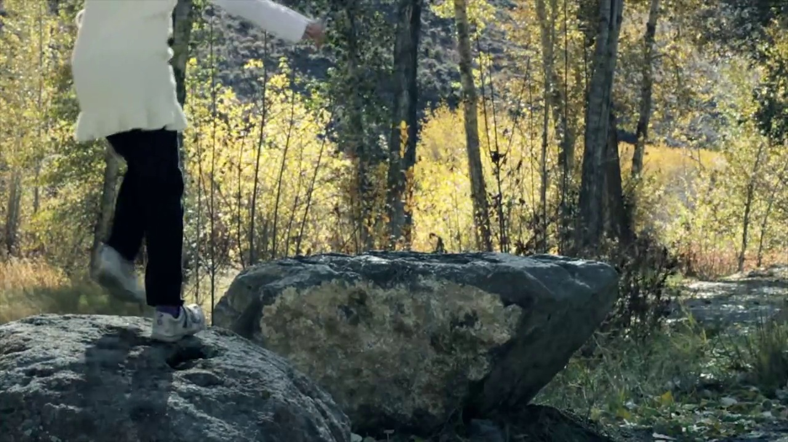
feature map
Encoder
Decoder
gradient
cross entropy

Slide 4
LSTM
LSTM
LSTM
LSTM
…
…
valence
1024-dimension
arousal
1024-dimension
1024-dimension
1024-dimension
…
…
1024-dimension
VGG16
share weights
VGG16
share weights
VGG16
share weights
share weights
VGG16
…
…

