Slide 1






$$I_{(i, j, c)}$$
$$k_{(i^{′}, j,^{′} c, k)}$$
$$S$$
$$O_{(i, j, k)}$$
$$S$$
$$I_{(i −\frac{S+1}{2}+i^{′}, j−\frac{S+1}{2}+j^{′}, c)}$$

Slide 2
Max Selection
2
7
5
2
7
9
0
3
9
4
8
6
2
3
2
3
Average Selection
8
7
6
5
2
7
5
2
3
5
0
3
9
4
4
4
2
3
2
3
8
7
6
5

Slide 3
0
7
0
0
0
0
9
0
7
9
0
0
0
0
8
6
8
0
6
0
Maxpooling Backward
0.75
0.75
1.25
1.25
0.75
0.75
1.25
1.25
3
5
1
1
1
1
4
4
1
1
1
1
Average pooling Backward

Slide 4
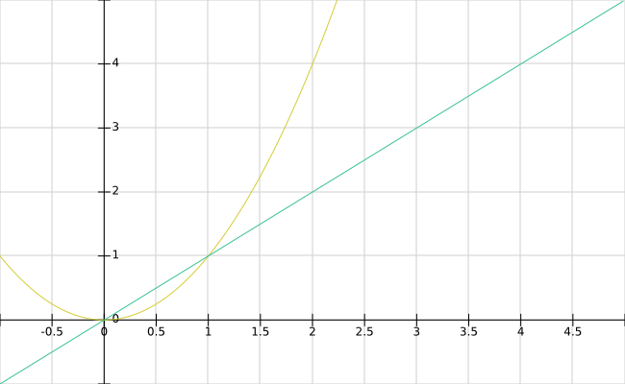

Slide 5
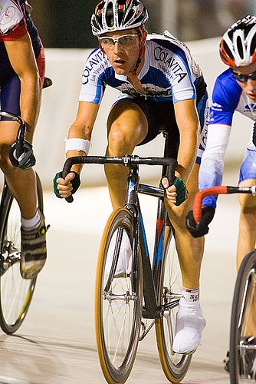
(x1, y1)
w
(x, y)
h
(x2, y2)

Slide 6
backbone
neck
head

