Slide 1






$$I_{(i, j, c)}$$
$$k_{(i^{′}, j,^{′} c, k)}$$
$$S$$
$$O_{(i, j, k)}$$
$$S$$
$$I_{(i −\frac{S+1}{2}+i^{′}, j−\frac{S+1}{2}+j^{′}, c)}$$

Slide 2
Max Selection
2
7
5
2
7
9
0
3
9
4
8
6
2
3
2
3
Average Selection
8
7
6
5
2
7
5
2
3
5
0
3
9
4
4
4
2
3
2
3
8
7
6
5

Slide 3
0
7
0
0
0
0
9
0
7
9
0
0
0
0
8
6
8
0
6
0
Maxpooling Backward
0.75
0.75
1.25
1.25
0.75
0.75
1.25
1.25
3
5
1
1
1
1
4
4
1
1
1
1
Average pooling Backward

Slide 4
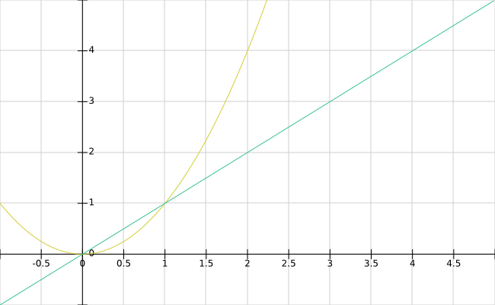

Slide 5
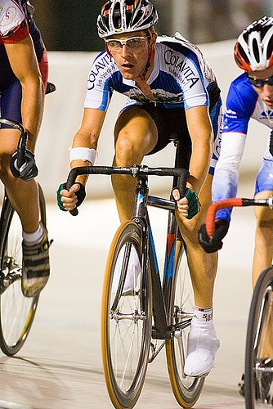
(x1, y1)
w
(x, y)
h
(x2, y2)

Slide 6
backbone
neck
head

Slide 7
Backbone
1x1 conv
1x1 conv
Head(large)
7x7x1024
7x7x255
3x3 conv
1x1 conv
7x7x512
1x1 conv
7x7x256
upsample
14x14x256
Head(middle)
14x14x512
14x14x768
14x14x1024
14x14x255
3x3 conv
1x1 conv
concatenate
1x1 conv
14x14x256
28x28x256
28x28x512
upsample
Head(tiny)
28x28x768
28x28x1024
28x28x255
3x3 conv
1x1 conv
concatenate

Slide 8
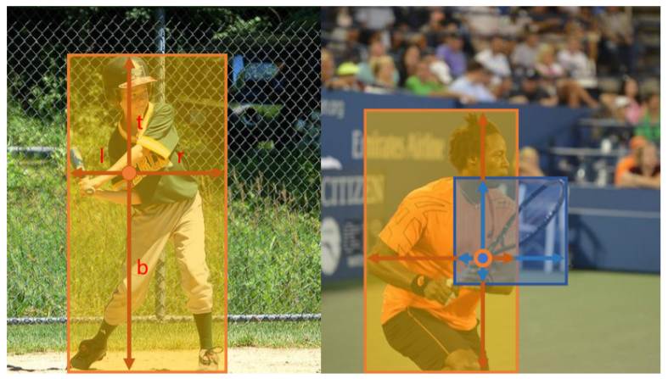
(x, y)

Slide 9
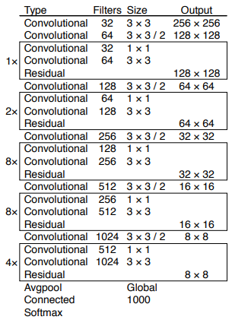
Backbone

Slide 10
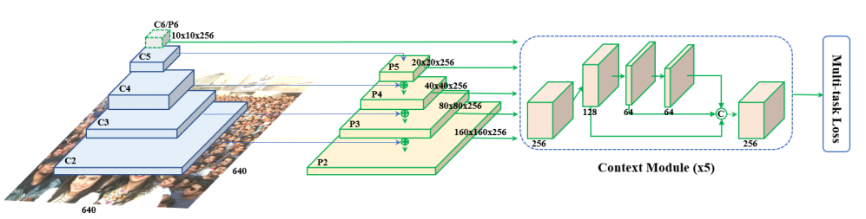
Backbone
Neck

Slide 11



Input Map $I∈R^{H×W×C}$
Kernel $k∈R^{S×S×C}$
Output Map $O∈R^{H×W×C}$

Slide 12


Input Map $I∈R^{H×W×C}$
Kernel $k∈R^{1×1×C×L}$
Output Map $O∈R^{H×W×L}$

Slide 13
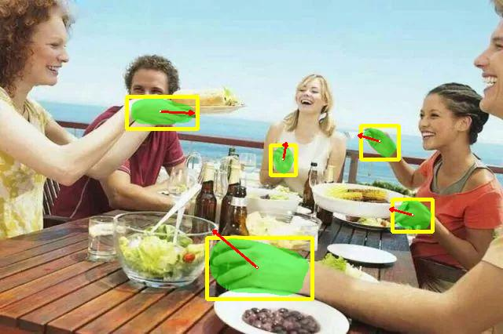
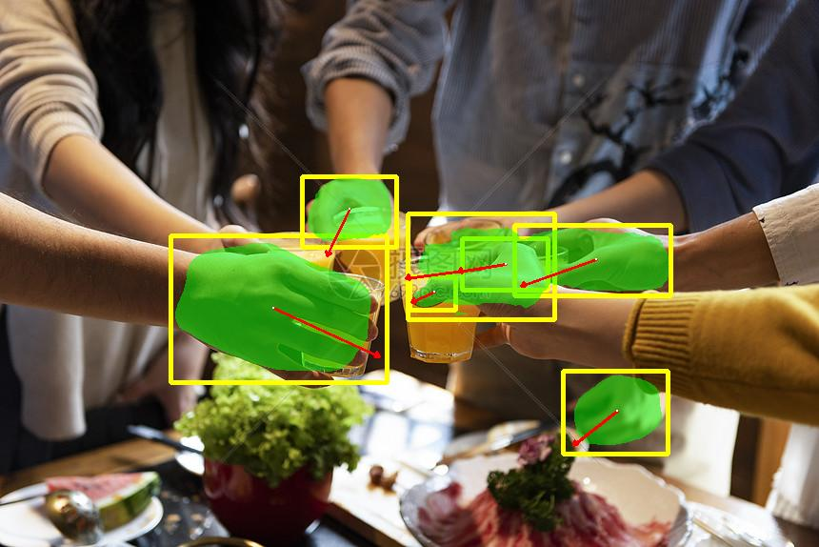

Slide 14
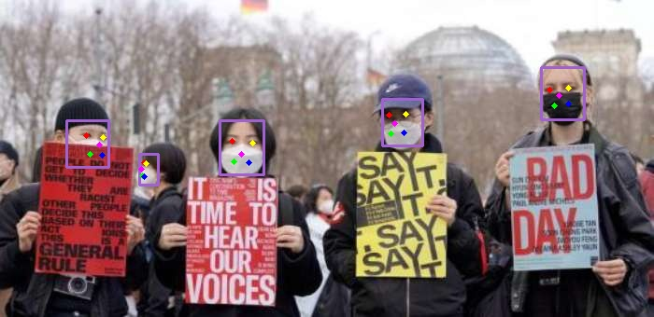
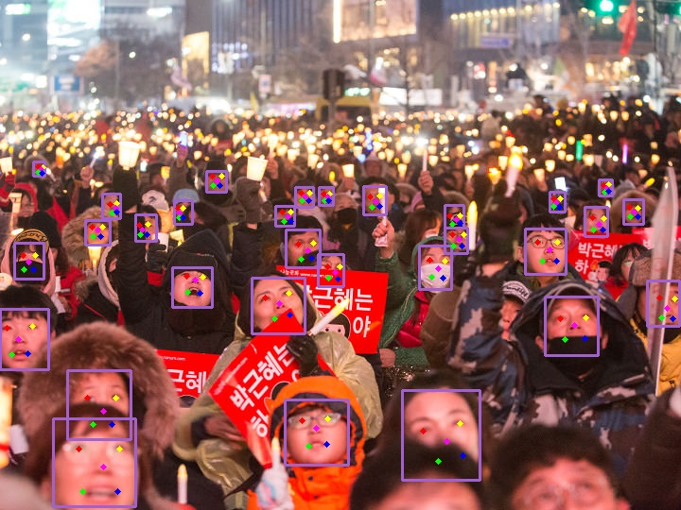

Slide 15
