Slide 1


AI-Powered CoPILOT: Cursor Revıew
Exploring Cursor as an Alternative to GitHub Copilot
Your Name & GitHub Profile Link

Slide 2
IntroductIon
- What is AI-powered coding?
- How AI tools improve the coding experience
- Examples of AI coding assistants: GitHub Copilot, Cursor, Codeium, Tabnine

Slide 3

What ıs Cursor?
- Cursor is an AI-powered code editor based on VS Code
- Uses OpenAI's GPT-4/3.5 models for AI-assisted coding
- Provides auto-completions, explanations, and bug fixing
- Official website: cursor.sh

Slide 4
Key Features of Cursor
- AI Code Completion: Cursor predicts and suggests code
- Code Explanation: AI explains what a selected code does
- Bug Fixing: AI suggests corrections for errors
- Refactoring: AI helps rewrite and optimize code
- Built-in Chat: AI assistant for queries inside the editor

Slide 5

How to Use Cursor ?
- Step 1: Download Cursor from cursor.sh
- Step 2: Open Python or any other language file
- Step 3: Start coding and let AI suggest completions
- Step 4: Use 'Explain with AI' or 'Fix with AI' features

Slide 6
Demo - UsIng Cursor to WrIte Code
- Example: A simple calculator in Python
- AI-generated suggestions for code completion

Slide 7
Cursor vs GItHub CopIlot - ComparIson
Feature | GitHub Copilot | Cursor
AI Model | GPT-4/3.5 | GPT-4/3.5
Code Completion | ✅ | ✅
Code Explanation | ❌ | ✅
Bug Fixing | ❌ | ✅
Free Plan Available | ❌ | ✅ (Limited)
Editor Compatibility | VS Code, JetBrains | Cursor Editor

Slide 8
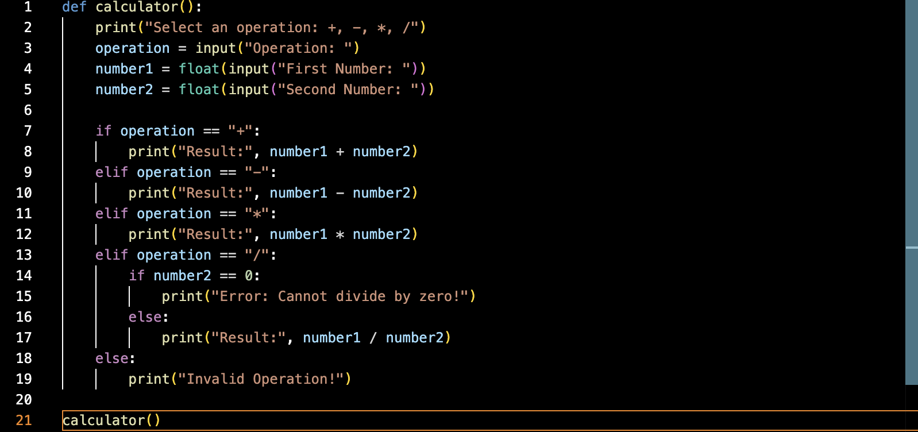
BEFORE WHEN I DONT USE THE CURSOR

Slide 9
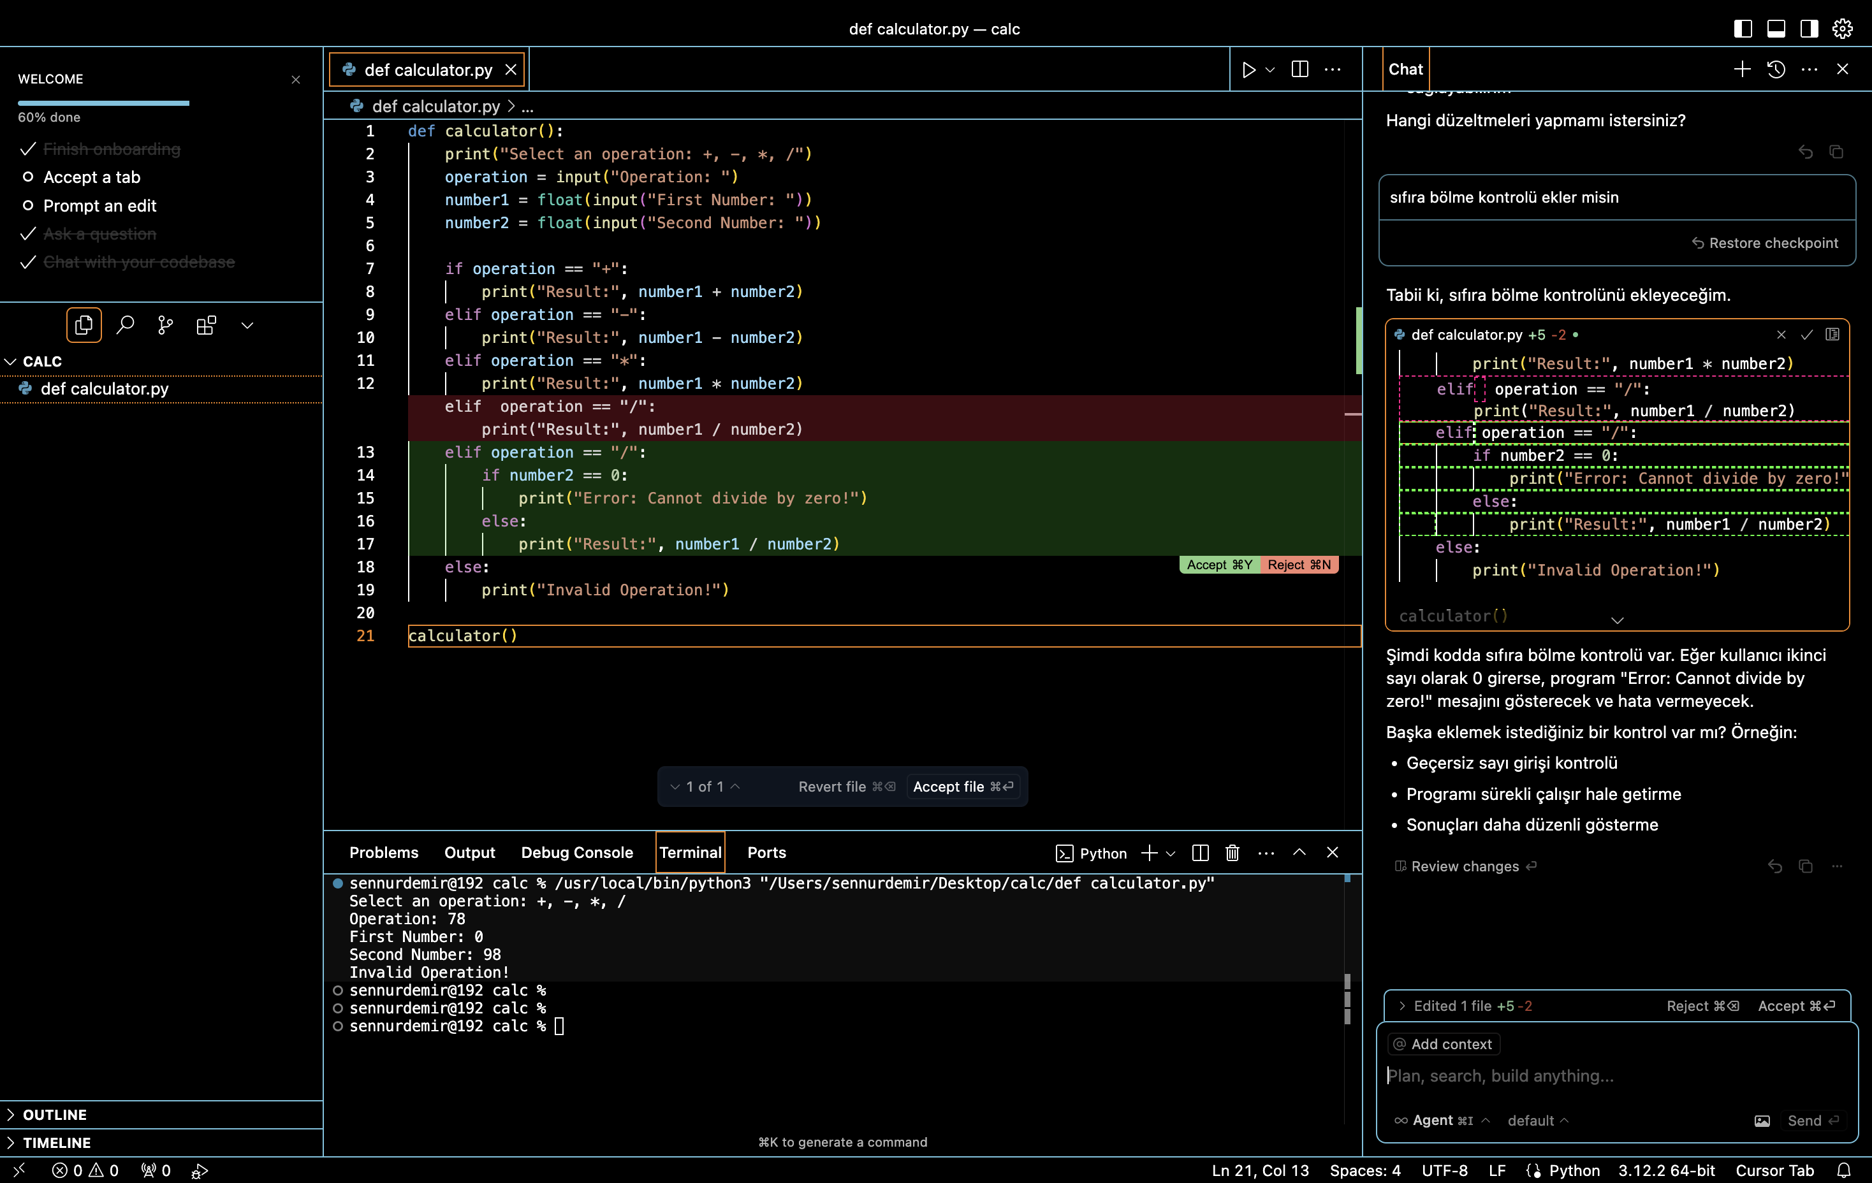
WHEN I USE IT

Slide 10
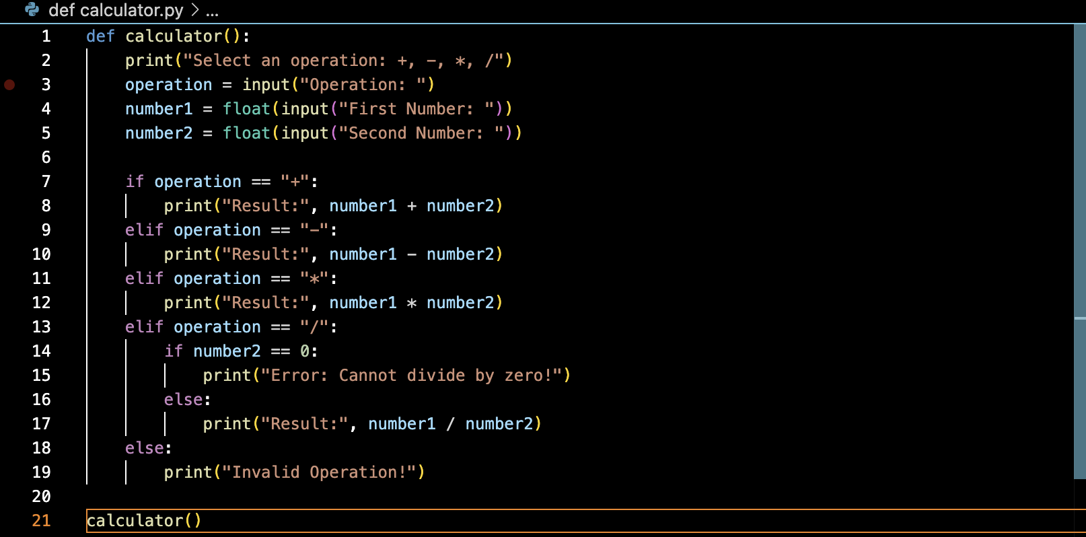
AFTER

Slide 11
My ExperIence wIth Cursor
- AI suggestions are fast and accurate
- Code explanation is helpful for learning
- Bug fixing is a great feature missing in Copilot
- Interface similar to VS Code, easy to adapt
- Free version is useful but has limitations

Slide 12
GItHub ProfIle & AssIgnment SubmIssIon
- My GitHub Profile:
https://github.com/sennurrdemir
- Presentation and codes uploaded to GitHub
- Screenshots of code written in Cursor are attached.

Slide 13
ConclusIon
- Cursor is one of the best free alternatives to Copilot
- AI coding tools improve productivity and learning
- Future of coding will be more AI-assisted
- Any Questions? Thank you!

Slide 14
THANK YOU 4 LISTENING.

