Slide 1
Data Analysis – Popular Games
Seno alrianto

Slide 2
Data Understanding
Main Games dataset (Maingames_DS_dataset.csv) is a dataset that contains followers data of various types of games in three countries (Indonesia, Philippines, and Vietnam) that have gender categories, and have other variables such as broadcast, and so on.

Slide 3
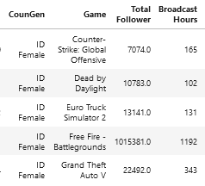
Data Preprocessing
This stage performs the process of cleaning data by deleting / unifying lost data / different from average data / often appears.
This stage performs the process of cleaning data by bringing together variable countries together with gender to group gender data of each game in each country.

Slide 4

Feature Selection
Check the correlation between variables and targets (followers) to find out the effect of variables on the data used.

Slide 5
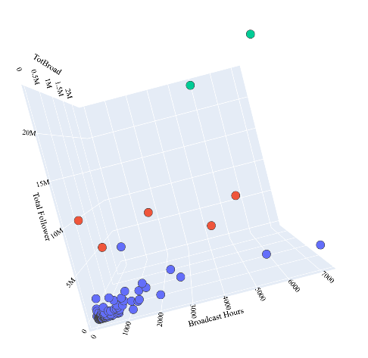
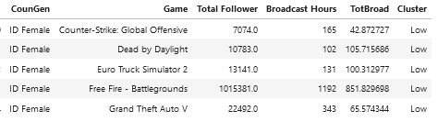
Clustering
Grouping data using K-Means Clustering is divided into 3 categories (low, medium, hight) to facilitate data recognition.

Slide 6
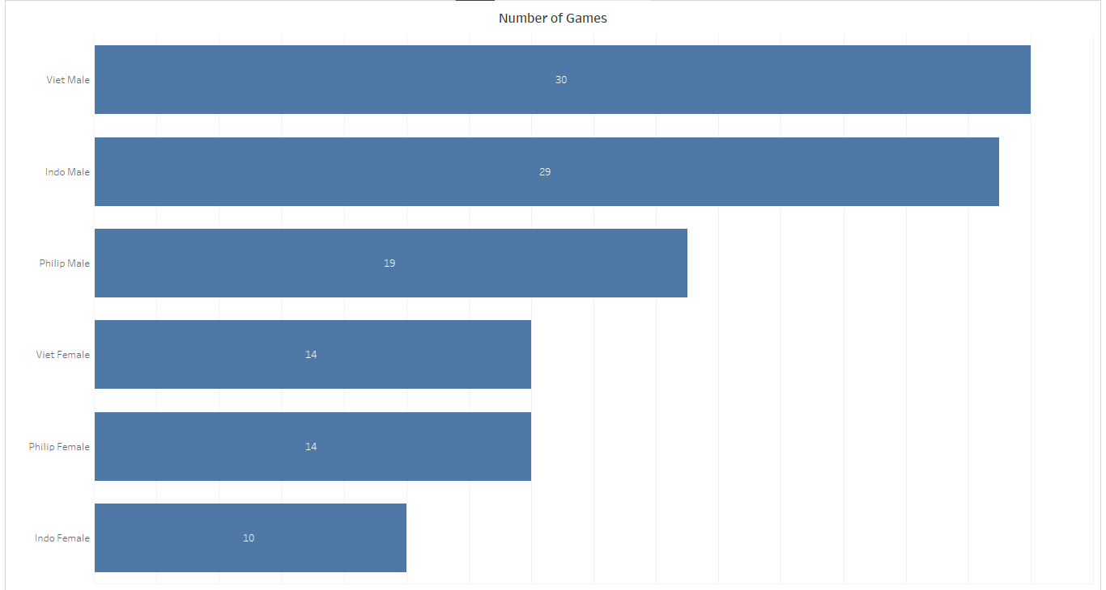
Number of the Games
Vietnam (male) is the largest user of the type of game with the number of 30 games, second place Indonesia (male) with the number of 29 games, here is a graph of the order of the number of games in each country based on gender.

Slide 7
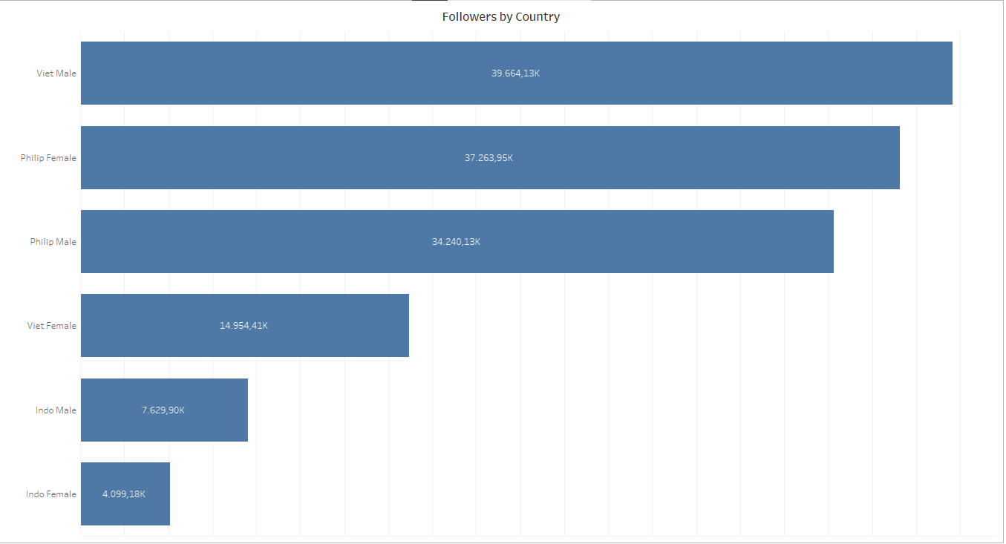
Followers by Country
Vietnam (male) has the most followers with a total of 39,664.13K, second place is the Philippines (female) with a total of 37,263.95K. Here is a sequence of the number of followers in each country based on gender.

Slide 8
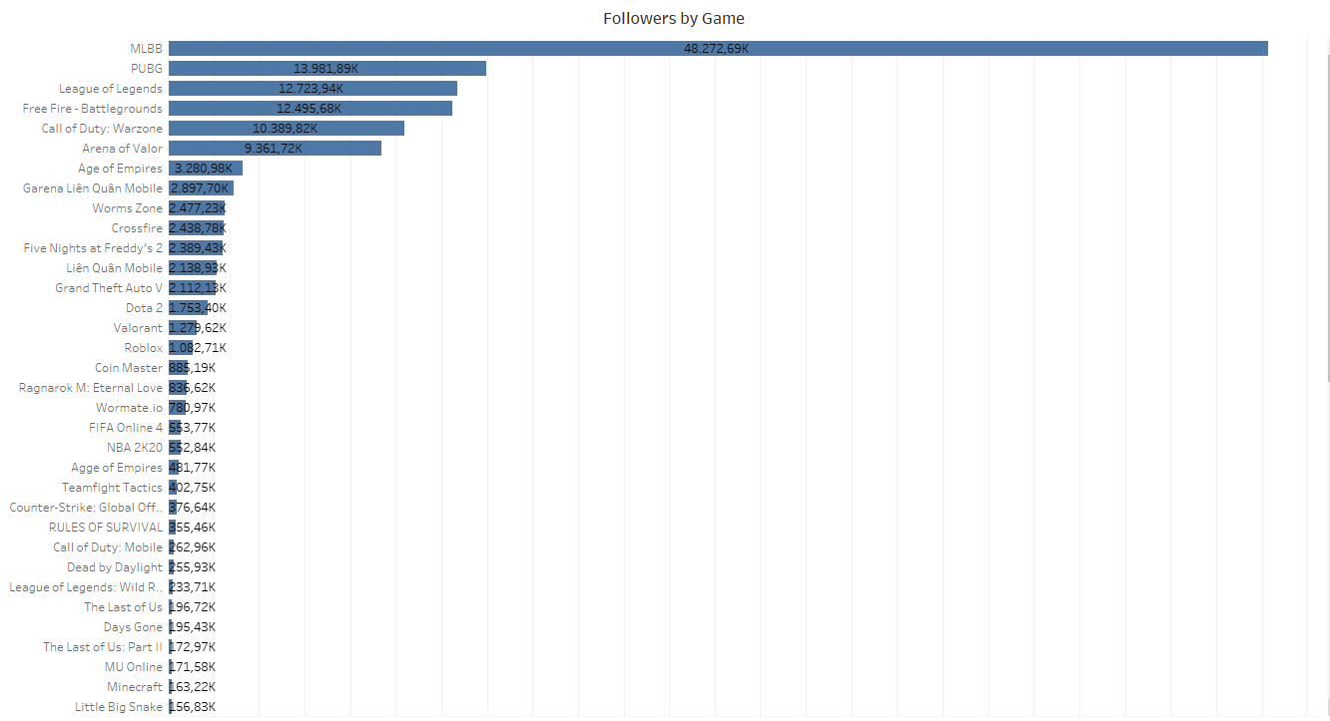
Followers by Game
The most popular game is MLBB with 48,272.69K, followed by PUBG with 13,981.89K. Here is a complete graph of the order of games based on followers.

Slide 9
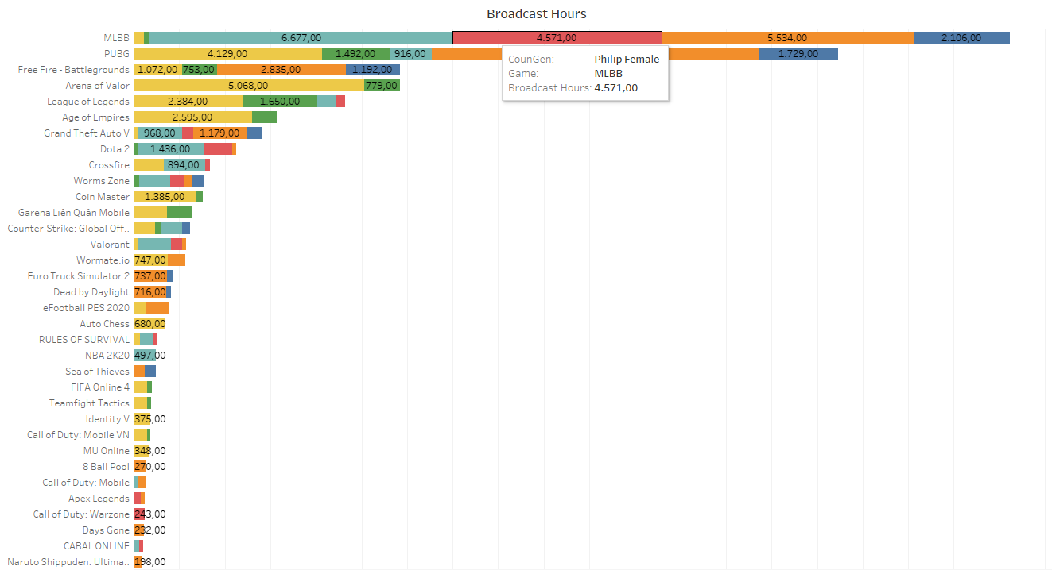
Broadcast Hours
The number of followers is greatly influenced by the number of broadcast hours where the higher the value of the broadcast hour, the more followers.

Slide 10
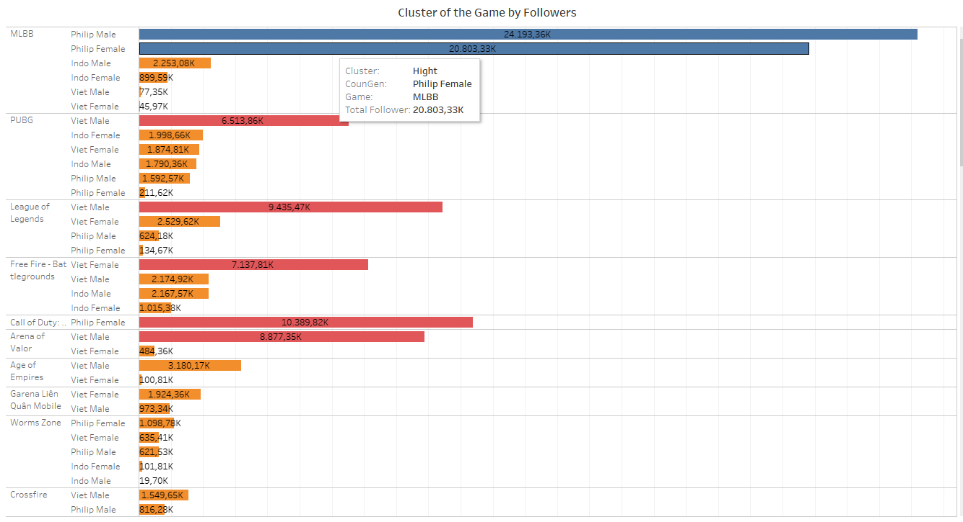
Cluster of the Game by Followers
Grouping games based on followers in each gender-country can be used as a benchmark for the development of game popularity.

Slide 11
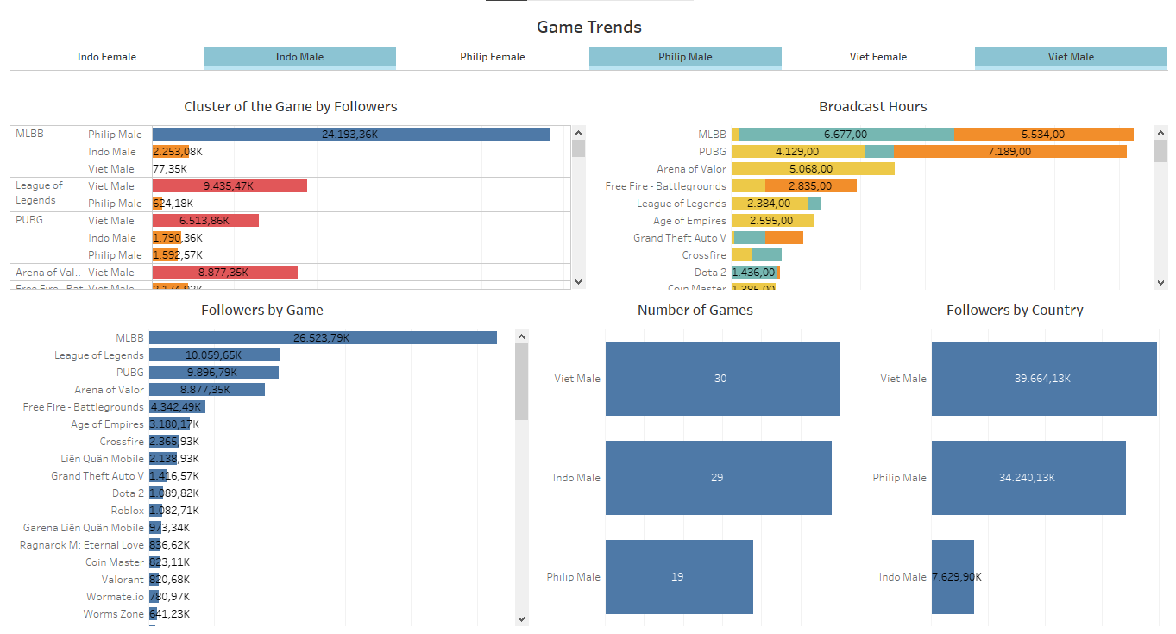
Sample Popularity of the Games
Here are some samples of gaming popularity from all three countries based on male gender.

Slide 12
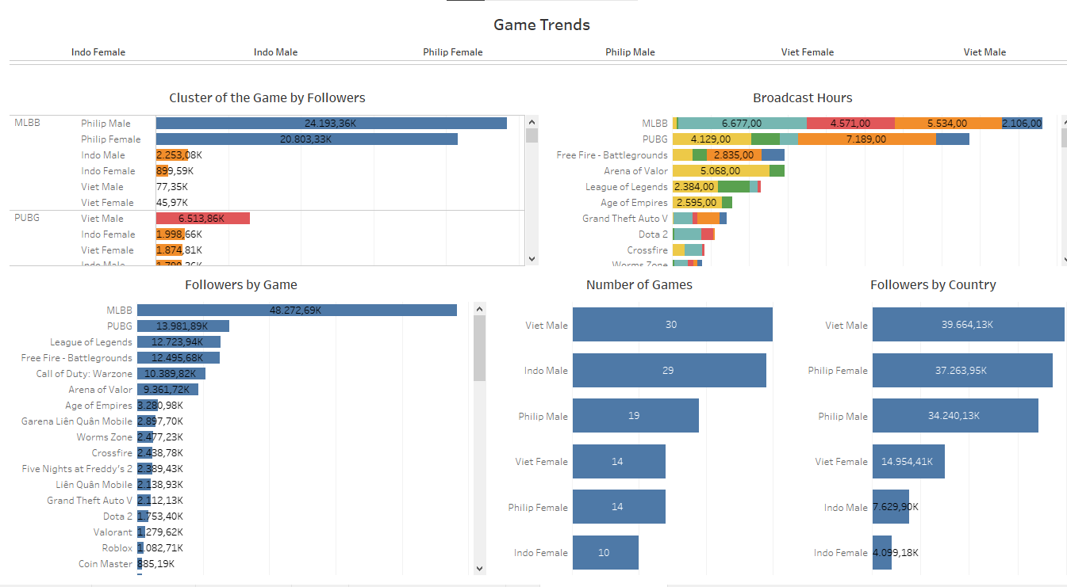
Dashboard
The dashboard that has been created contains a summary of the analysis that has been done as a thorough insight into the development of the popularity of the game.

Slide 13
Conclusion
To increase the number of followers each then the first thing to do is to increase the number of broadcast hours because the correlation of broadcast hour to followers is very important.

Slide 14
Thank you.

