Slide 1
People Analytics Dashboard
Employees percentages by Job Role
# of Employees
4,410
5.4%
5.6%
22.2%
Sales Executive Research Scientist Laboratory Technician Manufacturing Director
Healthcare Representative Manager
Sales Representative Research Director Human Resources
Avearge Tenure
6.9%
8.9%
7
Average Yearly Salary
19.9%
9.9%
₹780,352
17.6%
# Years Since Last Promotion
2
JobSatisfaction
WorkLifeBalance
1.5K
3K
Average Hours Worked (Per Day)
1K
WorkLifeBalance
2K
500
1K
11
0
4
3
1
2
0
0
3
2
4
1
0

Slide 2
JobSatisfaction
JobSatisfaction
Sales Executive
Research Scientist Laboratory Technician Manufacturing Director
Healthcare Representative
Manager
Research Director Sales Representative Human Resources
4K
3K
JobSatisfaction
2K
1K
0
500
1K
1.5K
2K
2.5K
3K
0
Travel_Rarely
Travel_Frequently
BusinessTravel
Non-Travel
WorkLifeBalance
Age
JobSatisfaction
1K
50
1.2K
800
40
1K
WorkLifeBalance
JobSatisfaction
800
600
30
600
400
20
400
200
10
200
0
0
0
2
0
7
3 8 4 1
YearsWithCurrManager
9
5
6
Sales…
Rese…
Labor…
Manu…
Healt…
Mana…
Sales…
Rese…
Hum…
JobRole

Slide 3
Training Time by Gender
Pay Increase by Gender
Male
Female
Male
Female
1K
981
500
800
843
400
600
660
630
300
400
200
200
219
219
54
100
150
138
159 54
117
108
0
5
TrainingTimesLastYear
78
0
15 18
PercentSalaryHike
2
3
4
1
6
0
11
13
14
12
17
16
19
22
# of Separation From the Previous Year
Company Headcount by Gender
Male
Female
Male
Female
Male
Female
2.5K
2K
100%
2,205
80%
1.5K
1,494
40%
EmployeeID
60%
1K
500
40%
60%
20%
441
270
0
No
Yes
0%
4
3
1
JobSatisfaction
2
0
Attrition

Slide 4

Correlation between Promotion, Age, and Years with Company
Age
15
12.5
10
7.5
5
2.5
YearsSinceLastPromotion
0
0
5
10
15
20
YearsAtCompany
25
30
35
40
Average time spent with Manager versus promotion
YearsAtCompany
YearsSinceLastPromotion
12.5
27
30
10
22 10
20
YearsSinceLastPromotion
20
19
17
9
18
20
YearsAtCompany
7.5
15
16
12
12
6
7
6
5
10
8
6
5
4
6
4
5
5
10
2.5
4
4
5
5
3
2
0
 |  |  | 1 |  | 1 |  | 1
2 |  | 7 | 3 | 8 | 4 |  | 1 | 9 | 5 |  | 6 |  | 10 |  | 11 |  | 12 |  | 13 |  | 17 |  | 14 |  | 15 |  | 16
0
1
0
0
YearsWithCurrManager

Slide 5
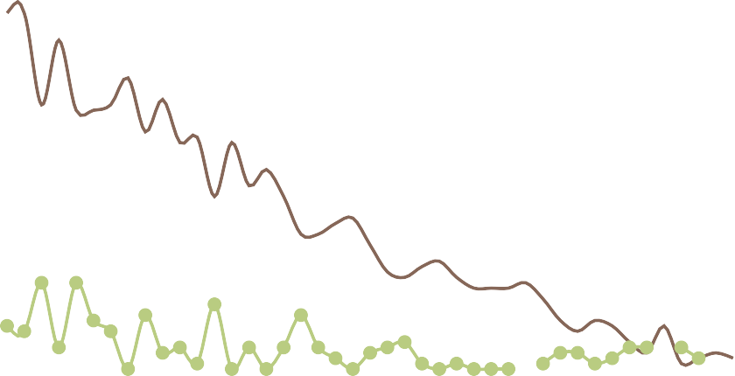
Attrition based on Job Level
No
Yes
1.5K
1,377
1,317
Attrition based on Age
1K
No
Yes
250
500
558
285
96
200
252
267
51
180
27
0
1
2
3
JobLevel
4
5
150
100
Attrition based on Years of Education
50
No
Yes
0
5K
35
36
30
40
28
45
44
50
47
51
54
58
21
19
57
4,347
Age
4K
4,032
3K
2K
1K
1,374
801
744
318
615
105 78
0
2
Education
432
3
4
5
1

Slide 6
YearsAtCompany
37
tenure forecast parameter
37
Tenure forecast multiplier
1
YearsAtCompany
tenure forecast parameter
JobSatisfaction
PerformanceRating
Sales Executive
3
7
32
3
28
Research Scientist
3
7
3
27
Laboratory Technician
3
7
3
25
Manufacturing Director
3
7
3
21
Healthcare Representative
3
7
3
24
Manager
3
7
3
17
Sales Representative
3
6
3
20
Research Director
3
7
3
19
Human Resources
3
8
3
0 2.5 5 7.5 10 12.5 15 17.5 20 22.5 25 27.5 30 32.5
YearsAtCompany

Slide 7
Observations
Management believes that the level of attrition is due to the following:
15 % of employees leaving every year
On their own or because they got fired
Job Satisfaction:
Sales Executives, Lab Technicians, and Research Scientists are very happy with their jobs.
Human Resources is the least satisfied with their jobs, followed by Sales Representatives and the Research Director.
The Manager role falls into the borderline area, and more analysis is needed.
Healthcare Representatives and Managing Directors are neutral in their satisfaction levels and need further analysis.
Employees are happy to travel sometimes but not frequently. More importantly, they are not happy with 'no travel' opportunities.
The highest work-life balance falls along the same trend lines as the job satisfaction breakdown. The Sales Executive has the highest work-life balance at an average age of 42.
Human Resources has the lowest work-life balance, and the average age is 24.
Gender breakdown:
More men are hired at the company than women (60% men to 40% women).
Men overall receive more training time than women. The highest amount of training time is 2-3 times per year.
Men receive a higher number of pay increases than their female counterparts at a significantly higher rate. The highest percentage of pay increase falls between 11-14%.
More men leave the company than women based on the previous year's numbers.
Men report a higher level of job satisfaction than their female counterparts by a wide margin.
Promotions:
There is a large and inconsistent gap between promotions at every level within the company.
Outliers: An employee with a tenure of 40 years with the company and 15 years since their last promotion versus an employee with one year at the company and one promotion.
Age seems to be a factor in promotions, with the highest number of promotions falling between the ages of 19 to 47.
The average time between promotions is anywhere from 2.5 to 12.5 years.
The longer employees stay with one manager, the more time between promotions increases dramatically.

Slide 8
Recommendations
Management believes that the level of attrition is due to the following:
15 % of employees leaving every year
On their own or because they got fired
Job Satisfaction:
a. Human Resources, Sales Representatives, and Research Director need more attention to their pain points around job satisfaction and travel opportunities.
Limit the average time with any single manager to 2-3 years. There is a higher level of satisfaction when employees can change
managers frequently. The highest satisfaction level is at 2 years.
Increase travel opportunities for roles outside of the Sales Executives. Some travel opportunities are desired across all job roles so long as it is not too often.
Employees are happy to travel sometimes but not frequently. More importantly, they are not happy with 'no travel' opportunities.
Gender breakdown:
a. Eliminated the salary increases and training time gaps between men and women.
Promotions:
Create greater consistency in how and when employees are promoted. Fifteen years is too long to go without any promotion.
Make sure that women are being promoted at a higher level than they are now which should accompany a salary increase.
Tie training time and promotion to a fast-track program for employees who have a bachelor's degree and/or master’s degree.
Require managers to increase role rotations in their departments for younger employees tied to job level increases based on performance ratings.
Male
Female
Resea…
Sales
Huma…
JobSatisfaction
100%
1K
4K
EmployeeID
JobSatisfact…
50%
500
2K
0%
4
3 1 2
JobSatisfaction
0
0
4
3
1
2
0
0
Travel_Rarely Non-Travel
Travel_Freque…
BusinessTravel

