Slide 1
Efficiency
Consumption of messages should be as cheap as possible because I/O is costly.
If Downstream consumers are not fast, small bottle necks can tip the system under heavy load before infrastructure.
2 common causes of inefficiency
  Too many I/O operations.
    Solved by bursty stream of random messages instead of single message.
  Excessive byte copying.
    To understand this, we have to understand how sendFile command works.
End-End Batch Compression:
In some cases, if the messages are sent over a wide area network, n/w bandwidth can be bottleneck.
Users can compress its messages but may lead to very poor compression ratios due to repetition between messages of same type. Kafka supports this with an efficient batching format. A batch of messages can be clumped together and sent to the server in this form. This type of messages will be written in compressed form and only decompressed by the consumer.

Slide 2
SendFile System Call
Common Data path for transfer of data from file to socket.
Kernel
1 . OS reads from Disk to Page Cache in Kernel Space
Socket buffer
PageCache
Disk
4. OS copies to NIC Buffer to send over the network.
NIC Buffer
2. Application reads data from Kernel Space into user-space buffer.
3. Writes back to socket buffer
Application
User-space
Buffer
This is inefficient as there are four copies and 2 system calls. Using sendFile, this recopying is avoided by allopwing the OS to send data from pagecache to n/w directly. So only 1 copy to NIC buffer is needed.

Slide 3
Common usecase:
Data is copied into page-cache exactly once and reused on each consumption instead of copying that to usermemory each time it is read.
Consumption rate will be limit of network connection.
=> As consumers are mostly caught up you will see no read activity on disks as they will be serving data entirely from cache.
Producer
Broker
Consumer

Slide 4
Producer
Load balancing
  Producer sends data directly to the broker and that is the leader for the partition.
  To help producer do this, all Kafka nodes can answer a request for metadata about which servers are alive and where the leaders for the partitions of a topic are at any given point of time.
  Partitioning can be done at random or with semantic partitioning function. Can be achieved by allowing the user to specify a key to partition by and using this hash to a partition. (For example, same users data can be sent to same partition always. OR this ability can allow locality-sensitive processing in consumers.

Slide 5
Producer
Asynchronous send
  Batching improves efficiency. Store messages in memory and after some fixed latency bound (10 ms) send them together in a single request.
  Configurable allowing tradeoffs for additional latency for better throughput.

Slide 6
Consumer
Issues “fetch” requests to brokers leading the partitions it wants to consume.
Consumer specifies its offset in the log with each request and receives significant control over this position and can rewind it to re-consume data if needed.

Slide 7
Consumer
Push vs pull
  Traditional design: Producers push into Brokers and Consumers pull from Brokers.
  Goal for consumer is to consume at maximum possible rate.

Slide 8
Consumer
Consumer Position
  Keeping track of what has been consumed is, surprisingly, one of the key performance points of a messaging system.
  How to track the position?
    Within broker? Too much processing for broker and issues while coming to a agreement that data is processed. How to acknowledge and if it did, what if there are issues while sending ack?
  We will maintain offset for the partition and logSize.

Slide 9
Message Delivery Semantics
At most once
  Messages may be lost but are never redelivered.
At least once
  Messages are never lost but may be redelivered.
Exactly once
  Each message if delivered only once (What we need)

Slide 10
Replication
Replicates log of each partition.
Replication factor can be configured by topic.
Kafka node alive?
  Node must maintain its session with zookeeper(heartbeat mechanism)
  If its a follower(replicated one), must replicate writes happening on leader and not fall “too far” behind.
We will consider message as committed only when all replicas have that message.
  Only committed messages are given out to the consumers.
  Producers have the option to either waiting till the message is committed or not (tradeoff; lowlatency vs durability). This preference is controlled by the ack setting
If the leader fails, one of the replication is made leader and it depends on which repliocation has the latest log consumed and based on voting mechanism a leader is picked.
What if they all die?
  First we try to pick from in sync replicas after waiting to come back to life and choose this replica as leader.(Hoping there is data)
  Choose the first replica(not necessarily ISR) that comes back to life as leader.
  TradeOff: with former approach, system will be unavailable if there is no data in ISR. Kafka since 0.11 favors first approach and its configurable with property unclean.leader.election.enable

Slide 11
Replication
Availability and Durability
  When writing to kafka producers can choose to wait for them message to be acknowldeged(0,1,-1(all))
    -1(ack by all replicas) doesn’t guarantee that full set of assigned replicas have received the message. By default, as soon as ISR receive that message -1 is acked.
    If there are only 2 replicas and if 1 goes down we will send -1 as ack if 1 receives it. This will provide availability but if the remaining 1 is lost, we lose messages.
  Kafka provides 2 topic-level configurations that can be used to prefer message durability over availability.
    Disable unclean leader election.
      If all replicas become unavilable, then partition will remain unavailable until the most recent leader becomes available. This effectively prefers unavailability over the risk of message loss.
    Specify a minimum ISR size.
      Partition will only accept writes if the size of ISR is above a certain minimum. This setting will take effect if producer uses acks=all and guarantees that the message will be ack’d by at least this many in-sync replicas.

Slide 12
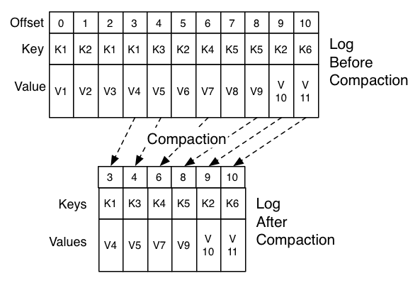
LogCompaction
Ordering of messages can
be maintained.
The offset for a message
never changes.
Any consumer from the start
of the log will see the final state of the record.

