Slide 1
How we’ll build this project
Programming languages: C++, Javascript, SQL.
Frameworks: Qt, Node.js, Express.js
Team:
- Burado: Team lead/Main developer
- Vadym: Software Engineer
- Myroslav: Software Engineer

Slide 2
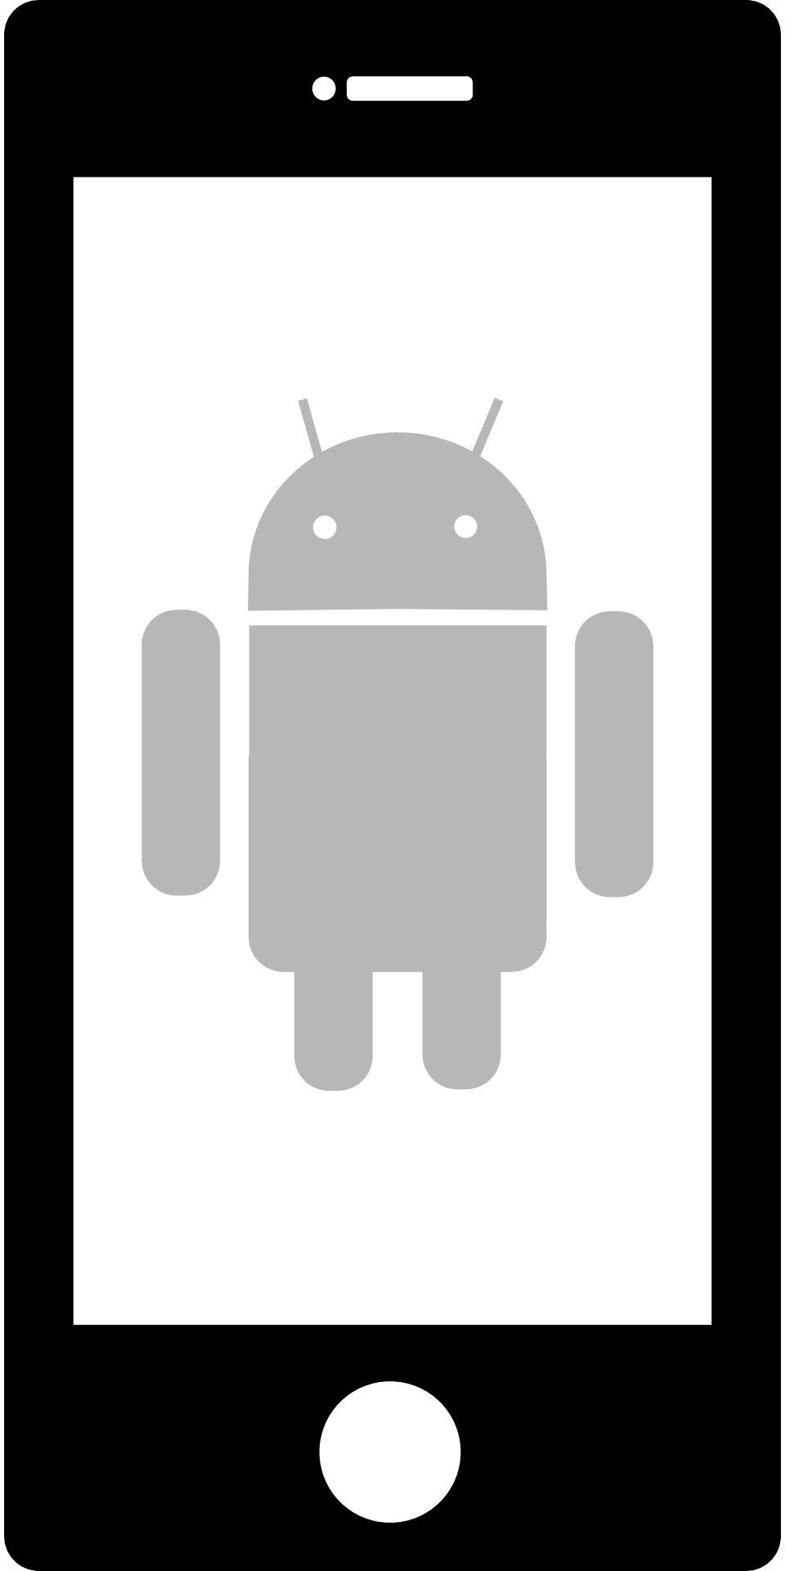

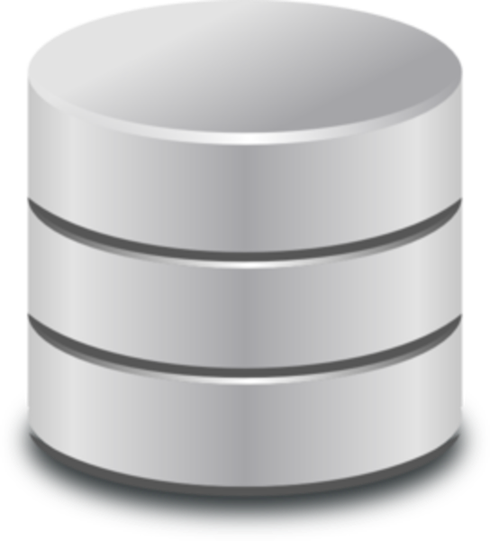

Project stucture
This application will consist of three parts: android program-client, remote SQL database and server that controls database operations.
client
server
database

Slide 3
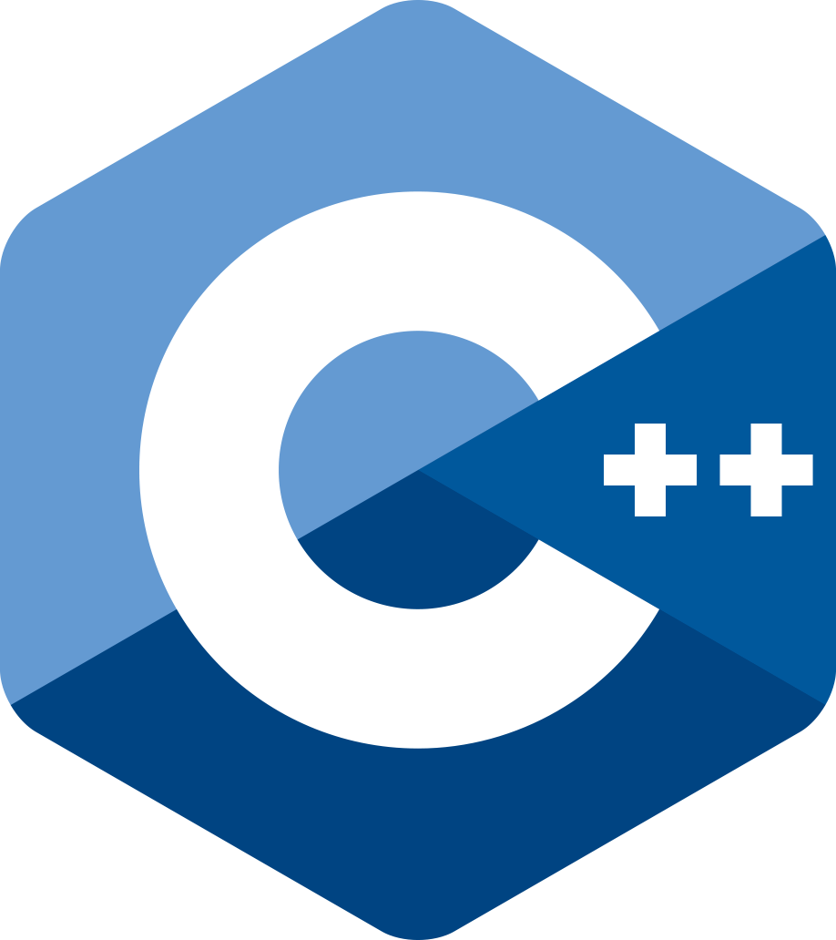


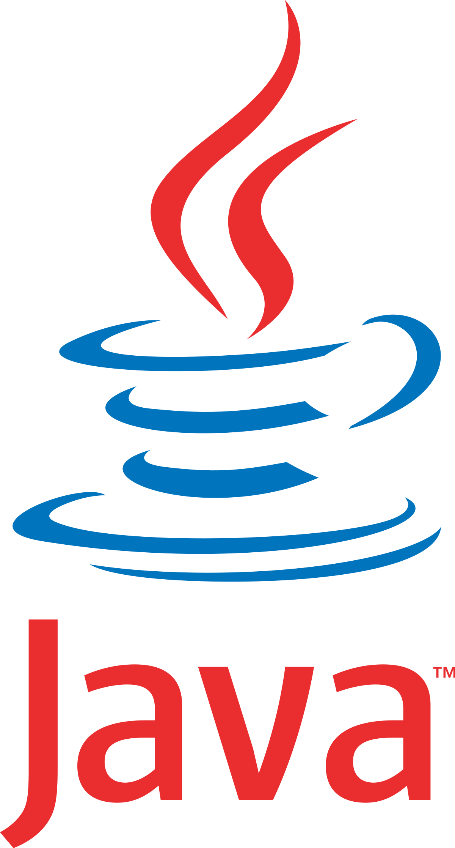
About technical features of client
We use QML to create convenient and adaptive graphical user interface.
It’s Qt’s mark-up language with javascript controller. It gets data from C++ code, processes it and shows to user. To identify employee we use Android API (Fingerprint API) and neural network + OpenCV for face recognition. To send messages or email letters we also use Android API. To make HTTP requests we use Qt’s library.
Every instance will have unique account to be identified by server.
Telegram Desktop and Skype are made using Qt.

Slide 4

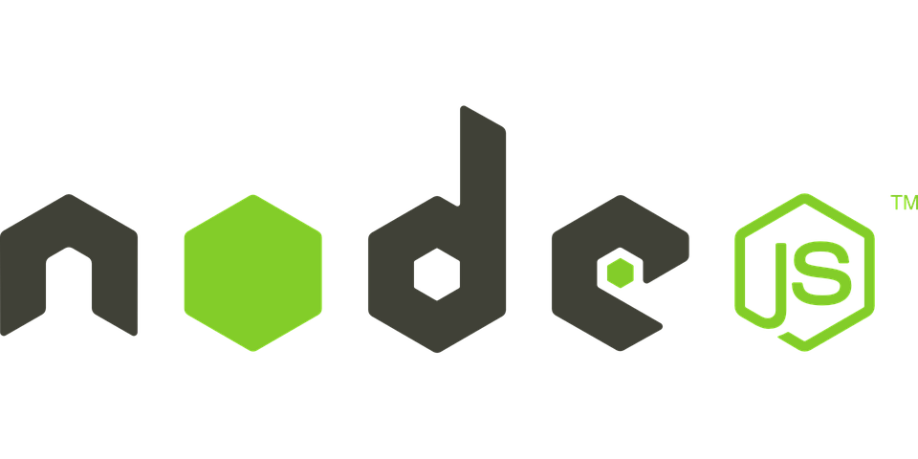
About server and technical features
Server will receive encrypted requests from client, decrypt them and process data.
Depend on client’s account data, server will load needed information from database using encrypted channel, ecrypt it and send to client answer. We will use asymmetric encryption.
Server is going to be written using Javascript + Node.js. These technologies allow developer to make good scalability in code. As MFA Auth will be used password and email confirmation.
PayPal and LinkedIn use Node.js to build their functionality.

Slide 5

Database
We will create MySQL database to store data.
MySQL is popular database and we use it in many applications. Out database will consist of many tables. Every table has three children and connects to unique account. This table and its children store logs, childrens at Kindergarden, employee work time and many another info and events.

Slide 6
A few words about development
We divided development to many steps.
At first step we create server prototype and application design. Then we create database and write its structure. After that team lead continue to develop server and other developers start to write client. First step of client development is to make front of main window. Then we can write functionality.

Slide 7
Conclusion
Our team is good choice for you if you want to develop your application very well.
We know a lot of programming languages. We know how to develop good programs.

