Slide 1


Bank of Baroda Hackathon - 2022
Technology Partner
Your Team Name : CODINGLY
Your team bio : We are from CSE Dept Mount Zion College of Engineering and Technology
Date : 15-09-2022

Slide 2
Problem Statement?
Banks are using video cameras for the purpose of surveillance at many branches, ATMs and digital lobbies. Getting video analytics of different parameters from the video recording will help the bank to resolve many operational issues at the branches. The bank wants to explore video analytics to understand the customer sentiments, understand the patterns /behaviors/actions in certain branches for proactive surveillance and provide better services to customers.

Slide 3
Proposed Solution
With opencv in python, person detection can be implemented. With the help of YOLO V4 and Deepsort algorithm, person tracking and person count can determined.
The person count is found by placing a divider in the opencv frame at the entrance of the Bank or ATM, so that it can be considered as a reference.
The emotions of the customers can be tracked using motion detection by detecting the movement of the individual.
If any type of emotion that requires attention will be sent to the staffs at the Bank.
Also Time taken for activity on premises can be found.

Slide 4
Technology Stack
Python 3
OpenCv
Tensorflow
YOLO V4
Deepsort
AI & ML

Slide 5
Azure tools or resources
Azure Data Science Virtual Machines Azure Machine Learning

Slide 6
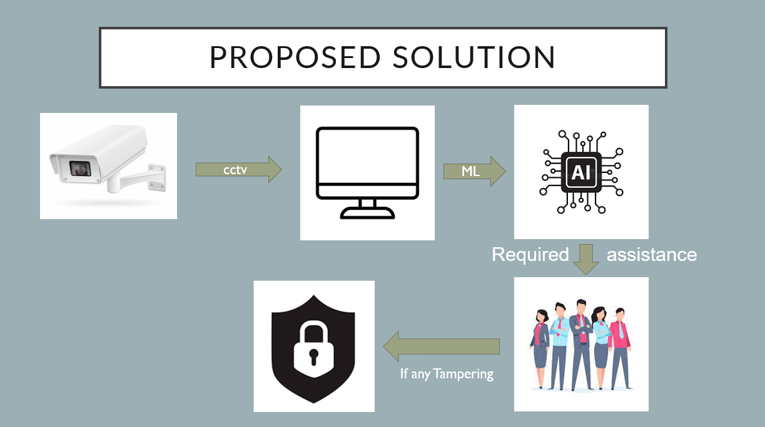
GitHub Repository Link & supporting diagrams, screenshots, if any

Slide 7
Thank You
Senthil Raja B
Vanchinathan P
Abdul Rahman S

