Slide 1
Why is Julia fast

Slide 2

What makes a language slow?

Slide 3
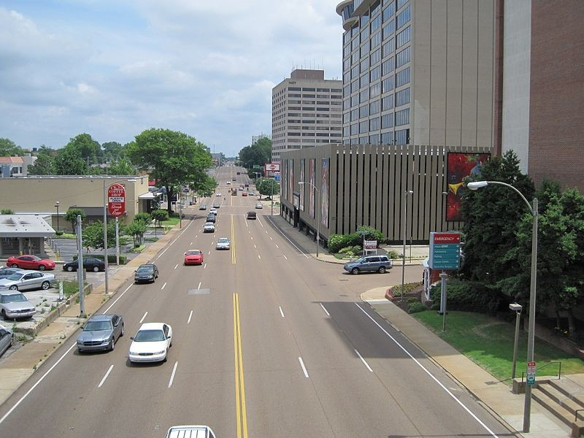
Interpreted Language
Dynamic variable type
Adaptive data structure
Interpreted line by line
Slow – every single time!

Slide 4
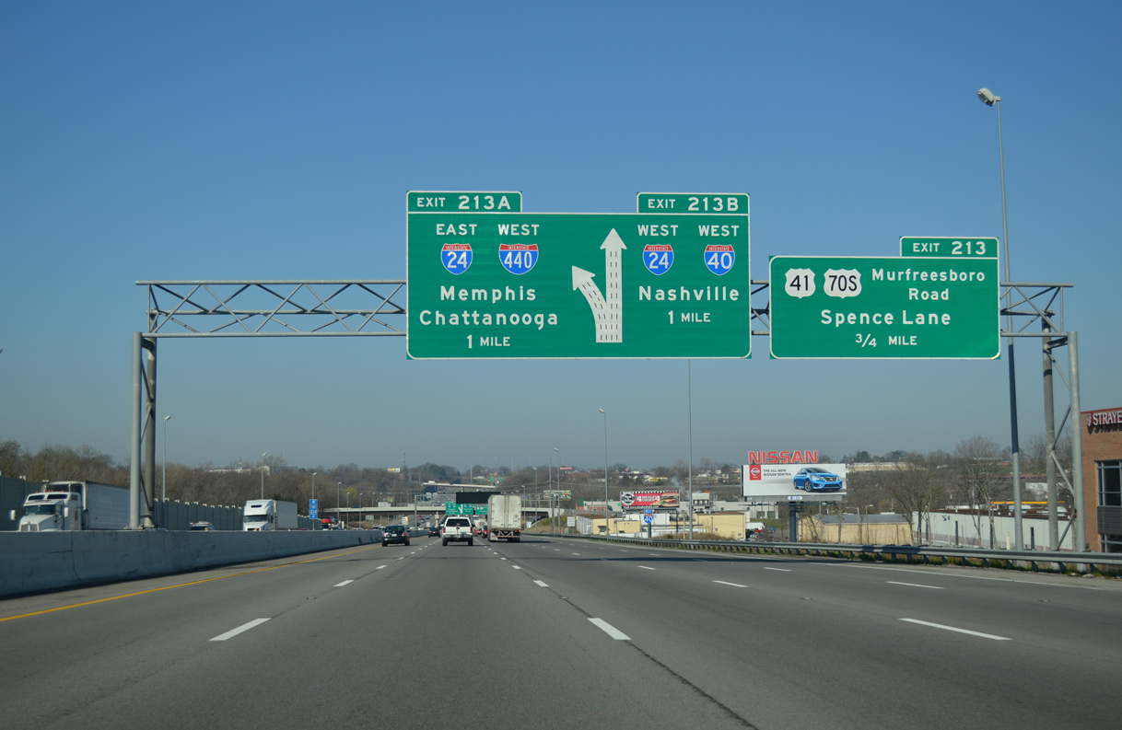
Compiled Language
Provide compiler optimizations based on type
Compilation takes time

Slide 5
Hello

