Slide 1
Cracking the crackers
Hacking passwords to keep them safe
sensei@securityguy.dev
@sensei_hacker
https://github.com/sensei-hacker
Notes:
This is a story of hacking the hackers.
Hashcat is used to crack password hashes, I cracked Hashcat.
Hashcat reveals secret passwords, this new code uses the secrets of Hashcat to protect users.

Slide 2
https://github.com/sensei-hacker/password-dog
sensei@securityguy.dev
@sensei_hacker
https://github.com/sensei-hacker
Notes:
I’m Sensei. I’ve been involved with password security for about 20 years. In the late 1990s I transitioned from physical locksmith work to website security. In the early 2000s I developed the most-used password security system for web sites at the time, Strongbox. Since then I’ve worked in a number of areas related to IT security. Last year, I turned my attention back to password cracking and strong passwords vs weak passwords.

Slide 3
Problem - Password1
Maga2020!
Yourefired
Solarwinds123
80% of data breaches are the result of poor or reused passwords.
According to Verizon Data Breach Report
Notes:
Weak passwords have led to breaches of a US President’s Twitter account not once, but twice (Carolina, 2018). Poorly chosen passwords led to the breach of the Canadian Revenue Agency, and contributed to the spread of the Purple Fox malware (Odogwu, 2021; Specops, 2021). According to court testimony, Victor Gevers (@0xDUDE) gained access to the president’s Twitter account in 2016 by guessing the password, “yourefired”. In 2020 he did it AGAIN. He guessed the password “maga2020!” on his fifth try. Any attacker who guessed “maga2020!” would be able to post as the president. This could have escalated international tensions with a message that would have appeared
to come from the president. Another attack in 2018 based on guerssing weak passwords targeted several members of the Northern Ireland Parliament (Carolina, 2018). In addition, companies such as Alibaba, Dunkin’ Donuts, and Magento have suffered breaches because of weak passwords (Odogwu, 2021).
80% of data breaches are caused by poorly chosen passwords, including reused passwords, according to the Verizon Data Breach report.

Slide 4
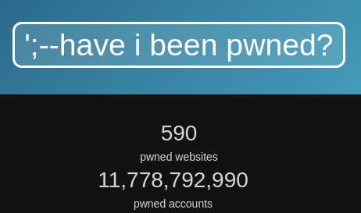
Problem - Password1!
Notes:
Haveibeenpwned catalogs nearly 12 BILLION leaked passwords and hashes, and over 600 million plaintext passwords. Your password is probably leaked on the web for anyone to download.
Often what is leaked is hashes of the passwords, rather than the plain text passwords themselves. Over 90% of the hashes can be cracked, however, because with existing solutions the passwords are often weak passwords such as “Password123” or “Defcon2022”.

Slide 5
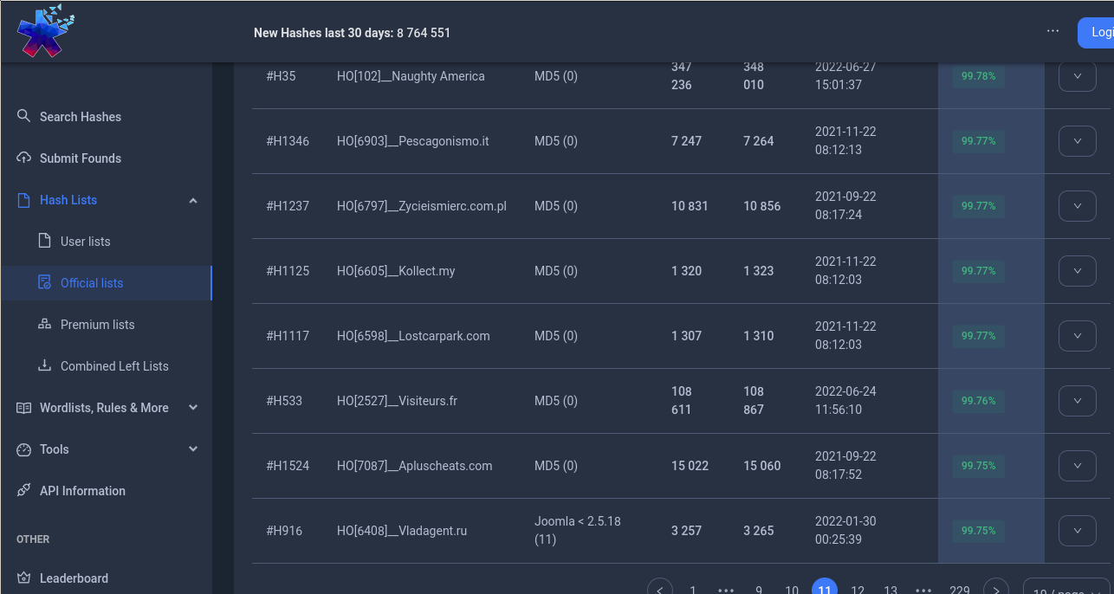
Problem - Password1!
Notes:
Password hashes are cracked by trying common patterns, such as city names or other words, followed by year number, for example. Software such as Hashcat or John the Ripper can try many passwords very quickly. For fast hashes, modern GPUs can try up to 9 BILLION SHA-2 hashes per second.
Hashes can also be retrieved by attackers who gain access to one system in a largenetwork. In a Windows environment, the Windows OS saves a DCC2 password hash of every user who logs in - including system administrators. Cracking these hashes by finding the matching password can often give the attacker access to an account with administrator access to every computer in the company.
At 9 billion tries per second, for many breaches the crackers have cracked over 99% of the password hashes. This can be tens of thousands of passwords for a given company or government entity. I submitted a list of 47,000 real user-chosen passwords and the crackers of Hashmob cracked over 99% of the hashes.
How can we avoid this?

Slide 6
Solution Limitations
Users do not design the system –
  has to work with Windows passwords
Rate Limiting
  Applies only online
  5 tries X 5,000 accounts = 25,000 tries
Multi-factor authentication
  MFA is 6 numeric digits – useless with a weak password
  At least three different codes are always valid
Existing strength meters – allow Password1, Spring2021!, etc.
Notes:
It is sometimes proposed that people should not use passwords. While smartcards and other options do have some benefits, they also have their problems and so have not widely replaced passwords in the decades they have been available. For better or worse, passwords ARE the most common authentication method. Users and IT professionals often cannot replace passwords with a more secure system that’s still convenient. This is because sysadmins and security teams don’t design and build the systems that are used. For example, most companies use Windows. They therefore have to work with what Windows and Cisco support - security teams can’t redesign Windows, or redesign their routers for better security.
Rate limiting is sometimes mentioned. While rate-limiting provides a degree of protection from *online* attacks, it does not protect from cracking leaked or stolen hashes. Rate limiting also provides only moderate protection from online attacks for larger organizations. If an organization with 5,000 users allows 5 attempts per account within say 15 minutes, that means an attacker can try 25,000 total times every 15 minutes.
Typical MFA systems which use a 6-digit code suffer the same problem. Keep in mind, standard 2FA system like TOTP or HOTP must accept at least three different codes as being valid at any time, due to slight clock differences and even the time it takes the user to type the code. That means it will only take, on average, 160,000 tries to guess a code and have it accepted. With 25,000 attempts per 15 minutes, on average it will take an hour and a half for the script to get a correct code. The hacker will most likely get in by just running a script for a couple hours.
Two factor systems work well only as a SECOND factor, WITH a strong password. Perhaps that’s why they are called TWO factor systems, it’s a second factor to be used WITH a strong password.
Similarly for rate limiting. An attacker can guess “Spring2022” even with rate-limiting in place. Rate-limiting is effective only in combination with strong passwords.

Slide 7
Current Meters
How well do the work?
What’s wrong with them?
Will something else work better?
A new open source method
Notes:
How about existing password meters and filters?
How well do they work?
How do existing meters fail?
And - Is there a better way?
I did some testing to find out, and made a new
Open source system available.

Slide 8
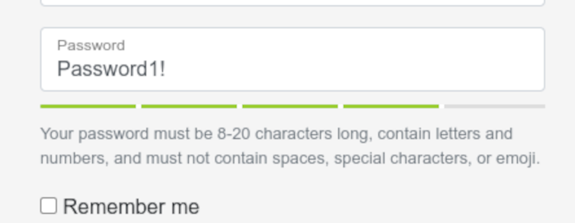
Existing Meters
Notes:
There are several existing solutions which attempt to predict if a proposed password will be easily cracked.Some give a pass/fail answer, some provide a score in order to display a password strength meter for the users. In this project I measured how well they work. The measured filters include libpwquality, openpasswordfilter, passfiltex, passwdqc, and zxcvbn. Passwdqc is notable because it was created by Solar Designer, the same person who created the famous cracking software John the Ripper. As the father of modern password cracking techniques, Solar Designer is an expert on cracking password hashes. Does that mean his tool for measuring a password’s resistance to cracking will be very effective? I measured to find out.

Slide 9


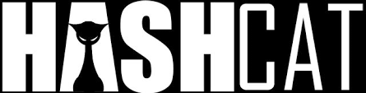
Measurement – vs Team Hashcat
Notes:
To measure how well these solutions predict if a password is likely to get cracked, we first need ground truth as to whether each password truly is crackable. For this, I recruited some of the world’s best password crackers to try cracking the password hashes in my dataset of real passwords chosen by users.
Each year at Defcon, there is a password-cracking contest. CMIYC. Each of the last three years, Team Hashcat has won. The members of Team Hashcat are therefore arguably the best password crackers in the world. Two members of Team Hashcat assisted me with understanding how they crack password hashes and measuring which passwords are crackable versus which are not.
On their advice, I also submitted the final corpus of test passwords to Hashmob, a group of excellent password crackers, which shares some members with Team Hashcat. To get the ground truth of which passwords will actually get cracked vs which will not, I looked at which passwords actually got cracked by Hashmob and by a member of Team Hashcat. I then measured how accurately each password meter or filter predicted the vulnerability of each password.

Slide 10
Typical Rules – Don’t work
Standard / Windows rules (3 of the following):
Uppercase
Lowercase
Digits
Punctuation
Password1!
Spring2022
Defcon123!
Solarwinds123
Notes:
The first password criteria tested in the password “complexity” rule built into Windows. With Windows, passwords must contain three of the following: Uppercase letters, lowercase, numbers, and “special characters” or punctuation.
–
Password crackers showed me that these rules most often just lead to users capitalizing the first letter and adding a number or exclamation point at the end. This leads to passwords like “Password1”, “spring2022!”. Or Solarwinds123. Each of these has three different types of characters. They are not strong passwords.

Slide 11
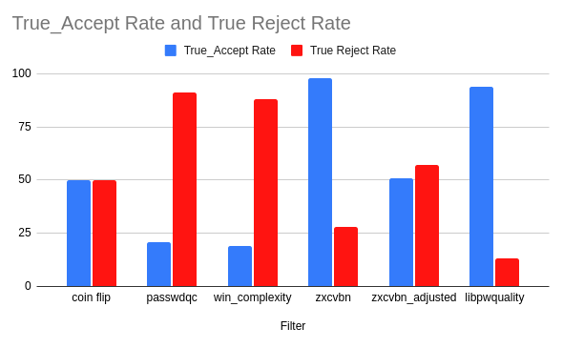
Existing Tools
Notes:
The chart shows the Windows complexity rule accepted only 19% of the passwords that were actually strong; the passwords that did not get cracked when tested by real expert password crackers. In comparison, simply flipping a coin and arbitrarily calling a password “strong” or “weak” based on a coin flip will be correct 50% of the time. So the Windows rule is less effective than flipping a coin. The Windows rule rejected 81% of strong passwords, making it inconvenient for users also.
Libpwquality and Zxcvbn accepted most of the strong passwords, but they rejected very few of the cracked passwords. Libpwquality rejected only 13% of the weak passwords, allowing 87% of the crackable passwords through. The chart shows the performance with the default or recommended settings. By making adjustments, I was able to get Zxcvbn to reject half of the weak passwords, at the cost of rejecting half of the strong passwords as well.

Slide 12
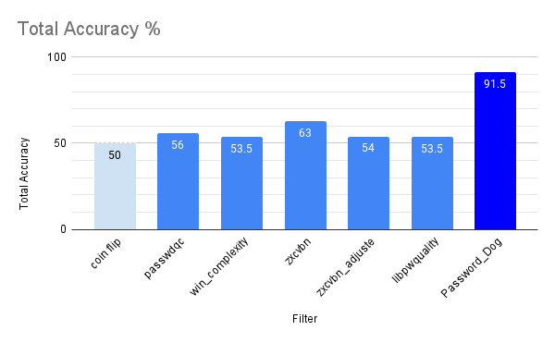
Existing Tools
Notes:
This chart of combined accuracy compares existing password meters and filters to a coin flip. Of the existing meters, only Zxcvbn stands above mere chance. Zxcvbn has a combined accuracy rate of 63%. That’s 13% better than flipping a coin.
The reason existing meters do not accurately predict which password candidates will get cracked may be because none of them attempts to model the cracking process. Existing meters look for things like “special characters”, or punctuation marks. Of course crackers can easily add punctuation, so that in no way prevents a password from being cracked. My hypothesis was that to determine whether or not cracking would reveal a particular password, it may be helpful to actually model the cracking process and see if it would in fact reveal that password.
I built an open source tool do that.

Slide 13
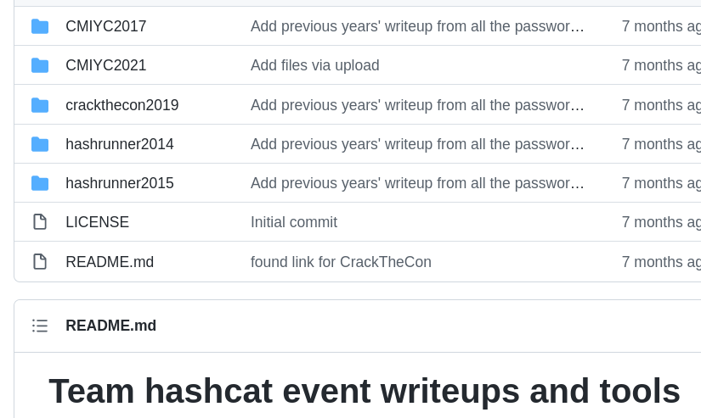
Solution – Simulate Attackers
Notes:
I wanted to create a password meter that will ACCURATELY tell people how strong their password is. If we could CORRECTLY tell people whether or not a particular candidate password will be cracked, people could use out password meter to choose truly strong passwords.|
Fortunately, team Hashcat and others document their process. We can see how they crack passwords. For example, I read through their reports on how they cracked the passwords at each of the CMIYC contests. By understanding how passwords are actually cracked, can we then determine which candidate passwords won’t be cracked? I did testing to find out.

Slide 14
Passwords vs Random Keys
Impossible to crack:
*7dfh#OfD^W+jd908-934*(*72E
Won’t be cracked:
Pool,57,Belted,Catching
Notes:
I should mention, we DO know how to generate random keys that mathematically CAN’T be cracked. 28 completely random characters, generated by a random number generator, can’t reasonably be cracked. BUUUT it also can’t be REMEMBERED. Who wants to type, and remember, 28 completely random characters? People use words and phrases, so I wanted to help them come up with passWORDS or passPHRASES that are unlikely to get cracked. These passwords or passphrases that WON’T be cracked should be distinguished from long random keys that CAN’T be cracked. My work is on strong passwords or passphrases, not random bytes, or keys.

Slide 15
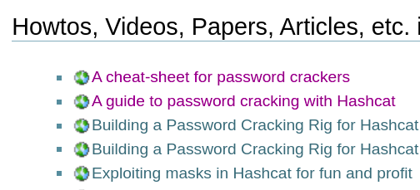
Solution – Simulate Attackers
Notes:
Even the home page for Hashcat includes tutorials on how to crack hashes. Other sites such as hashmob also include resources, including specific rule files and wordlists which work best in their experience and testing.
I figured if I had a thorough understanding of how a password actually gets cracked, I could reverse that process and determine if a candidate password is likely to be cracked via those methods. To understand how crackers crack passwords, I read everything I could find and spoke to experts such as Chick3nman and Tychotithonus. I also spent 12 weeks on the Hashcat and Hashmob Discord channels, engaging with the world’s top experts.

Slide 16
Solution – Simulate Attackers
Common Attacks
Dictionary
Rule based
Masks
Notes:
To determine whether a password would likely be cracked, I first made measurements of how much the results of different crackers overlap. I found that for the passwords cracked by one competent attacker, 95% of those were also cracked by a second attacker. This means that if we model a competent attacker, those results generalize fairly well to other attackers, who tend to use the same methods.
–
The primary methods used start with dictionary attacks, checking previously found passwords.
Next, rule-based attacks modify passwords that have been found before, sometimes using lists of millions of such passwords. The rules modify passwords in defined ways, such as by adding a number to the end or changing lowercase to upper case.
The third major method is masks, which generate defined patterns of letter, number, and special character which match those most commonly chosen by people. For example people typically capitalize the first letter, they normally don’t capitalize a letter in the middle. They tend to put punctuation at the end. Masks model these patterns and generate guesses.

Slide 17
Solution – Simulate Attackers
Dictionary Attack
Invert by – checking our own lookup tables – bloom filters.
Directly determines whether an attack would succeed when using commonly available lists.
Notes:
For a dictionary attack, the attacker tries the top million most common passwords, from readily available lists.
They may try the top 10 million, or even hundred million. Modern GPUs have the speed to allow millions or billions of tries on fast hashes like SHA-2, or even the DCC2 hash used by the Windows cache.
To determine if an attacker will crack the password via a dictionary attack, it is quite simple for our tool, Password Dog, to check the same lists that crackers use. If the candidate password is in a top one million list, it will most likely be cracked. Larger lists can be checked as well. If the hash is particularly slow, such as bcrypt(), one might check only shorter lists.
We need not try to estimate whether a particular password is in the top 10 million lists used by crackers. We can simply check the list. Bloom filters are a special data structure which allow us to check very quickly, with minimal resource cost. I built bloom filters for lists of the most common 1 million, 10 million, and 100 million passwords in leaks. I also built one for the full combined collection available to many crackers, which is 554 million passwords. This allows me to make a factual determination that a given password WILL be cracked by an attacker who uses the available lists, or that it will not be cracked using these lists, without needing to estimate.

Slide 18
Solution – Simulate Attackers
Rule-based
Rules modify entries from the word list.
Well-known rule lists -
OneRuleToRuleThemAll is 28,000 of the best rules.
Determine vulnerability by calculating which rules would be needed in order to create the candidate password.
Notes:
The rule attack takes it a step further. Rules for Hashcat or John the Ripper modify the password in the wordlist in some way. A rule may add a year on the end, such as “2021”, or may delete characters or change their case. Crackers have done significant public research on which rules work the best. A large collection known as OneRuleToRuleThemAll has 28,000 rules, in order of effectiveness. It is a compilation from other tests and compilations. An attacker might run the equivalent of the top 100, or 1,000 of these rules depending on the resources and time they have available. Also depending on the speed of the hash. In some cases, against fast hashes, a well resourced attacker with plenty of time could run all of them.
To determine whether this rule-based attack would crack a candidate password, one must figure out which rules could be used to generate the password, then check whether such a rule exists in even the larger rule collections that attackers are likely to use. If the rule is at the top of the list, it’s an effective rule, likely to be commonly used, and most attackers will probably crack that password via a rule attack. A rule at the bottom of the list would be less likely to be run. If no rule in a rule collection would generate a particular password, it won’t be cracked via this attack.
To find which rules would generate a particular password candidate, I leveraged some code from rulegen.py, from the PACK toolkit. Thanks to Peter Kacherginsky for this work.

Slide 19
Solution – Simulate Attackers
Mask Attack
?u = Upper case
?l = lower case
?d = digit
ulllllls
ulllllld
Notes:
The mask attack is often the last type of attack attempted.
Mask attacks are based on classes of characters such as upper case letters, lowercase, “special characters”, and digits.

Slide 20
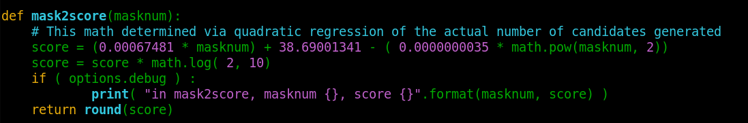
Solution – Simulate Attackers
Mask Attack
Sensei2022:
?u?l?l?l?l?l?d?d?d?d
Notes:
Because of password complexity policies, people commonly start with an uppercase letter, then six lowercase, then a digit or punctuation. An attacker can therefore try all passwords which fit these patterns, and other common patterns. In order to directly determine how long it would take to find a given password using this attack, my solution first computes the mask that fits this password. It then looks up that mask in a table giving the order attackers are likely to try masks. From that, it computes how many candidates each mask would generate. This computation is based on a quadratic regression on the actual number of candidates generated by each mask. Having computed all of that, the system computes how many guesses would be required before a mask attack would generate this password.

Slide 21
Results – Working Attacker Simulation
10^6 brute kd0
10^2 digits 123
10^9 digits 947302829
10^35 digits 37138510883541490834469392423908231
10^9 hybrid Portable744
10^8 hybrid 123Portable
10^9 bloom Portable123
10^11 rules Portable!
10^16 mask portABLE!
10^9 bloom ab8350
Notes:
After implementing all of the most common attacks, but in reverse, the new system can calculate how many tries would be needed for each attack to get a particular password. The number needed for the most efficient attack is the number of tries needed to hit upon that password. In other words, it tells us how long it would take an attacker to guess the password. Here the number of tries are shown as powers of ten - how many zeros are in the number. To be considered a strong password in a particular context, we might require that the password take 10^14 guesses, or 1 followed by 14 zeros.

Slide 22
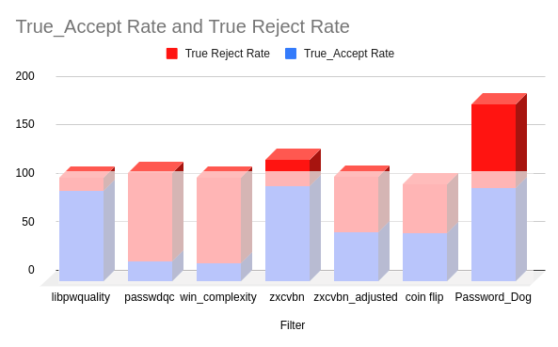
Results – Success!
Notes:
Because it works backwards from Hash Cat, I’ve called the new tool Password Dog.
This new password meter was tested by calculating how its predictions matched up to whether the password was actually cracked by the champion password crackers. Password Dog is significantly better at predicting whether a given password candidate will be cracked.
It correctly identified 96% of the strong passwords and 87% of the weak passwords.

Slide 23
Results – Success!
Notes:
This is really the bottom line of my talk -
Other password meters don’t work, they are barely more accurate than pure chance. This approach DOES work.
The lower half of the chart is the 50% success rate, equivalent to flipping a coin. Tools previously available ended up being roughly as effective as flipping a coin.
Password Dog, which simulates Hashcat in reverse, is far more effective.

Slide 24
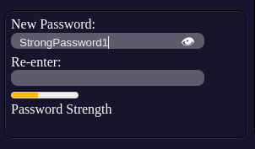
New UI with REAL PW Strength
Notes:
I developed a UI to show the user the relative strength of their password as they are typing it. This provides real time feedback to the user.
This is based on the actual time to crack that password calculated by running the actual attacks crackers would use, though in reverse.
Password Dog also provides more detailed information about which attack is most efficient and the actual numeric strength rating, if you want to use a different UI.

Slide 25
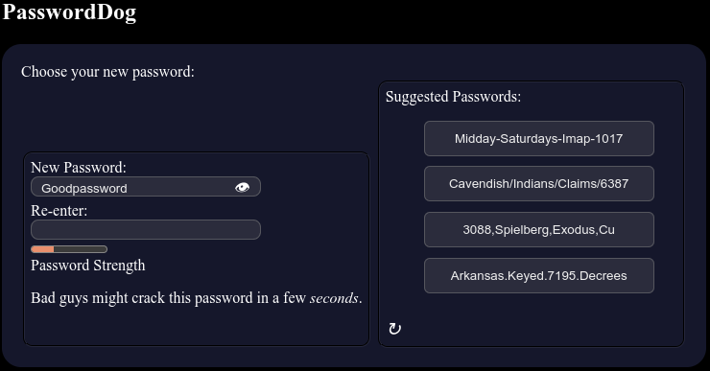
Strong Password Suggestions
Notes:
As a companion app, I also developed a tool which suggests strong passwords, but strong passwords that are relatively easy to type and to remember, if needed. These pull words randomly from a list of 30,000 words. They also contain numbers and punctuation in order to be compatible with application password policies or external standards. The keyspace for these passwords is 4 x 10^19, making them rather strong. That is, the number of possible passwords is 4 followed by 19 zeros – 40 quintillion. That can be brought to 10^24 by configuring it to add another word if extremely strong passwords are required.

Slide 26
Future work
Packaging / docs for ease of deployment
If a matching rule isn’t found, check for similar rules
Limitation – relies on available lists
Two or three sizes for rule dictionaries
Combine with Zxcvbn-type approach?
Notes:
There is some future work I plan to do, and some that someone else could do.
I have recently deployed Password Dog in an actual enterprise with thousands of employees, so I’m working on packaging and documenting it well for sysadmins to understand and be able to maintain.
The inverted rules attack could be improved by checking for rules similar to the needed rule.
Lastly, it’s possible that performance may be improved by combining this approach with the more traditional approach used by ZXCVBN and others. Done well, the combination may perform even better than this approach by itself.

Slide 27
Thank You!
@Chick3man512
@Tychothithonus
Hashmob.net
@DC214DFW
Notes:
I would like to thank Royce Williams (@TychoTithonus) [Tyco tith on us] of Team Hashcat, who provided invaluable advice from the perspective of a highly skilled attacker along with performing the first round of testing, cracking test hashes.
Sam Croley aka “Chick3nman”, a member of Team Hashcat and Hashcat Core Developer, also provided invaluable guidance. Chick3nman also assisted with producing part of the “ground truth” data, cracking the test hashes to determine which ones would be cracked by a very skilled attacker.
I would also like to thank the members of Hashmob for their advice and assistance. In particular, they carried out attacks on the test hashes, serving as the representative skilled attackers.

Slide 28
https://github.com/sensei-hacker/password-dog
sensei@securityguy.dev
@sensei_hacker
https://github.com/sensei-hacker
QUESTIONS?
Notes:
The code for Password Dog is available on my Github, sensei-hacker.
Also on Github is a 22 page academic paper covering this work, with citations for all of the facts I mentioned. A transcript of this talk will also be available.
I can be reached on twitter @sensei_hacker or email sensei@securityguy.dev

