Slide 1
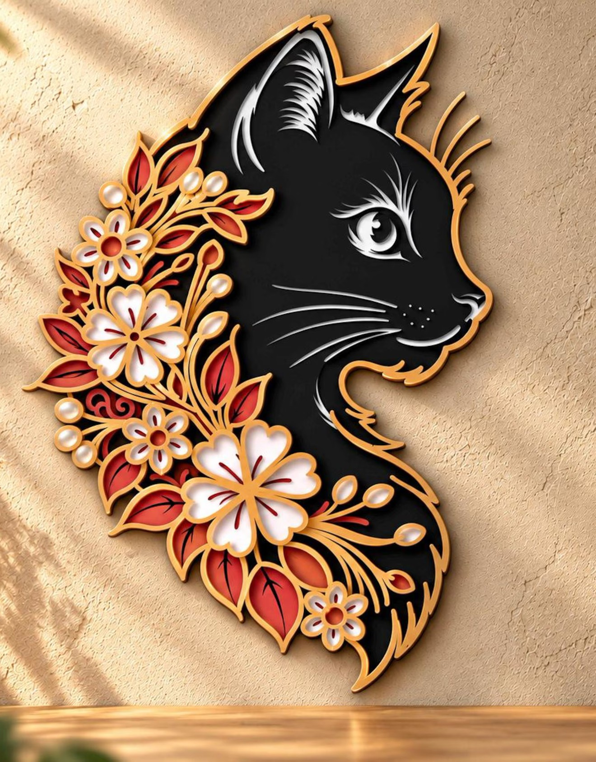

Katachi
From a photo to pieces you can cut
Show it. Say it. Make it.
Meta AI Developer Hackathon 2026 · Indie · Build for Your World
Notes:
Katachi turns a photo you love into pieces you can cut. It's a prototype, built this week on Meta's models, and this film was made with Muse Code, generated voice included.

Slide 2



Cutting is easy; designing the cut is hard
My world
Simple shapes were easy. Turning a picture I loved into cut files took hours.
Millions like me
Lasers and Cricuts sit idle: the design step is the barrier, not the machine.
Meta models, my domain
Build for Your World: Meta’s models applied to a craft I know first-hand.
Notes:
Cutting simple shapes on a laser is easy. Turning a picture into cut files takes hours of tracing and guessing. So Katachi brings Meta's models to that craft.

Slide 3


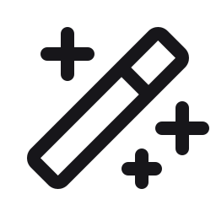



What it does: one photo in, cut-ready sheets out
1 · Snap
2 · Analyze
3 · Clean up
4 · Cut
5 · Assemble
A photo, a sketch, or several views
Background off, items and layers found
Upright, perspective, gaps, smoothing
Sheets per device, SVG · DXF · G-code
Step by step, in stacking order
Say it or tap it: the same actions, one undo
“Make them all the same size” · “undo”
Notes:
Snap a photo. Katachi finds the items and layers, cleans them up, lays out sheets for your machine, and guides assembly. You can say what you want or tap a button: the same actions, with one undo.

Slide 4
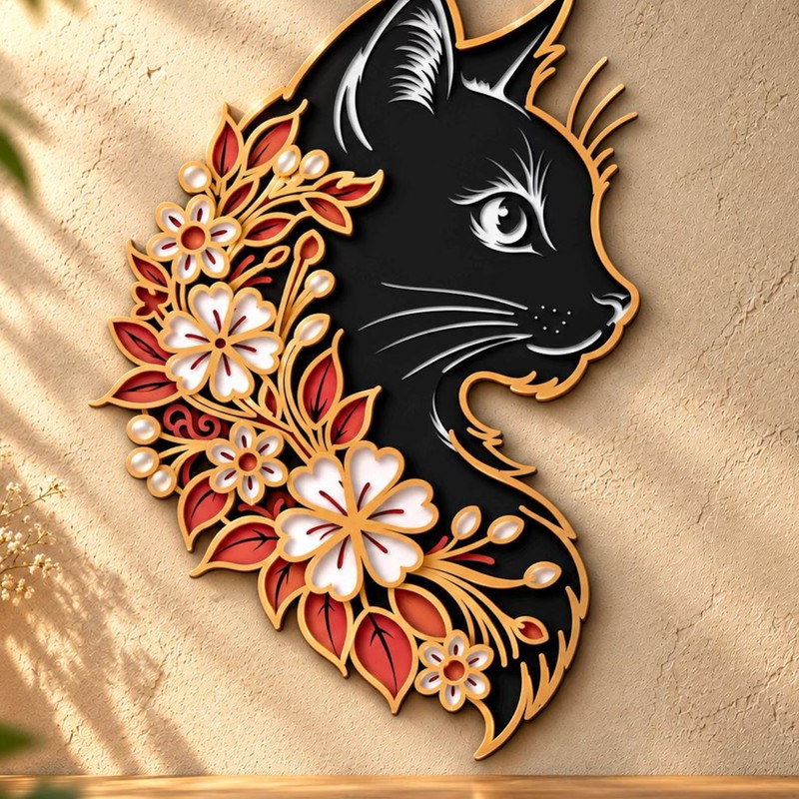
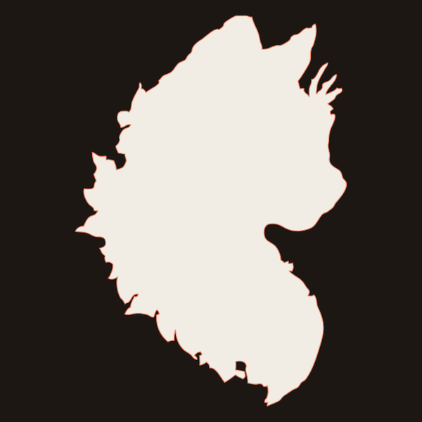
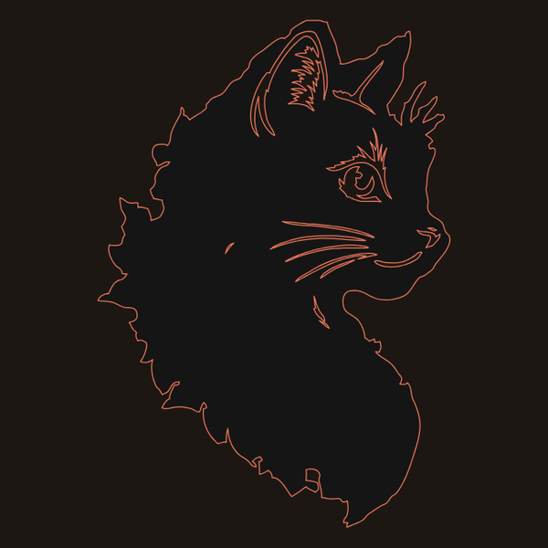
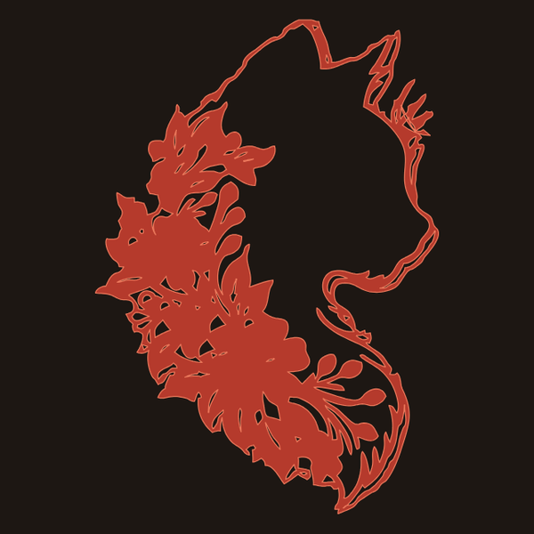


Example 1 · A layered cut: the paper cat
1 · White base
2 · Black cat
3 · Red leaves
4 · White flowers
5 · Gold outline
Five layers as asked, back to front: a solid base, the whiskers cut through the black, every sheet keeps the outline
The photo
$0.022
~1 min
in Meta model calls
photo to cut queue
Notes:
Example one, a layered cut. I tell Katachi how to stack it: a solid white base, black with the whiskers cut through, then red, white flowers and gold, every layer keeping the outline. Five sheets, built to that plan. Two cents.

Slide 5
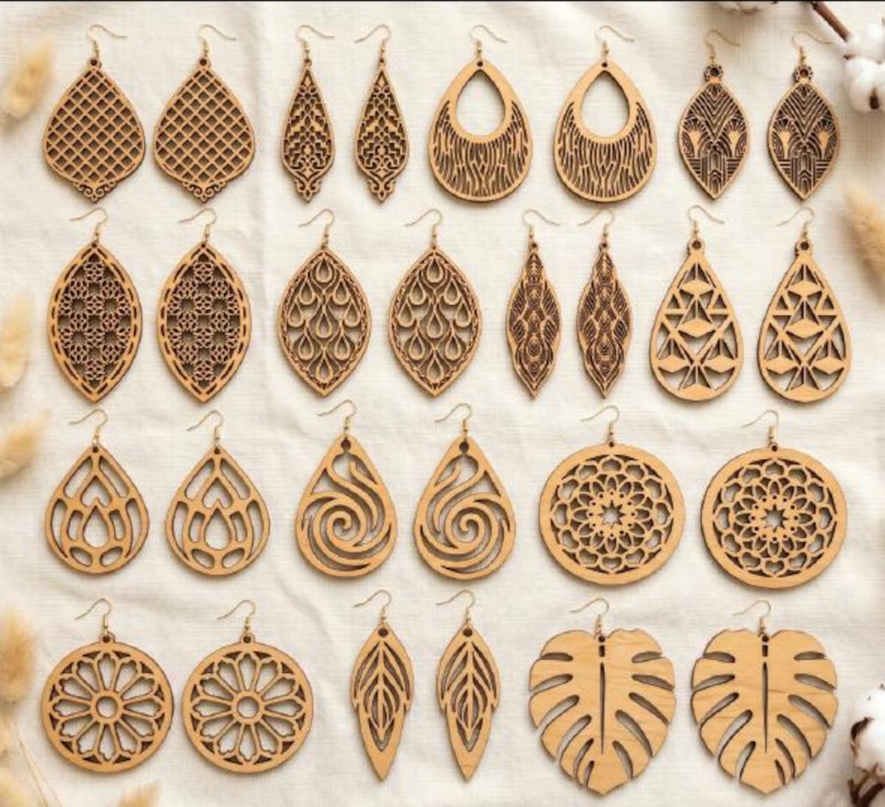
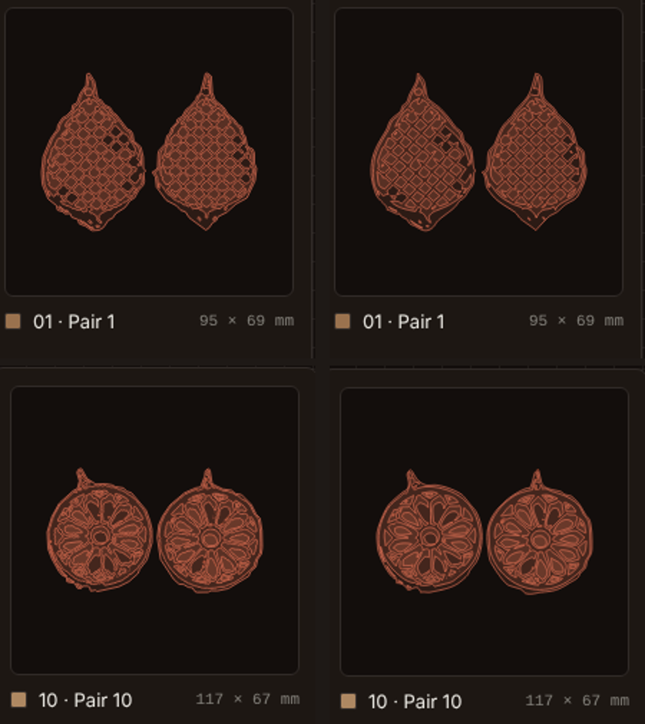
Example 2 · A collage of crafts: earring charms
28
pieces found on the tray
Pairs
matched by shape, each one size
$0.032
in Meta model calls
One photo, a whole tray
Before → after the clean-up
Notes:
Example two, a collage of crafts. From one tray photo it finds the earrings, matches the pairs by shape and cuts each pair to one size, with repeated holes evened out. About three cents.

Slide 6
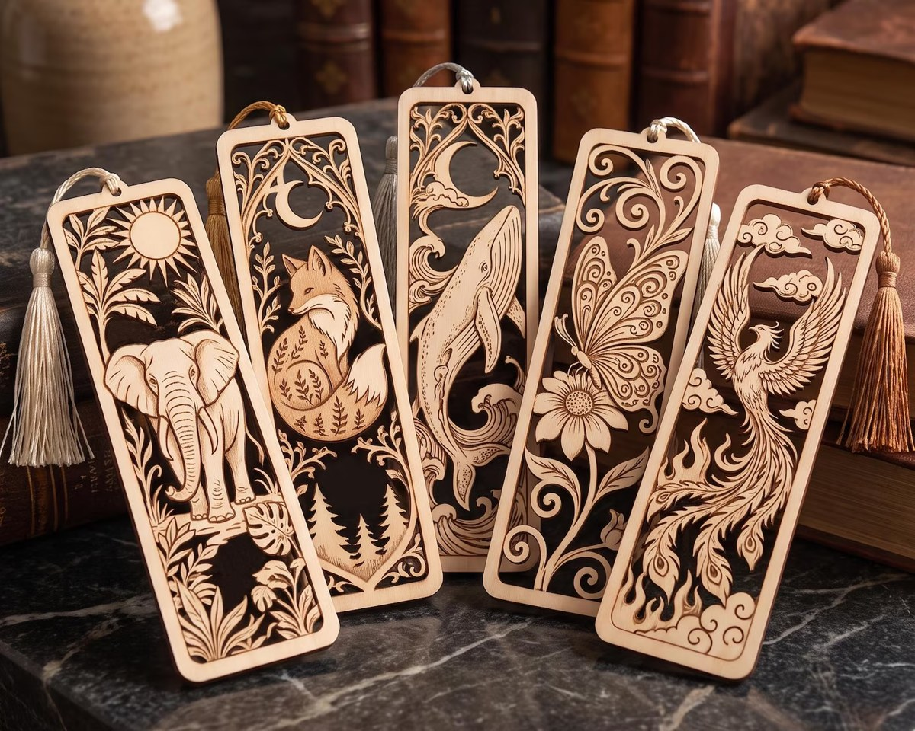
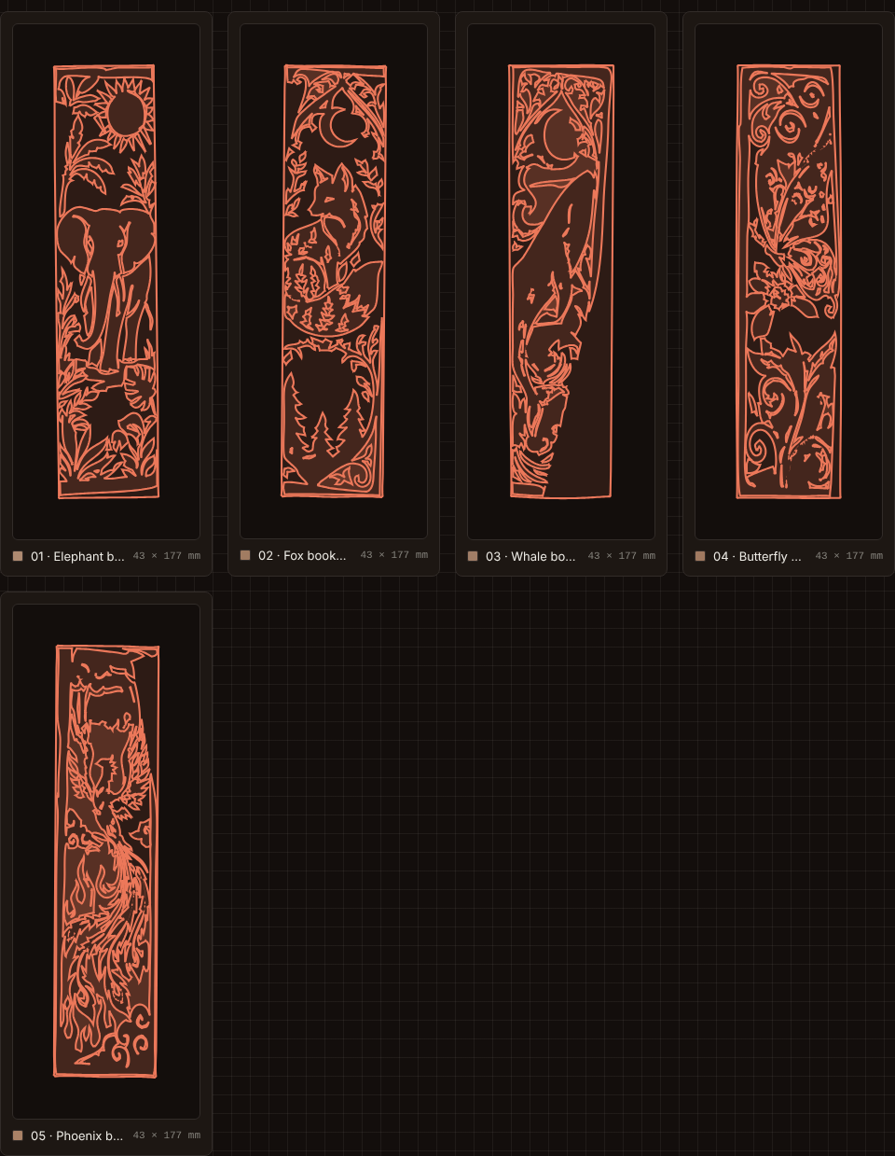
Example 3 · A set: five bookmarks, one photo
1 · Corrected perspective
2 · Turned upright
3 · Hidden edges rebuilt
4 · Made one size
$0.021
in Meta model calls
Notes:
Example three, a set. Five bookmarks, overlapping and shot at an angle. Katachi corrects the perspective, stands each one upright, rebuilds the hidden edges, and makes all five one size. Two cents.

Slide 7
Architecture: models perceive, code measures
In the browser
On the edge
Meta models
SvelteKit · the craft model
Cloudflare Worker
Meta Model API
The craft: items, parts, cuts
All geometry, in code
SVG · DXF · G-code out
The API key stays here
A budget per request
Every call and its cost logged
Muse Spark 1.3: reads, sizes, plans, understands requests
SAM 3.1: outlines every piece
Models see and decide. Code measures every line that gets cut.
Notes:
Under the hood: the browser holds the craft and code does all the geometry. A Cloudflare worker keeps the key server-side. Muse Spark reads and plans; SAM 3.1 outlines. Models never emit coordinates.

Slide 8




One action set, for the chat and the buttons
Structure
Geometry
merge · delete · split · group
flip · mirror · rotate · smooth · weld
Whole item
Clean-up
straighten · perspective · fill hidden · same size
tidy · even out patterns · symmetry
One contract: targets in, changed items out. Several steps in one request become one undo.
Notes:
Every edit is one action with one contract, shared by the chat and the buttons. Simple phrases run instantly. Complex requests go to Muse Spark, which plans the steps as a single undoable change.

Slide 9


A prototype with promise, not a product yet
Works today
Not there yet
Layered art split into colour layers
Items found, upright, paired, one size
Clean-up: smoothing, specks, patterns
Cut files for lasers and Cricuts
Shadows can add stray cut lines
Hidden fretwork is rebuilt solid
Real size is an estimate
3D kits from blurry plans are rough
Notes:
To be clear: this is a prototype, not a finished product. The core works, but traces still follow the photo, hidden fretwork is rebuilt solid, and real size is an estimate.

Slide 10
Roadmap: from prototype to maker’s tool
Now
Next
Later
Next few weeks
This quarter
After
One clean cut line per piece
True millimetres from a reference card
Imagine hidden detail with Muse Image
Send straight to the cutter
3D objects into flat-pack parts
Share and remix crafts
Notes:
Next: one clean cut line per piece, a reference card for true millimetres, and real cuts on a real machine. Then Muse Image for hidden detail, and jobs sent straight to the cutter. Later, 3D flat-pack.

Slide 11
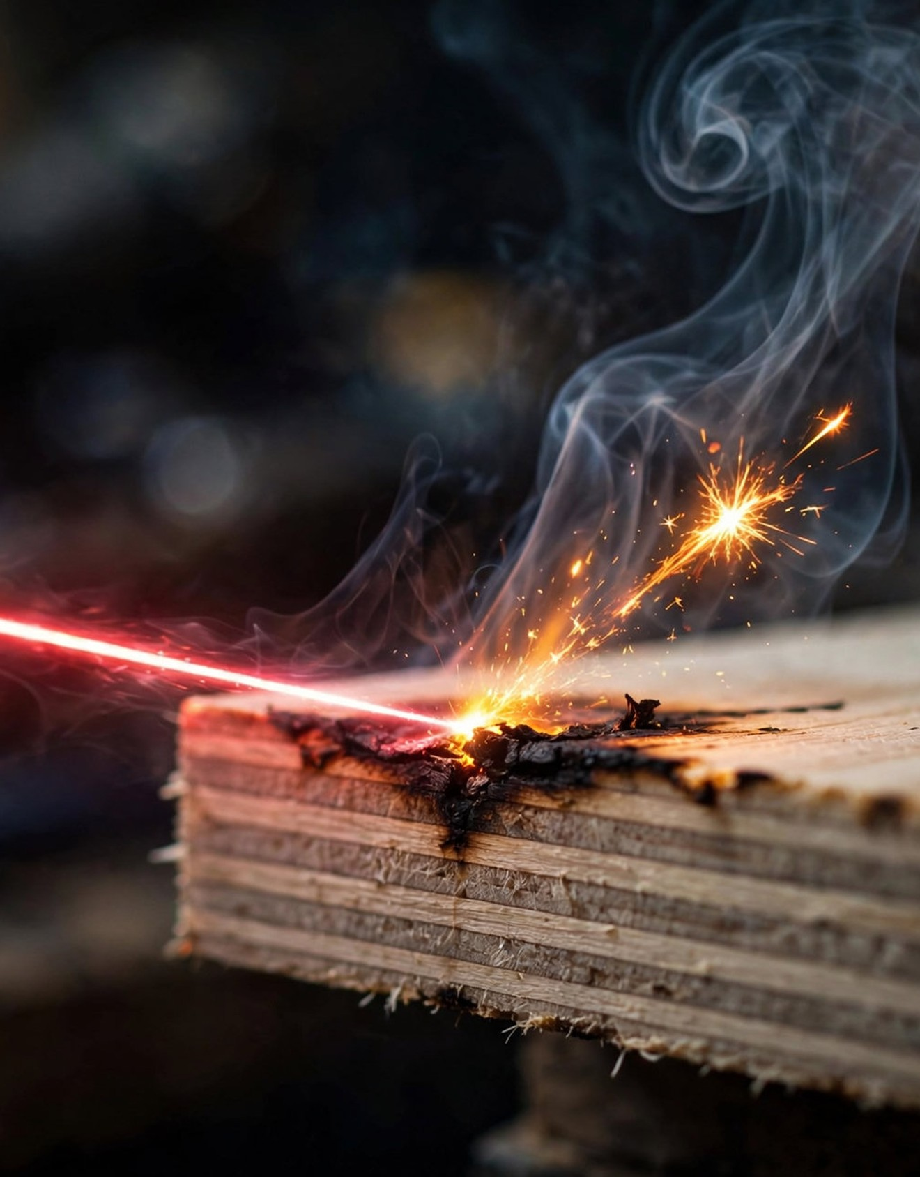
Build your world, one sheet at a time
Three crafts, under eight cents of model calls.
katachi.sensei-hq.com
Built during the hackathon. Pre-existing: my UI library Rokkit and open-source tools.
Notes:
Three crafts, under eight cents of Meta model calls. The hard part, seeing what to cut, already works. Build your world, one sheet at a time, at katachi dot sensei-hq dot com.

