Slide 1



English Sentence Structure
Understanding sentence structure is the foundation of effective English communication. It's the grammatical arrangement that makes words blend and make sense.
Course Name:
Course Code:
Instructor Name: Dr. Tamanna Priya
Duration: 50 minutes
Date of Conduction of Class:

Slide 2

The Building Blocks
Subject
The noun or pronoun that performs the action. Answers "who" or "what."
Predicate
Contains the verb and tells what the subject does or is.
Every sentence needs at least these two essential parts to be complete and meaningful.

Slide 3





Five Core Components
Subject
Verb
Object
The doer of the action. Usually appears first in declarative sentences.
Shows action or state of being. The most important word in any sentence.
Receives the action. Can be direct or indirect objects.
Complement
Adjunct
Completes the meaning by describing subject or object qualities.
Adds extra information about when, where, why, or how.

Slide 4
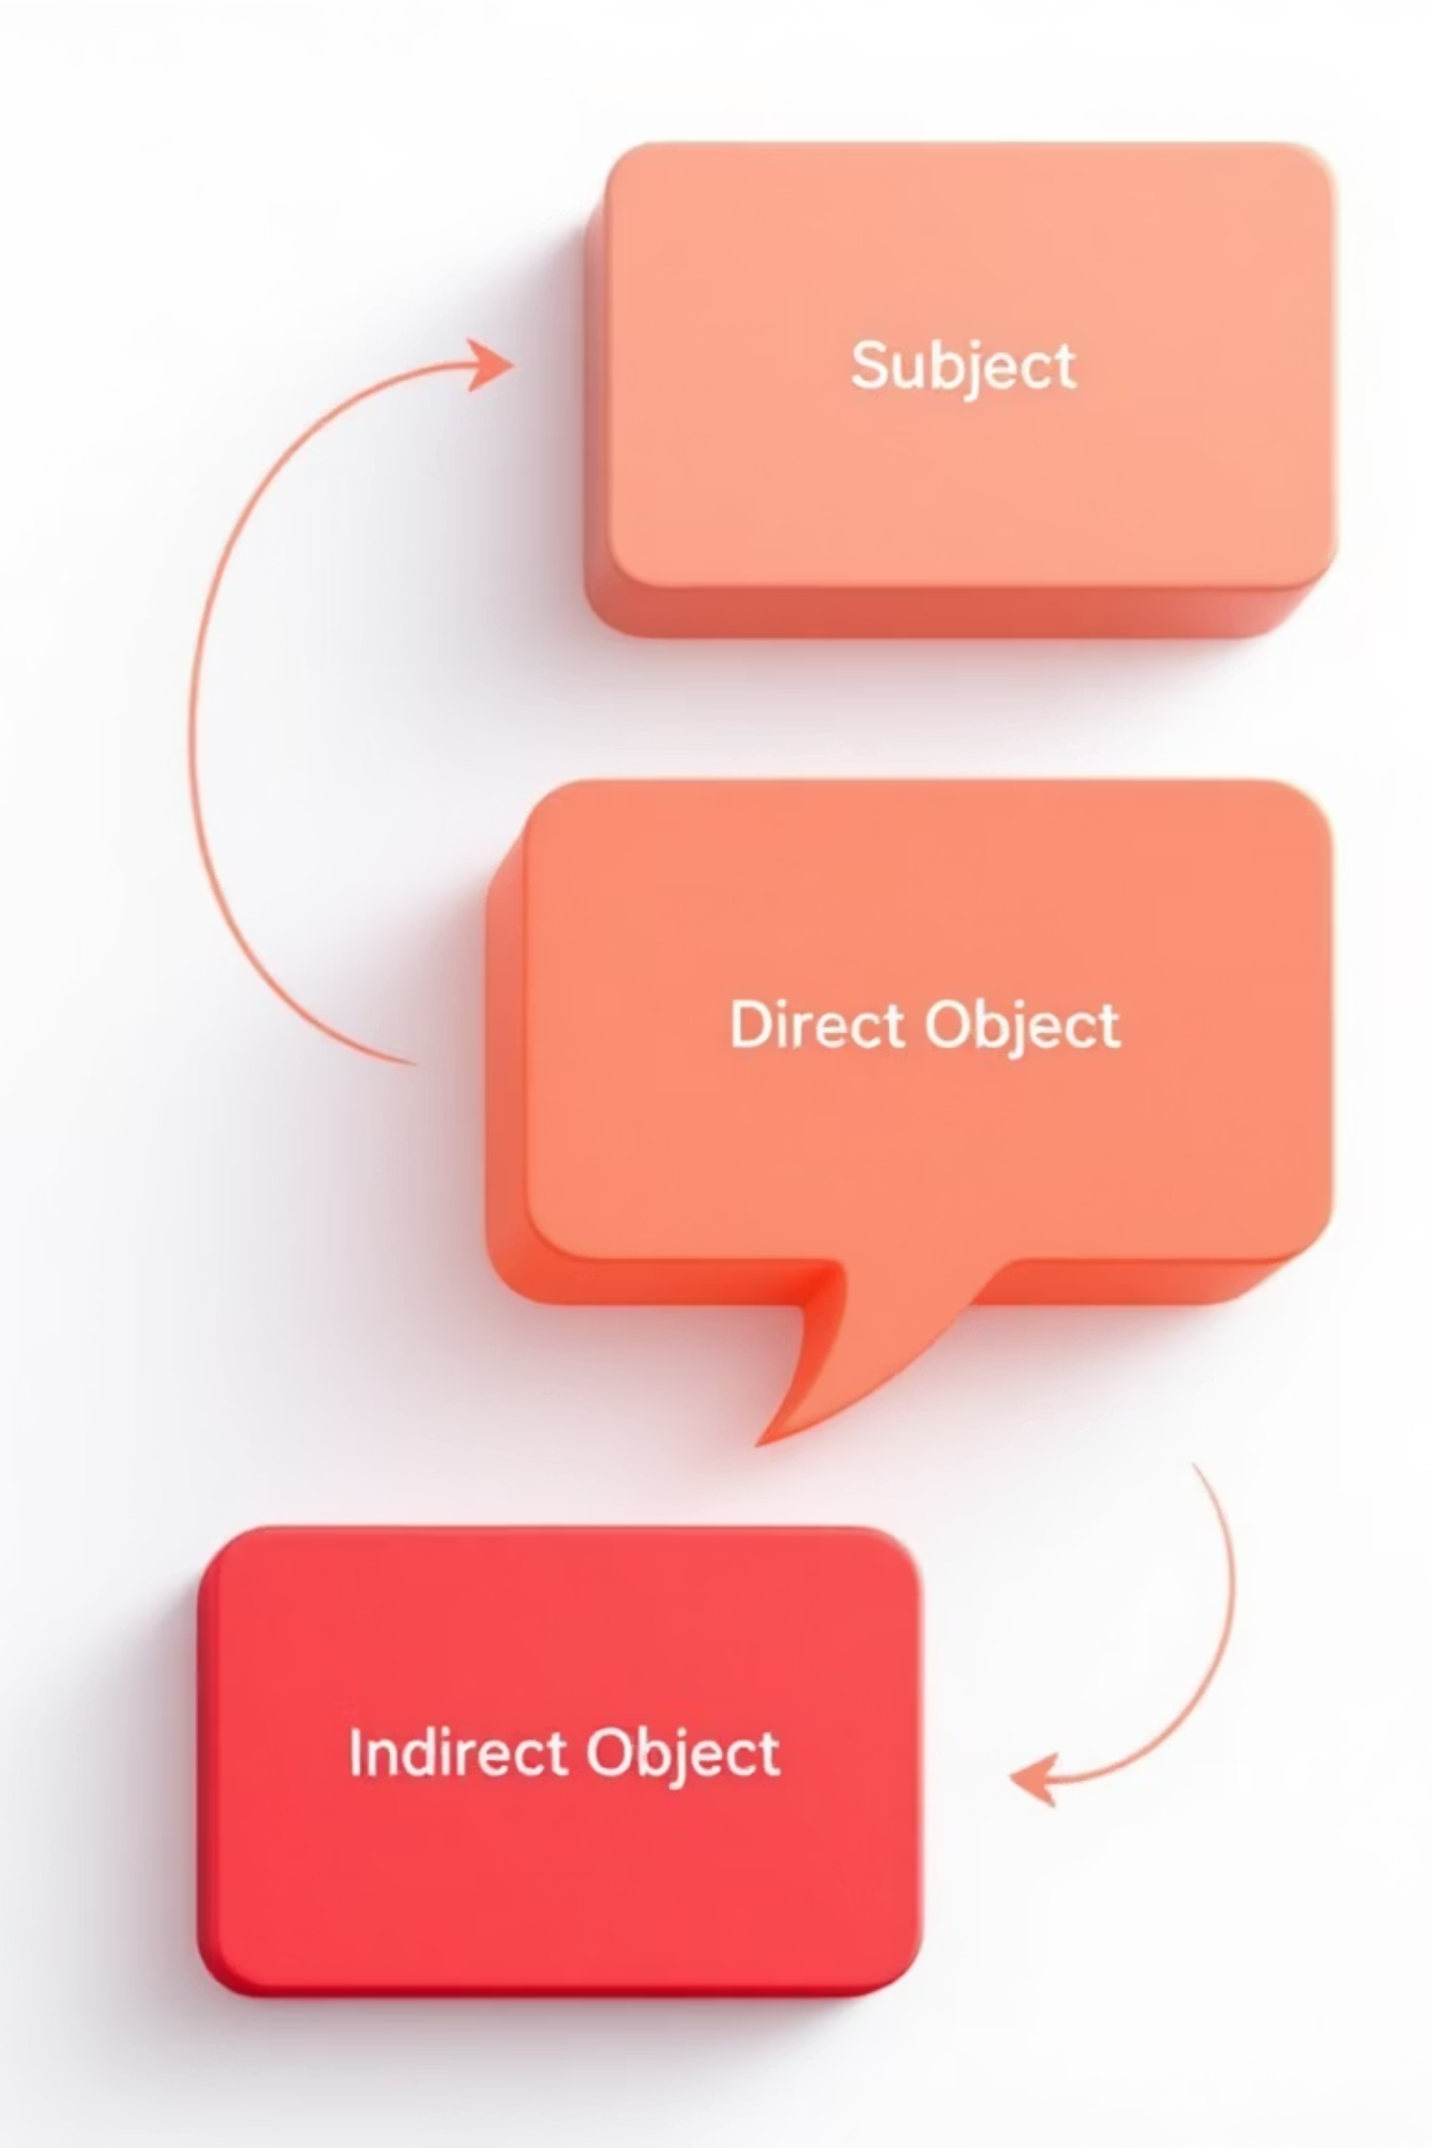
Understanding Objects
Direct Object
Indirect Object
Receives action directly from the verb. Answers "what" or "whom."
Secondary receiver, placed between verb and direct object. Answers "to whom."
Example: Harry bought a car.
Example: Mom bought me a dress.

Slide 5

Complements Explained
Subject Complement
Describes or identifies the subject after linking verbs.
"She is a doctor"
Object Complement
Describes or identifies the object, completing its meaning.
"They made her angry"

Slide 6

The Power of Adjuncts
Adjuncts add rich detail to sentences, answering key questions:
When, Where, Why
Provide context about time, location, and reason for actions.
How, How Often
Describe manner and frequency of actions or events.
Flexible Placement
Can appear at beginning, middle, or end of sentences.

Slide 7
Common Sentence Patterns
01
02
SV - Subject + Verb
SVO - Subject + Verb + Object
"The stars are shining"
"Children love ice cream"
03
04
SVC - Subject + Verb + Complement
SVA - Subject + Verb + Adjunct
"Carol is a nurse"
"He went upstairs"

Slide 8
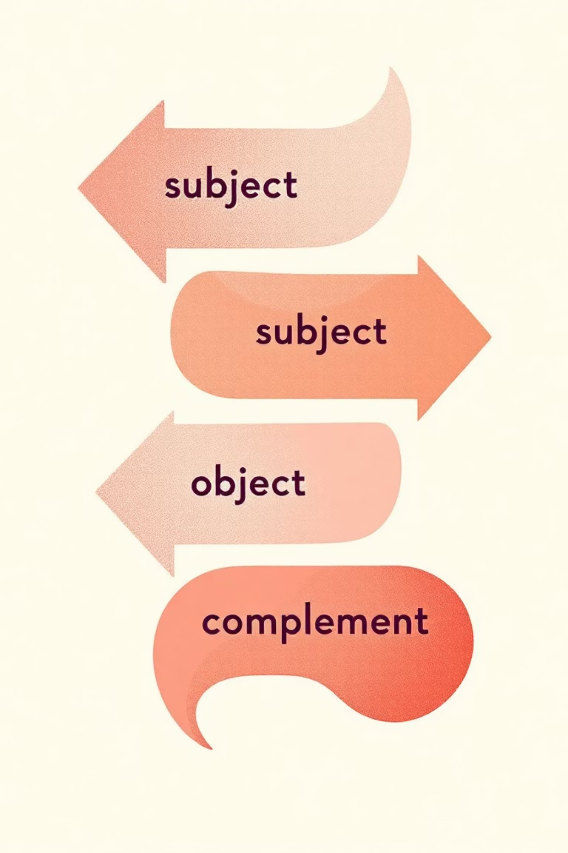



Advanced Patterns
SVOC
Subject + Verb + Object + Complement
"Everyone found the book controversial"
SVIODO
Subject + Verb + Indirect Object + Direct Object
"Rohit gave Reshmi his book"
ASVO
Adjunct + Subject + Verb + Object
"Last week, we celebrated Holi"

Slide 9

Practice Makes Perfect
Test your understanding with these sentence structure examples:
The sky is blue
1
Structure: SVC (Subject + Verb + Complement)
Brittany bought me shoes
2
Structure: SVIODO (Subject + Verb + Indirect Object + Direct Object)
Every year, the company updates its registry
3
Structure: ASVO (Adjunct + Subject + Verb + Object)

Slide 10
Practice Makes Perfect
Write the correct structure pattern (SV, SVO, SVC, SVA, etc.) for each of
the following:
The teacher explained the lesson clearly.
My brother is a pilot.
Riya dances beautifully.
They made him the captain.
The sun rises in the east.
Tomorrow, our class will visit the museum.
I gave my friend a gift.
The meeting ended late.
Suddenly, the lights went off.
Our parents travel by train every summer.

Slide 11
Answers:
SVOA – The teacher (S) explained (V) the lesson (O) clearly (A).
SVC – My brother (S) is (V) a pilot (C).
SVA – Riya (S) dances (V) beautifully (A).
SVOC – They (S) made (V) him (O) the captain (C).
SVA – The sun (S) rises (V) in the east (A).
ASVOA – Tomorrow (A), our class (S) will visit (V) the museum (O).
SVIODO – I (S) gave (V) my friend (IO) a gift (DO).
SVA – The meeting (S) ended (V) late (A).
ASVA – Suddenly (A), the lights (S) went (V) off (A).
SVAA – Our parents (S) travel (V) by train (A) every summer (A).

Slide 12

Master Your Communication
Build Strong Sentences
Understanding sentence structure transforms your writing and speaking. From simple SV patterns to complex ASVAA structures, each pattern serves a purpose in clear communication.
Foundation
Variety
Every sentence needs subject and verb
12 different patterns create engaging prose
Practice
Regular use builds natural fluency

