Slide 1
How to video pitch your project

Slide 2
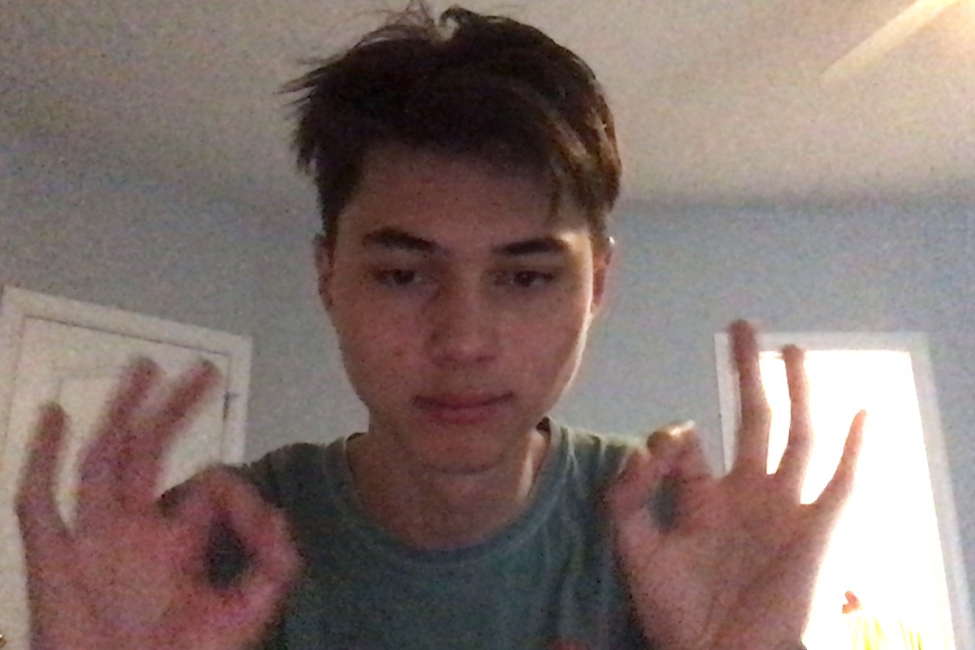

Who We Are
Emerson Berlik (‘22)
Major: Computer Science
Round Hill, VA
Veena Ramesh (’21)
Major: Computer Science, Statistics
Washington, D.C.

Slide 3
Key steps to a successful hackathon demo
Introducing the problem and the project
what is the problem I am trying to solve?
how do I talk about this?
Demo a working project
what aspect of my project should I focus on?
how do you present over Zoom?
Long-term goals
where is this project going?
what did I not have time to finish?

Slide 4
THE PROBLEM
01

Slide 5
Clearly state the problem and how your project aims to solve said problem
What is the status quo and why is it wrong?
How did you think about this problem and possible solutions?
Why did you pick this solution?

Slide 6
THE PROBLEM
01
02
THE DEMO

Slide 7
Focusing on the big picture
What is technical jargon?
Always mention the technologies you used to create your project, but never let that impede the big picture idea
When should I mention the function that took me four hours?
Never! Do not waste your time talking about itty-bity specifics of your project
You are telling a story about your project

Slide 8
Practice, practice, practice!
The virtual hackathon allows you to record a 3-minute demo
You have unlimited time to prepare and submit a recording (by 11:00pm tonight)
No question-answer period between the judges and the hackers
Lack of social cues between team members
How do you succeed virtually?
Practice what you are going to say and record multiple times
Focus on the most unique/coolest aspects of your project
Practice what each member is going to say

Slide 9
Practice, practice, practice!
The virtual hackathon allows you to record a 3-minute demo
You have unlimited time to prepare and submit a recording (by 11:00pm tonight)
No question-answer period between the judges and the hackers
Lack of social cues between team members
How do you succeed virtually?
Practice what you are going to say and record multiple times
Focus on the most unique/coolest aspects of your project
Practice what each member is going to say

Slide 10
THE PROBLEM
01
02
THE DEMO
03
STYLE

Slide 11
The Zoom recording makes your mistakes more visible
What makes are the most noticeable?
Lack of communication between group members (talking over each other)
Auditory and/or visual issues with Zoom
The style and aesthetic of the presentation itself (the slide deck)
Bumpy speaking (talking too fast or pausing at strange places)

Slide 12
The Zoom recording makes your mistakes more visible
How do you mitigate these mistakes?
Develop visual cues beforehand to ensure that you know who will speak or practice the demo before
Turn off your mic when you are not talking, use headphones to prevent spacy recording, and have your
camera on!
Spend time working on your slide deck and demo
Breathe and talk slowly – you are less likely to start pausing at strange places

Slide 13
SHOULD I LIVE-DEMO OR USE A SLIDE?

