Slide 1
PRISMA Review Agent
Automated Systematic Literature Review — PRISMA 2020
System Architecture | 9 LLM Agents | 15-Step Pipeline | PRISMA Flow
Tek Raj Chhetri | v1.0.0 | Apache 2.0
ReviewProtocol Input
9 Pydantic-AI Agents
PubMed + bioRxiv
PRISMA 2020 Output
GRADE + RoB Assessment
ReviewProtocol (PICO + criteria) -> Search Agent -> PubMed/bioRxiv Tools -> Two-Stage Screening -> Evidence/RoB/Data -> Parallel Synthesis -> PRISMA Report
Domain-agnostic | 11 RoB tools | GRADE certainty | Any OpenRouter model | SQLite cache
1

Slide 2
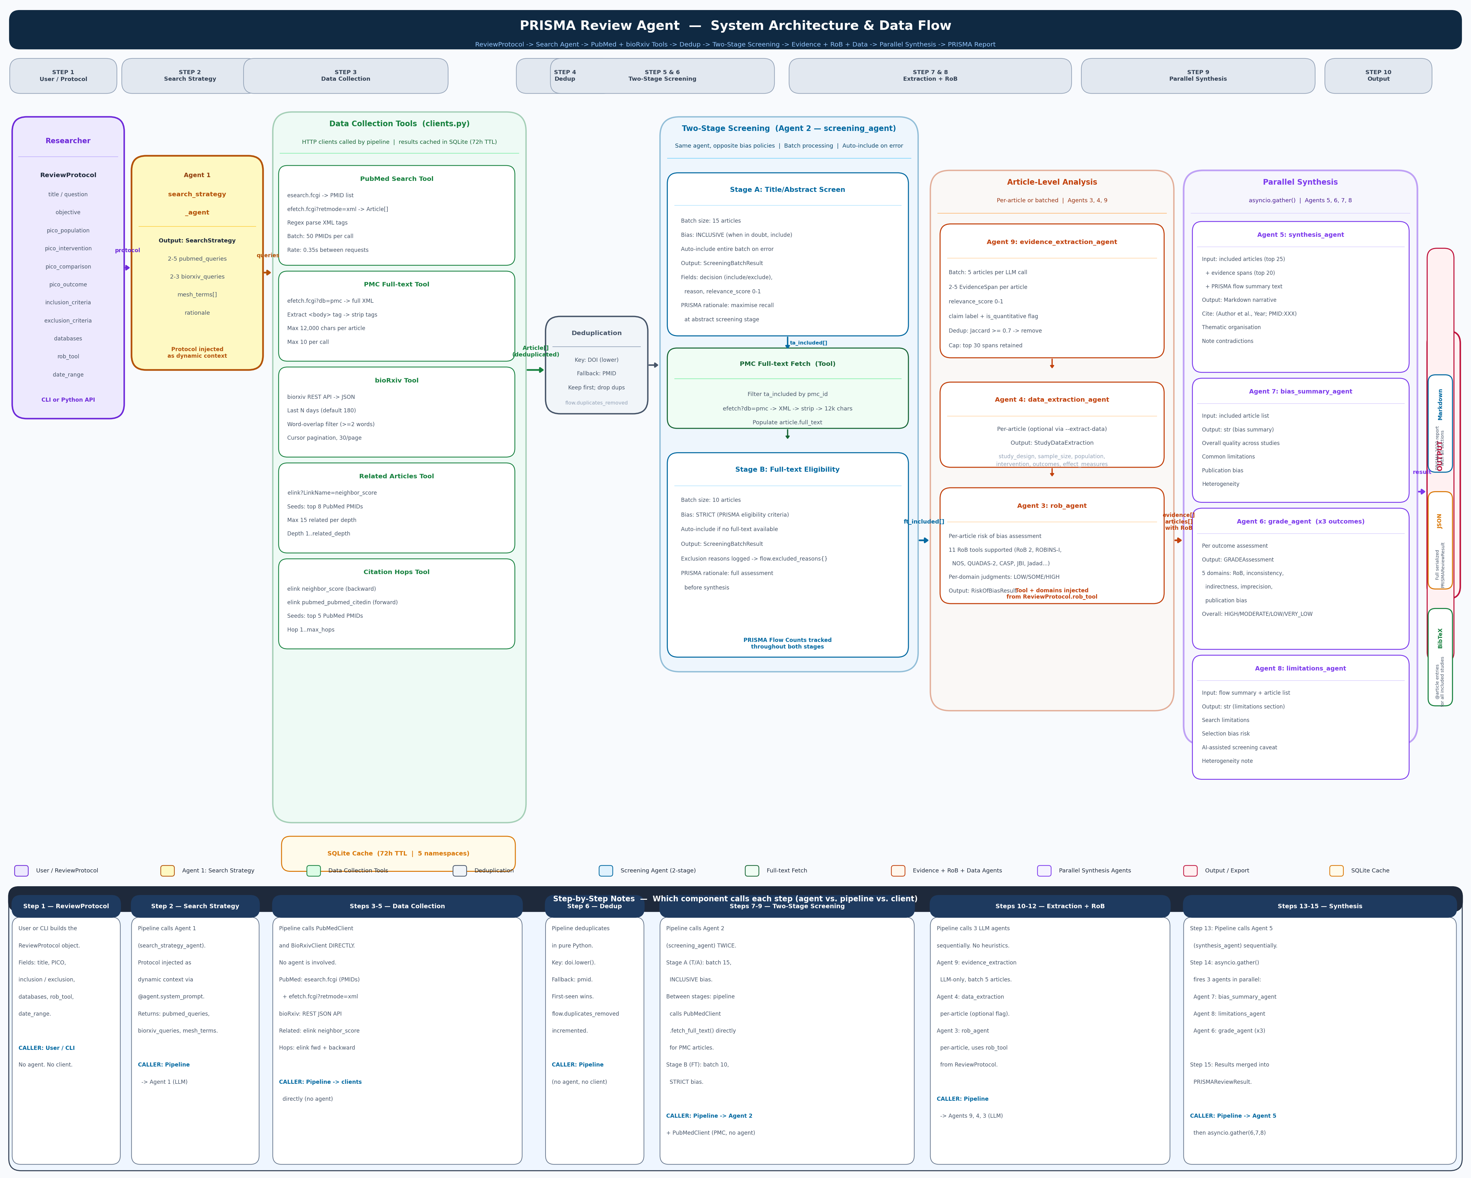
SYSTEM ARCHITECTURE DIAGRAM
2

Slide 3
REVIEW PROTOCOL — The System's Input
All domain knowledge injected at runtime — system is fully domain-agnostic
ReviewProtocol (models.py)
Why domain-agnostic design?
title
Research question / review title
No hardcoded medical knowledge anywhere
Same codebase conducts RCT reviews in cardiology,
objective
Detailed objective statement
cohort studies in neuroscience, qualitative studies
pico_population
Who — target population
in education — without any code changes
pico_intervention
What — intervention being studied
How it works:
pico_comparison
Comparator — control or alternative
Every LLM agent receives protocol fields via
pico_outcome
What is measured — primary outcome
dynamic @agent.system_prompt context at call time
Agent sees: question, PICO, criteria, RoB tool
inclusion_criteria
Full inclusion rules (free text)
Agent does NOT hardcode any disease/domain rules
exclusion_criteria
Full exclusion rules (free text)
Example: rob_agent uses protocol.rob_tool to select
databases
PubMed, bioRxiv (extensible)
domain list from ROB_DOMAINS dict:
rob_tool
1 of 11 RoB tools: RoB 2, ROBINS-I, NOS...
RoB 2 -> 5 domains
date_range_start/end
Optional date restriction
ROBINS-I -> 7 domains
Newcastle-Ottawa -> 3 groups
registration
PROSPERO or other registry number
QUADAS-2 -> 4 domains
...11 tools total
Outcome: one agent, eleven assessment frameworks,
3
zero code changes between reviews

Slide 4
TWO-STAGE SCREENING — Same Agent, Opposite Bias Policies
PRISMA best practice: maximise recall at abstract stage, maximise precision at full-text stage
Stage A: Title / Abstract Screening
Stage B: Full-text Eligibility Screening
Agent 2: screening_agent | Batch size: 15
Agent 2: screening_agent | Batch size: 10
POLICY: INCLUSIVE — when in doubt, INCLUDE
POLICY: STRICT — apply criteria rigorously
Input: title + abstract of each article
Input: full text (up to 12,000 chars from PMC)
Eligibility criteria injected from protocol
+ title + abstract
Decision per article: INCLUDE or EXCLUDE
Articles without PMC ID: auto-include
+ reason string + relevance_score 0-1
(cannot assess eligibility without text)
On agent error: auto-include entire batch
Decision: INCLUDE or EXCLUDE
(never lose an article to a transient failure)
+ specific exclusion reason
Batch size reduced to 10 (full text = more tokens)
PRISMA rationale:
Excluding a relevant article at abstract stage
Exclusion reasons accumulated into:
is more harmful than including an irrelevant one.
flow.excluded_reasons (dict: reason -> count)
Full-text screening is the precision filter.
Top 8 reasons shown in PRISMA flow diagram
Abstract screening is the recall filter.
PRISMA rationale:
Flow tracking: flow.excluded_title_abstract
Final gate before synthesis.
= count of excluded articles here
Only studies clearly satisfying ALL inclusion
criteria and violating NO exclusion criteria
4
proceed to evidence extraction and synthesis.

Slide 5
THE 9 LLM AGENTS (pydantic-ai + OpenRouter)
Each agent has a single PRISMA responsibility | defer_model_check=True -> any model at runtime
Agent 1
search_strategy_agent
Agent 2
screening_agent
Agent 3
rob_agent
In: ReviewProtocol Out: SearchStrategy
In: Article batch + criteria Out: ScreeningBatchResult
In: Article + rob_tool Out: RiskOfBiasResult
2-5 PubMed queries (MeSH, Boolean, field tags) 2-3 bioRxiv plain-text queries mesh_terms[] for methods documentation rationale for search strategy
Two-stage: T/A (batch 15, inclusive) + FT (batch 10, strict) Per article: decision, reason, relevance_score Auto-include entire batch on error Same agent, different bias from protocol stage
Per-article, per-domain judgment: LOW/SOME/HIGH/UNCLEAR 11 tools: RoB 2, ROBINS-I, NOS, QUADAS-2, CASP, JBI... Overall judgment + justification per domain Tool + domains injected from ReviewProtocol.rob_tool
Agent 4
data_extraction_agent
Agent 5
synthesis_agent
Agent 6
grade_agent
In: Article + data_items Out: StudyDataExtraction
In: articles (top 25) + evidence (top 20) Out: str Markdown narrative
In: outcome name + article list Out: GRADEAssessment
Optional (--extract-data flag) study_design, sample_size, population intervention, outcomes, key_findings effect_measures (ORs, MDs, HRs if reported)
Thematic organisation, not study-by-study Cite: (Author et al., Year; PMID: XXXXX) Explicitly note contradictions between studies PRISMA 2020 Results section format
Per-outcome certainty rating: HIGH/MODERATE/LOW/VERY LOW 5 domains: RoB, inconsistency, indirectness, imprecision, publication bias Run x3 outcomes in parallel via asyncio.gather()
Agent 7
bias_summary_agent
Agent 8
limitations_agent
Agent 9
evidence_extraction_agent
In: included article list Out: str (bias summary)
In: flow text + article list Out: str (limitations)
In: articles batch (5) Out: BatchEvidenceExtraction
Overall quality across all studies Common methodological weaknesses Publication bias concerns Confidence in body of evidence
Search scope and database limitations Full-text retrieval gaps (paywall) AI-assisted screening caveat (required) Heterogeneity and meta-analysis limitations
2-5 EvidenceSpan per article text, claim, section, relevance_score, is_quantitative Dedup: Jaccard word overlap >= 0.70 -> remove Cap: top 30 spans retained for synthesis
5

Slide 6
15-STEP PIPELINE (Steps 1–8: Protocol to Screened Articles)
Sequential execution with SQLite caching at every data collection step
Step 01 Protocol Input
Step 02 Search Strategy
[User / CLI]
[Agent 1]
ReviewProtocol: title, PICO, criteria, databases, rob_tool, date range. All domain knowledge lives here.
protocol -> search_strategy_agent -> SearchStrategy: 2-5 PubMed queries + 2-3 bioRxiv queries + mesh_terms
Step 03 PubMed Search
Step 04 bioRxiv Search
[PubMed Tool (NCBI)]
[bioRxiv Tool]
Each pubmed_query -> esearch.fcgi (PMID list) -> efetch.fcgi XML (batch 50) -> Article[]. Cached 72h.
Each biorxiv_query -> REST JSON API -> word-overlap filter (>=2 words) -> Article[source=biorxiv]. 180-day window.
Step 05 Related Articles
Step 06 Citation Hops
[elink Tool]
[elink Tool]
Top 8 PubMed PMIDs -> elink neighbor_score -> up to 15 related PMIDs per depth. Fetch and add. Depth 1..N.
Top 5 PMIDs -> backward (neighbor_score) + forward (citedin) -> combine unique -> fetch new articles. Hops 1..max.
Step 07 Deduplication
Step 08 Title/Abstract Screen
[Pipeline logic]
[Agent 2 (INCLUSIVE)]
Key = DOI.lower() if doi else pmid. Keep first occurrence per key. flow.duplicates_removed = total - unique.
Batch 15, inclusive bias. Per article: INCLUDE/EXCLUDE + reason + relevance_score. Auto-include on error.
6

Slide 7
15-STEP PIPELINE (Steps 9–15: Full-text to Final Report)
Article-level analysis then parallel synthesis via asyncio.gather()
Step 09 PMC Full-text Fetch
Step 10 Full-text Eligibility
[PMC Tool (NCBI XML)]
[Agent 2 (STRICT)]
Filter ta_included by pmc_id -> efetch?db=pmc XML -> extract <body> -> strip tags -> 12k chars max. 10/call.
Batch 10, strict bias. Exclusion reasons -> flow.excluded_reasons{}. Auto-include if no full text.
Step 11 Evidence Extraction
Step 12 Data Extraction
[Agent 9 (batch 5)]
[Agent 4 (per-article, optional)]
2-5 EvidenceSpan/article: text, claim, section, score. Jaccard dedup >= 0.70. Top 30 retained.
study_design, sample_size, population, intervention, outcomes, key_findings, effect_measures. --extract-data flag.
Step 13 Risk of Bias
Step 14 Parallel Synthesis
[Agent 3 (per-article)]
[asyncio.gather() — Agents 5,6,7,8]
Per-domain judgment (LOW/SOME/HIGH) using protocol.rob_tool. Overall judgment + justification. 11 tools supported.
Simultaneously: synthesis narrative (Agent 5) + bias summary (Agent 7) + GRADE per outcome (Agent 6) + limitations (Agent 8).
Step 15 Assemble Result
[Pipeline]
Construct PRISMAReviewResult: protocol, flow, included_articles, screening_log, evidence, synthesis, GRADE, timestamp.
7

Slide 8
PARALLEL SYNTHESIS (asyncio.gather — Step 14)
All four synthesis tasks are independent — run simultaneously to save time
asyncio.gather(run_synthesis(), run_bias_summary(), run_grade() x3, run_limitations(), return_exceptions=True)
Agent 5
synthesis_agent
Agent 7
bias_summary_agent
In: included_articles[:25] + evidence_spans[:20] + PRISMA flow summary text
In: included article list with RoB assessments
Out: str (Markdown narrative synthesis)
Out: str (overall quality summary)
Thematic organisation — groups findings across studies Citation format: (Author et al., Year; PMID: XXXXX) Explicitly note contradictions between studies Becomes the Results / Synthesis section of the report NEVER fabricates PMIDs or statistics
Proportion of studies at low/high/unclear risk Most common methodological weaknesses Publication bias concerns Confidence in the overall body of evidence
Agent 6
grade_agent (x3 outcomes)
Agent 8
limitations_agent
In: outcome name + list of relevant studies
In: PRISMA flow text + included article list
Out: GRADEAssessment (Pydantic model)
Out: str (limitations section)
5 GRADE domains: risk of bias, inconsistency, indirectness, imprecision, publication bias Per-domain: downgrade or no concerns Overall: HIGH / MODERATE / LOW / VERY LOW Appears as GRADE table in Methods section
Search scope (PubMed + bioRxiv only) Full-text retrieval gaps (paywall articles) AI-assisted screening caveat (required by PRISMA AI guidance) Language / date range restrictions Heterogeneity preventing meta-analysis
8

Slide 9
RISK OF BIAS & GRADE CERTAINTY
11 RoB tools supported | GRADE certainty for up to 3 outcomes | all injected from ReviewProtocol
Risk of Bias Assessment (Agent 3)
GRADE Certainty Assessment (Agent 6)
RoB 2
Randomised trials: 5 domains
5 GRADE Domains:
ROBINS-I
Non-randomised studies: 7 domains
Risk of bias
RoB assessments across included studies
Newcastle-Ottawa
Case-control/cohort: 3 groups
Inconsistency
Variation in findings across studies
QUADAS-2
Diagnostic accuracy: 4 domains
Indirectness
How directly evidence addresses question
CASP
Qualitative: 10 items
JBI
Prevalence/cross-sectional: 7 items
Imprecision
Width of confidence intervals / sample size
Murad
Case reports/series: 4 items
Publication bias
Selective reporting, funnel plot asymmetry
Jadad
RCT quality: 5-point scale
Overall Certainty:
ROBINS-E
Environmental exposures
HIGH
Strong confidence in estimate
SYRCLE
Animal studies
MODERATE
Moderate confidence; likely close
MINORS
Non-randomised surgical
LOW
Limited confidence; substantially different
Per domain: LOW / SOME CONCERNS / HIGH / UNCLEAR Overall judgment + justification per domain
VERY LOW
Very little confidence
9

Slide 10
DATA COLLECTION TOOLS (clients.py)
HTTP clients called by pipeline | all results cached in SQLite (72h TTL) | no pydantic-ai @agent.tool
PubMed Search Tool
PMC Full-text Tool
API: NCBI E-utilities REST esearch.fcgi?db=pubmed -> PMID list (JSON) efetch.fcgi?db=pubmed&retmode=xml -> PubMed XML Batch: 50 PMIDs per fetch call Parse: regex on <ArticleTitle> <AbstractText> <Author> <ISOAbbreviation> <PubDate> <ArticleId> <MeshHeading> Rate: 0.35s between calls (3 req/s; 10 with NCBI key) Cache: search namespace (PMID lists) + article namespace
API: NCBI E-utilities (same client) efetch.fcgi?db=pmc&id=<pmc_id>&rettype=xml Extract <body> XML tag content Strip all HTML/XML tags (regex) Normalise whitespace, truncate to 12,000 chars Max 10 per call; only open-access articles Cache: fulltext namespace NO PDF — direct structured XML only
bioRxiv Tool
Related Articles Tool
API: bioRxiv REST API (JSON, not XML) https://api.biorxiv.org/details/biorxiv/{start}/{end}/{cursor}/30 Default window: last 180 days (--biorxiv-days) Pagination: 30 per page, up to 4 pages (120 candidates) Filter: word-overlap >= 2 non-trivial words Article.pmid = 'biorxiv_{doi_suffix}' Article.source = 'biorxiv' Cache: biorxiv namespace
API: NCBI elink.fcgi LinkName=pubmed_pubmed_related (neighbor_score) Seeds: top 8 PubMed PMIDs per depth level Max 15 related per call Depth: 1..related_depth (default: 1) Article.source = 'related_N' (depth number) Cache: related namespace
Citation Hops Tool
10
SQLite Cache (cache.py)
Backward: elink neighbor_score (same as Related) Forward: elink?LinkName=pubmed_pubmed_citedin Seeds: top 5 PubMed PMIDs Combine backward + forward unique PMIDs Article.hop_level + Article.parent_id set Article.source = 'hop_N' Max hops: --hops parameter (default: 1, max: 4)
TTL: 72 hours | 5 namespaces search: PubMed PMID lists article: individual Article records related: elink PMID lists fulltext: PMC body text biorxiv: bioRxiv results Key: SHA256(namespace:identifier) Lazy expiry: check on read, delete if expired

Slide 11
DATA MODELS (models.py — 15+ Pydantic v2 Classes)
Runtime-validated typed schemas for every input, intermediate state, and output
INPUT
SEARCH
ARTICLE
SCREENING
ReviewProtocol title, objective pico_population/intervention/comparison/outcome inclusion_criteria, exclusion_criteria databases, rob_tool, date_range registration
SearchStrategy pubmed_queries: list[str] biorxiv_queries: list[str] mesh_terms: list[str] rationale: str
Article pmid, title, abstract authors, journal, year doi, pmc_id, mesh_terms full_text (after PMC fetch) extracted_data: StudyDataExtraction risk_of_bias: RiskOfBiasResult inclusion_status: InclusionStatus source, hop_level, parent_id
ScreeningBatchResult decisions: list[ScreeningDecision] ScreeningDecision: index, decision (INCLUDE/EXCLUDE) reason: str relevance_score: float InclusionStatus (Enum): PENDING / INCLUDED / EXCLUDED
EVIDENCE
RoB + GRADE
DATA EXTRACT
RESULT
EvidenceSpan text, paper_pmid, claim section, relevance_score BatchEvidenceExtraction articles: list[ArticleEvidenceExtraction] ExtractedEvidenceItem: quote, claim, section relevance (0-1), is_quantitative
RiskOfBiasResult assessments: list[RoBDomainAssessment] overall: RoBJudgment summary: str GRADEAssessment outcome, domains{} overall_certainty: GRADECertainty summary: str
StudyDataExtraction study_design, sample_size population, intervention outcomes, key_findings effect_measures (optional)
PRISMAReviewResult protocol, flow, included_articles screening_log, evidence_spans synthesis_text, bias_assessment grade_assessments, limitations timestamp PRISMAFlowCounts: all PRISMA flow diagram numbers
11

Slide 12
PRISMA 2020 FLOW COUNTING (PRISMAFlowCounts)
Every article transition tracked throughout pipeline — renders as PRISMA flow diagram in output report
Flow counters updated at each pipeline step -> rendered as PRISMA 2020 flow table in Markdown output
Step 3
db_pubmed
Articles from PubMed searches
Step 4
db_biorxiv
Articles from bioRxiv searches
Step 5
db_related
Articles from related expansion
Step 6
db_hops
Articles from citation hops
Steps 3-6
total_identified
Sum of all above (before dedup)
Step 7
duplicates_removed
Removed by DOI/PMID deduplication
Step 7
after_dedup
Articles entering screening
Step 8
screened_title_abstract
= after_dedup (all screened)
Step 8
excluded_title_abstract
Excluded at T/A stage
Steps 8-9
sought_fulltext
Passed T/A -> sought full text
Step 9
not_retrieved
No PMC ID or retrieval failed
Step 10
assessed_eligibility
= sought_fulltext
Step 10
excluded_eligibility
Excluded at full-text stage
Step 10
excluded_reasons
Dict: reason -> count (top 8)
Step 10
included_synthesis
Final included articles
12

Slide 13
EXPORT FORMATS & CLI (export.py + main.py)
Three PRISMA-structured formats + full CLI control over every pipeline parameter
Markdown
JSON
BibTeX
Use: PRISMA 2020 report, journal submission
Use: Programmatic use, REST APIs, databases
Use: Zotero, Mendeley, LaTeX reference managers
Abstract (structured summary) Introduction (rationale + PICO) Methods (criteria, queries, databases, RoB tool) Results 3.1: PRISMA Flow table Results 3.2: Study Characteristics table Results 3.3: Narrative Synthesis Results 3.4: Risk of Bias Summary Results 3.5: GRADE Certainty table Discussion: Limitations
Full PRISMAReviewResult via model_dump_json() All nested Pydantic objects included Protocol, flow, articles, screening_log evidence_spans, synthesis_text bias_assessment, grade_assessments limitations, timestamp
@article entries for each included study Fields: title, author, journal, year, doi, pmid Files saved to prisma_results/{slug}_{timestamp}.bib
CLI (prisma-review entry point)
prisma-review \ --title "Effects of BDNF on hippocampal plasticity in major depression" \ --population "Adults with MDD" --intervention "BDNF-targeted therapy" \ --comparison "Placebo or standard care" --outcome "Depressive symptom reduction" \ --inclusion "RCTs and cohort studies, adults, English" \ --exclusion "Animal studies, review articles, case reports" \ --rob-tool "RoB 2" --model anthropic/claude-sonnet-4 \ --max-results 25 --related-depth 2 --hops 2 --biorxiv-days 365 \ --extract-data --export md json bib # or --interactive for guided setup
13

Slide 14
KEY DESIGN DECISIONS & RATIONALE
Every architectural choice reflects PRISMA methodology or engineering constraint
Agent-per-PRISMA-task (not a mega-agent)
Two-stage screening, opposite bias policies
Each PRISMA step gets its own agent: independent prompt tuning, isolated retry logic, typed output. Changing the screening bias policy only touches the screening agent. Adding GRADE for a new outcome adds one agent call.
PRISMA methodology requires recall-first, precision-second screening. Inclusive T/A ensures no relevant study is missed. Strict FT ensures only eligible studies enter synthesis. Same agent, different instruction from pipeline stage parameter.
defer_model_check=True on all agents
asyncio.gather() for Step 14 only
Model injected at runtime via build_model(). Researcher can use claude-haiku for screening (fast/cheap), claude-sonnet for synthesis (quality). Same agents work with any of 100+ OpenRouter models.
Synthesis, bias summary, GRADE, and limitations are independent tasks with no shared mutable state. Parallelising them with asyncio.gather saves time proportional to the slowest task instead of their sum.
SQLite cache, 72h TTL
Domain-agnostic by design
Researcher re-runs with different screening criteria or model. All 500 article fetches come from cache in milliseconds. 72h (vs 48h in BioSynth) because PRISMA searches are longer sessions and article metadata changes infrequently.
All domain knowledge in ReviewProtocol. No hardcoded medical terminology, RoB domain lists, or outcome definitions. Injected as @agent.system_prompt context. Same binary, any medical/social/environmental domain.
Auto-include on agent failure
Evidence dedup: Jaccard >= 0.70
Pipeline must always produce a result. If screening batch fails, auto-include entire batch. Losing an article to a transient API error is a validity threat; over-inclusion is recoverable by human review.
Same threshold as BioSynth. Removes paraphrased near-duplicates from the 30-span evidence set. Prevents the synthesis agent from seeing the same finding quoted five times and over-weighting it.
14

Slide 15
PRISMA Review Agent — Architecture Summary
15-Step Pipeline
9 Specialised LLM Agents
Two-Stage Screening
PRISMAReviewPipeline orchestrates everything. Calls tools, manages state, tracks PRISMA flow counts, assembles result.
One agent per PRISMA step. All use pydantic-ai typed outputs + defer_model_check=True for any OpenRouter model.
Agent 2 runs twice: INCLUSIVE T/A screening (batch 15) then STRICT FT screening (batch 10). PRISMA best practice.
Domain-Agnostic Design
GRADE + RoB
Parallel Synthesis
All clinical knowledge in ReviewProtocol. 11 RoB tools, any PICO, any outcome — zero code changes between reviews.
Agent 3 assesses RoB per study (11 tools). Agent 6 produces GRADE certainty per outcome. Both in final report.
asyncio.gather(): narrative + bias summary + GRADE x3 + limitations simultaneously. Report complete in one pass.
ReviewProtocol -> Agent 1 (search queries) -> PubMed + bioRxiv Tools -> Dedup -> Agent 2 T/A Screening (inclusive) -> PMC Full-text -> Agent 2 FT Screening (strict) -> Agents 9/4/3 per article -> asyncio.gather Agents 5/7/6/8 -> PRISMAReviewResult -> PRISMA 2020 Report
PRISMA Review Agent v1.0.0 | Tek Raj Chhetri | Apache 2.0 | 2026 | pip install prisma-review-agent
15

