Slide 1
undata
A Universal Data Element Registry
for Neuroscience
Building a shared language for neuroscience data schemas
Satrajit Ghosh
MIT | 2026

Slide 2
Neuroscience has
no shared language
for data elements.
5 major ecosystems × 5 different formats × 0 interoperability
BIDS • NWB • DANDI • openMINDS • AIND

Slide 3
Three Problems Nobody Has Solved
1 SCHEMA FRAGMENTATION
2 IDENTITY CONFLATION
3 INVISIBLE TRANSFORMS
Same concept, different formats
What something IS ≠
Silent data transformations
JSON Schema, YAML, LinkML,
where it came FROM
Unit conversions, type coercions
Python classes, JSON-LD
happen in ad-hoc scripts
'age' in BIDS and 'age' in AIND
No way to ask: "What does BIDS
are treated as different things
No provenance record
call the thing NWB calls
despite being semantically
Breaking reproducibility
ElectrodeArray?"
identical
These problems scale with every new dataset, standard, and ecosystem.

Slide 4
Why This Matters
Researchers waste weeks mapping between formats manually
Cross-ecosystem analyses require heroic bespoke engineering
Transformations are undocumented → results not reproducible
New standards fragment the landscape further
No machine-readable crosswalk between any two ecosystems
The cost compounds with every dataset, every study, every collaboration.

Slide 5
Three Core Innovations
CONTENT-ADDRESSED IDENTITY
IDENTITY ≠ PROVENANCE
EXPLICIT TRANSFORMS
SHA-256 hash from semantic
An element's identity (what it IS)
Every conversion documented:
properties (data type, unit,
is separate from provenance
• Unit (years → months)
pattern, constraints, ontology)
(where it came FROM)
• Type (float → string)
• Value (M/F → male/female)
Two elements from different
A single element accumulates
sources describing the same
provenance from multiple sources
Content-addressed with their
concept → same hash
instead of duplicating
own provenance chains
automatically

Slide 6
The undata Pipeline
Extract
Enrich
Align
Commit
Transform
Source adapters
Embedding similarity
Cross-source
Content addressing
Conversion logic
→ LinkML → entities
→
+ LLM verification
→
alias detection
→
+ dedup + merge
→
generation
Sources:
BIDS • NWB • DANDI • openMINDS • AIND • OpenNeuro • ReproSchema • NDA
Knowledge Service:
13 ontologies • 2.99M terms • 268K embedded • pyoxigraph RDF store

Slide 7
Three-Layer Architecture
FRONTEND — Next.js
BACKEND — FastAPI
LIBRARY — Pure Python
Apollo Client + Tailwind CSS
Strawberry GraphQL + PostgreSQL 16
No DB dependencies, standalone CLI
Browse, search, curation, chat
pgvector for embeddings
All pipeline logic: extract → transform
Entity navigator (ER diagram)
JSONB for flexible entity storage
StorageBackend protocol (file or DB)
Infinite scroll + server-side sort
Keycloak OIDC authentication
436 tests, Python 3.14
Real-time LLM curation assistant
PROV-O audit trail for all mutations
uv for dependency management
StorageBackend Protocol: read() • write() • list() • exists() • delete() • merge_provenance()
FileBackend (YAML + Parquet + pyoxigraph) | DatabaseBackend (PostgreSQL + pgvector)

Slide 8
Content-Addressed Entity Model
Element
Schema
Value
ValueSet
Field-level: age, weight
Class-level: Subject, Session
Categorical: male, MRI
Collection: modalities
type, unit, constraints
properties, inheritance
ontology grounding
members list
sha256 (identity)
sha256 (identity)
sha256 (identity)
sha256 (identity)
semantic{} (content)
semantic{} (content)
semantic{} (content)
semantic{} (content)
provenance[] (origins)
provenance[] (origins)
provenance[] (origins)
provenance[] (origins)
annotations[] (ontology)
annotations[] (ontology)
annotations[] (ontology)
annotations[] (ontology)
+ Transform (conversions) + CurationFlag (quality) + AuditLog (provenance)
All entities: staged → curated through curator review. No automated changes without evidence.

Slide 9
Multi-Precision Enrichment
Embedding similarity: all-MiniLM-L6-v2 → cosine similarity to 268K ontology terms
SKOS mapping: exactMatch (≥0.95) • closeMatch (≥0.85) • broadMatch • relatedMatch
LLM verification for borderline matches (0.5–0.7) via litellm
Ontology hierarchy traversal: ancestors added as broadMatch
Evidence Chain for every annotation: score + URI verification + reasoning
Curated annotations protected from re-enrichment
NCBITaxon filtered to 20 neuroscience-relevant species (from 2.7M terms)

Slide 10
Engineering Process: Speckit Lifecycle
/speckit.specify
/speckit.clarify
/speckit.plan
/speckit.tasks
/speckit.analyze
/speckit.implement
User stories
Ambiguity detection
Architecture
Dependency-ordered
Cross-artifact
Phase-by-phase
Acceptance criteria
→
Spec updates
→
Data model, contracts
→
task breakdown
→
consistency check
→
execution
38 features specified and implemented through this lifecycle
Project constitution (v2.1.0) with 7 core principles enforced at every stage

Slide 11
Project Constitution: 7 Core Principles
I. Simplicity First
YAGNI at all levels — complexity must be justified
II. Test-Driven Development
Red-Green-Refactor, non-negotiable
III. API-First Design
Contracts before implementation
IV. Observability
Structured JSON logs, no silent failures
V. No Deprecation
System has no consumers — rewrite freely
VI. Environment Isolation
uv + venvs, bridge venv exception for adapters
VII. Developer Experience
docker compose up → everything works
Version 2.1.0 • Ratified 2026-03-07 • Enforced on every PR

Slide 12
38 Features: From Brainstorm to Production
Iteration 1: Exploration (001–027)
001–010: Schema integration, backend, explorer, migration, enrichment
011–020: Metamodel, provenance, fullstack, ingestion overhaul, extraction
021–027: Source acquisition, repo restructure, ontology, staged enrichment
Iteration 2: Production (028–038)
028–029: Storage abstraction, backend service layer
030–032: Frontend integration, CivicDB-inspired UI, authentication
033–034: Unit standardization, curation interface
035–037: UX overhaul, knowledge service, data export
038: System hardening — 47 tasks, 9 user stories, all complete

Slide 13
The Registry: Scale & Coverage
7,055
1,005
15,881
2,426
15
Elements
Schemas
Values
Value Sets
Transforms
7 Sources:
BIDS
NWB
DANDI
openMINDS
585 elements • JSON Schema
179 elements • Python/hdmf
398 elements • Pydantic
473 elements • JSON-LD
AIND
OpenNeuro
ReproSchema
556 elements • JSON Schema
28 elements • TSV/datalad
4,836 elements • JSON-LD

Slide 14
Enrichment Coverage
openMINDS
70%
AIND
34.4%
DANDI
25.9%
BIDS
10.3%
NWB
1.1%
13 Ontologies • 2.99M total terms • 268K embedded
Evidence Chain: similarity score + URI verification + reasoning chain
LLM verification (gpt-5.4-nano: 0.06s/pair, ollama/qwen3.5: 0.5s/pair)
NCBITaxon filtered to 20 neuroscience species (from 2.7M terms)

Slide 15
Knowledge Service: Expanding the Semantic Universe
ONTOLOGIES
DATA REPOSITORIES
KNOWLEDGE BASES
Core: NCIT, PATO, UBERON, HP, OBI
OpenNeuro (BIDS, datalad API)
Cognitive Atlas (concepts→tasks)
Neuro: NIDM, CogPO, NIF-std
DANDI (NWB + schema.org)
InterLex (NIF registry)
Imaging: DICOM, RadLex, NeuroNames
openMINDS instances (4,390)
NITRC (tools + capabilities)
New: HoMBA (brain anatomy)
NDA data dictionary API
NIH CDE Repository
ReproSchema library (JSON-LD)
CDISC, FHIR, schema.org
pyoxigraph RDF + SPARQL
Checksum-based dedup per source
Adapter pattern: BaseAdapter
Discovery service polls daily

Slide 16
Adapter Architecture: 8 Source Adapters
BIDS
LinkML-first, raw JSON Schema descriptors
NWB
Python/hdmf introspection via bridge venv (Python 3.12)
DANDI
Pydantic model introspection, inheritance handling
openMINDS
JSON-LD → LinkML, 4,390 instance values
AIND
JSON Schema with $ref resolution, enum extraction
OpenNeuro
datalad Python API, TSV/CSV + JSON sidecar scanning
ReproSchema
JSON-LD with relative path ref resolution
NDA
REST API, data dictionary extraction with value ranges
All adapters: BaseAdapter → extract() → list[ClassifiedEntity]

Slide 17
Content-Addressed Identity: How It Works
TWO-MODE HASHING
PROVENANCE ACCUMULATION
Mode 1 — Ontology-Anchored:
Element: age (sha256: 240539a4c71f...)
hash(data_type + unit + pattern + constraints
+ primary_ontology_uri)
Provenance[0]: source=bids, class=participants
→ Same concept across sources gets same hash
Provenance[1]: source=nwb, class=Subject
Provenance[2]: source=aind, class=Subject
Mode 2 — Structural Fallback:
Provenance[3]: source=openneuro/ds000228
hash(data_type + unit + pattern + constraints
+ class + attribute + description)
One entity, many origins
→ Unique within context when no ontology match
Cross-referenced automatically
Short key: 12 hex chars from SHA-256

Slide 18
Transform Generation: Three Strategies
1. SHARED ONTOLOGY URI
2. NAME-BASED MATCHING
3. EMBEDDING SIMILARITY
Elements with same primary
Group by provenance name
Cosine similarity between
annotation (e.g., NCIT:C25150)
(case-insensitive)
element description embeddings
Original method: 15 transforms
Cross-source only
Threshold: 0.8 (cross-source)
(BIDS age ↔ NWB age)
Detects: identity, unit_conversion
Catches semantic matches missed
type_conversion, value_mapping
Dramatically increases coverage:
by name or ontology matching
structural, unknown
100+ transforms (up from 15)
Capped at 500 pairs
Many-to-one: source_elements[] for composite transforms (age + age_unit → age_in_years)

Slide 19
Evidence-Based Curation Workflow
EVIDENCE CHAIN
CURATION ROLES
AUDIT TRAIL
similarity_score: 0.85
Contributor (default):
PROV-O style for every mutation:
similarity_method: cosine
Suggest annotations, flag issues
agent (who)
source_text: 'Age in years'
activity (what)
target: NCIT:C25150 'Age'
Curator (reviews):
entity (on what)
uri_verified: true ✓
Approve/reject proposals
generated_entity (new version)
reasoning: 'Cosine similarity...'
Resolve curation flags
timestamp
LLM-assisted chat curation
No hallucinated confidence.
Queryable by entity, user, time
Every claim backed by
Admin (manages):
14,984 curation flags tracked
verifiable evidence.
Import, manage ontologies

Slide 20
LLM-Powered Curation Assistant
Real-time chat connected to configurable LLM (litellm: OpenAI, ollama, Anthropic)
Entity context injected into every conversation (fields, provenance, annotations)
Auto-suggest improvements on entity load (missing annotations, units, descriptions)
Tool execution: lookup_ontology_term, propose_entity_change, fetch_entity
Proposals appear as reviewable diffs with evidence chains
Borderline candidates (0.5–0.7) batch-verified via LLM with disk cache

Slide 21
Search: Lexical, Semantic, and Combined
LEXICAL SEARCH
SEMANTIC SEARCH
COMBINED MODE
PostgreSQL tsvector full-text
pgvector nearest-neighbor
Default: lexical + semantic
ILIKE fallback for simple queries
Query → embedding → cosine dist
Lexical matches first (exact)
Cross-entity: elements, schemas,
"brain area" → brain_region,
Semantic matches after (related)
values, valuesets
cortical_area, anatomical_region
Mode toggle in search page UI

Slide 22
UI: Entity Navigator — ER Diagram in a Browser
Every entity links to related entities — schemas ↔ elements ↔ values ↔ transforms
Server-side sorting on all columns (not client-side re-sort of loaded page)
Infinite scroll with IntersectionObserver sentinel (200px before end)
Source filtering on every browse page (BIDS, NWB, DANDI, openMINDS, AIND, ...)
Cross-entity search with results grouped by type
Annotation chips with expandable evidence chains
Provenance badge strips showing all source attestations

Slide 23
UI: Entity Detail — Full Semantic Context
Identity: sha256, data type, unit, unit URI, pattern, min/max, value domain
Semantic fields: description, question text, response options
Ontology annotations with SKOS relation, score, expandable evidence chain
Provenance entries with W3C PROV-O metadata (source, class, activity, timestamp)
Cross-references: schemas containing this element, transforms involving it
Curation flags with context, LLM verification, resolve buttons
Versioning: superseded_by link chain, curation_update transforms

Slide 24
Feature 038: System Hardening
47 tasks • 9 user stories • 12 phases • 47/47 complete
US1 P1
LLM Curation Chat
Auto-suggest, evidence chains, tool execution
US2 P1
Name-Based Transforms
100+ transforms (up from 15), many-to-one
US3 P1
Additional Sources
OpenNeuro, ReproSchema, NDA adapters
US4 P2
Search Modes
Lexical/semantic/both with pgvector
US5 P2
Ontology Admin
pyoxigraph store info, NCBITaxon filter
US6 P2
Server-Side Sorting
All browse pages, infinite scroll
US7 P3
Audit + Downloads
PROV-O audit, nightly exports
US8 P3
CI + Pipeline
Action v6, index auto-rebuild, LLM enrichment
US9 P1
Versioned Dependencies
Checksum detection, auto re-enrich

Slide 25
Evidence Chain: No Hallucinated Confidence
EVIDENCE CHAIN STRUCTURE
THREE VERIFICATION LAYERS
┌─────────────────────────────────────┐
1. SEMANTIC SIMILARITY
│ Similarity Score: 0.85 [85%] │
Embedding cosine score (0.0–1.0)
│ Method: cosine_embedding │
Threshold: 0.7 for annotation
│ Source: 'Age of participant (years)' │
│ Target: NCIT:C25150 'Age' │
2. LINK VERIFICATION
│ Def: 'How long something existed' │
HTTP HEAD check on proposed URI
│ URI Verified: ✓ (HTTP 200) │
Detects stale ontology references
│ Reasoning: Cosine similarity 0.85 │
│ between element and term. Relation: │
3. REASONING CHAIN
│ skos:closeMatch │
Step-by-step explanation
└─────────────────────────────────────┘
LLM or template generated

Slide 26
Versioned Dependency Management
Scheduled checksum comparison for all registered ontologies and sources
When change detected → automatic re-enrichment of affected entities
Curator-approved annotations preserved (curated_annotations field)
Only automated annotations from old version are re-evaluated
VersionTransition recorded: old checksum → new checksum → timestamp
checkDependencyVersions GraphQL mutation for manual trigger
HoMBA ontology loaded from brain-bican GitHub releases (OWL→TTL fallback)

Slide 27
Polyglot Storage: Right Tool for Each Data Type
Data
Pattern
File Backend
DB Backend
Entities
CRUD, filter, paginate
YAML
PostgreSQL JSONB
Ontology terms
Graph traversal, SPARQL
pyoxigraph
RDF store
Embeddings
Nearest-neighbor, cosine
Parquet + numpy
pgvector
Full-text search
Keyword, faceted
grep/memory
tsvector
LLM cache
Key-value lookup
JSON file
PostgreSQL
Curation flags
CRUD, status filter
YAML
PostgreSQL
Audit log
Append-only, time-range
YAML
PostgreSQL

Slide 28
GraphQL API: Single Unified Interface
QUERIES
MUTATIONS
element(sha256) → Element
resolveFlag / batchResolveFlags
browseElements(source, sort, search)
updateElement / updateSchema / updateValue
browseSchemas / browseValues / browseValuesets
approveAnnotation / rejectAnnotation
search(query, mode) → SearchResult[]
versionElement(sha256, changes)
curationQueue(flagType, status)
approveIngestion / rejectIngestion
flagsForEntity / schemasUsingElement
reviewProposal / requestEnrichment
transformsForElement / ontologyStoreInfo
importRegistry / exportRegistry
auditLog(entity, agent, activity)
checkDependencyVersions / tagRelease
enrichmentProposals / releases

Slide 29
Testing: 436 Library Tests + Full Stack CI
436
16
9
0
Library Tests
Transform Tests
CI Workflows
TS Errors
pytest + pytest-asyncio for all Python tests
TypeScript strict mode with zero non-test errors
GitHub Actions: library, backend, frontend, e2e, lint, build-images
Actions updated to v5/v6 (Node.js 24 compatible)
Docker compose for integration testing

Slide 30
Standing on the Shoulders of Giants
NEUROSCIENCE STANDARDS
KNOWLEDGE RESOURCES
TECHNOLOGIES
BIDS — Gorgolewski et al., 2016
NCIT — NCI Thesaurus (209K)
LinkML — Moxon et al., 2021
NWB — Teeters et al., 2015
UBERON — Anatomy ontology
SKOS — W3C vocabulary
DANDI — Halchenko et al., 2024
PATO — Phenotype/trait
W3C PROV-O — provenance
openMINDS — Zehl et al., 2023
RadLex — Radiology (46K)
sentence-transformers
AIND — Allen Institute, 2023
DICOM — Imaging (5K)
pyoxigraph — RDF store
ReproSchema — ReproNim
NIDM — Neuroimaging DM
pgvector — embeddings
NDA — NIMH Data Archive
HoMBA — Brain anatomy
litellm — LLM abstraction
Cognitive Atlas — Poldrack et al.
datalad — distributed data
CivicDB — curation model

Slide 31
Community Curation Model (Inspired by CivicDB)
Three-tier graduated engagement: Contributor → Curator → Admin
Revision-based: suggestions with evidence, curator approves/rejects
Polymorphic concerns: any entity type can be commented, flagged, subscribed to
Evidence panels: automated match candidates + scores, LLM verification
Activity feed filterable by action, user, source
Organization-level attribution and contribution statistics
Every change goes through curation — no automated change applied without review.

Slide 32
Data Export & Downloads
Nightly export scheduler: asyncio background task, daily archive production
Export format: YAML entities + Parquet embeddings + manifest
Release records: version, file size, entity counts, download count
Static file serving at /api/downloads/
Downloads page in UI with version, date, size, entity counts
Versioned releases: tag any nightly export with a version string

Slide 33
Cross-Ecosystem Impact
Before undata:
Each ecosystem defines 'age' independently
Converting BIDS↔NWB requires custom scripts per field
No machine-readable way to discover equivalences
Transformation provenance lost in pipeline scripts
After undata:
One 'age' element with provenance from 5+ sources
Transforms auto-generated with documented logic
Semantic search finds related concepts across ecosystems
Every annotation backed by evidence chain + curation

Slide 34
Reproducibility Through Provenance
Content-addressed identity: same semantic → same hash, deterministic
W3C PROV-O audit trail: who, what, when, why, and what was generated
Version transitions: old ontology → new ontology → affected entities
Transform provenance: explicit conversion logic, not hidden scripts
Curation flags: machine-generated quality concerns for human review
Nightly exports: timestamped, versioned snapshots of complete registry

Slide 35
Scalability & Performance
<5s
<1s
<10m
7K+
Chat response
Search latency
Pipeline run
Elements
PostgreSQL 16 JSONB for flexible entity storage at scale
pgvector for embedding nearest-neighbor in milliseconds
Cursor-based pagination (not offset) for consistent performance
Ontology store handles 2.99M terms in pyoxigraph
Apollo cache with paginationMerge for frontend efficiency

Slide 36
Developer Experience: One Command to Everything
$ docker compose up -d
→ Database seeded • Backend running • Frontend live • Auth configured
Library standalone: uv run undata-library pipeline --source bids (no Docker)
Hot reload for backend and frontend development
docker-compose.override.yml for full registry mounting
Curated seed subset (70 elements, 7 sources) committed for quick start
Full registry at ~/.cache/undata/registry/ for comprehensive testing

Slide 37
What's Next
NEAR TERM
MEDIUM TERM
LONG TERM
Full enrichment with all 7 sources
Custom LLM fine-tuning
Community-driven ontology creation
100+ transforms (3 strategies)
Real-time collaborative curation
Federated registry network
Deploy to staging environment
Cross-registry federation
Standard adoption by ecosystems
Community beta with curators
API consumers and integrations
Training data for neuro NLP
HoMBA + additional ontologies
Automated pipeline scheduling
Integration with analysis pipelines
OpenNeuro batch (100+ datasets)

Slide 38
Key Takeaways
Content-addressed identity solves schema fragmentation across 7+ ecosystems
Evidence-based curation prevents hallucinated confidence — every claim verifiable
38 features, 436 tests, 7,055 elements from a rigorous speckit-driven process
Three enrichment strategies: embedding + LLM verification + ontology hierarchy
Three transform strategies: shared URI + name matching + embedding similarity
Full audit trail with PROV-O provenance for every mutation
Library + backend + frontend — all open, all tested, all documented

Slide 39
By The Numbers
38
47
436
7,055
Features specified
Tasks in hardening
Library tests
Elements
15,881
1,005
2,426
9
Values
Schemas
Value Sets
Ontologies loaded
268K
8
7
3
Terms embedded
Source adapters
Principles
Architecture layers

Slide 40
Thank You
undata: A Universal Data Element Registry for Neuroscience
github.com/sensein/undata
satra@mit.edu
Built with: Python 3.14 • FastAPI • Next.js • PostgreSQL • pyoxigraph
Powered by: speckit lifecycle • litellm • sentence-transformers • datalad

Slide 41
Appendix: Feature Map — Iteration 1 (001–027)
Foundation (001–005)
Adapters (006–010)
Core Model (011–015)
001 Schema integration
006 Dual-path adapters
011 Metamodel provenance
002 Schema backend
007 End-to-end pipeline
012 Fullstack compose
003 Schema explorer
008 Schema import roundtrip
013 Migration UI
004 Migration API
009 Tutorials
014 Deployment pipeline
005 Schema enrichment
010 JupyterBook
015 undata-library
Data Richness (016–020)
Pipeline (021–027)
016 Value concepts
021 Source acquisition
017 Backend-library alignment
022 Full re-extract
018 Rich data model
023 Repo restructure
019 Ingestion overhaul
024 Ontology service
020 Extract transforms
025 Ontology expansion
026 Staged enrichment
027 Library hardening

Slide 42
Appendix: Feature Map — Iteration 2 (028–038)
Infrastructure (028–029)
Frontend (030–032)
Data Quality (033–034)
028 Storage abstraction — StorageBackend protocol
030 Frontend integration — Next.js + Apollo
033 Unit standardization — QUDT + cmixf
029 Backend service — FastAPI + Strawberry GraphQL
031 CivicDB UI — community curation model
034 Curation interface — flags, queue, chat
032 Authentication — Keycloak OIDC
UX + Knowledge (035–037)
Hardening (038)
035 UX overhaul — EntityDataGrid, PropertyTable, search
038 System hardening — 47 tasks, 9 user stories:
036 Knowledge service — ontology store, adapters, LLM
LLM chat, evidence chains, transforms,
037 Data export — YAML + Parquet + manifest
search modes, audit log, versioning,
7 sources, downloads, CI updates

Slide 43
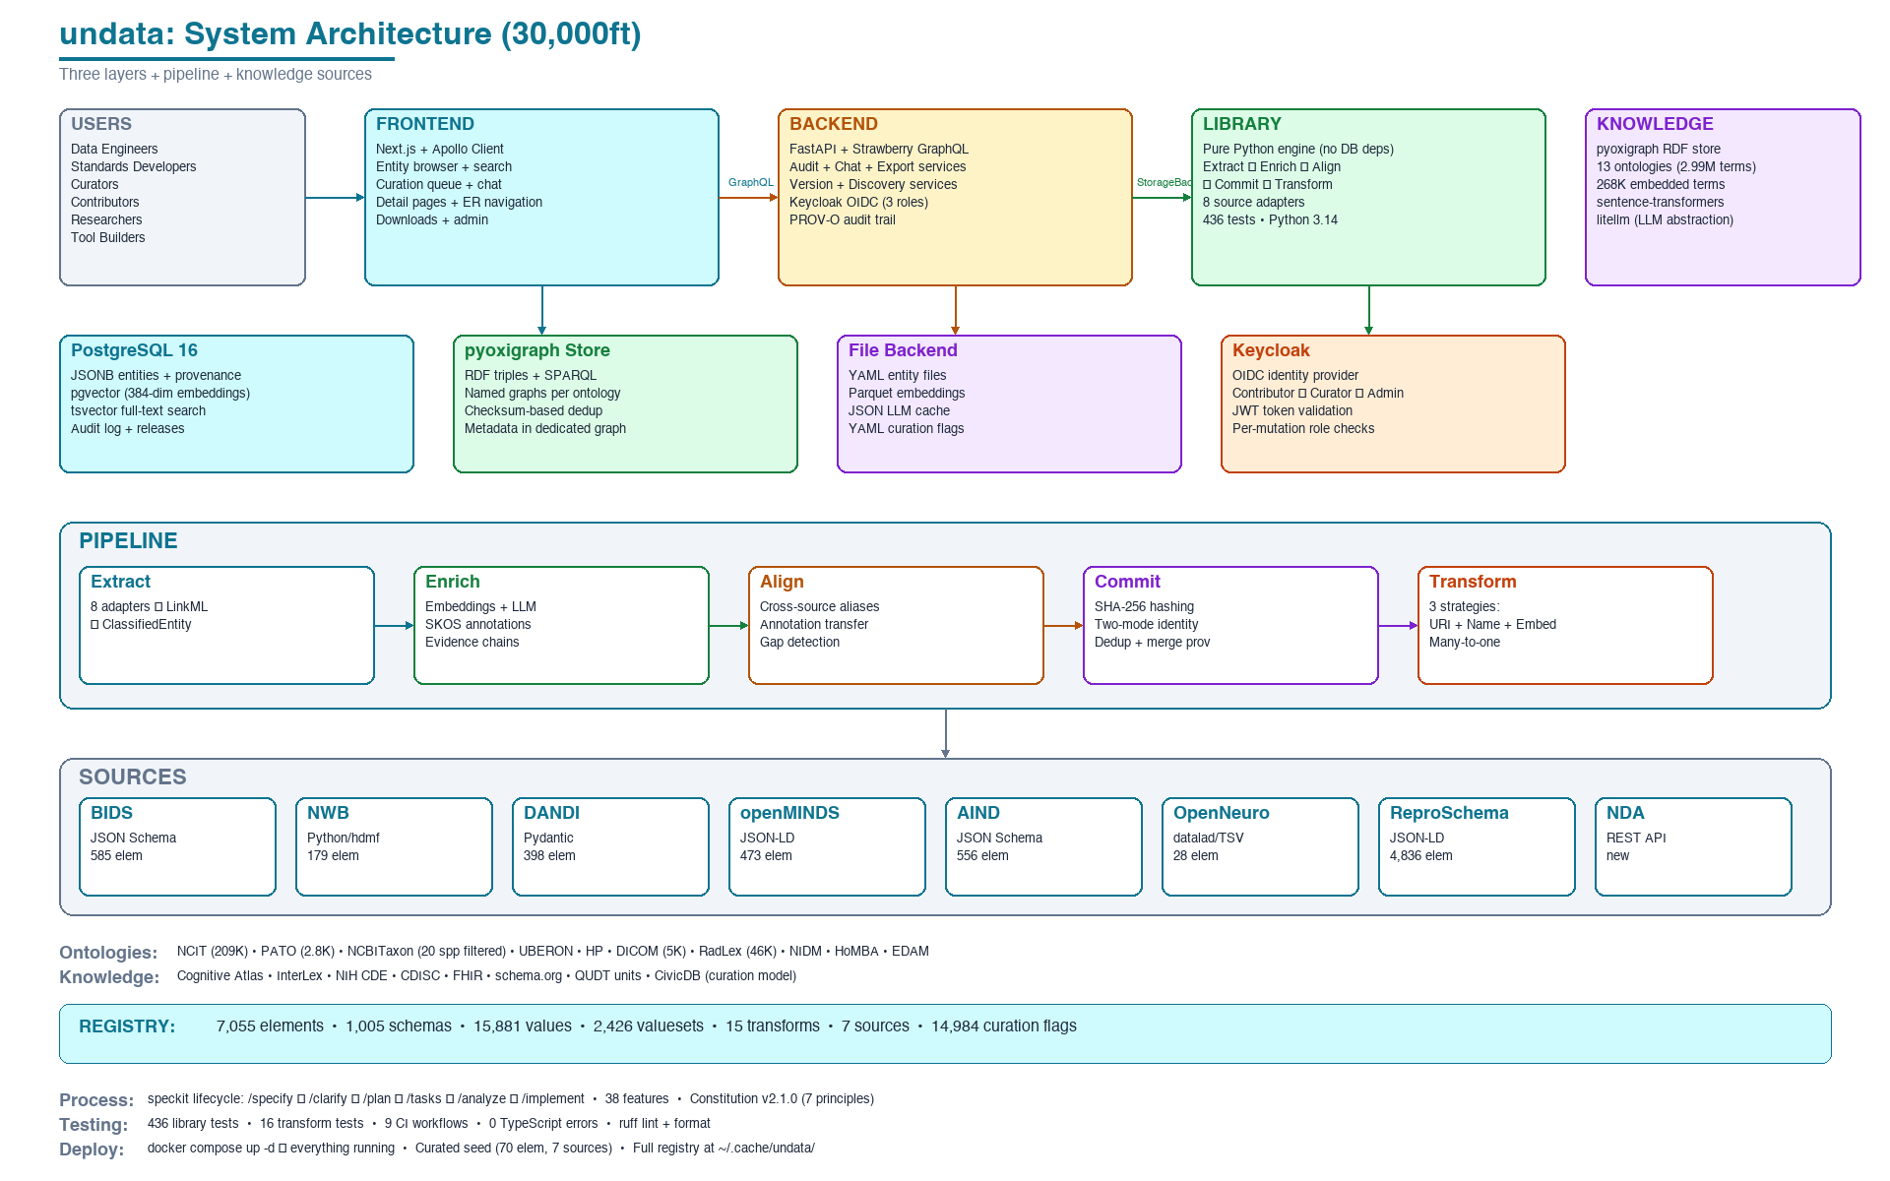
Architecture: 30,000ft Overview

Slide 44
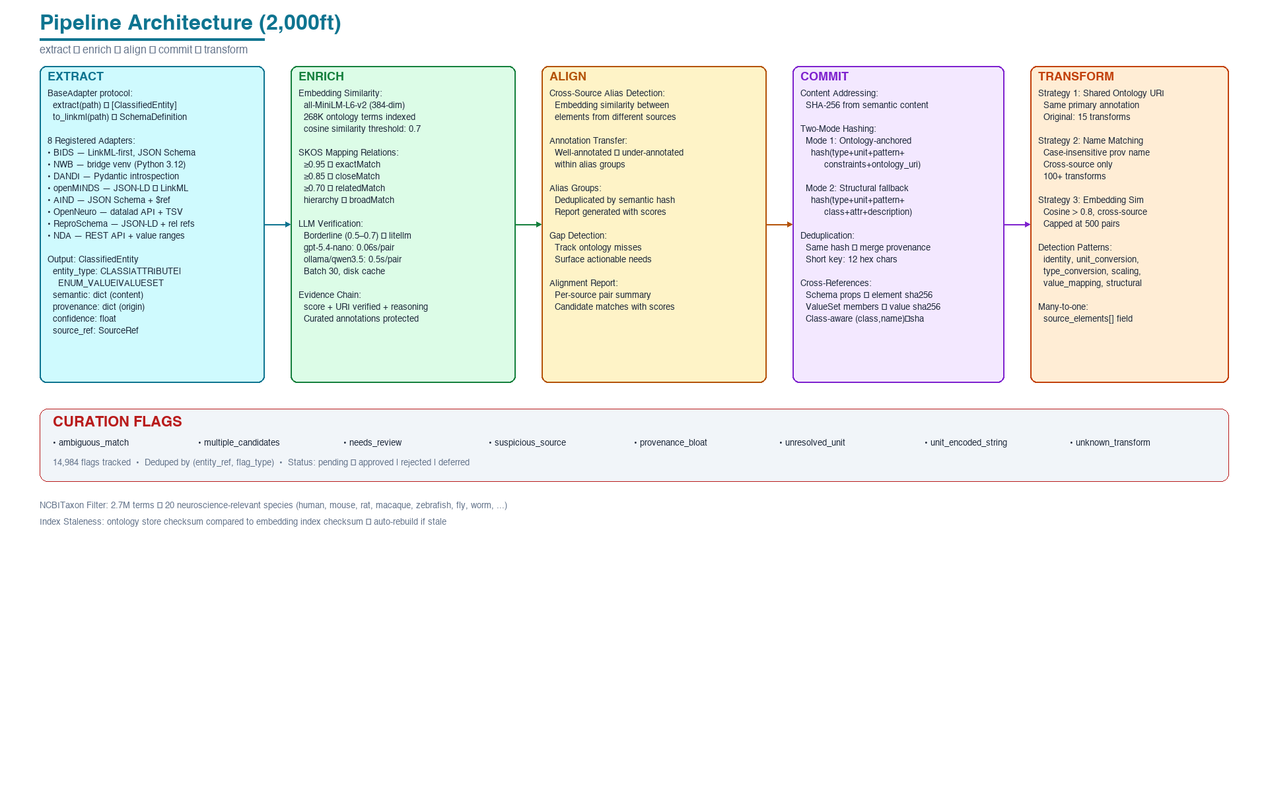
Architecture: Pipeline Detail

Slide 45
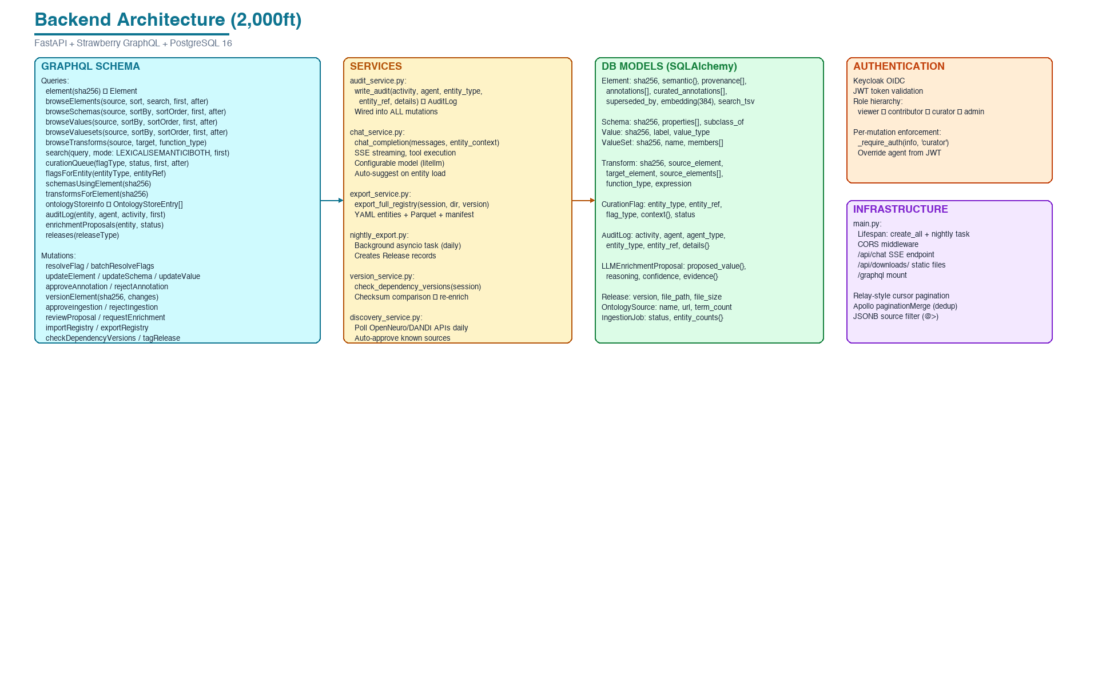
Architecture: Backend Detail

Slide 46
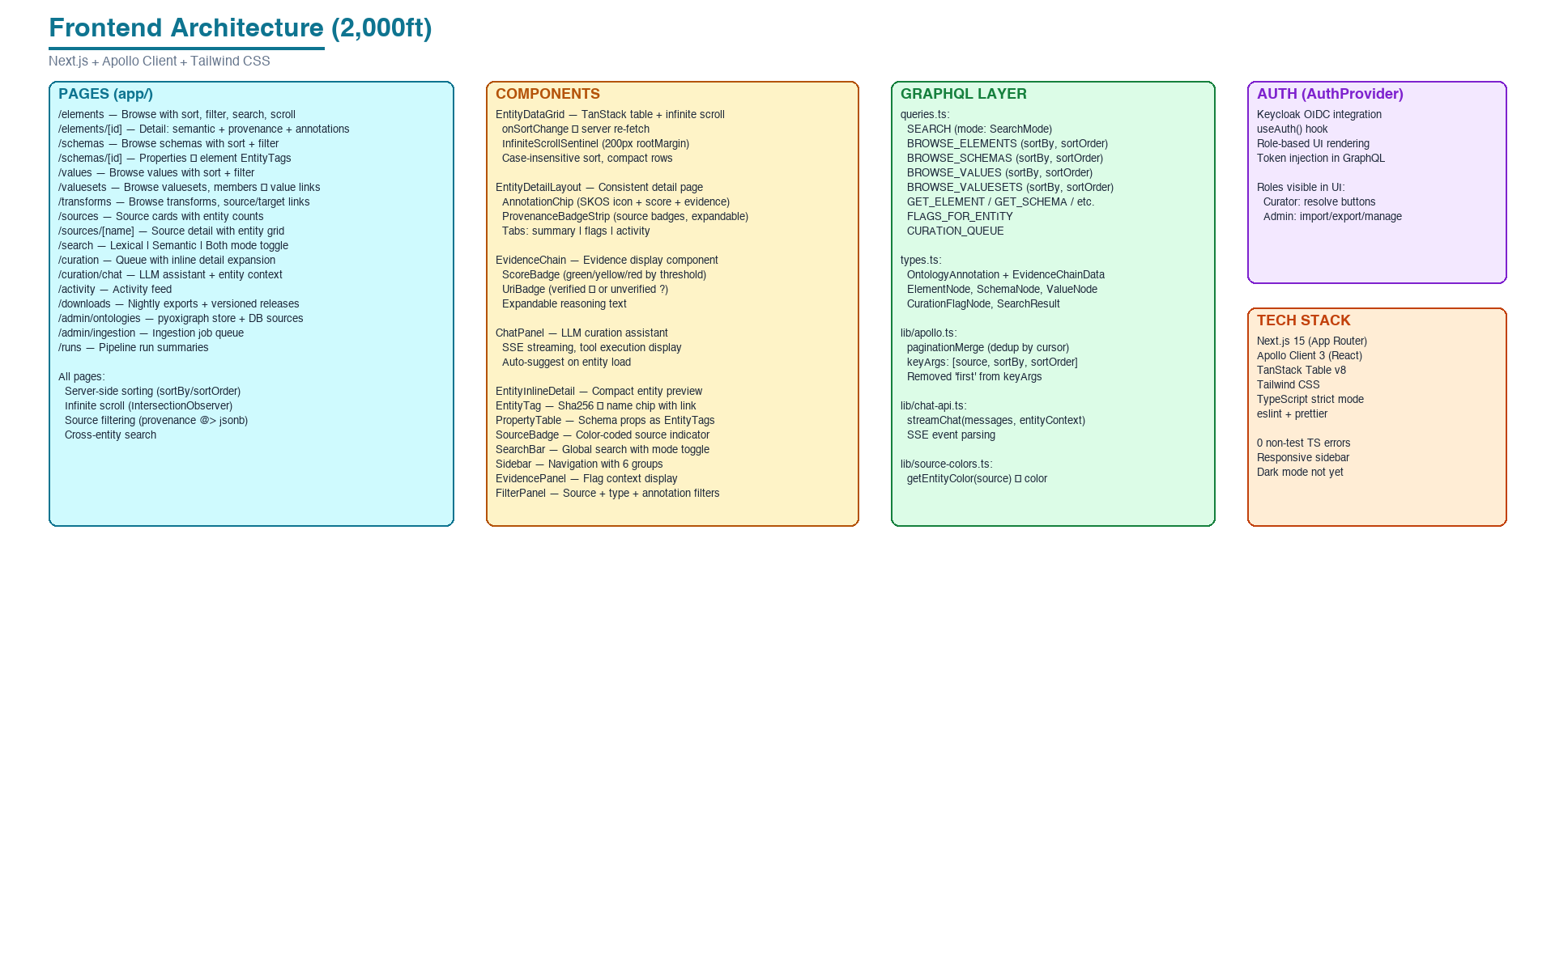
Architecture: Frontend Detail

Slide 47
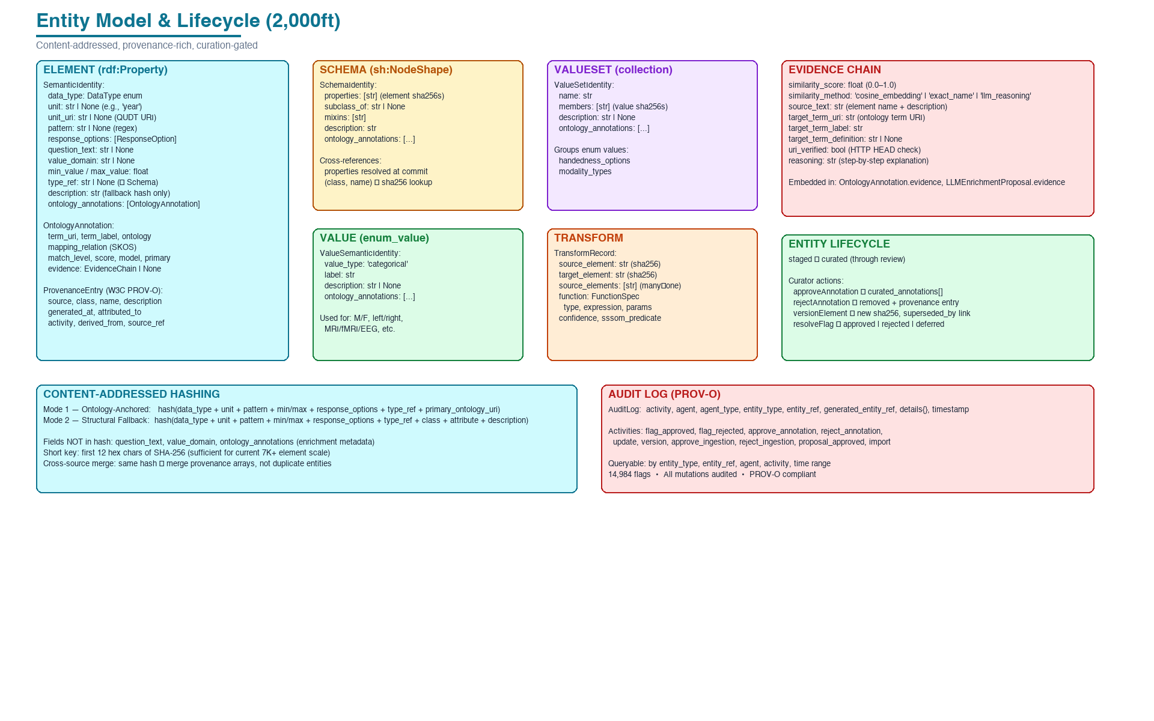
Architecture: Entity Model Detail

