Slide 1
Phase 3 Project
Flatiron Online Data Science Course

Slide 2
Summary
This is the third end-of-module project in the Flatiron Online Data Science Course
The project aims at testing and reinforcing the fundamental machine learning theory and algorithms taught in phase 3 of the Flatiron School curriculum
Applying the tools of logistic regression enables determining the likelihood of a given data point being associated with one of two categories. In combination with regularization techniques and machine learning algorithms, it can be used to solve various different classification problems.

Slide 3
Outline
Business Problem
Data & Methodology
Results
Conclusions & Actionable Insights
Further studies

Slide 4
Business Problem
The telecom business of SyriaTel is interested in reliable ways to forcast customer churn and hence either focus on its remaining customers or find ways to prolong customer lonjevity.
Forecasting whether or not a customer is likely to churn is a binary classification problem requiring models to predict potential customer churn as accurately as possible.

Slide 5
Data & Methodology
The SyriaTel dataset consists of 3,333 entries with information on its US customer base
After careful exploration and cleaning of the data, different variables were analyzed in order to reveal their predictive capabilities for customer churn
Ultimately, the data was used to find the predictive model with the highest accuracy

Slide 6
Results
The following key features were explored throughout the project:
Region
Total Charge
Customer Service Calls
International Plan
After testing several models with different algorithms and comparing their predictive abilities, the model with the highest accurcacy has been identified to predict customer churn.

Slide 7
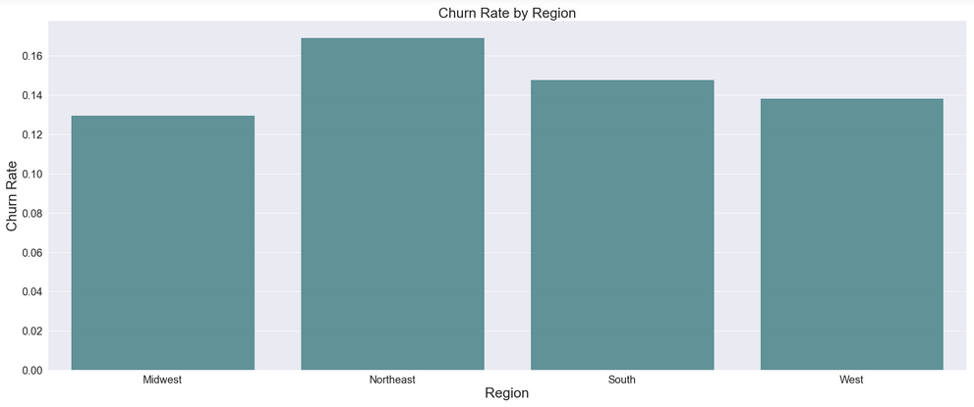
1. Region
Is customer churn dependent on the location of the customer?

Slide 8
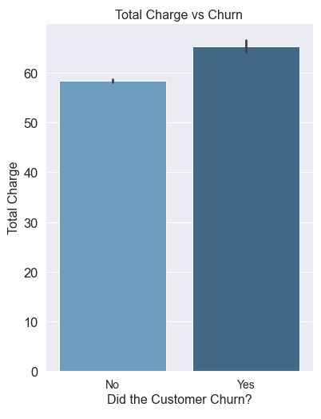
2. Total Charge
How does total charge of phone services affect customer churn?

Slide 9
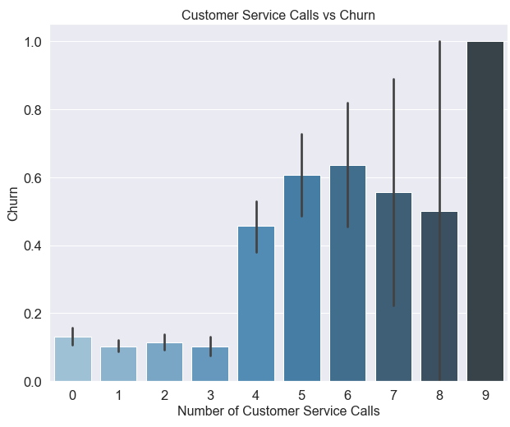
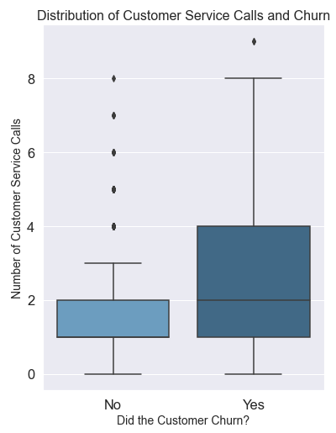
3. Customer Service Calls
What is the effect of customer service calls on customer churn?

Slide 10
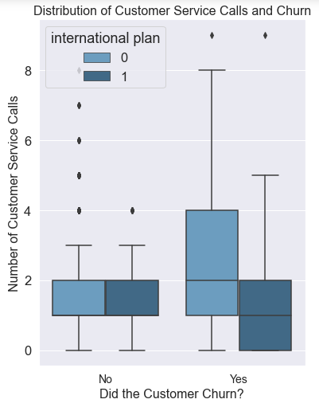
4. International Plan
Does the availability of an international plan affect customer churn?

Slide 11
Predictive models
Model type | Description | Test Score | Train Score | Precision | Recall | F1-Score
Random Forest | Bagging | 98.1% | 98.0% | 100% | 87.1% | 93.1%
XGBoost | Base | 98.1% | 98.3% | 100% | 87.1% | 93.1%
Gradient Boost | Base | 97.9% | 98.3% | 98.9% | 87.1% | 92.6%
Decision Tree | Tuning/Pruning | 96.7% | 97.7% | 90.7% | 87.1% | 88.9%
Decision Tree | Base | 95.1% | 100% | 80.9% | 88.1% | 84.4%
Random Forest | SMOTE | 94.6% | 94.9% | 100% | 63.4% | 77.6%
Random Forest | Base | 94.4% | 95.5% | 85.5% | 70.3% | 77.2%
Adaboost | Base | 92.3% | 92.6% | 83.8% | 61.4% | 70.9%
KNN | Base | 89.8% | 92.2% | 90.2% | 36.6% | 52.1%
KNN | Best k | 88.1% | 90.1% | 93.5% | 23.0% | 36.9%
Logistic Regression | SMOTE | 85.9% | 89.7% | 61.9% | 25.7% | 36.4%
KNN | SMOTE | 78.2% | 92.4% | 38.9% | 72.2% | 50.6%
Logistic Regression | Base | 77.9% | 76.9% | 38.8% | 79.2% | 52.1%

Slide 12
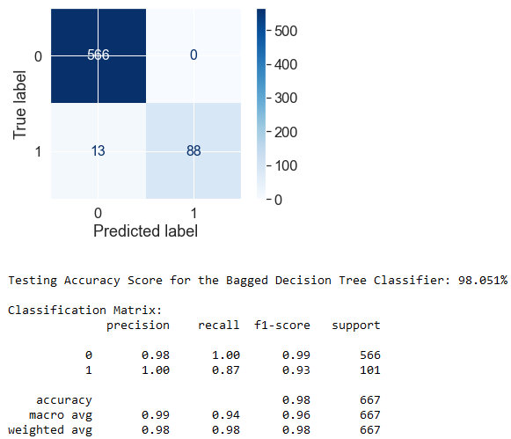
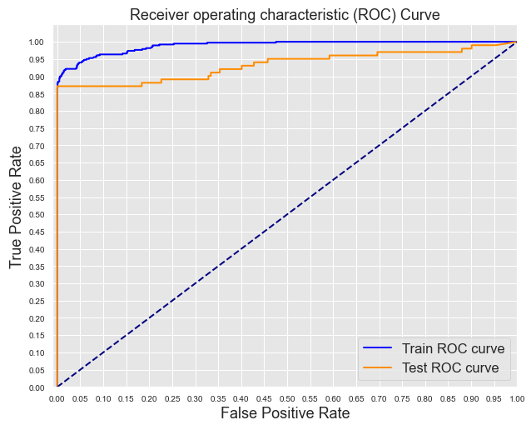
Best performing model
Random Forest with Bagging
Accuracy: 98%
F1-score: 93%

Slide 13
Conclusions & Actionable Insights
Focus on lower pricing or cost benefits such as discounts
Ensure higher quality customer service, reaching a benign solution for the customer after three customer service calls in order to avoid an increased potential for churn
Focus analytical efforts on the international plan as it has been shown that it has a strong influence on whether or not a customer is retained.
Possible aspects to investigate are availability and pricing

Slide 14
Further Studies
Gridsearch (Gradient Boost or XGBoost)
Find the best combination or parameters
Expand research and analysis by more variables
E.g. Number of Voicemail messages or in-depth analysis of call lenghts
Model refinements
Analyze feature importance

Slide 15
Thank You!
Email: kontakt@oliverzimmer.eu
GitHub: @senseize
LinkedIn: linkedin.com/in/username/oliver-zimmer-cfa-8824881ab/

