Slide 1

Navigating the New Normal in the Office Furniture and Equipment Industry:
Insights and Strategies for Contoso's Business Growth
Presentation by:
Group 2
Kawitsara Boonvisud z5234091
Mitisha Paleja z5301779
Yujing Zhou z5433189
Junxiao Wang z5447902

Slide 2
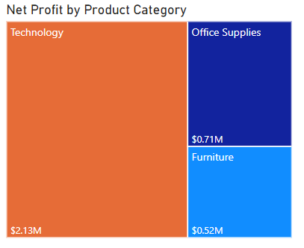
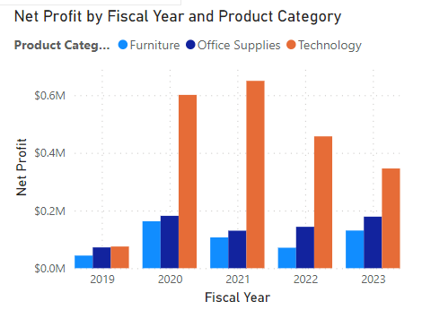
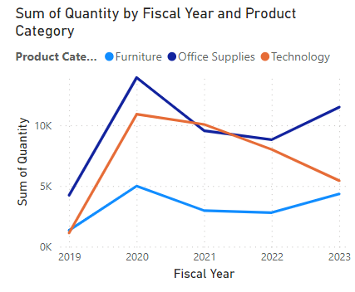
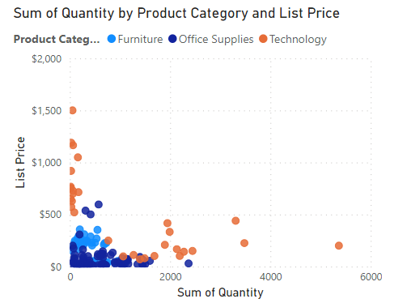
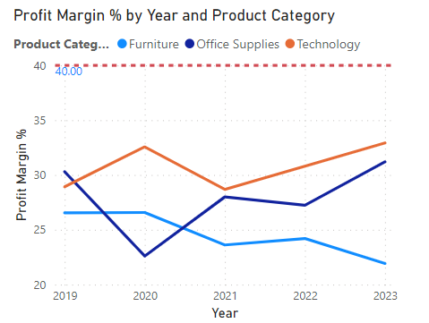
Current Market Landscape
During 2019 –2020, The profit and quantity sold of Technology significantly increased which might be due to lockdown and work from home. However, from 2021 onwards, the profit in Technology continue decreasing but the units sold of office supplies is increasing which might be because the work mode has been changed back to on-site.

Slide 3
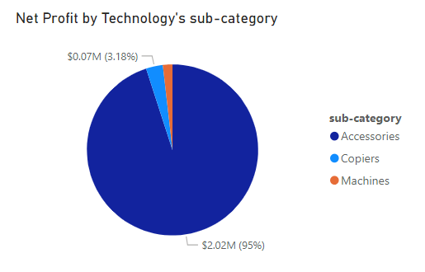
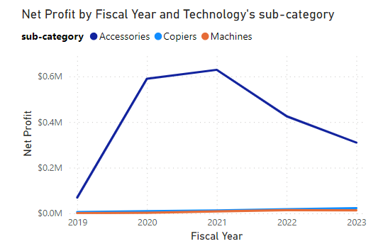
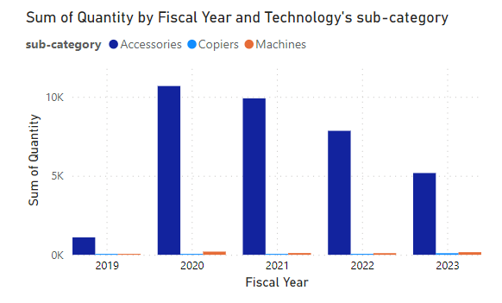
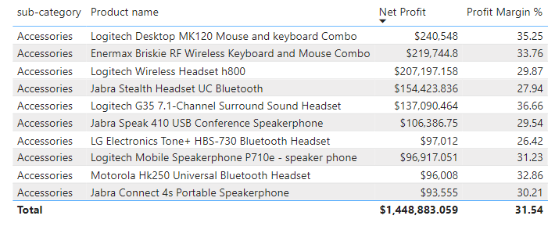
Technology Product Category
The main subcategory that contributes to profit the most is Accessories. The table on the left shows the top 10 highest profit of Accessories products.
The main subcategory that contributes to profit the most is Accessories. The table on the left shows the top 10 highest profit of Accessories products.

Slide 4
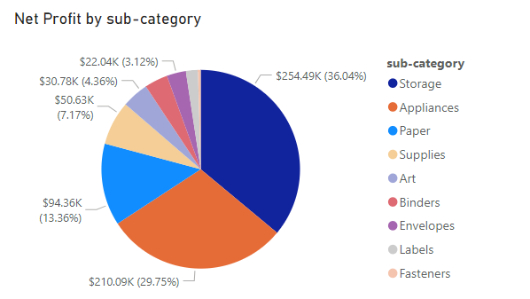
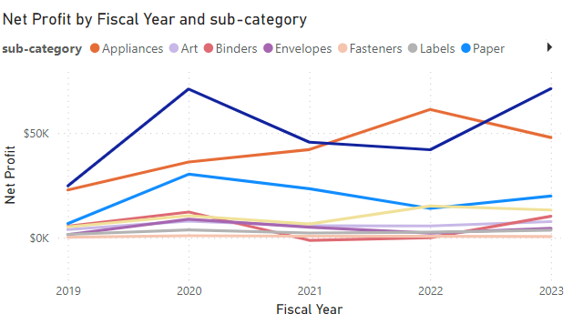
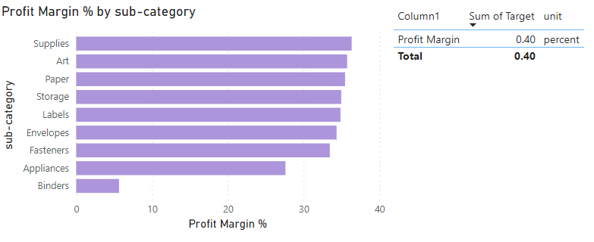
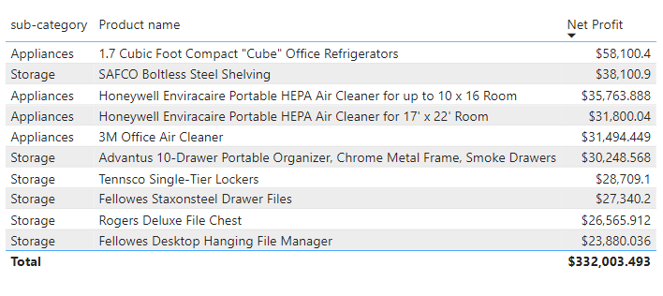
Office Supplies Product Category
The main subcategories that contributes to profit significantly for Office Supplies are Storage and Appliances.
This table shows the top 10 highest profit of Storage and Appliances products.​

Slide 5
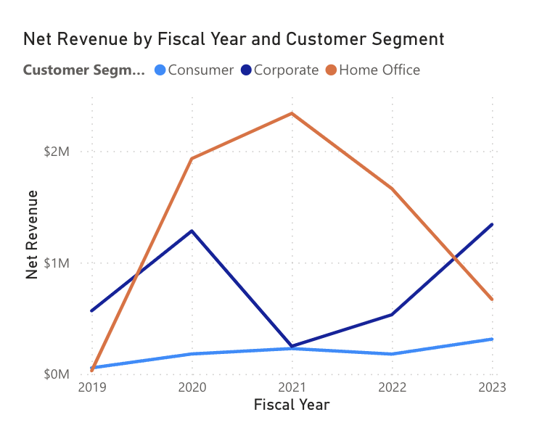
Overall Customer Segment Analysis
The line chart shows the changes of net revenue generated by different customer segments. During the Covid period (19-21), Home office is main customer; After Covid (22-23), Corporate gradually contributed to growth of net revenue, implying a transformation from work from home to work on site.
From this graph, corporate seems to be our target customer in future.

Slide 6
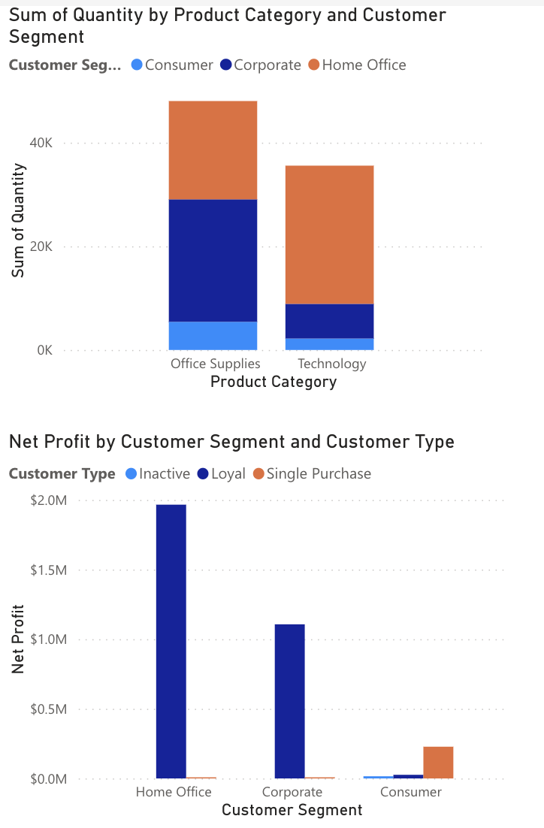
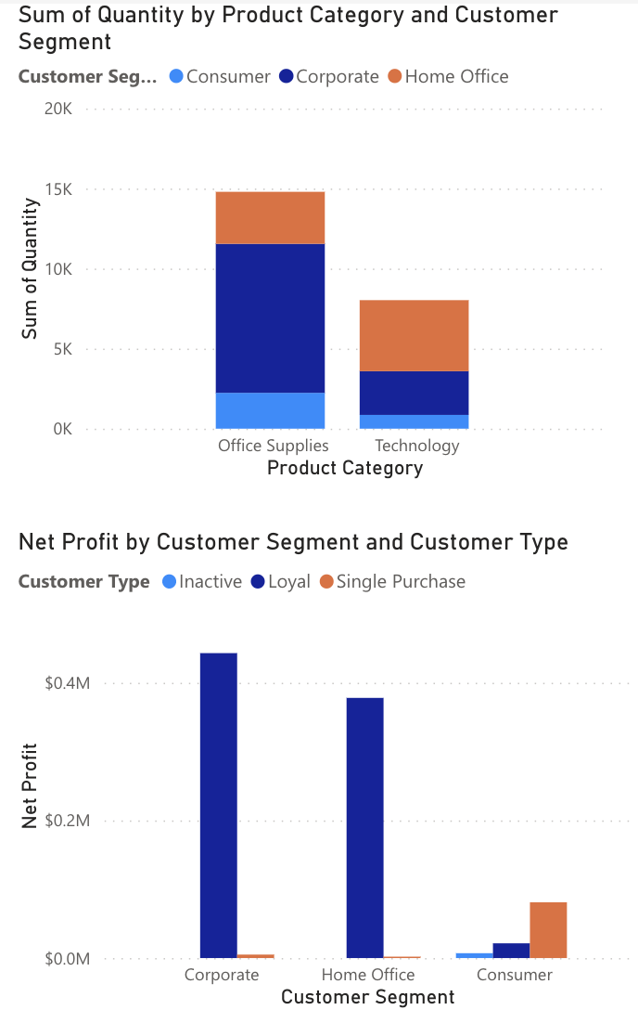
Target Customer Type for Target Product Category
2019
2022
Comparing the quantities in 2019 and 2022, the sales of Office Supplies and Technology have declined from an initial 30-40k to the current 10-15k, there is still a downward trend. It can be seen that as the pandemic ends and the return to offline work gradually becomes the norm, the demand for related products is gradually decreasing. In addition, the proportion of Corporate consumers is rising, while Home Office is declining.
Loyal type are always our target.

Slide 7
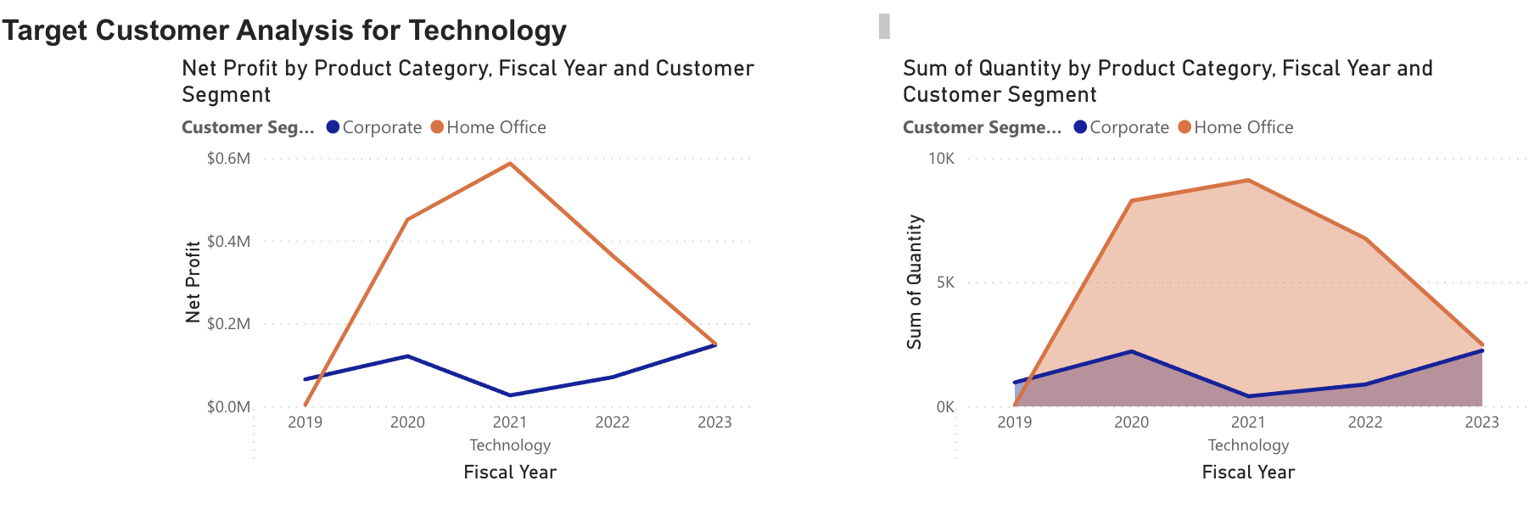
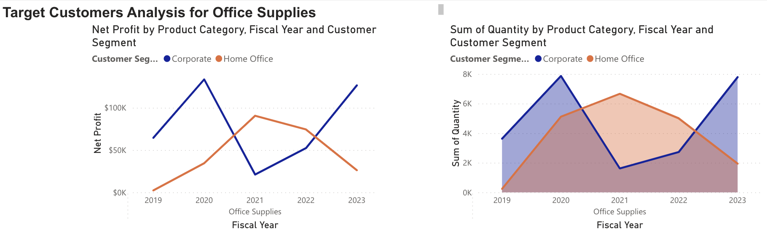
Target Customer Segment for Target Product Category

Slide 8
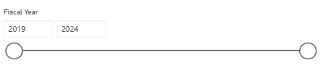
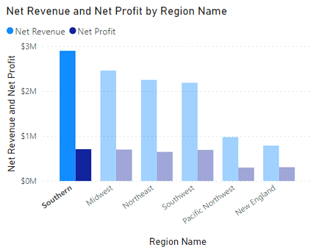
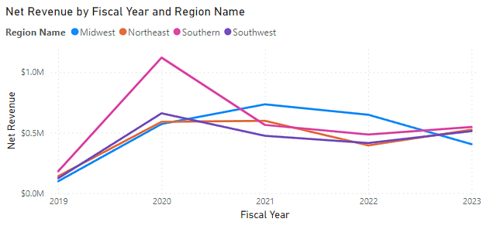
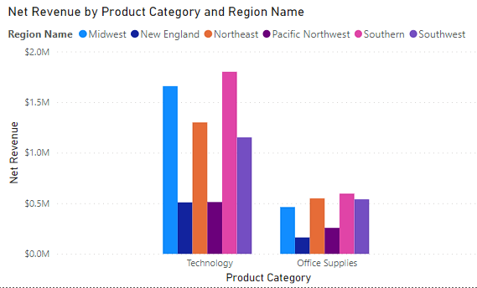
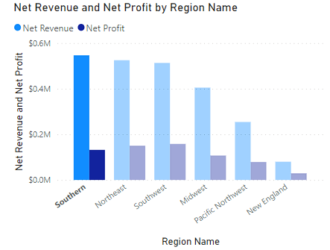
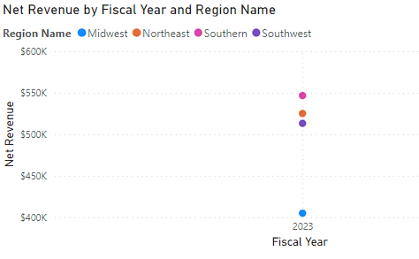
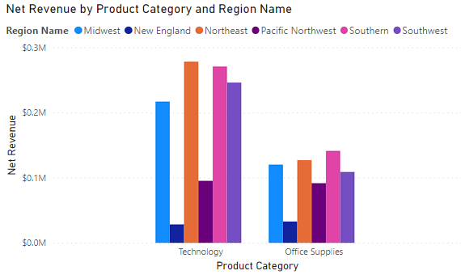
Target Location: Region Analysis

Slide 9
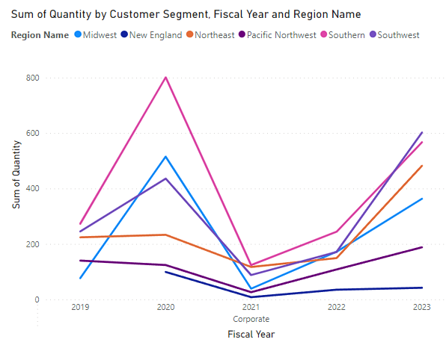
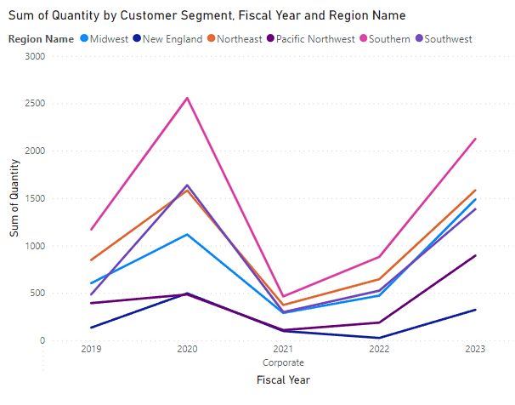
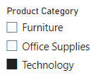
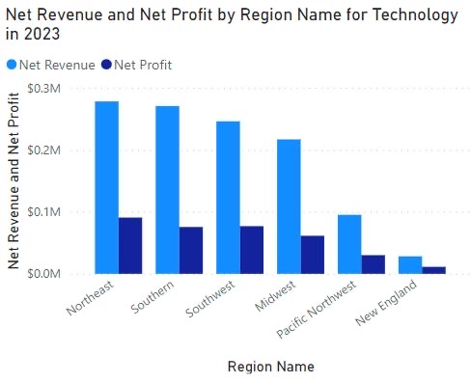
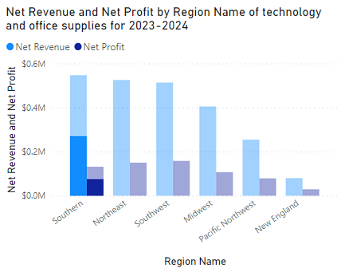
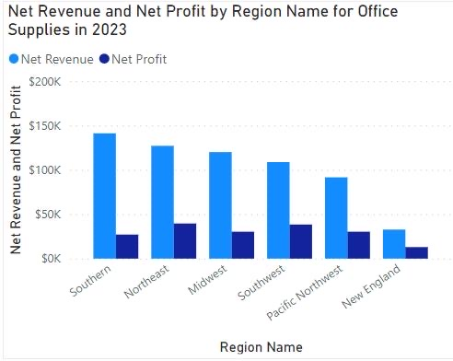
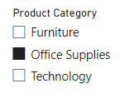
Target Region Analysis Technology and Office Supplies (Target products) for Corporate group of customers (Target customer)
Technology
Office supplies

Slide 10
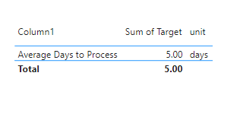
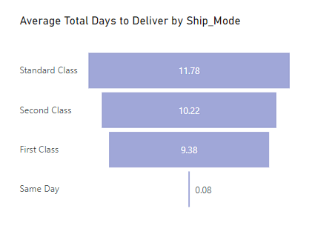
Shipping & Process Days
"Same Day" delivery meets the target of 5 days, ensuring prompt service for customers who prioritize quick deliveries.
The fact that "Standard Class" is the most popular choice across all ship modes implies that many customers prioritize cost savings over faster delivery.

Slide 11
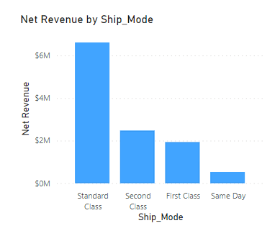
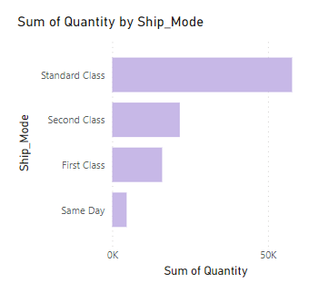
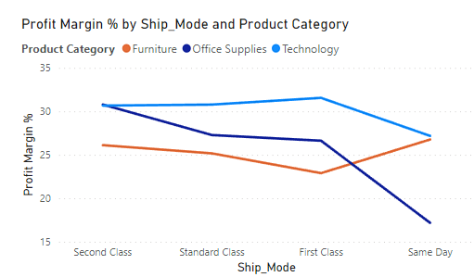
Shipping and Process Days

Slide 12
Conclusion
Thank you for your attention!
Presented by:
Group 2
INFS5700
W18A

