Slide 1
Yara Tutorial
0856069 Weichun, Lin

Slide 2
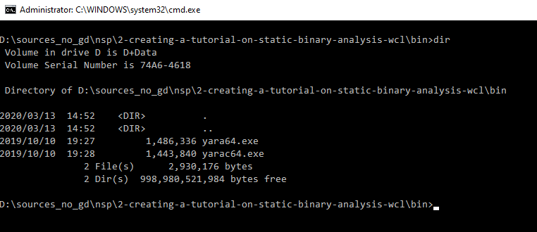
Installation
Download yara binary from GitHub Release Page: https://github.com/VirusTotal/yara/releases and unzip it. Files are already put at bin folder.

Slide 3
Try find any URL in file
Execute yara64.exe ..\01_find_url.yar ..\target to check if files in target folder is matched rule: 01_find_url.yar
Some string contains \x00 since strings are store in UTF-16LE format. Just replace \x00 in string make it readable.
If you want to see matched pattern, add -s parameter in yara64
rule MatchUrl
{
strings:
$urlPattern1 = /https?:\/\/([^\x00-\x0A]*)/
$urlPattern2 = /h\x00t\x00t\x00p\x00(s\x00)?:\x00\/\x00\/\x00([^\x01-\x0A]*)/
condition:
$urlPattern1 or $urlPattern2
}

Slide 4
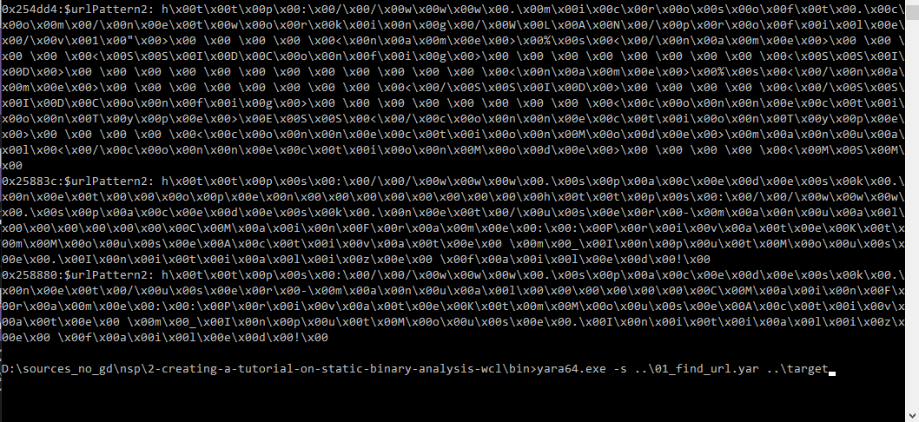
Try find any URL in file
→
\x00 Removed
0x25883c:$urlPattern2: https://www.spacedesk.netopenhttps://www.spacedesk.net/user-manualCMainFrame::PrivateKtmMouseActivate m_InputMouse.Initialize failed!
0x258880:$urlPattern2: https://www.spacedesk.net/user-manualCMainFrame::PrivateKtmMouseActivate m_InputMouse.Initialize failed!

Slide 5
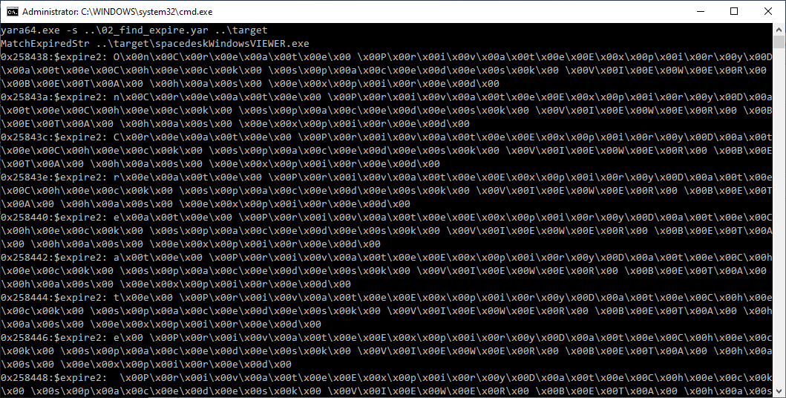
Another try: find keyword: “expired”
rule MatchExpiredStr
{
strings:
$expire1 = /expired/i
$expire2 = /([\w\s]\x00)+e\x00x\x00p\x00i\x00r\x00e\x00d\x00/i
condition:
$expire1 or $expire2
}

Slide 6
Another try: find keyword: “expired”
MatchExpiredStr ..\target\spacedeskWindowsVIEWER.exe
0x258438:$expire2: OnCreate PrivateExpiryDateCheck spacedesk VIEWER BETA has expired
0x25843a:$expire2: nCreate PrivateExpiryDateCheck spacedesk VIEWER BETA has expired
0x25843c:$expire2: Create PrivateExpiryDateCheck spacedesk VIEWER BETA has expired
0x25843e:$expire2: reate PrivateExpiryDateCheck spacedesk VIEWER BETA has expired
0x258440:$expire2: eate PrivateExpiryDateCheck spacedesk VIEWER BETA has expired
0x258442:$expire2: ate PrivateExpiryDateCheck spacedesk VIEWER BETA has expired
0x258444:$expire2: te PrivateExpiryDateCheck spacedesk VIEWER BETA has expired
0x258446:$expire2: e PrivateExpiryDateCheck spacedesk VIEWER BETA has expired
0x258448:$expire2: PrivateExpiryDateCheck spacedesk VIEWER BETA has expired
...
0x2584ce:$expire2: spacedesk VIEWER BETA has expired
0x2584d0:$expire2: pacedesk VIEWER BETA has expired
...
0x258500:$expire2: expired

