Slide 1
Ghidra Tutorial
0856069 Weichun, Lin

Slide 2
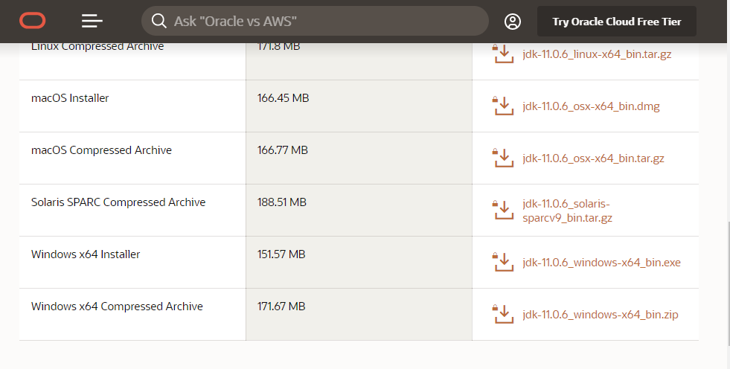
Installation: Java
Download Java environment from following link (An Oracle account required) : https://www.oracle.com/java/technologies/javase-jdk11-downloads.html

Slide 3
Installation: Java
Download Java environment from following link (An Oracle account required) : https://www.oracle.com/java/technologies/javase-jdk11-downloads.html

Slide 4
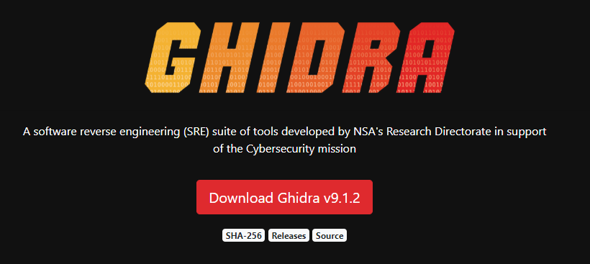
Download and extract Ghidra
Download Ghidra from following link: https://ghidra-sre.org/

Slide 5
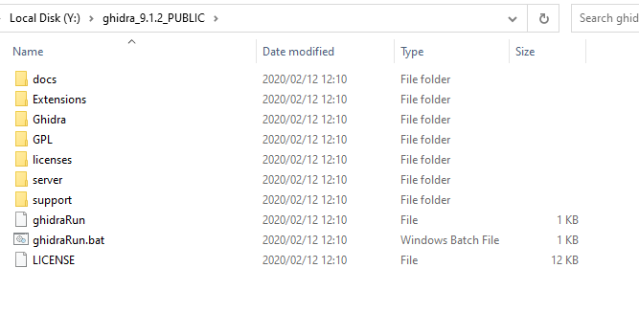
Download and extract Ghidra
Unzip it and run ghidraRun.bat

Slide 6
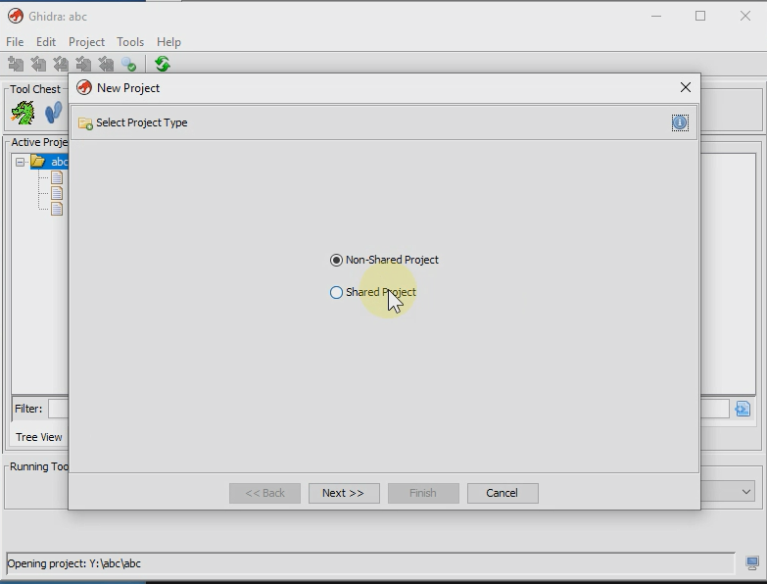
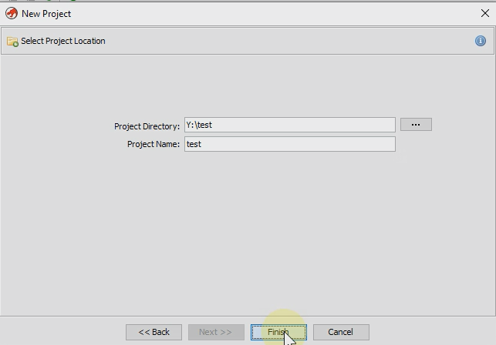
Create New Project
[File]/[New Project]
Select [Non-shared project]
Enter Project directory and name (ensure directory for project exists)
[Finish]

Slide 7
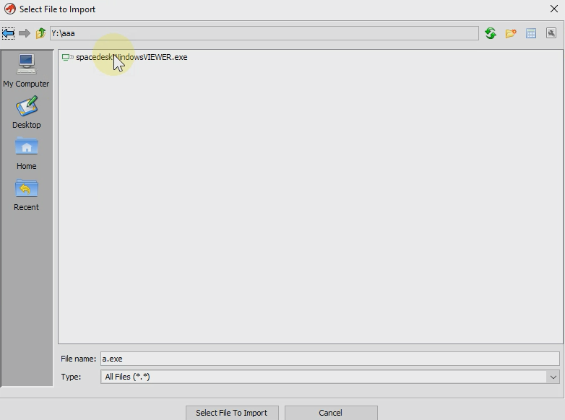
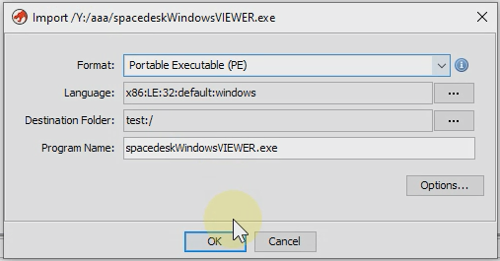
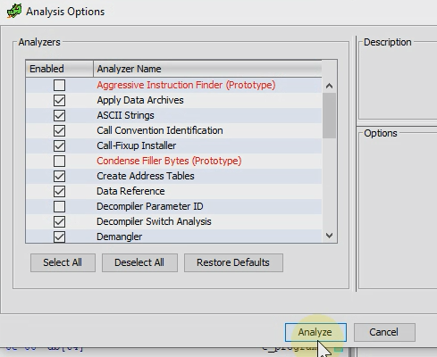
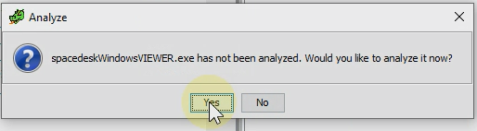
Import executable file
[File]/[Import File]
Select file that you want to analysis.
Click [OK]
On [Analyze] dialog, click [Yes] and [Analyze]
Wait a moment until analysis done, progress can check by right-bottom of window.

Slide 8
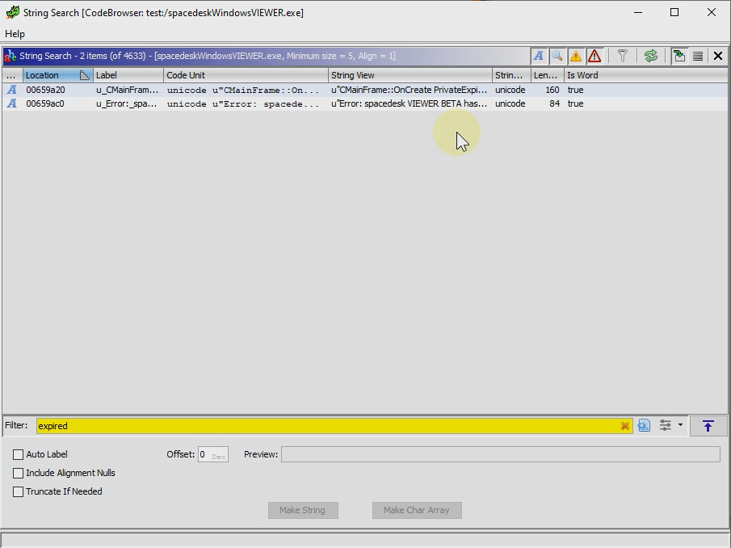
Find string reference
We can find string reference by [Search]/[For Strings]
Double click on row can go to string location.

Slide 9
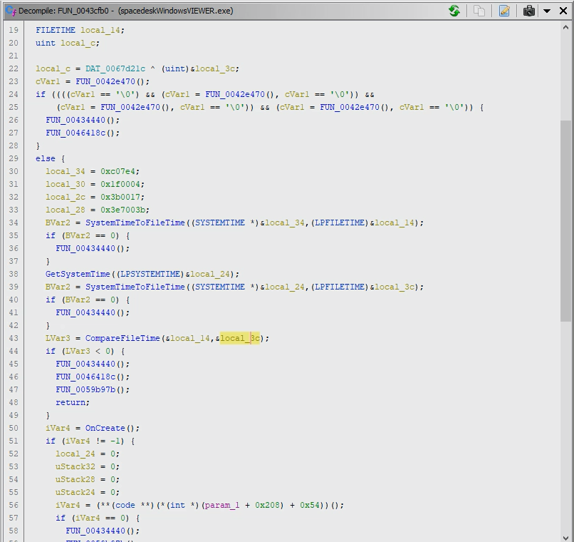
Decompile
After we go to referenced function, Decompile window will show this function in C.
As we see in right panel, local_34 is a specified date, local_14 is FILETIME converted from local_34, and local_24 is current time, local_3c is FILETIME converted from local_24.

Slide 10
Decompile
LVar3 is result of compare local_14 and local_3c.
If local_14 is less than local_3c, that is after specified date, this program will show expired dialog and no longer to use.

