Slide 1
NS Mini Project 3 SSL Certificate
網工所 0856502 林彥傑

Slide 2
Outline
HTTPS with Perfect Forward Secrecy
ACME protocol introduction
Let’s encrypt tutorial
HTTPS with Self-signed Certificate
Notes:
這是我今天的outline
分成兩大部分
第一部分是HTTPS with Perfect Forward Secrecy
會先簡單介紹ACME這個protocol以及let’s encrypt的教學
第二部分則是如何自簽憑證

Slide 3
ACME Protocol
Automatic Certificate Management Environment
Automatically obtain a browser-trusted certificate
without human intervention
defined in RFC 8555
Let’s encrypt use ACME protocol to issue certificates

Slide 4
ACME Protocol - Steps
Domain validation
Prove to the CA that the web server controls the domain
Challenge
Certificate Issuance and Revocation

Slide 5
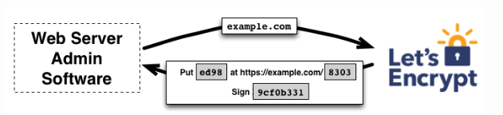
HTTP-01 Challenge
The most common challenge type

Slide 6
HTTP-01 Challenge - Steps
ACME client send a initial request to Let’s encrypt
Let’s encrypt gives a token to the ACME client
The ACME client puts a file on your web server at http://<DOMAIN>/.well-known/acme-challenge/<TOKEN>
the file contains the token, plus a thumbprint of the account key
The client tells Let’s encrypt that the file is ready
Let’s encrypt try to access the file

Slide 7
Let’s Encrypt Tutorial
Preparation
set up a web server by nginx
Obtain certificate
Notes:
首先需要準備一個 web server, 這裡我用 nginx 為範例

Slide 8
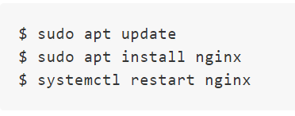
Preparation
Demo OS: Ubuntu 18.04
Install and run nginx

Slide 9
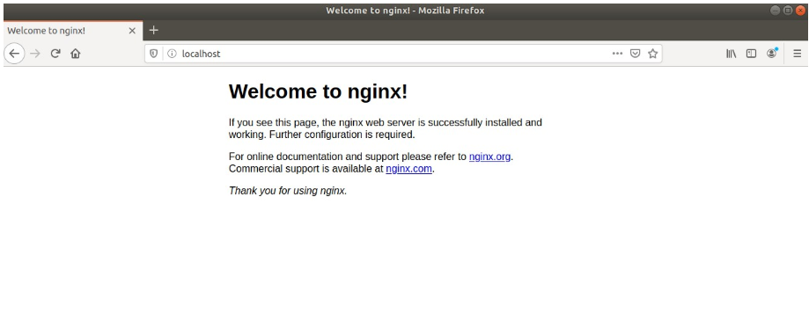
Visit localhost

Slide 10
Step 0 – Apply a domain for your website
Let’s encrypt does not issue certificates to the websites that have no domain name
https://140.113.1.1 (X)
https://example.com (O)
Can use free domain service
e.g. nctu.me
Notes:
如果你的網站沒有 domain name 的話，le 不會發給你憑證
所以要先申請一個 domain name
可以使用 nctu.me

Slide 11
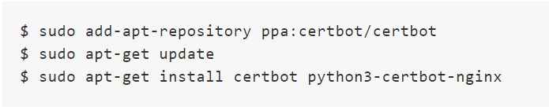
Step 1 – Install Certbot
An ACME client
Installation
Notes:
- 首先我們要下載一個 ACME client 這樣才可以跟 le的 server 互動

Slide 12
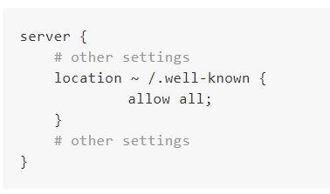
Step 2 – Modify nginx configuration
/etc/nginx/sites-available/default

Slide 13

Step 3 – Apply a certificate (1/3)
Apply for a real certificate
use test environment
--dry-run option
Notes:
因為有安全上的考量，如果你失敗太多次的話會被 let’s encrypt ban 掉
所以 le 提供了測試環境，在指令後面加上 --dry-run, 那這個request就會打向 le 的測試 server, 可以用來檢查你的server有沒有設定錯誤
向是防火牆設定、nginx 設定等等
- 使用測試指令確定沒有錯誤後，再把 --dry-run 拿掉向 真正的 le server 申請憑證

Slide 14
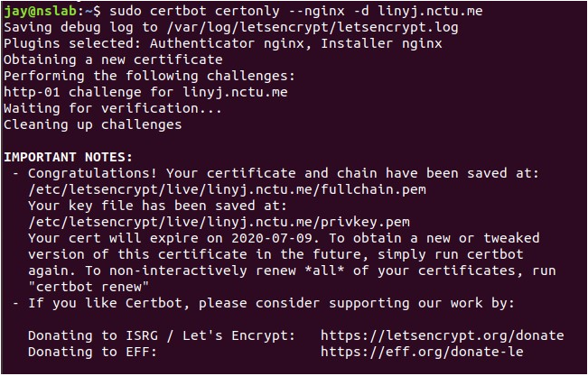
Step 3 – Apply a certificate (2/3)
Notes:
- 成功申請候就可以看到成功訊息了

Slide 15
Step 3 – Apply a certificate (3/3)
/etc/letsencrypt/live/<domain>
Notes:
- Le 會在 /etc/letsencrypt/live/你的domain底下生成這幾個檔案

Slide 16

Step 4 – Enable https with perfect forward secrecy (1/4)
Edit /etc/nginx/snippets/ssl-linyj.nctu.me.conf
Add the following lines to the file

Slide 17
Step 4 – Enable https with perfect forward secrecy (2/4)
Generate Diffie-Hellman parameters
Notes:
那前面我們已經設定完網站的憑證了
接著就是要告訴 nginx 說我們要 啟用 Perfect forward secrecy 的功能
要啟用這個功能就需要先 gen 一個 DF的參數

Slide 18
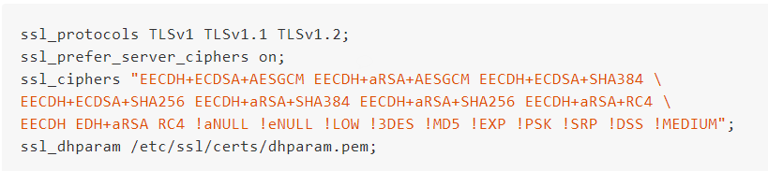
Step 4 – Enable https with perfect forward secrecy (3/4)
Edit /etc/nginx/snippets/ssl-params.conf

Slide 19

Step 4 – Enable https with perfect forward secrecy (4/4)
Edit the server block in /etc/nginx/sites-available/default
Comment the following 2 lines

Slide 20
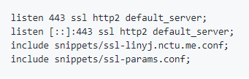
Step 4 – Enable https with perfect forward secrecy (4/4)
Edit the server block in /etc/nginx/sites-available/default
Add the following lines

Slide 21
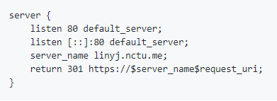
Step 4 – Enable https with perfect forward secrecy (4/4)
Edit the server block in /etc/nginx/sites-available/default
(Optional) redirect http to https automatically

Slide 22
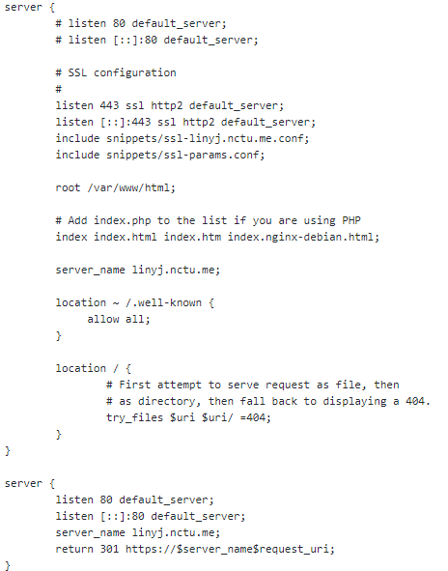

Slide 23
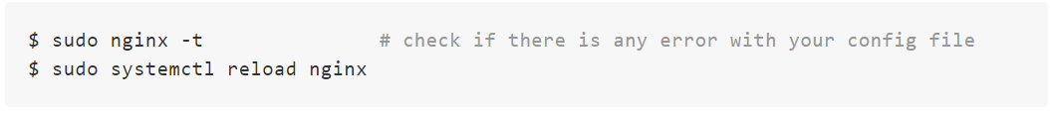
Step 5 – Reload nginx

Slide 24
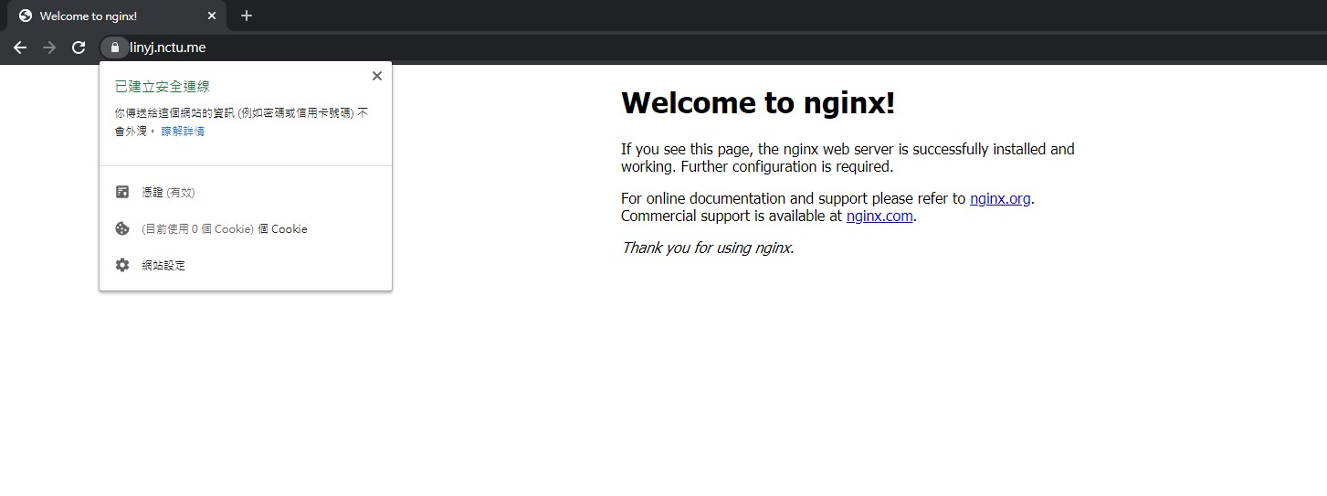
Result

Slide 25
HTTPS with self-signed certificate
Self-signed root CA
Self-signed server certificate

Slide 26


Step 1 – Self-signed root CA (1/3)
Generate the private key of root CA
Notes:
使用 openssl 生出一個 root CA 的 private key

Slide 27
Step 1 – Self-signed root CA (2/3)
Generate root certificate request file

Slide 28
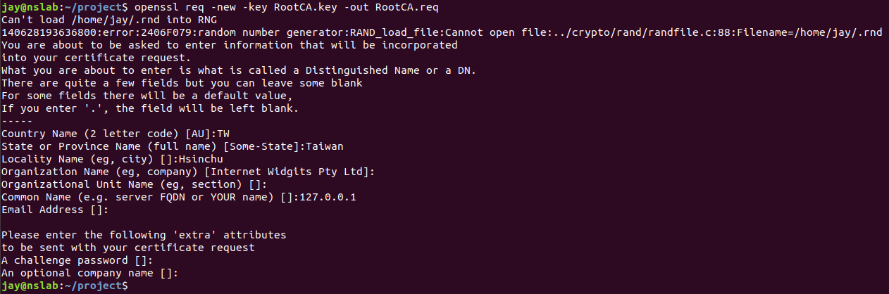
Step 1 – Self-signed root CA (2/3)
Notes:
這個步驟會需要填一些有關這個 Root CA 憑證的資訊，如地區，公司名稱等，可填可不填

Slide 29

Step 1 – Self-signed root CA (3/3)
Use the request file to generate the root certificate
Notes:
產生完 request file 後，就可以用來生 Root CA 憑證了
指令如圖，一樣如果沒問題的話就會有一些關於憑證的訊息

Slide 30
Next step
Now we have created a Root CA by ourselves
We can issue ourselves a certificate for the website via this Root CA

Slide 31

Step 2 – Self-signed Server Certificate (1/3)
Generate the private key of the server
Notes:
- 跟 Root CA 一樣 都要先生成一個 private key

Slide 32

Step 2 – Self-signed Server Certificate (2/3)
Generate the certificate request file

Slide 33
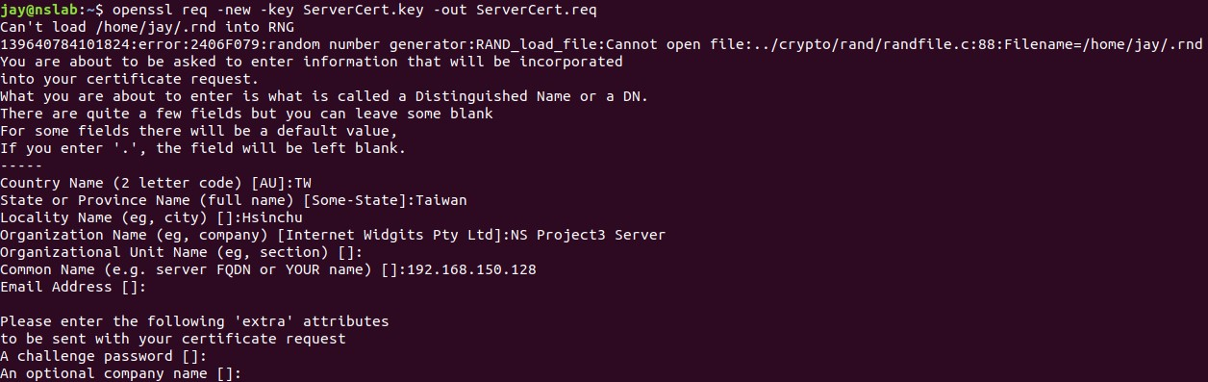
Step 2 – Self-signed Server Certificate (2/3)
Common Name must match the IP or FQDN of the website
Notes:
這裡一樣會需要填關於這個網站憑證的資訊
須注意 Common Name 這個欄位不能亂填，必須填你的網站的 IP或是 domain name
如範例這裡我填192.168.150.128，這是我的網站的 IP
那如果你的網站是 XXX.com 那就是填 XXX.com 這樣
如果這裡填錯的話，雖然之後設定完後你的網站一樣是走HTTPS，但瀏覽器會不信任這個憑證
瀏覽器不會標成安全的網站

Slide 34
Step 2 – Self-signed Server Certificate (3/3)
Generate the server certificate
Notes:
最後，就可以生成網站的憑證了
從這個指令可以看到，我們使用 RootCA 的憑證去簽出網站的憑證

Slide 35
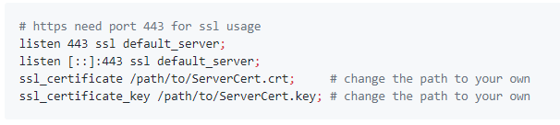
Step 3 – Configure nginx
Edit /etc/nginx/sites-available/default
add the following lines to the server block
Reload nginx after modification

Slide 36
Step 4 – Add Root CA certificate to the browser (1/3)
This Root CA is created by ourselves
The browser won’t trust any certificate issued by this Root CA
We need to tell the browser that we trust this Root CA

Slide 37
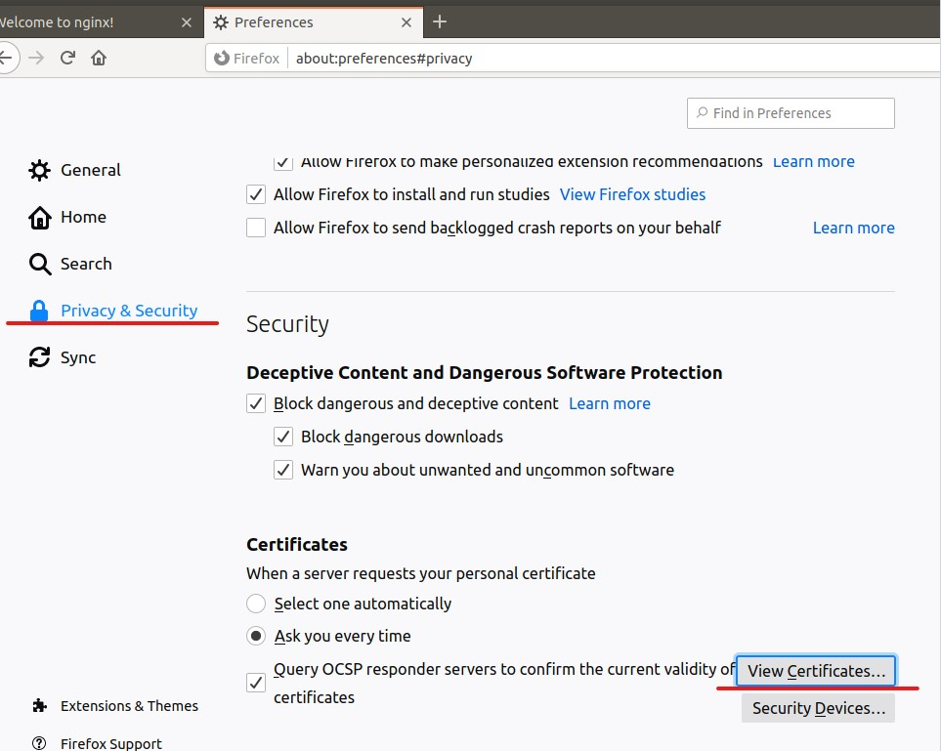
Step 4 – Add Root CA certificate to the browser (2/3)

Slide 38
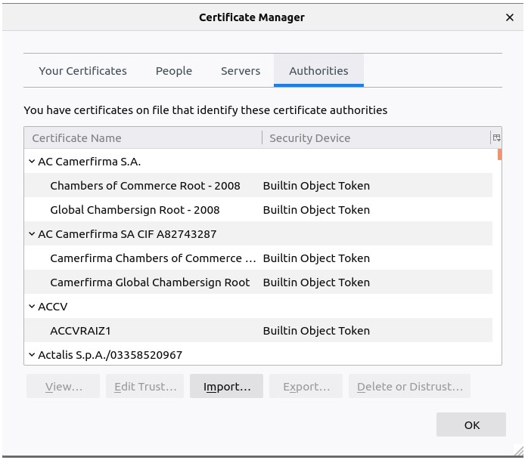
Step 4 – Add Root CA certificate to the browser (3/3)
Notes:
- Import server.crt

Slide 39
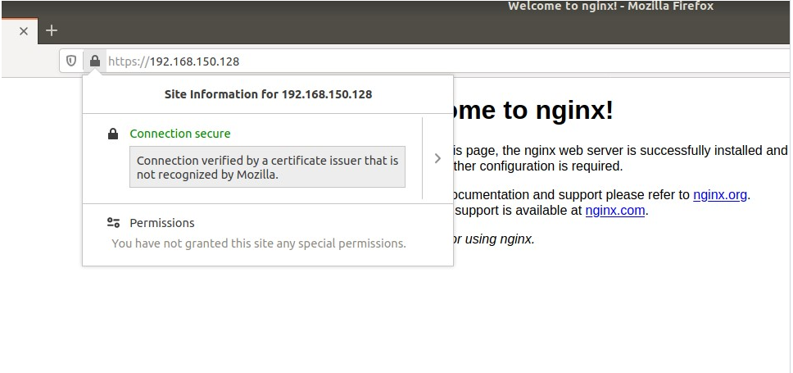
Result
Notes:
- Import server.crt

Slide 40
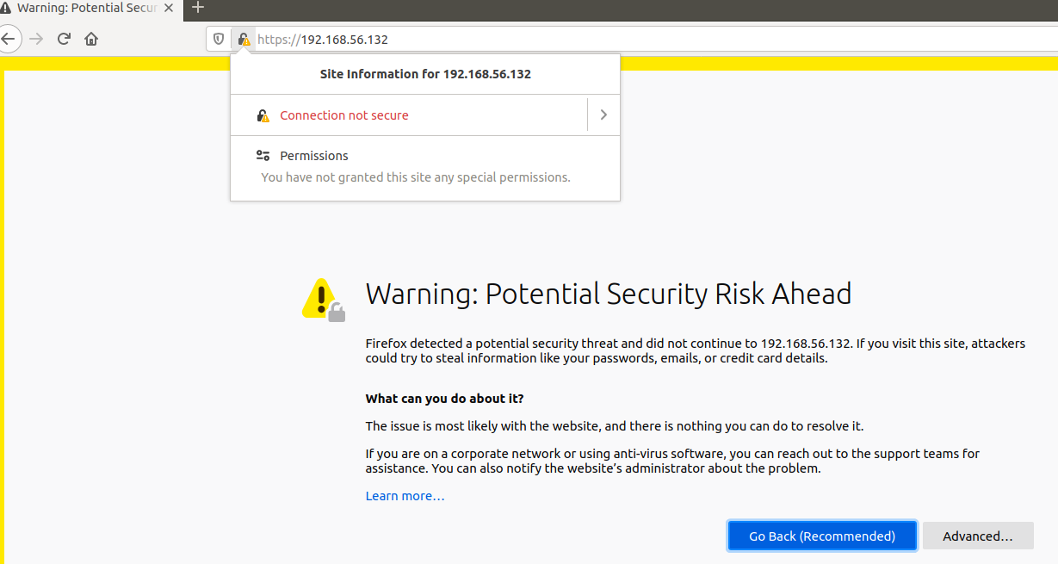
Failed Result
Notes:
如果前面的 Common Name 打錯，或是沒有把 Root CA 的憑證加到瀏覽器的話就會出現圖中的結果
瀏覽器不信任你的憑證，而且會阻擋連線

Slide 41
Thank you for listening!

