Slide 1
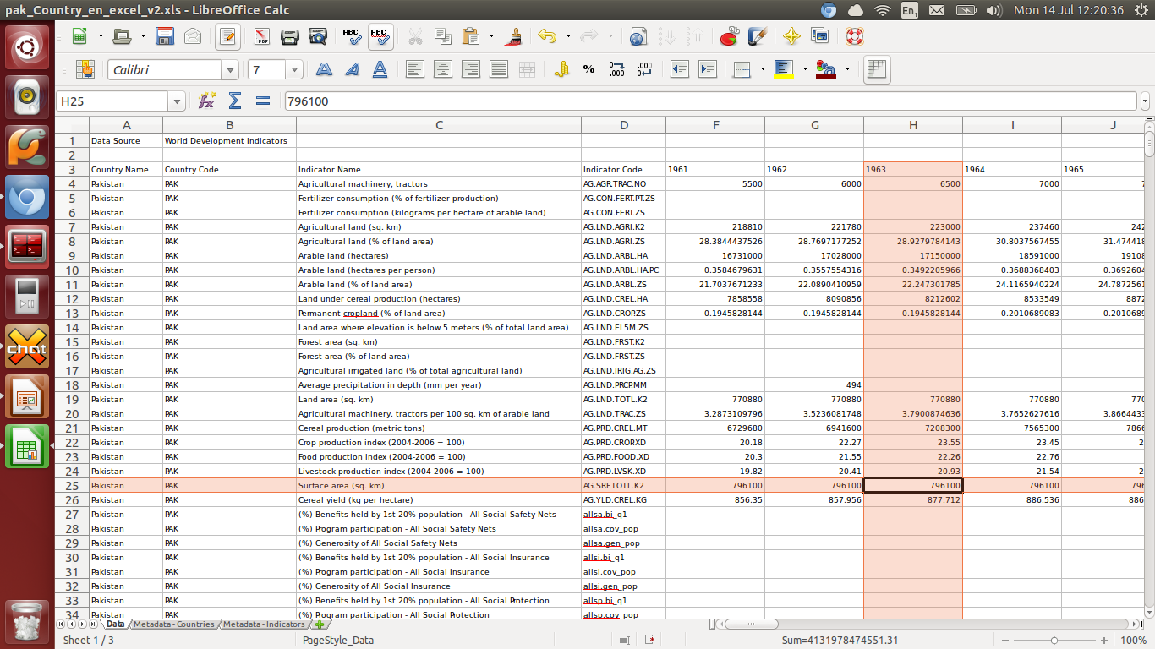
XYPath

Slide 2






The problem
Spreadsheets / tables contain data
… in many different file formats
  [excel, excelx, libreoffice, csv, html icons]
… in many different shapes ...

Slide 3
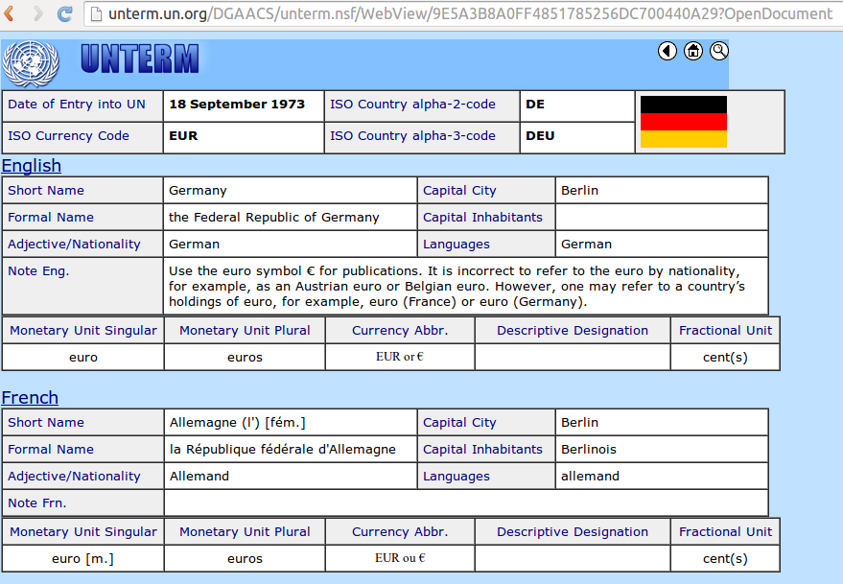
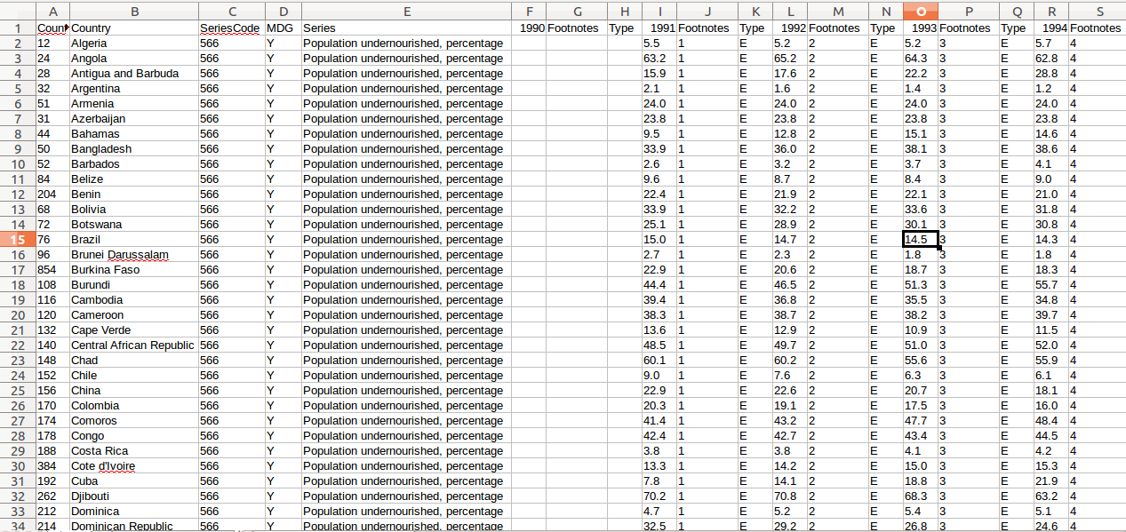
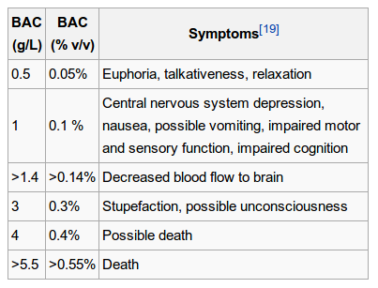
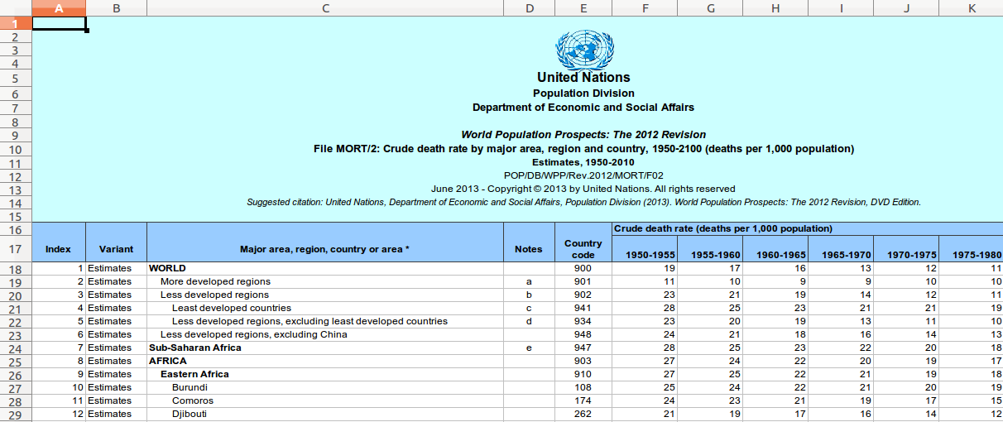
Shapes of tables

Slide 4
The challenge
Get data from non-standardised spreadsheets into a nice regular database.
Never going to be an automatic process
Build the tools which enable us to reason about spreadsheets on their own terms
Specifically, spreadsheet → Python → SQLite

Slide 5
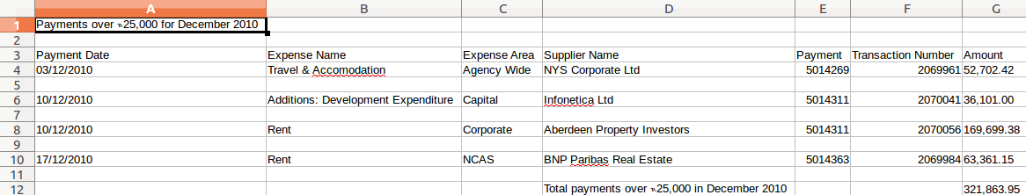
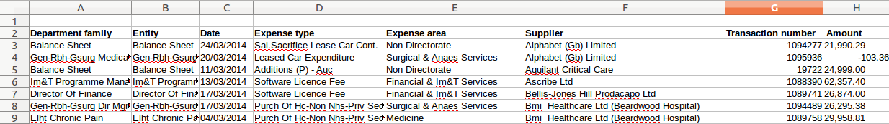
Aim: parse similar spreadsheets

Slide 6
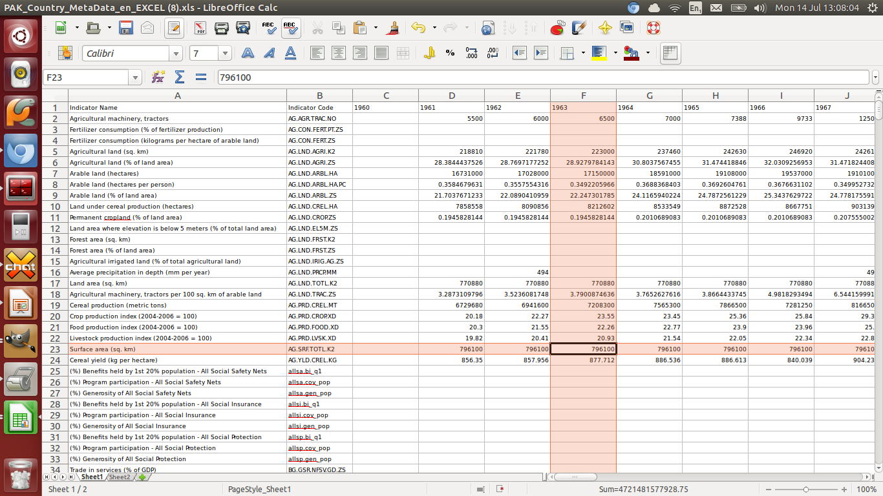
Aim: resilience to minor changes
Have a reasonable chance of being able to parse new spreadsheets, even if they aren't exactly the same...

Slide 7
Multiple File Formats
Solved by http://github.com/okfn/messytables
csv, tsv, xls, xlsx, ods, html, zipped csv support
Common interface for all formats:
tableset = messytables.any.any_tableset(open('x.csv'))
for table in tableset.tables():
for row in table:
for cell in row:
print cell.value
Many minor issues, but the best I've seen so far.
<credit people, issues include interface clunk, libmagic>

Slide 8
XYPath design goals
How do humans navigate spreadsheets?
  Here are the years; here are the the countries
  <talk through actual spreadsheet>
Initial concept:
“Like XPath, but for spreadsheets”
Elements → XPath→ Elements
'Bag' of cells → XYPath → Bag
(with return loop)
Bags can contain any set of cells from a table.

Slide 9
XYPath examples
Actual worked example

Slide 10
XYZZY

Slide 11
Future

Slide 12
Downsides
Python-specific – turn into language?
Slow, memory hog
'Good enough' – hard to know next steps
No clear output format for generic tool... csv?
…?

