Slide 1

Introduction to Git concepts and everyday commands
https://github.com/sensorflo/git-introduction-presentation.git
License: See last slide

Slide 2

git – British slang for
"pig headed,
think they are always correct,
argumentative"
I'm an egotistical bastard, so
I name all my projects after
myself. First Linux, now Git.
– Linus Torvalds
Notes:
We come back to Linus being a git later

Slide 3
About this presentation
Tailored towards SW engineers.
Ask questions any time.
Notes:
Concepts & data structures part is the toughest part. Bear with me

Slide 4
Notably not part of this presentation
Concrete work flow how to actually use Git.
  By design Git is very versatile, it doesn’t impose any work flow.
  Each project has to define / choose a work flow.
  If you understand the Git concepts,
  you understand any work flow confidently.
Configuring / customizing Git.
Best practices, guidelines.

Slide 5

Slides with gray background:
Further details.
Not important to understand
the first time you see this presentation.
Valuable when studying the slides.
Notes:
Depending on how you learn better
If you like background details, pay attention
If you dislike too many details, only listen with one ear. Don’t let the details confuse you.

Slide 6
Table of contents
Introduction to Git by distinguishing it from SVN
Git Concepts & Data Structures
Everyday Git Commands
Distributed Repositories / Collaboration
Further Git Commands
Further Details to Git Concepts
Repeat or delve into voted for topics

Slide 7

Introduction to Git
by distinguishing it from SVN

Slide 8
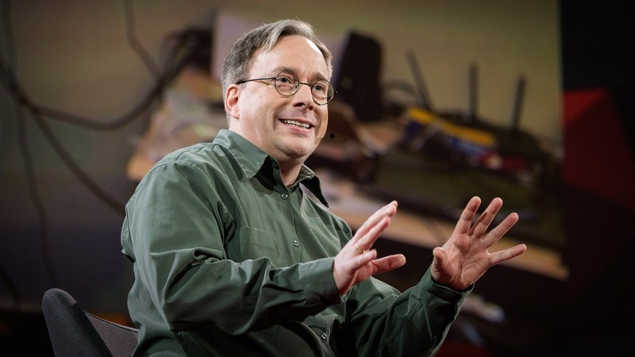
Git has a fundamentally different design than SVN
I hate CVS with a passion.
[Paraphrasing] SVN is pointless. It says 'CVS done right' – there’s no way to do CVS right.
[Part of Git’s design:] Take CVS as an example of what not to do.
– Linus Torvalds
Notes:
Git has a rather unique design in the SCM world.
Git’s success proves Git’s design right.
Git dominates the SCM world more and more. Without advertesing.

Slide 9


Git is a distributed system
All repositories are technically equivalent
You work primarily with your own local repository
In SVN there is a single central repository
Jon
Alice
computer
repository
(repo)
Bob
Alice
Jon
server
Bob
Notes:
SVN central repo can be anywhere
Git repos can be anywhere
Point is to show that in Git typically everyone has her local repo

Slide 10
Each project can define how repos semantically relate to each other
In corporate environments there is often one repo semantically the central repo.
Jon
Alice
server
Fred
Bob

Slide 11
In Git most operation are on local repo → fast
In SVN most operations need network → slow
clone, fetch, push
network
quasi all other cmds
a remote repo
local repo
most
commands
very few commands
network
few local metadata
the central repo
Notes:
The git repo tends to be about the same size or a few multiple of the working tree
The .svn folder contains an uncompressed ‘pristine copy’ of the working tree.
Thus .git size is in the same ballpark as .svn, but having the _whole_ history.

Slide 12
Advantages of a local repository
You can do nearly everything without network. In the train, park, yacht, …
Thus much faster. Consider also writing scripts calling Git commands repeatedly.
Central repository: Everything you do must meet guidelines.
Local repo is your private repo, do whatever you see fit.
  Nobody writes perfect code the first around – local repo is your sandbox
  Commit as often as you like. E.g. to have save points.
  Try out cool ideas / variants on local branches.
  Cleanup local commits before sharing them to meet guidelines.
Notes:
With SVN you can’t even commit

Slide 13
Some different attitudes of SVN / Git users
Due to different design choices of SVN / Git
Justifications later.
In SVN, branches and merging them feels as something special.
In Git, it’s inherently natural, simple, relyable and fast.
SVN users care about single files.
Git users care about project’s file tree as a whole.
For Git user’s its easier to be creative,
since they have their private repo to try out ideas / variants.

Slide 14

Further small differences
term for tree of files you edit
default branch name
working copy
trunk
working tree
master

Slide 15
Doing the simple SVN work flow in Git
It’s about getting you in touch with Git
You’re not exptected to understand it yet
Scenario:
  A single central repository on a server
  A single branch
  Multiple developers

Slide 16
Start working on a project
local
computer
working
tree
clone
central repo
creates
a new dir
local repo
within .git dir
local
computer
checkout
working
copy
creates
a new dir
few local metadata
within .svn dirs
central repo
Notes:
Recall: Working tree/dir = the file tree you edit

Slide 17
Work a new single task
1) Bring newest version from central repository into working tree.
2) Work locally.
3) Merge your changes with the changes others did in the meantime. No conflicts assumed.
4) Bring your work into central repository.
1) pull
‘checkout’ newest commit
working
tree
fetches
new
commits
2.1) edit files
2.2) commit
3) pull
merge, result is in working tree
central
repo
fetches
new
commits
and is then auto commited
4) push
local repo
1) update
working
directory
2) edit files
3) update
merge, result is in working dir
central
repo
4) commit
Notes:
0) start with clean working tree
1) includes trivial merge
Explain high level, no details what pull does

Slide 18
Preview: More details how that looks like in Git
Start working on a project
Next Slide: Work on a single task
New example, does not continue the above example
central
repo
local repo
newest commit
master
void
a branch:
just a pointer
to a commit
clone
oldest commit
origin/master
master
Notes:
You’re not expected to understand that yet.
It’s intendet for those for whom the previous slides where too abstract.
In these examples, content of working tree equals the commit the master branch points to

Slide 19
central
repo
origin/master
master
local repo
master
1) pull = fetch + merge
origin/master
master
2) edit files and commit.
Two times
Somebody else pushes
to central repo
master
origin/master
master
3) pull = fetch + merge
master
Note that there
are inherently
multiple branches:
- master in central repo
- master in our local repo
- master in Bob’s, …, repo
Note that we inherently
merge branches.
Somewhat analogous to SVN
update which also does a merge
origin/master
4) push
master
origin/master
master
Notes:
First merge is trivial (aka fast forward)
Note that in this example, the other did not have to merge. In practice, there more merge commits on the central repo.
In Git, you always can store intermediate work by committing.
svn update cannot be aborted / undone. If youre stuck while resolving conflicts you practically lost your local work. It’s ridiculous.

Slide 20
Git user love branches and merging
SVN users tend to dislike branches and merging
Merging branches is simple, fast and relyable.
You can always merge any branch into any branch.
Being a distributed system, …
  … inherently there are multiple branches anyway.
  … inherently you merge branches when pulling anyway.
We often have additional branches. E.g:
  main development branch, release branch.
  One local branch per task you are currently working on.
  Try out ideas / variants on local branches.

Slide 21

Quick Break

Slide 22
Table of contents
Introduction to Git by distinguishing it from SVN
Git Concepts & Data Structures
Everyday Git Commands
Distributed Repositories / Collaboration
Further Git Commands
Further Details to Git Concepts
Repeat or delve into voted for topics

Slide 23

Git Data Structures &
Concepts
Git actually has a simple design, with stable and reasonably well-documented data structures. In fact, I’m a huge proponent of designing your code around the data, rather than the other way around. – Linus Torvalds
Notes:
It doesn’t matter if we agree
It shows the strong influence to Git’s design
Which is strongly visible on the UI

Slide 24
Git’s UI is designed directly around
Git’s simple data structures
Most prominently a DAG (directed acyclic Graph)
To confidently understand Git’s commands
you have to understand Git’s simple data structures.
commit
branch
log
master
merge
push
pull
Notes:
The drawing is about to give you an idea what we mean by Git’s DAG
You’re not expected to understand it yet

Slide 25

Understand Git’s DAG, because Einstein is right:
Make it as simple as possible,
but not simpler.
– Albert Einstein

Slide 26
Don’t try to replace the DAG with an apparently simpler way/model of thinking about Git
Sadly many (older) Git information found on the web tries to avoid mentioning the DAG.
Often not really simpler – for a SW engineer a DAG already is simple.
Thinking in an inappropriate model calls for trouble.
When you understand the DAG, then after mistakes, it’s much easier to help yourself and to understand help found on the web.
Easier communication if everybody uses the same model.
The official Git documentation explains commands in terms of the DAG.
Notes:
Skip – unless you think there are enough people in the audience who think the DAG is just an implementation detail

Slide 27

Let’s dive in

Slide 28

Don’t let the details scare you
In everyday usage it’s intuitive

Slide 29
Example: New repository after two commits
master
The default branch
name is master.
2nd commit modifies readme.txt.
1st commit adds readme.txt.
Notes:
What ‘current branch’ means will become apparent during the presentation
Recall: master is the default branch name in Git,
just as trunk in svn
40 digit id is not so often used by humans. We mostly use the branches to refer to objects.

Slide 30

Let’s zoom in …

Slide 31
There’s a DAG of commits and branches
master
a branch points
to a commit
a commit points to its
parent (previous) commits
Notes:
HEAD is properly introduced soon

Slide 32
More generally: A DAG of objects and references
References (refs.)
most notably branches and HEAD
master
HEAD
Objects (objs.)
most notably commits
readme.txt
what’s up
readme.txt
hello world
Notes:
SVN & Co store changes of single files
Git’s way is space efficient:
Objs. are always compressed
offline delta compressed
same content → same id → same object → stored once

Slide 33
Objects (objs.)
Store the actual content of a repository
object types
Commit stores a file tree.
As a DAG of tree & blob objs.
Git stores content.
Not changes.
Object id = hash (SHA-1)
of object’s content.
A 40 digit hex number.
Commit id = commit object id
commit
tree
(directories)
blob
(files)
main.cpp
int main(){}
src
readme.txt
readme.txt
what’s up
readme.txt
welcome
Notes:
SVN & Co store changes of single files
Git’s way is space efficient:
Objs. are always compressed
offline delta compressed
same content → same id → same object → stored once

Slide 34
Example: Commit object content slightly simplified
id = babe...
Rename foo to bar
committer flo flo@sensor.ch 07/02/2012 13:00
tree f00d...
parent beaf...
SHA-1
id = beaf...
id = f00d...
src
readme.txt

Slide 35
Graph theory terms
descendants of A:
everyone reaching A
child
of A
child
of A
B
parent
of B
ancestors of B:
everyone reachable by B
parent
of B
A
Notes:
Notably parent commit is used often, because each commit points to its parent commits

Slide 36
References (refs)
Refer (point) to an object or another reference
A branch is a reference.
A branch is a pointer to a commit.
HEAD defines the current branch
aka the currently checked-out branch
Current commit
aka HEAD commit
HEAD
master
Notes:
If you remember only one sentence of this presentation, remember ‘A branch is just a pointer to a commit’

Slide 37
Exact terminology
The term ‘branch’ is overloaded
(Branch) head: A reference, i.e. a pointer to a commit.
Tip (of branch): Commit pointed to by head.
Branch: Complete history of tip. All objs. reachable from head.
master
foo
has no name
Notes:
“line of development” is from git manual. However it’s not really a line, it’s a DAG

Slide 38
reflog preview
Each reference has a log (aka history) of it’s value.
Records when and why a reference pointed to a new commit.
Notes:
Only introduced here because a couple of slides
say ‘unreferenced except by reflog’
So you have a rough idea what reflog is

Slide 39
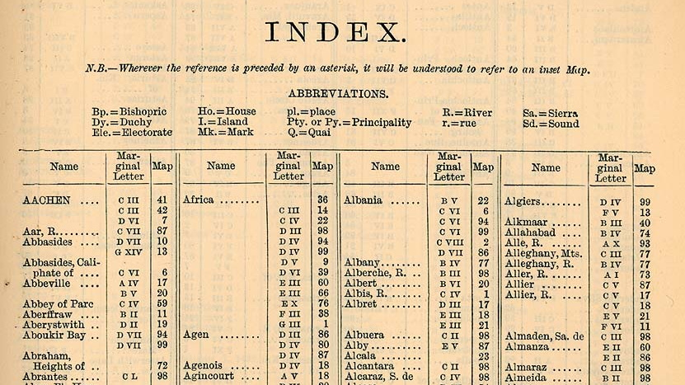
Notes:
In an index, you look up something by key/name
As a beginner you’re not _required_ to understand and use the index
But you _should_ use it and thus understand it

Slide 40
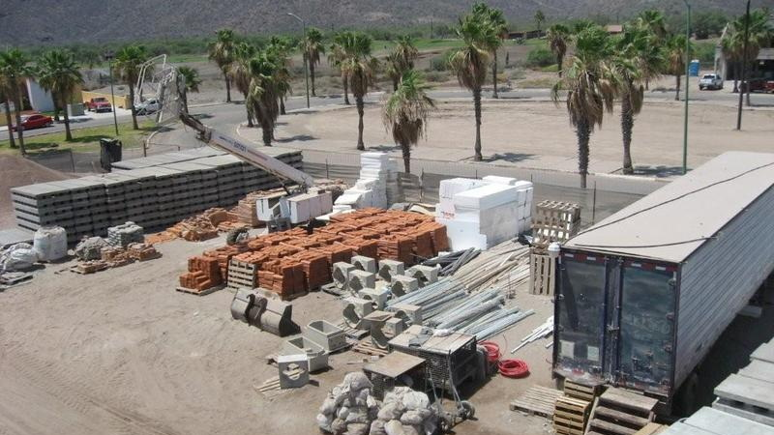
aka Staging Area
Notes:
The term index is more often use by Git itself
The term staging area might be more inuitive for some
Is ofen used by GUI frontends
German translation:
staging area = Bereitstellungsplatz
to stage = bereitsstellen

Slide 41

Analogy to a real staging area
The file tree becoming file tree of next commit.
To craft next commit.
next commit
staging area (aka index)
unstage
stage
copy files/hunks
current commit
working tree
the files you directly edit
Notes:
Yes, in SVN you also can choose which of the modified files should be recorded by the next commit
But with Git’s index, you can craft commit step by step, opposed to in one single command

Slide 42
Assume a repo with many files
edit
readme
src/foo.h
src/foo.c
stage
src/foo.h
src/foo.c
start
clean
unstage
src/foo.h
working
tree
commit
readme
src/foo.h
src/foo.c
readme
src/foo.h
src/foo.c
readme
src/foo.h
src/foo.c
readme
src/foo.h
src/foo.c
unstaged
changes
index
staged
changes
b
c
current
commit’s
changes
a
b
Notes:
Yes, in SVN you also can choose which of the modified files should be recorded by the next commit
But with Git’s index, you can craft commit step by step, opposed to in one single command

Slide 43
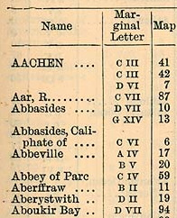
Analogy to a real index
The file tree is implemented as an index:
key = file’s pathname
value = pointer to blob containing file’s content, and few other details.
blob objects
pathname
few details
src/main.cpp
int main() {}
readme.txt
what’s up
Notes:
As you can see, it really is a index:
key=pathname, value basically blob id

Slide 44
Example of staging and committing
Initial state:
src/main.cpp
int main() {}
tree
objs.
a
readme.txt
welcome
1) edit readme.txt, now it’s “what’s up”
2) stage readme.txt
int main() {}
not shown
src/main.cpp
readme.txt
what’s up
3) git commit
File tree of index becomes
file tree of new commit.
src/main.cpp
int main() {}
tree
objs.
b
readme.txt
what’s up
not shown
a

Slide 45
Index (aka staging area)
Purposes
Repetition: Stage file tree of next commit
If you’re a genious and all your local modifactions together constitute a good commit,
then you don’t need the index to craft next commit.
Mark conflicted files as resolved. E.g. after a merge. See ‘resolve conflicts’ slide.
Together with stash (introduced later),
you can test (build, test suite, …) the exact content of next commit,
without any further modifications lying around. See stash slides.
Notes:
Skip
Good commit:
obeys single responsibility principle
→ easy to understand/review
→ easy to spot bugs
buildable
test suite succeeds

Slide 46

file status

Slide 47
working tree
index
current
commit
Status of file in working tree
untracked: file is not also in index
ignored: file matches an ignore pattern
tracked: file is also in index
unmodifed
modified
deleted (aka missing)
Status of file in index
unmodified
Has staged changes
new
modified
deleted

Slide 48
dirty / clean working tree / index
clean = no modifications
dirty = some modifications
working tree
index
current
commit

Slide 49
Data structures summary
There’s a DAG of commits and branches:
  A branch is a pointer to a commit.
  A commit points to its parent commits.
HEAD defines the current branch and current commit
HEAD
master
Notes:
Immutable DAG: you can append to the DAG

Slide 50
Index (aka staging area)
The file tree becoming file tree of next commit.
To craft next commit.
next commit
staging area (aka index)
unstage
stage
copy files/hunks
current commit
working tree
the files you directly edit
Notes:
Index is also used in connection with conflicted files and resolving these conflicted files.

Slide 51

Tough part is over

Slide 52

Break

Slide 53

Let’s start working again

Slide 54

Basic Everyday Git Commands

Slide 55
Table of contents
Introduction to Git by distinguishing it from SVN
Git Concepts & Data Structures
Everyday Git Commands
Distributed Repositories / Collaborations
Further Git Commands
Further Details to Git Concepts
Repeat or delve into voted for topics

Slide 56

init

Slide 57
init
Creates a new empty Git repository
Creates a directory named .git, where Git stores all its data.
Notes:
Often you want to contribute to an already existing project in which case you use clone instead, which is introduced later
There’s only one .git at the root. Subversion has a .svn in every (sub)directory.

Slide 58
Working with staging area (aka index)
Notes:
The term index is more often use by Git itself
The term staging area might be more inuitive for some
Is ofen used by GUI frontends
German translation:
staging area = Bereitstellungsplatz
to stage = bereitsstellen

Slide 59
Working with staging area
stage: add foo.c
unstage: restore --staged foo.c

Slide 60
Working with staging area
Add an untracked file to index: add foo.c
Remove a file from working tree and index: rm foo.c
Git has no concept of renames. Still: mv foo.c bar.c
See slides about renaming.
See also slides on the restore command.

Slide 61

commit (aka checkin)

Slide 62
commit
Creates a new commit object.
Lets current branch point to that new commit.
master
commit
master

Slide 63
Which files are committed?
commit: The files in the index.
commit --all: Stages all modified/removed (but not untracked) files, then commits index.
commit files…: The given files, ignoring index.
Typical GUI: It’s typically intuitive

Slide 64

create branch

Slide 65
branch <name> [<commit>]
Creates a new branch named <name> pointing to <commit>.
<commit> defaults to current commit.
foo
branch foo
master
master

Slide 66


switch (aka checkout branch)

Slide 67
switch <branch> legacy: checkout <branch>
Makes <branch> the current branch.
I.e. lets HEAD point to <branch>.
switch foo
master
master
HEAD
HEAD
foo
foo
Notes:
I.e. let the HEAD ref point to <branch>
However in most work flows you have no local modifications before running this command

Slide 68
switch <branch> legacy: checkout <branch>
Keeps modifications to working tree and index
switch foo
index
master
master
HEAD
working
tree
HEAD
index
foo
foo
working
tree
same
modifications
Notes:
I.e. let the HEAD ref point to <branch>
However in most work flows you have no local modifications before running this command

Slide 69
switch branch does not overwrite modifications
Example for working tree, index is analogous.
working tree
Files modified in working tree
Checkout does nothing if these two sets overlap
current commit
Files changed between current commit and foo
Files that checkout would overwrite
foo
Notes:
I.e. let the HEAD ref point to <branch>
However in most work flows you have no local modifications before running this command

Slide 70
Legacy: checkout files
Overwrite file in working tree with one from a commit or index
Now called restore files, see restore slides

Slide 71

merge branch

Slide 72
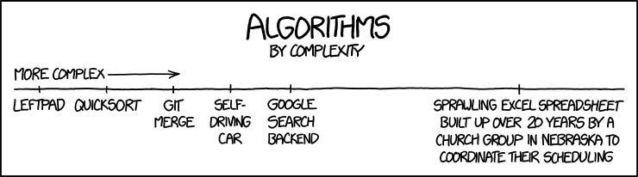
Git is really good at merging

Slide 73
merge <branch>
Merges <branch> into current branch.
Creates merge commit. A normal commit, only that it has 2 parents.
master
master
foo
merge foo
foo
Notes:
Here, the term branch means ‘line of development’.
i.e. we merge two lines of developments.
i.e. we can merge any commits (not just branch heads)
You can merge more than two commits → octopus merge

Slide 74
merge <branch>
Merge conflicts: See ‘resolve conflicts’ slides.
You should start with clean working tree and index.
Notes:
Here, the term branch means ‘line of development’.
i.e. we merge two lines of developments.
i.e. we can merge any commits (not just branch heads)
You can merge more than two commits → octopus merge

Slide 75
merge
A 3-way merge by definition needs 3 versions: base, ours, theirs.
Git finds the base, a common ancestor, with graph algorithms.
One can merge any branch with any branch.
master
foo
ours
theirs
arbitrarily complex
DAG
merge base =
best common ancestor
Notes:
See git-merge-base for which is the best common ancestor

Slide 76
fast forward merge
When current branch is ancestor of other branch.
I.e. current branch made no commits (‘changes’).
Current branch is reset to other branch.
Working tree & index are set to content of new current commit.
foo
master
foo
merge foo
master
merge base =
common ancestor

Slide 77

delete branch

Slide 78

branch --delete <branch>
Deletes <branch> and it’s reflog.
just deletes a pointer
branch --delete foo
master
foo
master

Slide 79
branch --delete <branch>
T
Typical use case: delete a branch after merging it.
branch --delete foo
master
master
foo

Slide 80

branch --delete --force <branch>
If <branch> is not yet ‘merged’, you have to use force.
branch --delete --force foo
Reachable only
by HEAD’s reflog.
master
foo
master
Unreachable objects are removed eventually (> 3 months). See garbage collector slides.
Notes:
‘was not yet merged’ → Exact wording when –force has to be used is more complicated

Slide 81
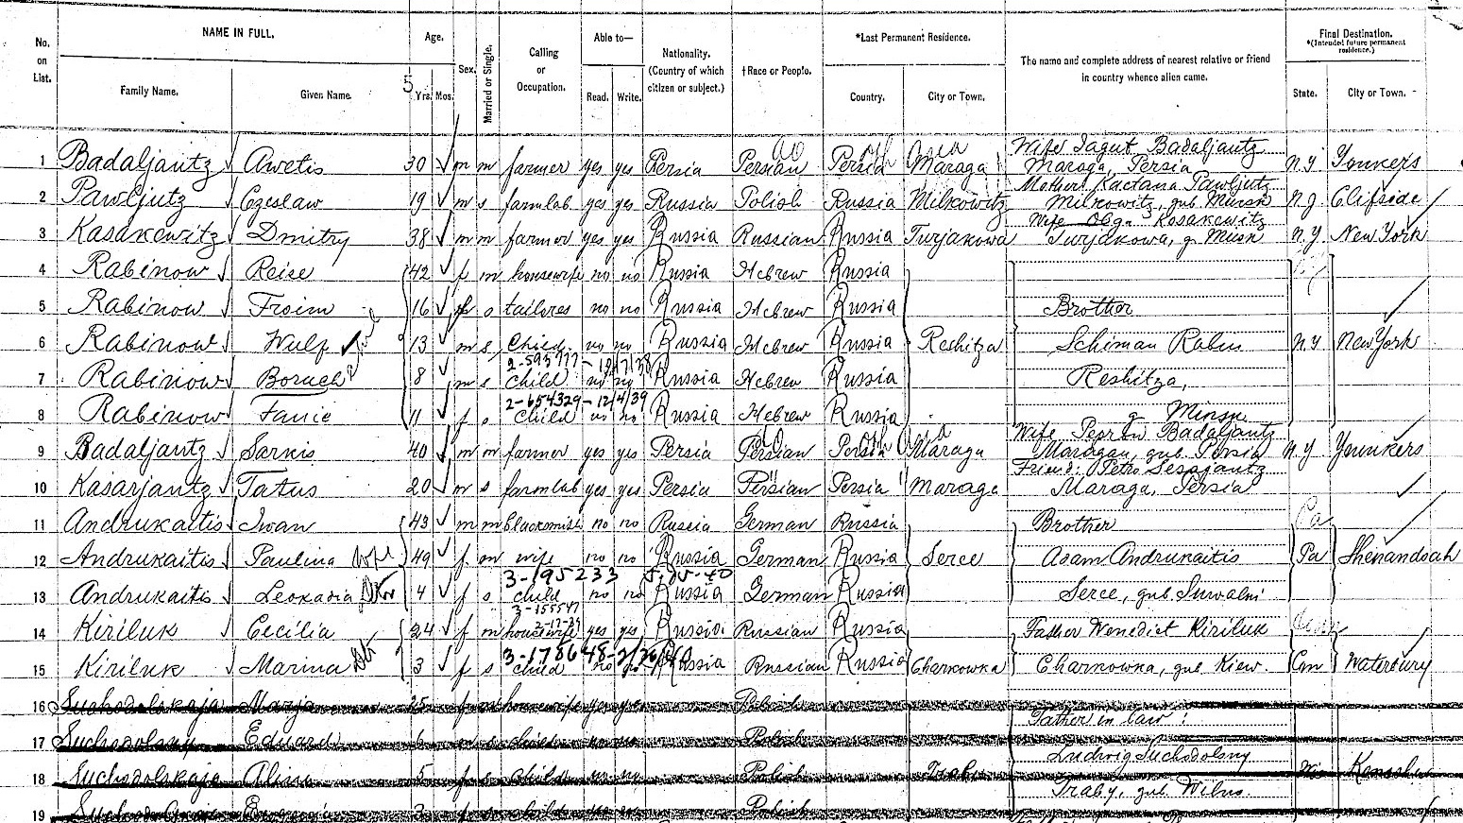
log

Slide 82
Command line: log / GUI: gitk
Show parts of the commit DAG.
Which parts depends on arguments:
  --all: Complete DAG. Commits reachable from any ref.
  <revisions>…: Commits reachable from given revisions.
  no args: Commits reachable from HEAD.
Informally: anything naming a commit
master
gitk
gitk master
foo
gitk foo 2
2
bar

Slide 83

Quick Break

Slide 84

Distributed Repositories /
Collaboration

Slide 85
Table of contents
Introduction to Git by distinguishing it from SVN
Git Concepts & Data Structures
Everyday Git Commands
Distributed Repositories / Collaboration
Further Git Commands
Further Details to Git Concepts
Repeat or delve into voted for topics

Slide 86
Distributed repositories / collaboration
Copy objects or patches between repositories.
Objects are the information that is really stored in a repo.
All other things (index, references, etc.), are local concepts.
Only due to defaults it appears like references are copied.
clone / fetch
copy objects
pull = fetch + merge/rebase
push
remote repo
local repo
Notes:
rebase, reflog, patches are introduced later
collaboration via patches is not covered in this presi

Slide 87

Remote
Repositories

Slide 88
Remote Repositories (aka remotes)
A local repository has zero or more remotes.
Each has an arbitrary local name and an URL (i.e. universal name).
“origin” is the default local name for a remote repository.
remotes of
local repository
URL = https://.../cool.git
URL | local name
https://.../cool.git | origin
https://.../bob/cool.git | bob
../cool2 | myclone
URL = https://.../bob/cool.git
URL = ../cool2

Slide 89
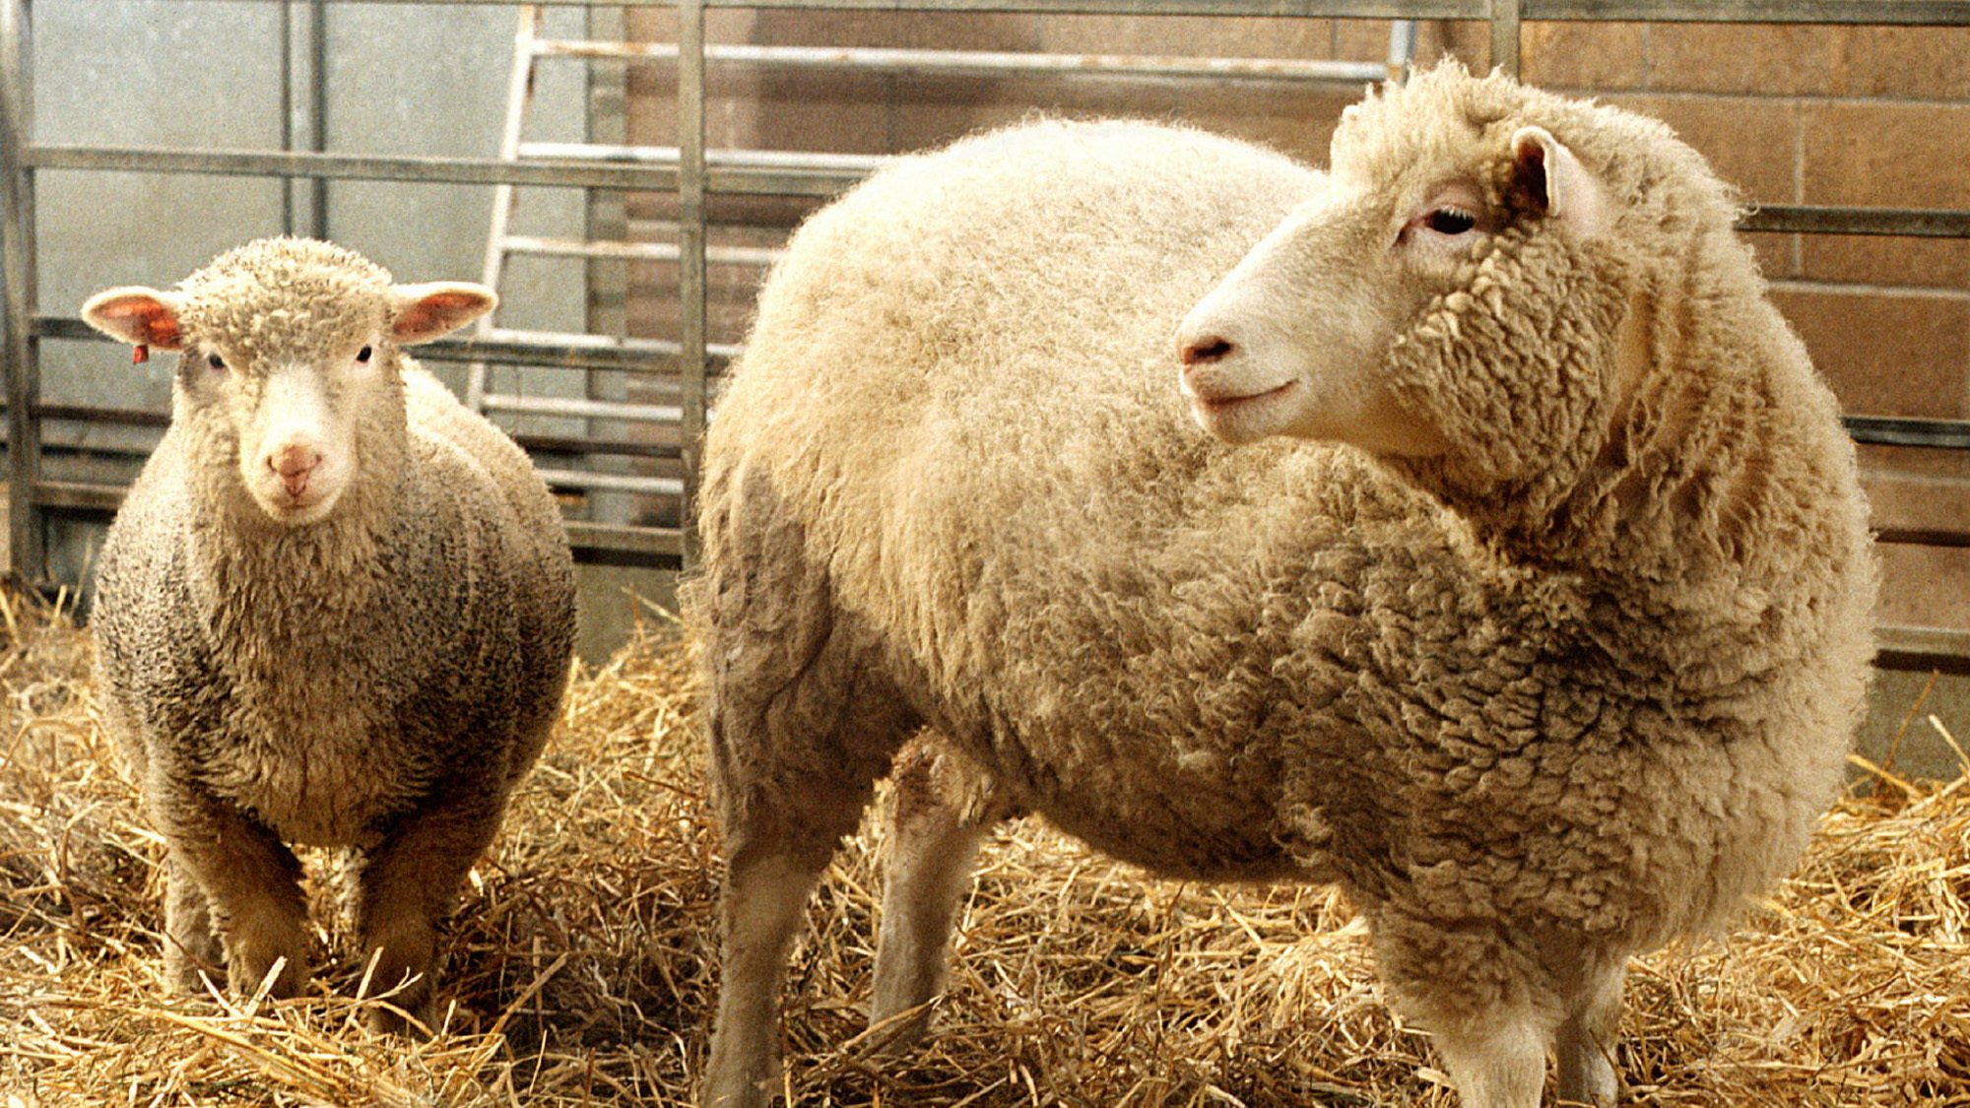
clone

Slide 90
clone <url> informal
Copies all objects.
Creates the ‘right’ branches and tags.
Checks out the ‘right’ branch.
clone https://cool.git
remote repo
URL = https://cool.git
local repo
master
b
origin/master
b
master
foo
a
origin/foo
a

Slide 91
Local branch
<branchname>
Can be checked out and commited to.
master
origin/master
origin/foo
foo

Slide 92
Remote tracking branch
<remotename>/<branchname>
Follows changes from a remote repository.
origin/foo: The last time we talked to origin, origin’s branch foo pointed to this commit.
‘Read-only’: You cannot check it out and thus cannot commit to it.
remote repo
local repo
master
b
origin/master
b
foo
foo
a
origin/foo
a
Notes:
Remember: origin is our local name for the remote repo. It’s more or less just an abrevition for the remote repo’s URL

Slide 93
Upstream (aka tracking) branch
A configurable property of a local branch.
Allows you to call merge / rebase / pull without argument.
E.g. if origin/foo is the upstream branch of foo:
  git merge is short for git merge origin/foo.
  We say “foo is tracking origin/foo”.
Any branch can be the upstream branch of a local branch.
origin/foo is the upstream branch of foo
foo
origin/foo
Notes:
recall: rebase is introduced later

Slide 94
clone <repo_url>
Creates a new directory containing the .git dir and the working tree.
Gives remote repo a local name, by default “origin”. Universal name is the URL.
For each branch x in remote, creates a remote tracking branch origin/x.
Copies all objects.
Say remote’s current branch is master, creates and checks out a local branch called master, having origin/master as upstream branch.
clone https://cool.git
remote repo
URL = https://cool.git
local repo
upstream branch
master
b
origin/master
b
master
foo
a
origin/foo
a
Notes:
‘remot tracking branch’ is soon explained
‘… is tracking...’ is also soon explained

Slide 95

fetch

Slide 96
fetch informal
Copies all new commits from the ‘right’ remote.
Updates all remote tracking branches.
origin
local
a
master
origin/master
a
b
c
fetch
master
a
b
c
master
origin/master

Slide 97
fetch [<remote>]
The default <remote> is a configurable property of current branch.
For each local branch x of <remote>:
  Sets <remote>/x = x.
  Recall: branches are pointers, value being commit id.
  Copies required objects.
  Those reachable from x, so we have the complete history (DAG) of x’s tip.
  ‘Copies’ all remote’s the tags pointing to objects reachable from x.
  But don’t modify existing tags. See upcoming tag slides.

Slide 98
origin
id of parent commit
commit id
local
P:a
P:b
...
b
c
...
a
a
id of commit the branch is pointing to
master
c
master
a
origin/master
a
fetch
...
c
Set origin/master=master(of origin)
a
master
a
origin/master
c
Commit c is referenced but missing,
so copy it. Recall: Obj ids are universally
unique.
P:b
...
b
c
a
master
a
origin/master
c
Recurse until we copied all missing objs. reachable from origin/master.
P:b
...
c
a
P:a
b
master
origin/master
a
c
Notes:
Update remote tracking branches

Slide 99
Fetch is save to be called any time
Objects and references are only added.
Nothing is modified, except for remote tracking branches.
Thus it’s save to fetch from untrusted sources. See also tags slides.
Notes:
Most notably unchanged: Working tree, index, local branches

Slide 100

pull

Slide 101
pull = fetch + merge
You can configure to rebase instead merge
master
origin/master
fetch
origin/master
master
pull
merge
master
origin/master

Slide 102

push

Slide 103
push informal
Copies all new commits of current branch to the ‘right’ remote.
Updates remotes’ local branch with same name.
origin
local
a
a
b
c
foo
origin/foo
foo
push
a
b
c
a
b
c
foo
foo
origin/foo

Slide 104
push [<remote>]
The default <remote> is a configurable property of current branch.
Say x is current branch.
Sets <remotes>’s local branch x to x.
Recall: branches are pointers, value being commit id.
Copies required objects.
Those reachable from x, so <remote> has complete history (DAG) of x’s tip.
Sets remote tracking branch <remote>/x to x.
Note that by default tags are not copied.
--follow-tags: Copies annotated tags pointing to objects reachable from x, but does not modify existing tags.
Notes:
Note in the origin repo, it’s a fast forward merge.
Shown is what Git 2.0 does. Its highly configurable
- which local branches are pushed
- to which remote repo
- to which branch in remote repo

Slide 105
push/fetch [<remote>] [<refspec>]
<refspec> = <src-revision>:<dst-ref>
The destination’s (local) reference <dst-ref> shall point to source’s commit <src-revision>.
Technically two related repos can have a different set of references, with different names and pointing to different commits.
a
origin
local
a
b
c
foo
fred
push origin b:refs/heads/bar
fully qualified ref name
a
b
a
b
c
note there’s no
local branch bar
foo
bar
origin/bar
fred

Slide 106
Informal: you must pull before you can push
In other words: Merging your changes with others’ changes
must be done in your local repo.
Like in SVN, where you must update before you can commit.

Slide 107
Remote repo only allows fast-forward merges
Else you would get ‘unreachable’ commits, i.e. ‘loose’ commits.
To push nevertheless, use --force.
origin
local
Sally pushed b
since we fetched
b
master
c
master
a
a
origin/master
push --force
Reachable only by remote’s reflog.
Sally’s work is ‘lost’.
master
c
master
b
c
origin/master
a
a
Notes:
Probably Sally’s commit is still in some repo, so it’s probably not irrevocably lost.
Also it depends on the garbage collector and reflog when commit is actually removed.

Slide 108
push
Remote repo can’t do a true merge
Being a distributed system
by design you must do work locally and then publish it.
Possible further reasons:
  Recall: To merge, in particular to resolve conflicts, you need a working tree.
  Remote is often a bare repo, i.e. one without working tree.
  By design working tree is private to a repo.
  It’s rude to use private stuff of others for your own purposes.
Notes:
Skip in a beginners presentation.
Warning: The author is not sure why _exactly_ git doesn’t allow it, he only can do educated guess.

Slide 109

Quick Break

Slide 110

Further Git commands

Slide 111
Table of contents
Introduction to Git by distinguishing it from SVN
Git Concepts & Data Structures
Everyday Git Commands
Distributed Repositories / Collaboration
Further Git Commands
Further Details to Git Concepts
Repeat or delve into voted for topics

Slide 112

tag
Notes:
The author admits that he’s not well experienced with tags.

Slide 113
Lightweight Tag create: tag <tagname> [<commit>]
Meant to locally give a name / label to an object.
Is a reference, i.e. just a pointer to an object.
<commit> defaults to the current commit.
tag bad
master
master
bad

Slide 114
Annotated Tag create: tag -a <tagname> [<commit>]
Meant to publicly label a release.
In addition to lightweight tag, stores tagger, date, and a message.
You know who did the tag, when, and why.
master
tag -a v1.0
master
v1.0
tag object
reference

Slide 115
Tags
Meant to be immutable. Eternally point to same object. Rational soon
Cannot be checked out or committed to. But you can …
  … checkout the commit in detached head mode. See slide ‘detached head’
  … create and checkout a branch pointing to that commit.

Slide 116
A tag is a semantic promise
“This commit is release v1.0, it’s not malicious”
Thus users must be able to trust their local tags.
Recall: fetch is designed to be used to fetch from untrusted sources.
Thus fetch does not update already existing local tags, unless you explicitly allow it.
Say an attacker lures you into fetching from him. If fetch would modify your tags, your v1.0 tag could be modified behind your back and point to a malicious commit.
Cryptographically sign a tag to prove you’re the tagger.
Prevents an attacker from creating a fraud tag in your name, pointing to a malicious commit.
Implicitly that signs the whole DAG reachable from that tag.
Recall: object id = hash over content. Content contains pointers (obj. id) to other objs.
Notes:
Skip in a beginner presentation
Is just background info why tags & fetch work the way they do
Does less apply in a coorporate environment where contributors trust each other
But gives you the rational for Git’s behavior

Slide 117
Thou shalt not modify an already published tag
If your really want to, you can modify a tag (re-tag).
Say you taged the wrong commit with v1.0:
If you never published the tag, just re-tag.
If you already published the tag:
  Proper solution depends on the workflow a project uses.
  Considerations if you re-tag and push the modified tag again:
    In an async. distributed system, inherently, during some time for some people v1.0 points to X, for others to Y → confusion!
    Others won’t automatically get the new tag (if they have standard config.),
    because fetch does not update tags behind users’ back. See prev. slide.
Notes:
Skip in a beginer presentation – why published tags should not be modified
Again, applies less to an typicall corporate environment with central repository.
What if you taged the wrong commit but already pushed?
Sane solution: Admit you screwed up. Create a new tag and push that.
Insane solution: Push the modified tag. Broadcast a message (can you reach everybody?):
“Sorry, I messed up. Do ‘git tag -d v1.0; git fetch origin tag v1.0’”.
If in your project everybody trust his sources: always fetch with --tags (can be configured). Then everybody can just push a modified tag.

Slide 118

patch & apply

Slide 119


Create patch / apply patch
Informal: Copy a difference / change to somewhere else. E.g. a bugfix.
Maybe even another repository.
Slide is about concept of patches, not concrete commands.
Basis of commands that follow: cherry-pick, rebase, …
1
master
b
some difference
create patch
same
difference
0
master
a
a
apply that patch
somewhere else

Slide 120

resolve conflicts
Notes:
Conflict: when two sides change the same ‘area’
Can’t be automatically merged;
That is, git merge is quite defensive in merging.
Human needs to resolve the conflict
I.e. manually merge the two changes

Slide 121
Resolve merge conflicts
Merge result is in working tree.
Text of conflicted files is amended with conflict markes.
Files with no conflicts are automatically staged.
No conflicts: A commit is automatically made. Done.
Manually resolve conflicted files with any tool.
Start via git mergetool wrapper.
To mark a file as resolved, stage it.
Commit to finish the merge.
To abort merge and restore prev. state: git merge --abort
Notes:
git mergetool just fires up the tool that you configured
That merge --abort restores prev. state is a white lye: Git may not be able to restore working tree modifications prior to the merge.
Note that svn update has no analogy to --abort. In svn you loose your local modification if you’re stuck while resolving the conflicts.
Thus in general only merge with clean working tree

Slide 122
Resolve apply conflicts
Works analogously.
Recall: apply is basis for cherry-pick, rebase, apply stash, ...
Notes:
git mergetool just fires up the tool that you configured
That merge --abort restores prev. state is a white lye: Git may not be able to restore working tree modifications prior to the merge.
Note that svn update has no analogy to --abort. In svn you loose your local modification if you’re stuck while resolving the conflicts.
Thus in general only merge with clean working tree

Slide 123
Resolve conflicts
Index stores whether a file is conflicted or not
Details: Index has a version ‘column’
  0 marks file as unconflicted / resolved
  1-3 gives access to content of involved file versions
Example: After merge crazy
README.txt is conflicted
master
crazy
Pathname
version
ours
theirs
src/main.cpp
0
…
unconflicted / resolved file
…
base (common ancestor)
README.txt
1
README.txt
2
…
ours (current commit)
base
README.txt
3
…
theirs (merged in commit)
Notes:
When primarily working with GUI Git frontends you never are in touch with this version column

Slide 124

cherry-pick

Slide 125

cherry-pick <commit>
Apply the difference (aka patch) the <commit> introduces to
the current branch.
Automatically commit the result.
See also ‘resolve conflicts’ slide.
master
2
b
adds
sweet
feature
master
also adds
that sweet
feature
cherry-pick 2
1
a
a
irrelevant
relation
Notes:
For merge commits you have to state which parent

Slide 126

revert a commit
Notes:
Skip revert

Slide 127

revert <commit>
Reverts <commit>: Like cherry-pick, but inverts the patch.
Idea: Remove the problem a bad commit introduced.
master
c
removes
bug
master
b
b
adds
bug
adds
bug
revert b
a
a

Slide 128
Revert
Typically used when you already pushed the culprit commit.
If all involved commits are unpublished,
you can rewrite local history instead.
reset, interactive rebase, commit --amend, etc.

Slide 129
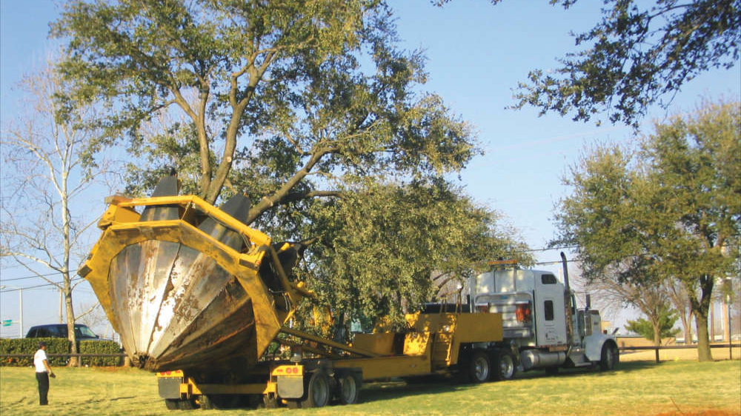
rebase

Slide 130
rebase <branch> informal
‘Move’ current ‘side branch’ onto a new base, namely <branch>.
b2
master
rebase foo
b1
master
a2
foo
1
a1
foo
1
new base
b1
a1
0
old base
0
Notes:
Cannot really move commits. Immutable.
Recall: cherry pick a commit is applying the patch the commit introduces

Slide 131
rebase <branch>
b1, a1, 0, ...
‘Cherry-pick’ all commits of current branch
that are not reachable from <branch>,
onto <branch>.
b1, a1
1, 0, ...
b2
master
rebase foo
b1’s patch
b1
master
b1
a2
b1’s patch
a1’s patch
foo
1
a1
foo
1
a1
a1’s patch
only reachable by reflog
0
0
...
...
Notes:
Cannot really move commits. Immutable.
Recall: cherry pick a commit is applying the patch the commit introduces

Slide 132
rebase
In each ‘cherry-pick’ step a conflict can occur. See slide ‘resolve conflicts’.
rebase --continue: after having resolved conflicts.
rebase --abort: forget about rebase and restore prev. state.

Slide 133
Thou shalt not modify published history
E.g. don’t rebase commits you already pushed
Szenario: Alice and Bob work both on branch foo:
Alice
central (here same as Bob)
Bob
master
B1
foo
master
B1
foo
master
B1
foo
Alice commits
Bob rebases
and pushes
A
foo
B2
foo
B2
foo
master
B1
master
master
Bob and central no longer have B1
Alice still
has B1
Alice pulls
foo
B2
A
master
B1
Notes:
Skip reasoning, just title

Slide 134
rebase --interactive
Recall: rebase is a sequence of cherry picks.
Interactive rebase lets you edit/reorder the sequence in an editor.
Meant to cleanup local commits.
save &
close
Rebase
executes
the script
from top to bottom
pick babe added foo
pick d00d addeT bar
pick c001 fix 'Added foo'
pick beef private test!!
edit
pick babe added foo
fixup c001 fix 'Added foo'
reword d00d addeT bar
pick: Cherry-pick.
fixup / squash: Squash with previous commit into one commit. squash lets you edit commit message.
reword: Let’s you modify the commit message.
edit: Interrupts script and you can do whatever you want. Continue script with git rebase --continue.
drop / delete line: Drops commit.
Notes:
Skip, comes in AA presentation

Slide 135
Rebase vs merge
Two alternative ways of integrating two branches
The relevant end result – the content of files – is the same.
Only history (i.e. DAG) is different.
master
a
b
foo
0
rebase foo
merge foo
files have
same content
master
6
9
master
a
b
foo
a
b
foo
0
0

Slide 136

stash

Slide 137
stash [save]
Stashes the modifications of a dirty working tree and index.
Resulting in a clean working tree and index.
To quickly be able to work on sth. else.
dirty working tree
dirty index
stash
clean working tree
clean index

Slide 138
stash pop = stash apply + stash pop
Applies stash.
I.e. applies your previous changes to working tree and index.
Drops the stash.
working tree and index
have the same changes
(not files) you initially had.
clean working tree
clean index
stash pop

Slide 139
stash
--include-untracked: Also stashes untracked files.
--keep-index: Index isn’t touched.
Together with --include-untracked usefull to test the next commit, without any further modifications.
There can be multiple stashes: stash@{0}, stash@{1}, …
You can apply a stash while any commit is current. Just like cherry-pick.
Notes:
Skip

Slide 140
stash
One commit for working tree, one commit for index.
With --include-untracked, also one for untracked files.
Each reflog entry of the stash reference points to another stash.
stash@{0} → most recent stash
stash@{1} → 2nd recent stash
etc.
working tree
stash@{0}
stash
index
master
master

Slide 141
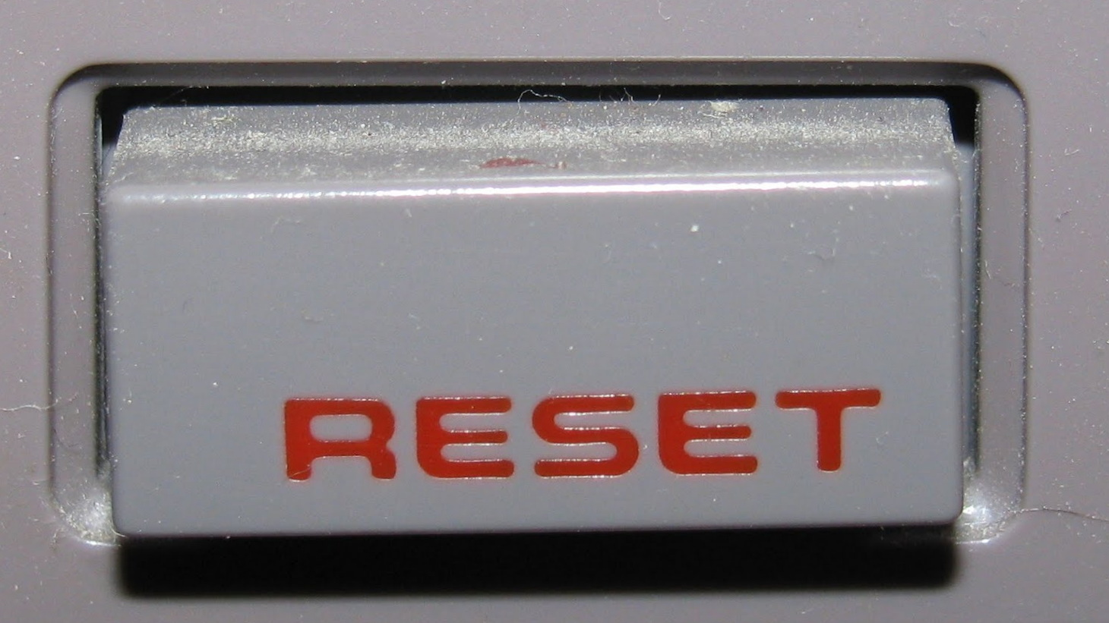
reset branch
Notes:
Skip reset
(Yes, it’s the NES)

Slide 142
reset [<mode>] <commit>
Resets current branch to <commit>. I.e. just reseats a pointer.
<mode> defines what happens to working tree and index.
--soft (default): To keep working tree and index files, discarding commits. E.g. to undo having committed.
commit
reset a
only reachable by reflog
foo
b
b
foo
a
a
foo
a
same state as before commit.

Slide 143
reset [<mode>] <commit>
Often used do undo having committed.
--hard: To discard working tree, index, and commits.
changes in working
tree and index
only reachable by reflog
foo
c
c
reset --hard a
b
b
a
foo
a
clean index and working tree

Slide 144
reset [<mode>] <commit>
mode | working tree (WT) | index | notes / usage example
--soft | unchanged | unchanged | To undo having committed.
--mixed | unchanged | reset | To undo having staged and committed.
--hard | reset | reset | To discard working tree and index and commits.
--keep | reset, but leave files changed HEAD↔WT. | reset | Aborts if HEAD↔<commit> change the same file as either index↔HEAD or index↔WT. Equivalent to switch -C <currentbranch> <commit>. To move a new branch to which you haven’t committed yet.
--merge | reset, but leaves unstaged files. | reset | Aborts if index↔<commit> changes an unstaged file.

Slide 145
Legacy: Reset Files
Overwrite file in index with one from a commit.
Now called restore files, see restore slides.

Slide 146

restore

Slide 147
restore … <path>…
Overwrites paths in given destinations from given source.
Destinations: --staged (index) and/or --worktree
Source: --source=<commit>
Examples:
discard working tree changes relative to index: restore foo.c
discard working tree changes relative to HEAD: restore --source=HEAD foo.c
unstage: restore --staged foo.c
Default:
--worktree
Default depends on destination:
--staged: HEAD
--worktree: index
both: no default

Slide 148
checkout [<commit>] [--] <files>…
Superseded by the restore command.
Overwrites <files> in working tree and the index with the content they have in <commit>.

Slide 149
reset [<commit>] [--] <files>…
Superseded by the restore command.
Overwrites <files> in index with content they have in <commit>.

Slide 150

Quick Break

Slide 151

Further Concepts and Details

Slide 152
Table of contents
Introduction to Git by distinguishing it from SVN
Git Concepts & Data Structures
Everyday Git Commands
Distributed Repositories / Collaboration
Further Git Commands
Further Details to Git Concepts
Repeat or delve into voted for topics

Slide 153


There are no locks

Slide 154
There are no file locks
Consequences:
Mergable files (most text files):
Git is really good at merging, thus less need for locks.
Unmergable files (most binary files):
Human communication required to avoid merge conflicts.

Slide 155
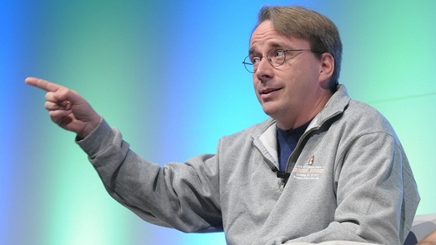
By design Git does not store file renames / does not track single files
In other words, I'm right. I'm always right, but sometimes I'm more right than other times. And dammit, when I say "[single] files don't matter"*, I'm really really Right(tm).
– Linus Torvalds –
* Meaning only the file tree as a whole does
Notes:
Remember first slide? Linus can be a git / (egoistical) bastard
https://web.archive.org/web/20160206150253/http://article.gmane.org/gmane.comp.version-control.git/217
http://gitster.livejournal.com/35628.html

Slide 156
Recall: Git stores content not changes (such as renames)
Each commit stores a file tree
main.cpp
int main(){}
src
readme.txt
welcome
git mv old new is identical to
/bin/mv old new; git add old new

Slide 157
There are many reasonable history queries
E.g the history of …
… a function, including moves across file boundaries.
… a chapter in a libre office document.
At commit time Git can’t know all possible history queries.
Note: Renaming a file is just a special case of moving content.

Slide 158
Git’s design:
Query tools shall be smart and configurable not the commit
Query tool: log, diff, 3rd party tools, …
It’s the job of the query tool to answer history queries.
Existing tools can improve over time. New ones can be written.
All based on the way Git stores commits since its first version.
log, diff, etc. use configurable heuristics to detect file renames.
Use options to trade speed for accuracy.
Notes:
Full disclore: Git itself doesn’t provide any tools to conveniently track history of e.g. single functions.
To the best of my knowledge, there are not many tools available. I know DeepGit.

Slide 159
Git’s world-view:
Project’s file tree as a whole matters not single files
Thus commits track the file tree as a whole.
A smaller granularity, like single files, makes no sense,
since by definition, a "project” depends on the other files,
or it wouldn't be a project, it would be two projects or more.

Slide 160
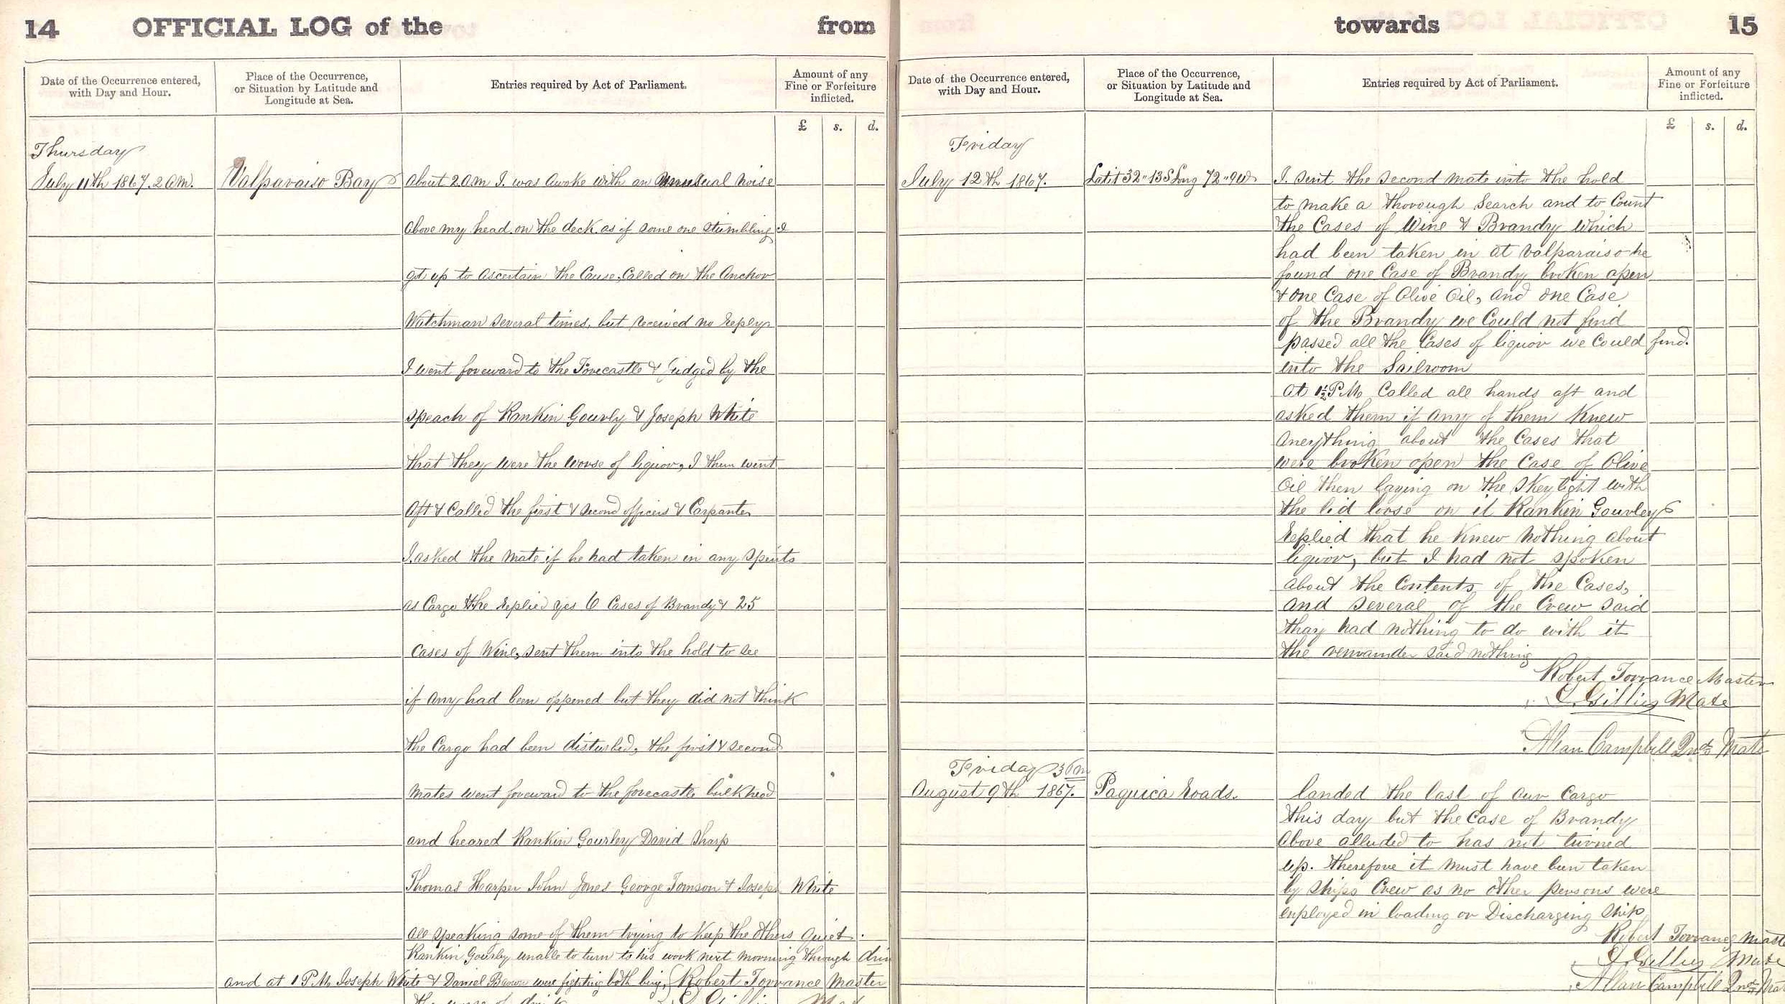
reflog

Slide 161
reflog
Each reference has a log (aka history) of it’s value.
Records when and why a reference pointed to a new commit.
Example: reflog of HEAD
HEAD
further
details
bar
git command causing the change
notation
foo
checkout: moving from foo to bar
b
HEAD@{0}
b
time
commit: fix hang-up
e
HEAD@{1}
e
commit: improved performance
d
HEAD@{2}
d
date
new value
of reference
Notes:
Only introduced here because a couple of slides
say ‘unreferenced except by reflog’
So you have a rough idea what reflog is

Slide 162
reflog
Reflog is local only. Just like refs.
Useful to recover otherwise unreachable commits.
master
foo
master
bar
HEAD@{42}
HEAD@{42}
branch --delete --force foo
branch bar HEAD@{42}
master
HEAD@{42}

Slide 163

detached HEAD

Slide 164
detached HEAD
HEAD directly points to a commit. There’s no current branch.
Nothing else really is special. But be careful when committing.
E.g. to build an old commit.
HEAD
foo
foo
a
HEAD
a
checkout a

Slide 165
detached HEAD
When committing, be careful
not to end up with unreachable commits.
detached HEAD
reachable only
by HEAD’s reflog
foo
foo
foo
HEAD
foo
HEAD
a
HEAD
a
a
HEAD
a
checkout a
commit
checkout foo

Slide 166

bisect

Slide 167
bisect
To find the commit introducing a problem.
Tell Git a known good and a known bad commit.
Until Git has found the offending commit
  Git checks a commit out.
  You test the current commit.
  Tell Git whether it’s good or bad.

Slide 168

Garbage Collector

Slide 169
git gc --auto
If needed, runs a number of housekeeping tasks, such as:
  Stores some objects and references more efficiently.
  Removes old entries from reflogs.
  Removes old unreachable objects.
Is run implicitly by certain commands.
Explicitly running gc is generally not required.

Slide 170
Terminology
Loose object
An obj. stored as an individual compressed file, as opposed to within a packfile.
Packfile
Multiple objs. delta compressed in one file.
Unreachable object
An obj which is not reachable from any ref / reflog.
Dangling object
An unreachable obj which is not directly referenced by anything.

Slide 171
git gc --auto still simplified
If there are less than 6700 loose objects, does nothing & stops.
Packs references.
Prunes reflogs = removes reflog entries older than 90 days.
Packs reachable loose objects and maybe consolidates packs.
Removes loose unreachable objects older than 2 weeks (file modification).

Slide 172
Review of
Objects & References
References (refs.)
most notably branches and HEAD
HEAD
master
Objects (objs.)
most notably commits
readme.txt
what’s up
readme.txt
welcome

Slide 173
Object Id
Hash (SHA-1) of object’s content.
More precisely: SHA-1 of object type + object size + object content.
A 40 digit hex number.
Usually the first few digits, say 6, are locally unique.
Universally unique / an universal name.
E.g. allows fetch / push to know which objects to copy.

Slide 174
Objects are immutable
Different content → different hash / id → a different object.
Commands apparently modifying commits
actually write new commits. E.g. (interactive) rebase, amend commit.
commit --amend -m 'better commit message'
reachable only
by reflog
master
b1
master
b2
b1
a
a

Slide 175
References
References are local and have an hierarchical name.
HEAD
📁refs
📁heads (local branches)
master
📁mygroup
foo
📁remotes (remote tracking branches)
📁origin
master
📁bob
master
📁tags
v1.0 example: fully qualified name is refs/tags/v1.0
stash

Slide 176
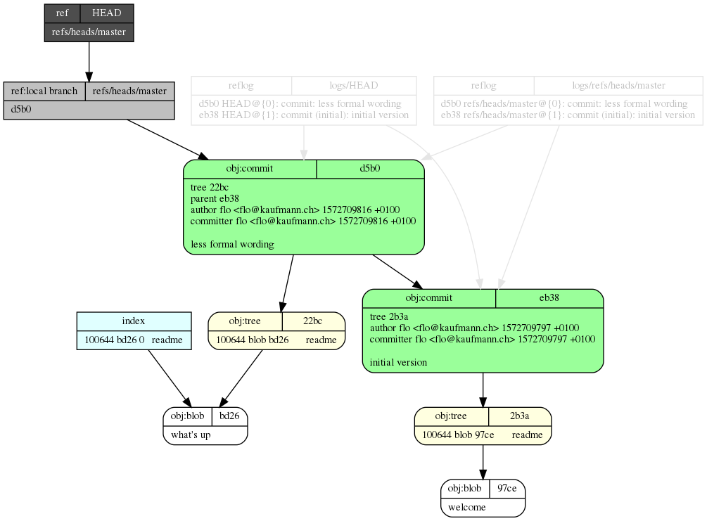
Exact* content of a tiny repo
To demonstrate that you now know all there is about Git’s data structures except for pack files and submodules.
* The only simplifications: Abbreviated SHA-1s. Omitted config files.
Notes:
Drawing made with git-draw
Use it to learn Git’s objects & references

Slide 177
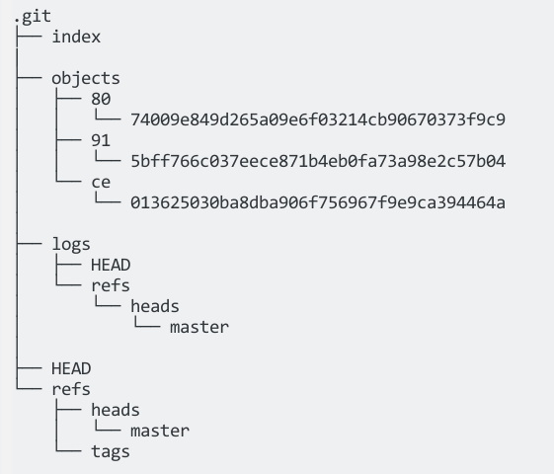
Repository file system Layout
To demonstrate Git is simple and straightforward.
Omitted: Internal optimizations (packs), and configuration files.
Tiny repo, one file, one commit.

Slide 178
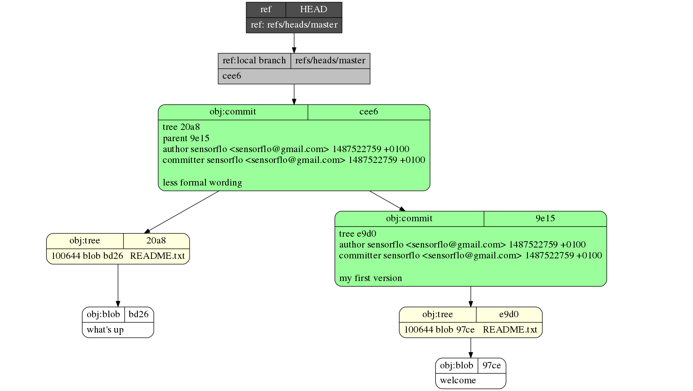
git-draw
Draws nearly the full content
of a tiny toy Git repo as a graph.
To help learn Git’s concepts.
https://github.com/sensorflo/git-draw

Slide 179
Data Integrity & Security
hash over direct content, the file tree it stores, the whole history. generally the dag of objs reachable
data integrity
signing tag signs whole DAG reachable (history)

Slide 180


Slide 181
Data structures summary
There’s a DAG of references and objects,
most notably commits and branches.
  A branch is a pointer to a commit.
  A commit points to its parent commits.
  HEAD defines the current branch and current commit.
Object id = SHA-1 of content
→ Objects are immutable.
→ Object id is an universal name.
References are local and have an hierarchical name.
HEAD
master
foo
HEAD
refs
heads
master
tags
v1.0
Notes:
Immutable DAG: you can append to the DAG

Slide 182
Index (aka staging area)
The file tree becoming file tree of next commit.
To craft next commit.
next commit
staging area (aka index)
unstage
stage
copy files/hunks
current commit
working tree
the files you directly edit
Notes:
Index is also used in connection with conflicted files and resolving these conflicted files.

Slide 183


Slide 184


Slide 185
Todo
branch: rename/move(reseat)/configure/list
submodules
revision range. used e.g. for log, cherry-pick, rebase
config in 3 places
author vs commiter
first parent, octopus merge, subtree merge
.gitignore (possibly in each subdir) / .git/info/exclude

Slide 186

This presentation is licensed under aCreative Commons Attribution-ShareAlike 4.0 International License.
It is attributed to Florian Kaufmann <sensorflo@gmail.com>.

