Slide 1
Math 2 Braille
A software solution for mathematical documents.
Sensus Aps.

Slide 2
Table of contents
Introduction
The Problem Domain
Key notions
  Mathematical Representation
  MathML – Word MathML
  Latex
The Solution Domain
  UMCL
  FMath & LaTeX
Math2Braille Solution
Future Development
  Incorporating new libraries
  Image conversion
Conclusion

Slide 3
Introduction
The purpose of this presentation is to illustrate an automated software solution for converting MS Word Documents (.doc/.docx) containing text, mathematical equations and images into accessible documents that can be easily embossed on braille printers and/or used on refreshable braille displays.

Slide 4
The Problem Domain
Design a universal software solution for converting documents containing mathematical notation into an accessible format that can be used with braille embossers.
Transform the 2D representation of mathematical formulas into a linear representation that is understandable by both the visually impaired students and their teacher.
Seamlessly merge the text and the formulas into a single document.

Slide 5
Key Notions
Office MathML: Standard mathematical representation in all word documents.
MATHML: MATH-XML representation of mathematical equations using XML. Universal and standardized. MathML is a markup language for describing mathematical notation and capturing both its structure and content. The goal of MathML is to enable mathematics to be served, received, and processed on the World Wide Web, just as HTML has enabled this functionality for text.
LaTeX/Mathematics: Document preparation system for typesetting. Used in scientific documents because of its extensive support of mathematical notations.
Country specific braille notations.

Slide 6
Existing formats
Existing Formats
Office MathML
MathML
Nemeth
Unified English Braille
Marburg
Latex
Lambda
……………..
Many libraries already exist and various formats are used for representing mathematical notations.
Some have a higher learning curve than others.
Harder for teachers to understand specific braille notations for mathematics.

Slide 7
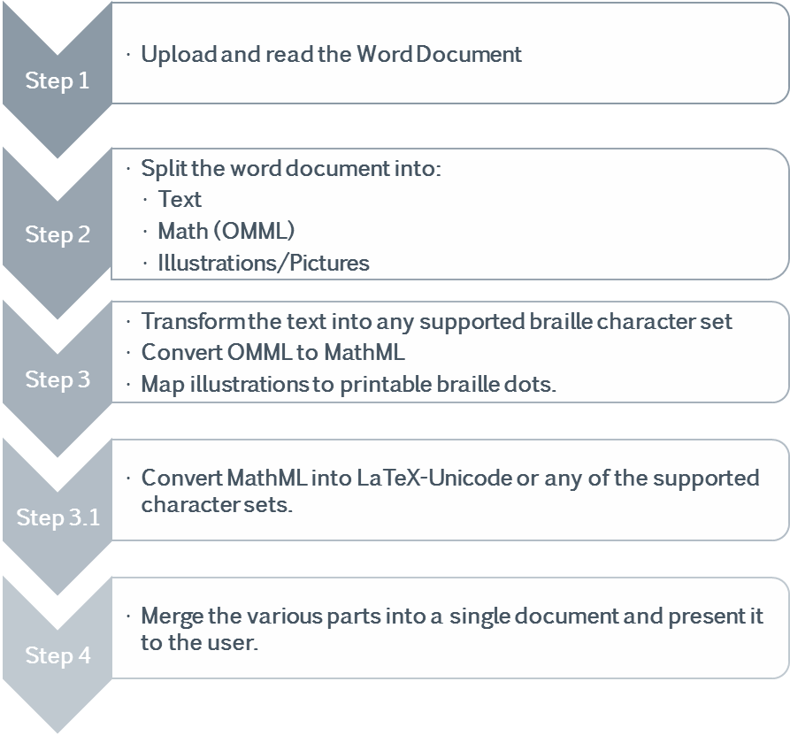
The Solution Domain
The proposed solution is to unify the existing mathematical conversion tools and use:
  A Latex mathematical notation that can be directly mapped to Unicode Braille or any other national character set for braille.
  Existing conversion tools to maintain support for existing mathematical formats.

Slide 8
Getting into the details
The setup needs to be extensible and easily support the addition of new conversion tools as the need arises
The current solution uses the existing conversion tool implemented by the www.robobraille.org service for it’s text conversions. It is developed in house at Sensus. (Danish, English and Norwegian available for now).
The goal is to join all existing mathematical conversion tools under a single service and facilitate the development of new tools.
UMCL and FMath libraries currently used for math conversions.

Slide 9
UMCL
Currently supported output formats:
  BrailleBr (British), BrailleCz, BrailleFr1971, BrailleFr2001, BrailleFr2007, BrailleIt, Marburg and Nemeth
Currently supported character sets:
  french-cp1252, Italian, jaws, simbraille, US, UK, Spanish, German, Swedish, Unicode (U2800-U28FF)
Can support new modules such as the Czech module developed by Martin Jamar at the Masaryk University in the Czech Republic.
Universal Maths Conversion Library
An open source project developed by Dominique Archambault and his team.
Uses MathML as the standard input.
Extensible and able to support new formats that can be used by output modules, created by following their API.
More information available on the project website:
http://sourceforge.net/projects/umcl/files/?source=navbar

Slide 10
FMATH
The starting point for the mathematical conversion is MathML. It is a universal math xml format which is better understood by computers than humans.
With the help of FMath the MathML is transformed into Latex
The Latex notation can optionally be refined, abbreviated or contracted, after that the individual characters that form the Latex formula are mapped to a specific character set (in the current case to Unicode 2800-28FF).
Free library originally intended to display and edit equations on web pages.
Capable of converting between Latex, MathML and OMML.
Developed by Ionel Alexandru.
More information available on the project website:
http://www.fmath.info/

Slide 11
Advantages of Latex
Linear representation of any existing mathematical formula
Universal notation used in all countries around the world
Lower learning curve
Not just for mathematics. Useful within other subject areas: chemistry, physics, music…
Understandable by both student and teacher

Slide 12
Math2Braille
All the conversions will be exposed through a RESTful web service, which is available for now on the following link: http://www.math2braille.org/RestM2B/
The service is still being developed and will most probably change from the current one, in order to have a better refinement of the input/output data.
The main advantage of the solution is that it allows for components to easily be added, without the need of adhering to a specific API.
The only requirements are that the component is written in a common programming language (C#, C++, Java …) and that it has a good enough documentation for it to be implemented.

Slide 13
Process Overview
New Component
Text Conversion
Document Splitter
Web Service
Math Conversion (UMCL)
Math Conversion (LaTeX)
Image Conversion
Communicates with all components
Process Manager
Document Aggregator

Slide 14

MATHML
LATEX
- <mml:math xmlns:mml="http://www.w3.org/1998/Math/MathML" xmlns:m="http://schemas.openxmlformats.org/officeDocument/2006/math">
- <mml:mfrac>
- <mml:mrow>
<mml:mi>a</mml:mi>
</mml:mrow>
- <mml:mrow>
<mml:mn>2</mml:mn>
</mml:mrow>
</mml:mfrac>
<mml:mo>+</mml:mo>
- <mml:msup>
- <mml:mrow>
- <mml:mfenced separators="|">
- <mml:mrow>
<mml:mi>b</mml:mi>
<mml:mo>-</mml:mo>
- <mml:msqrt>
<mml:mi>c</mml:mi>
</mml:msqrt>
</mml:mrow>
</mml:mfenced>
</mml:mrow>
- <mml:mrow>
<mml:mn>3</mml:mn>
</mml:mrow>
</mml:msup>
<mml:mo>=</mml:mo>
<mml:mi>x</mml:mi>
</mml:math>
Simple Latex:
\frac{a}{2} + \left( b - \sqrt{c}\right)^3 = x
Processed Latex:
a/2+(b-\sqrt{c})^3=x
Note: processed Latex simplifies fractions and brackets.
Latex in Unicode:
⣲⠁⢌⢃⢖⢦⠃⢤⡌⠎⠟⠗⠞⣧⠉⣼⢴⢏⢉⢶⠭⣠⣲
Note: uses the $(⣲)...$(⣲) to escape mathematical notations.

Slide 15
MARBURG
NEMETH
German:
'a8; +b -3c5"l -3c5"l3c|: =x
Unicode:
⠠⠁⠳⠆⠀⠖⠃⠀⠤⠩⠉⠱⠈⠇⠀⠤⠩⠉⠱⠈⠇⠩⠉⠌⠒⠀⠶⠭
UK:
4a/;!|b-)c(7$-)c(7$)c((: %k x
Unicode:
⠹⠁⠌⠆⠼⠬⠃⠤⠜⠉⠘⠻⠸⠤⠜⠉⠘⠻⠸⠜⠉⠘⠘⠒⠀⠨⠅⠀⠭

Slide 16
Future Development
Refining the solution
  Integrating it with the existing RoboBraille solution
Adding new components/modules
  Languages
  Mathematical notations
Image Processing

Slide 17
Image processing
Currently there is little support for automated image conversions
Why is it difficult?
  Cannot represent different color intensities
  Mapping lines to braille dots is difficult and error prone
  Not all braille embossers support tactile graphics
The researched solution: Convert a color image into a black and white image that only shows the contour of various objects present in the image. Map the black contour into braille dots.

Slide 18
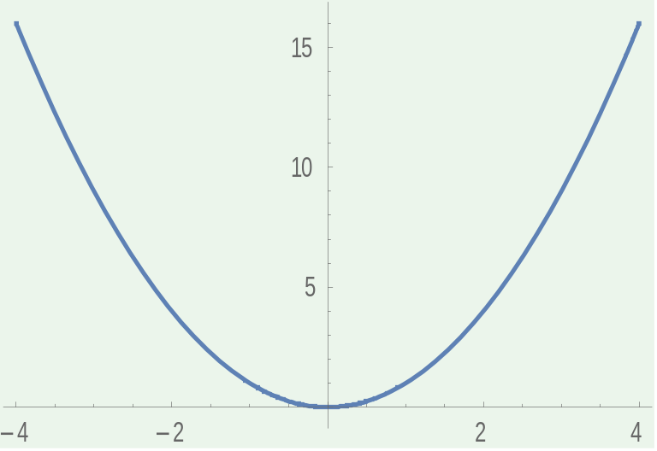
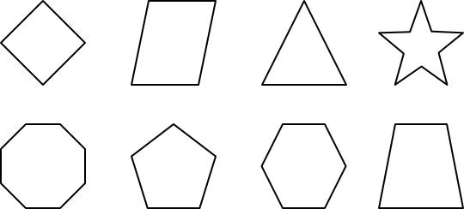
The solution will best fit with mathematical documents and it will help in better representing 2D function graphs or geometric objects.
Two options exist:
Map braille characters as close as possible to the image lines
Use a special braille embosser that can emboss braille graphics
Software: Potrace and Inkscape.

Slide 19
Conclusion
Math2Braille is a service that converts word documents, that contain mathematical notation and text into accessible documents written in Unicode braille.
It has a flexible architecture capable of extending it’s current functionality to support new languages and mathematical formats
It exposes it’s capabilities through a web service, therefore it is meant to be used as a component within a bigger solution
Future work and research will be done for supporting image conversion

