Slide 1
Hydroclimatology for
Water Resources Management (CIVL 7740 T05)
Term project presentation on:
Pre-Seasonal Streamflow Forecasting using a Principal Component Regression Model in the Michipicoten Watershed, Canada
Presented by:
Setogn Abate Getu

Slide 2
Presentation outlines
      Introduction and Motivation
      Objectives
      Data sources
      Methods and tools
      Methodology and Approach
      Data Analysis
      Results and Discussions
      Conclusions

Slide 3
Introduction and Motivation
Accurate pre-seasonal streamflow forecasts are essential
The complex interrelationships among hydroclimatic variables are challenging.
The Michipicoten watershed shows significant variability in streamflow forecast due to the complex interactions.
Some prediction methods often struggle with;
      Multicollinearity and
      High dimensionality of climate data
    limiting forecast accuracy
This project aims to provide a reliable forecasts of AMJ streamflow using JFM predictors.

Slide 4

Objectives
To forecast AMJ streamflow using PCR and MLR based on predictors obtained from early months (JFM)
To identify and rank the most influential predictors for the prediction of AMJ streamflow in the watershed.
Evaluate the model’s performance and reliability using statistical metrics such as Pearson correlation, RMSE, NSE, and MAE.

Slide 5
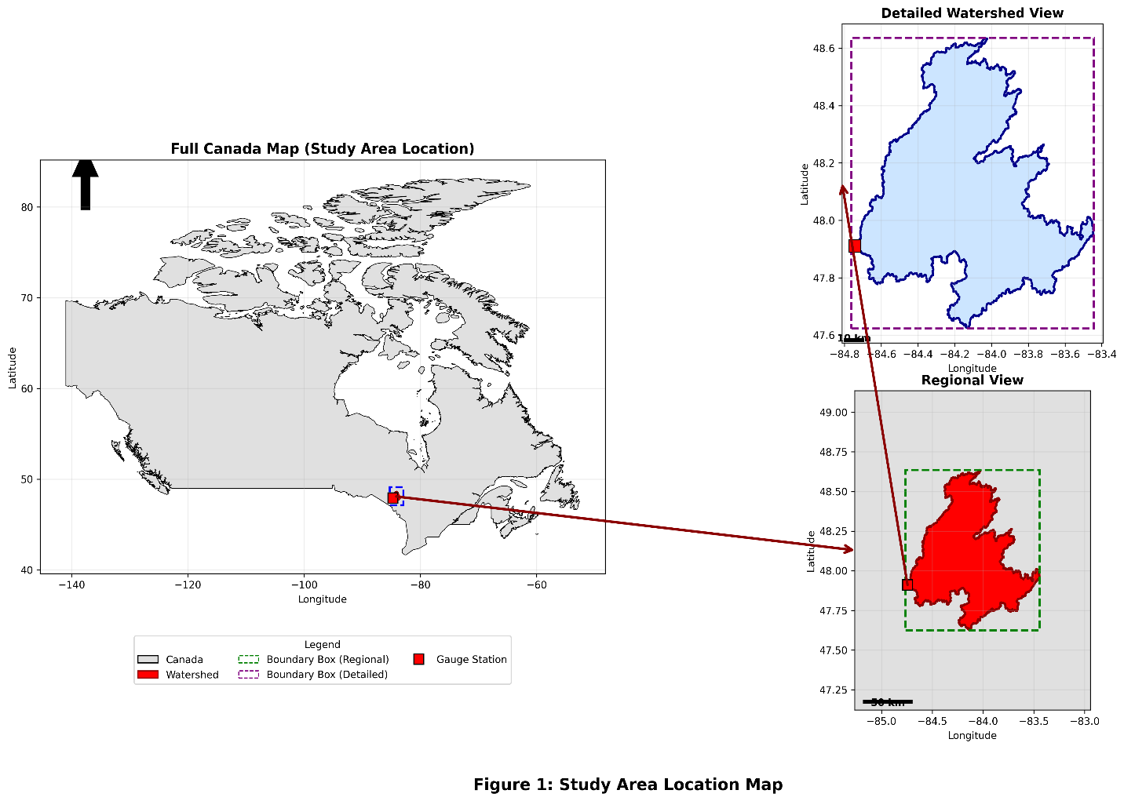
Location of Study Area
The Michipicoten River watershed is a large basin draining into northeastern Lake Superior, Ontario, Canada.

Slide 6

Data sources
Predictand:
Historical streamflow data (1991–2019)
From ECCC (gauge station number 02BD002)
Predictors:
Basin-averaged climate data from the ERA5
Original predictor variables:
      Precipitation (Pr)
      Temperature (T)
      Snow Water Equivalent (SWE)
      potential evapotranspiration(PET)
      Mean sea level pressure (MSLP) and
      Surface Pressure (SP)

Slide 7

Methods and tools
QGIS; used for shapefile/watershed preparation.
Python: Data processing, analysis and visualization
PCR and CPT : For streamflow forecasting
    PCA applied to handle multicollinearity
    PCs used as a predictor to forecast streamflow.
    AMJ streamflow was forecasted using;
    $QAMJ(m3/s)=β_{0}+β_{1}PC_{1}+β_{2}PC_{2}+β_{3}PC_{3}+β_{4}PC_{4}++β_{5}PC_{5}+β_{6}PC_{6}+ε$
    Model performance : R, RMSE, NSE, and MAE
    The most influential predictors were identified

Slide 8
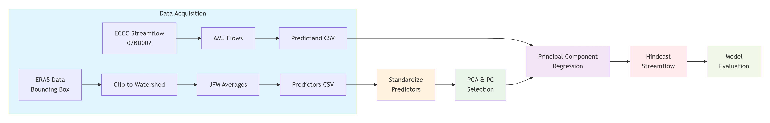
Methodology and Approach

Slide 9
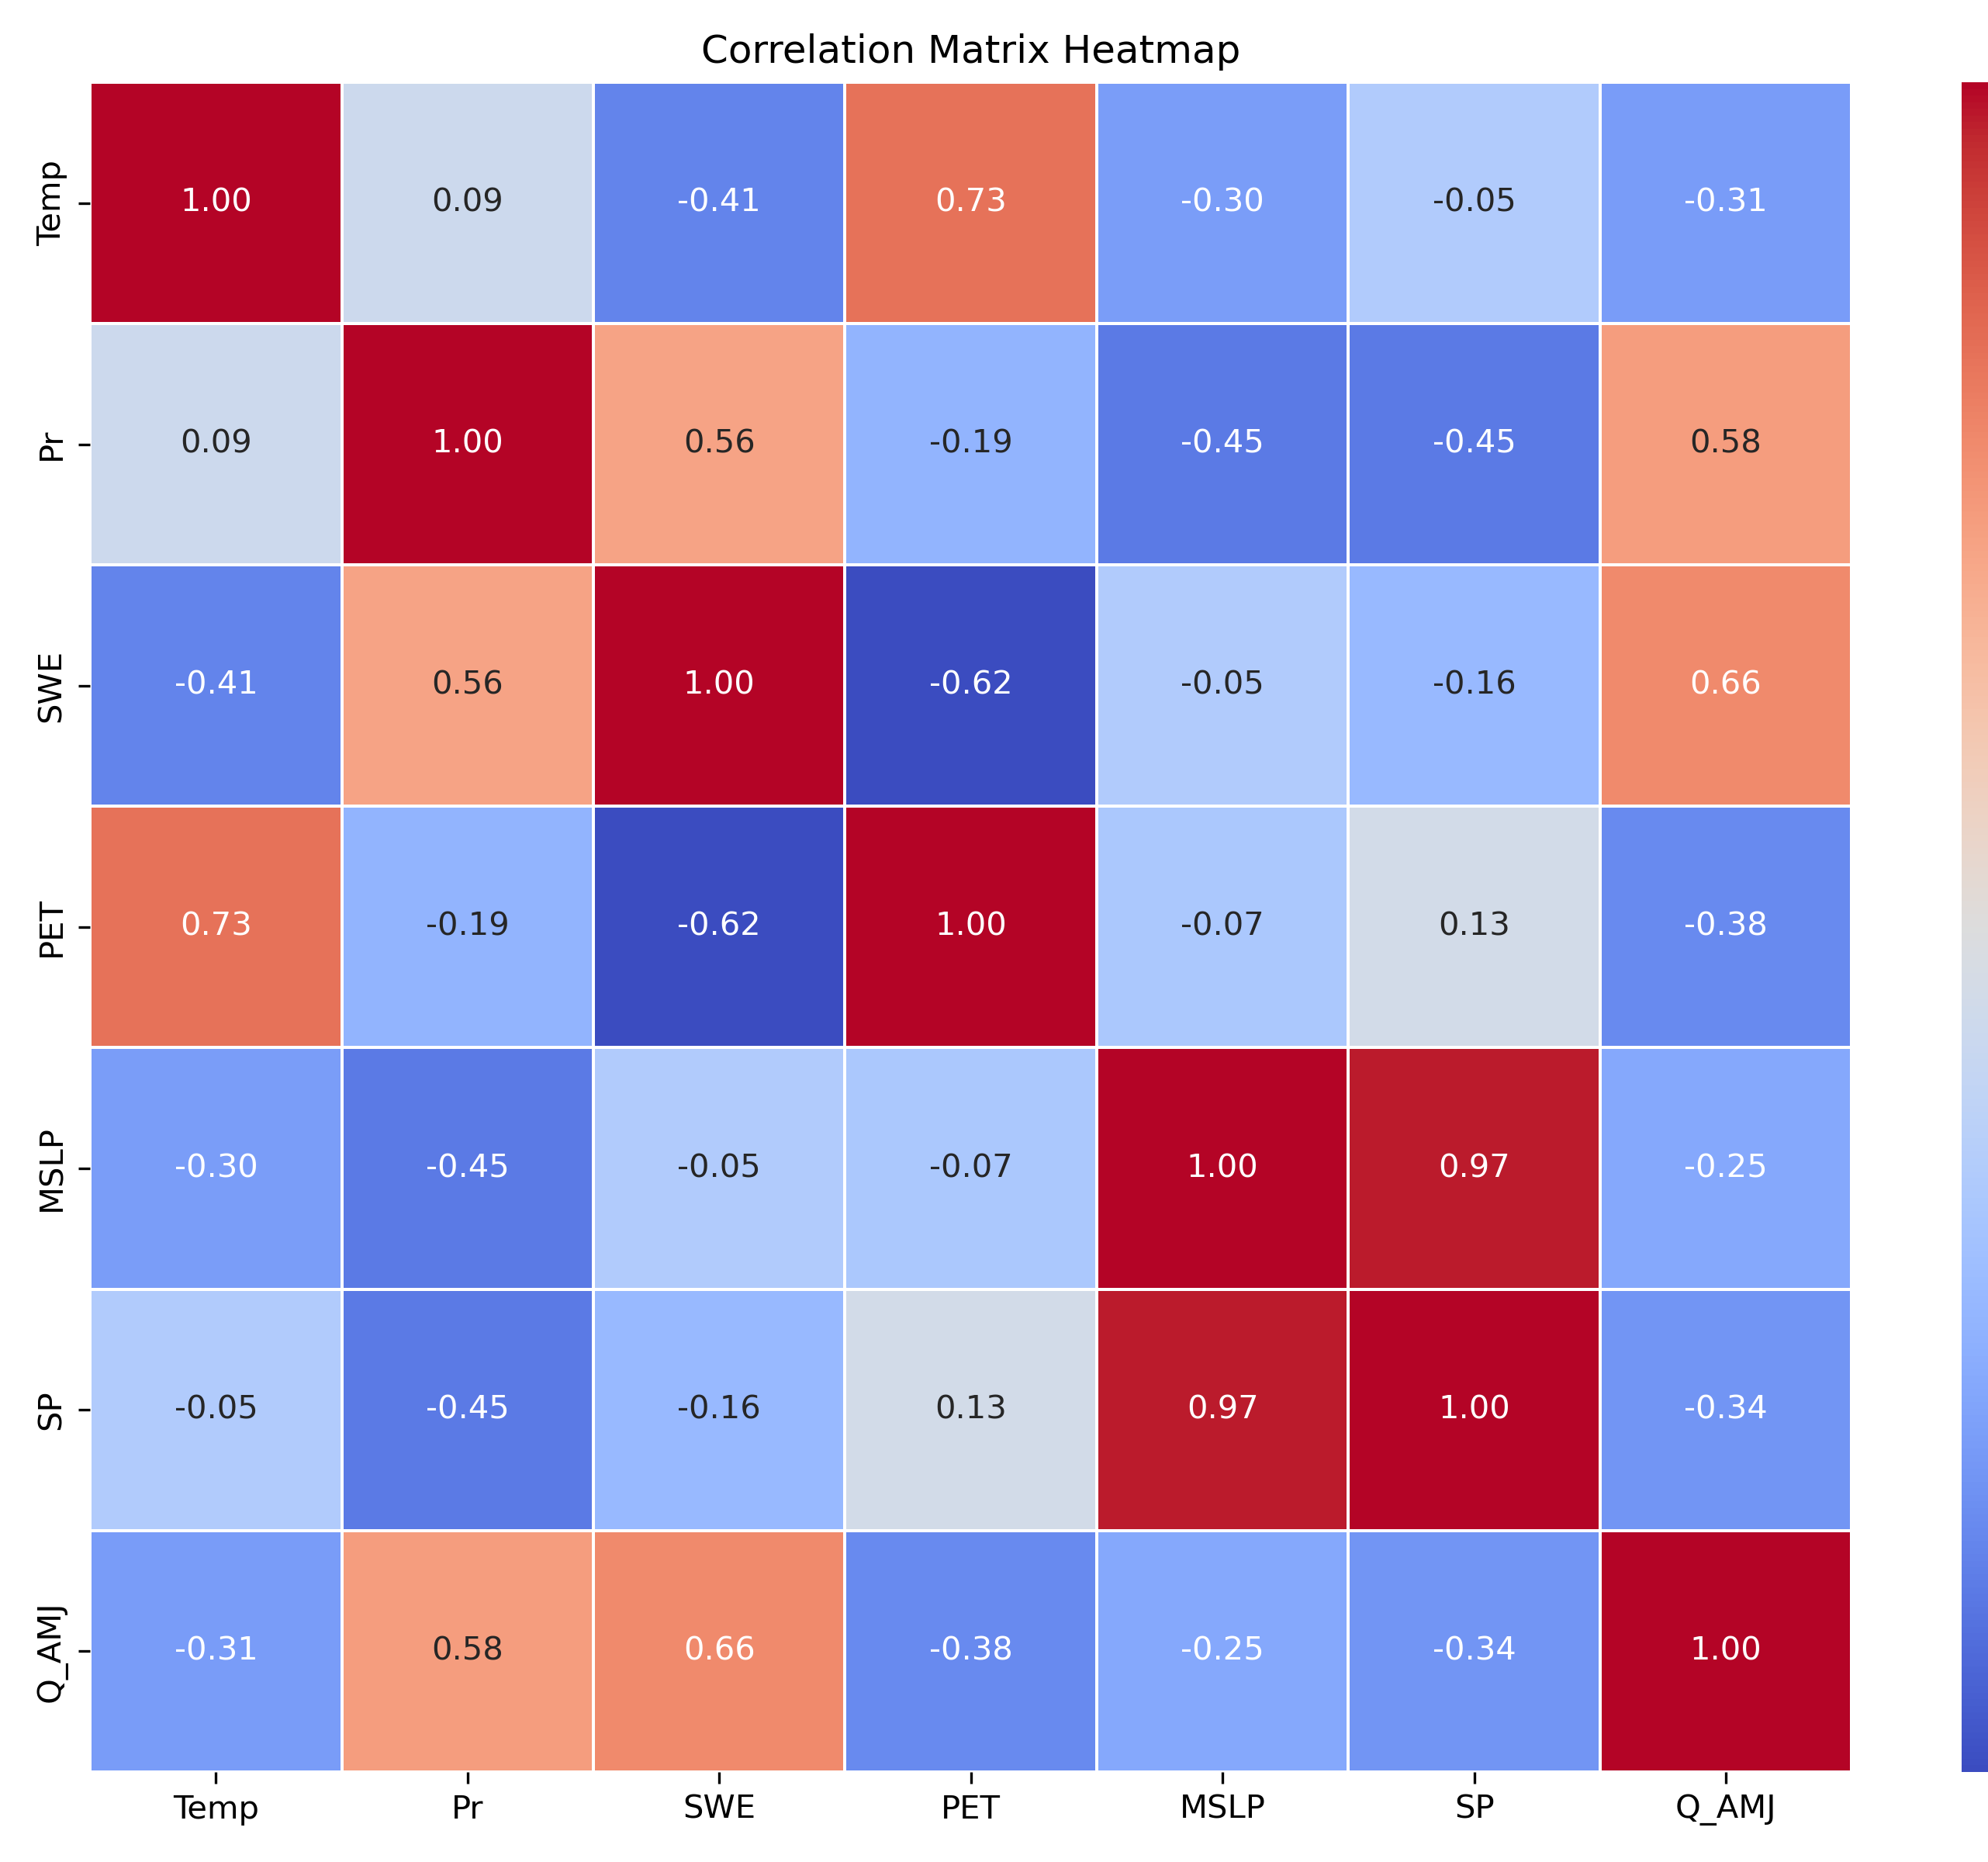
Data Analysis: Correlation between predictors and predictand

Slide 10
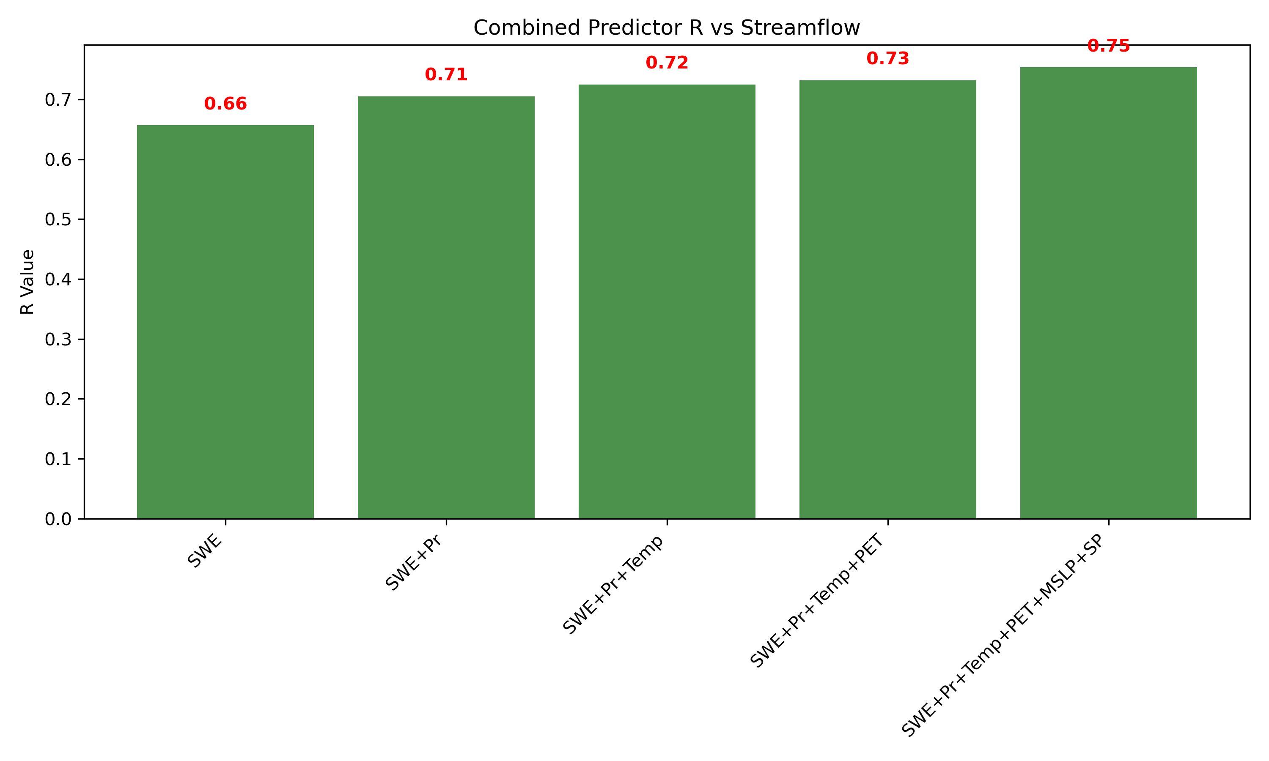
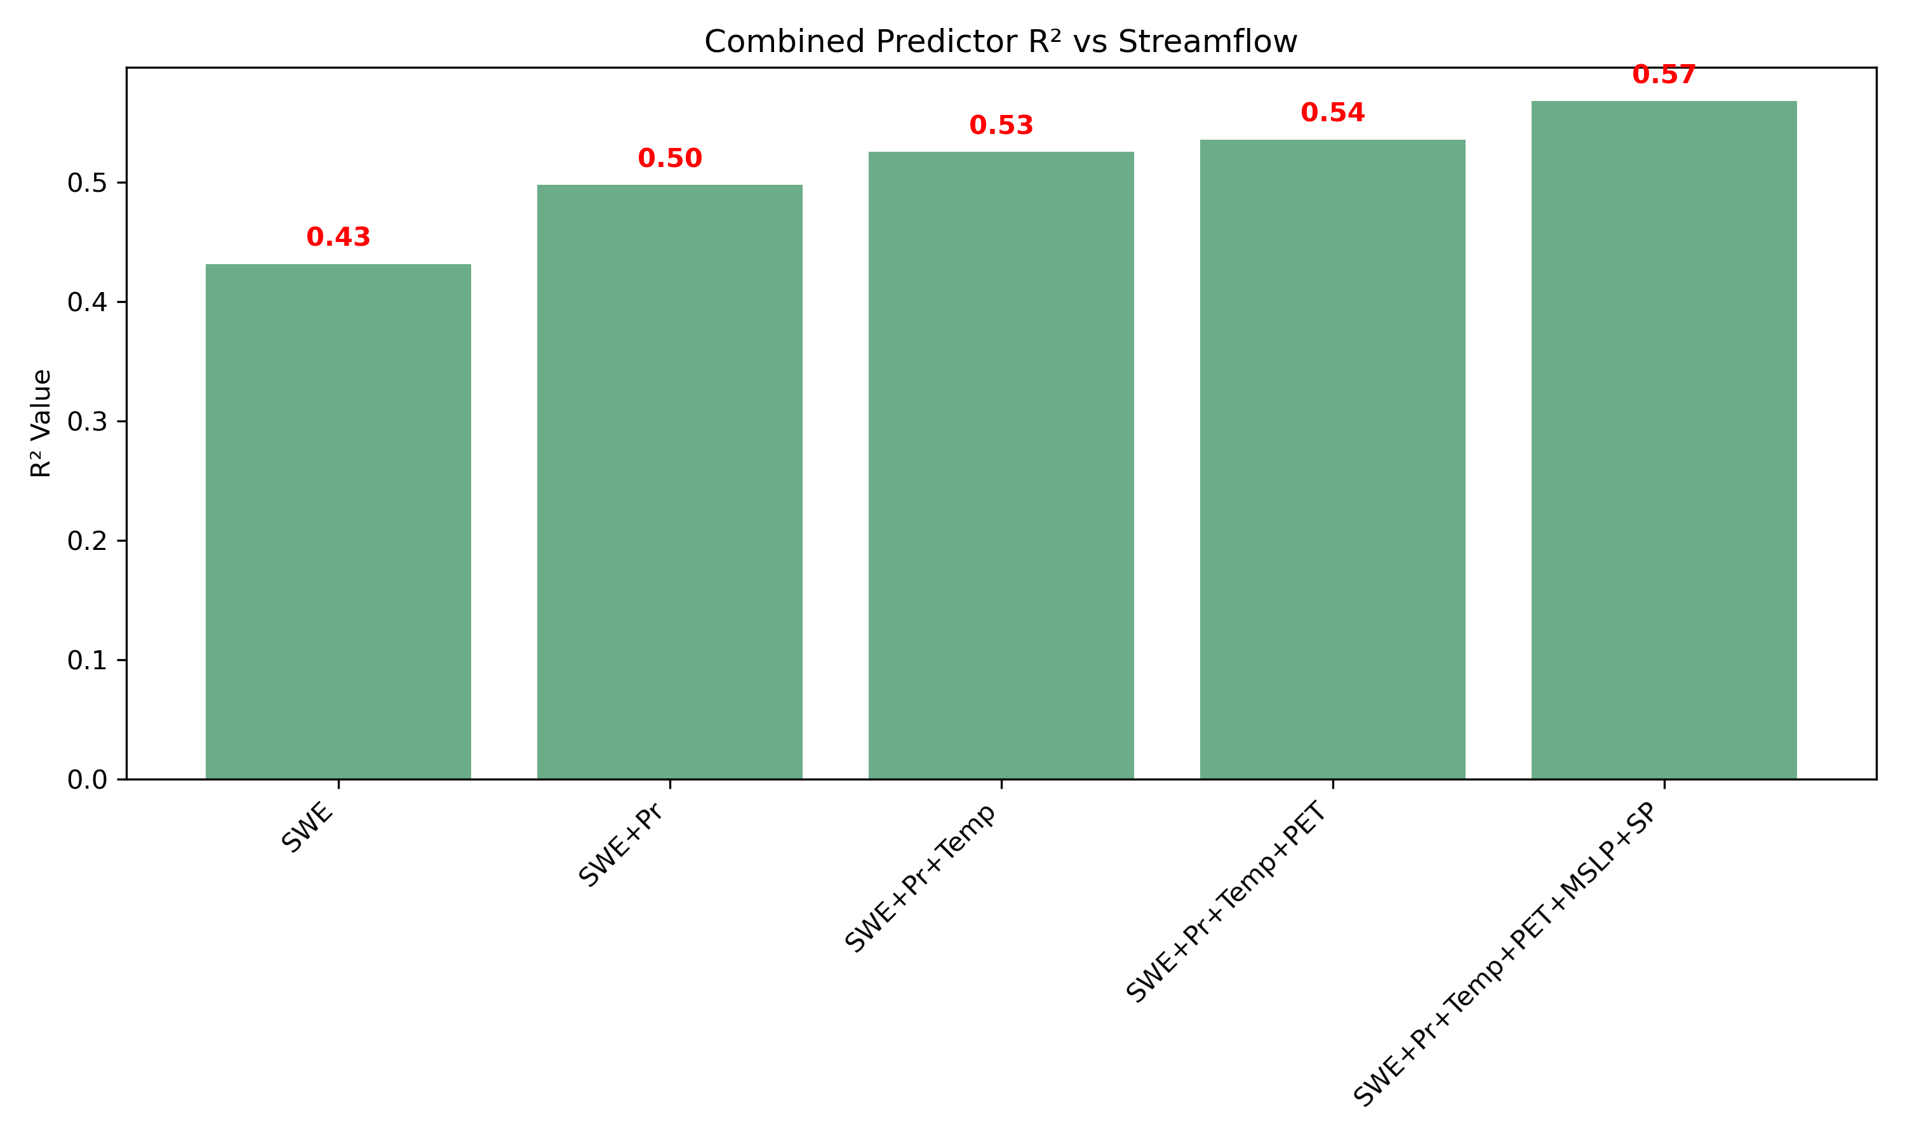
Correlations between combined predictors and streamflow

Slide 11
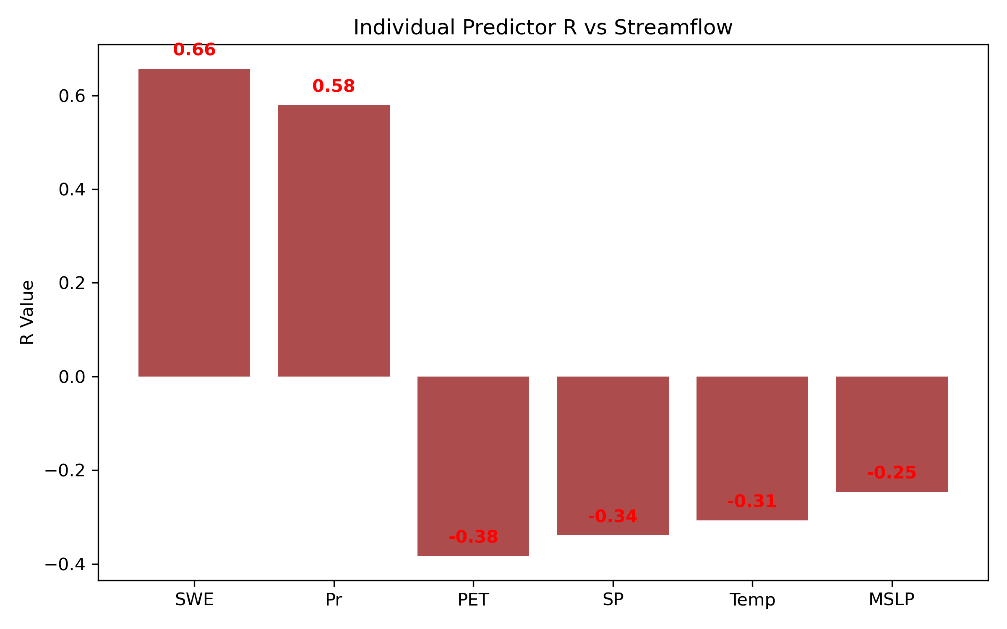
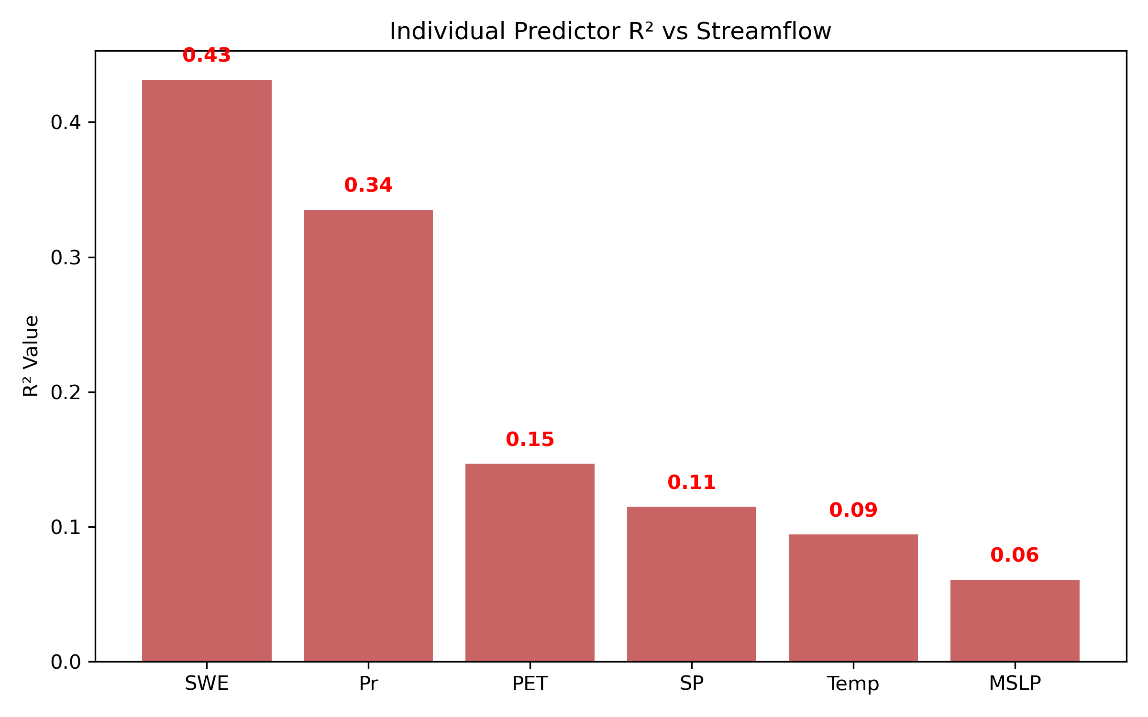
Correlation of each predictor with predictand

Slide 12
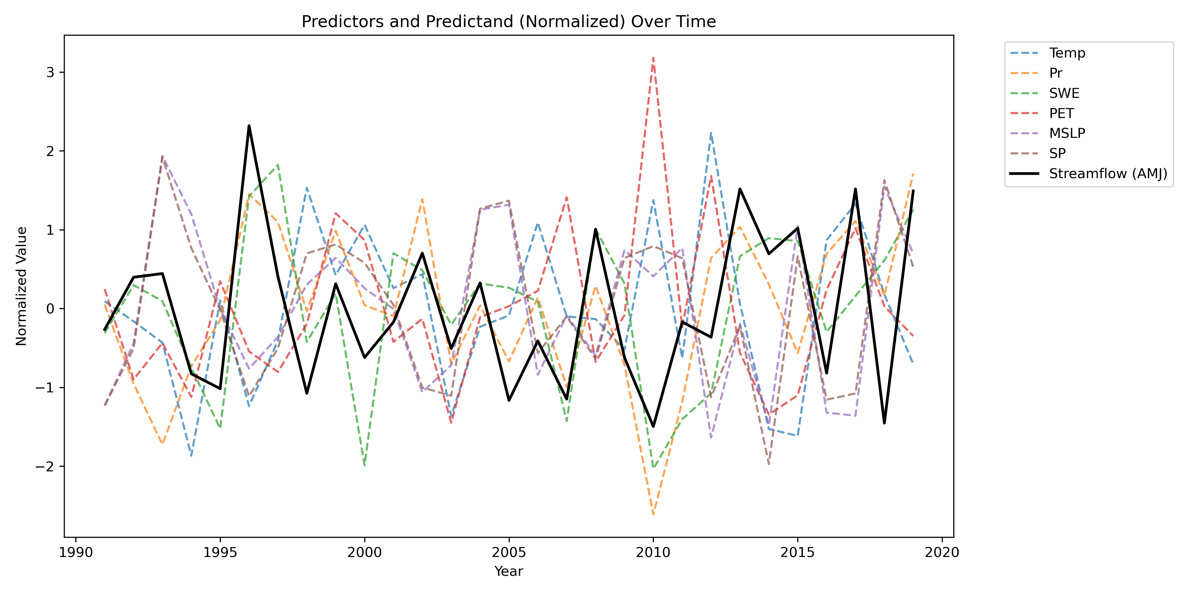
Standardization/Normalization

Slide 13
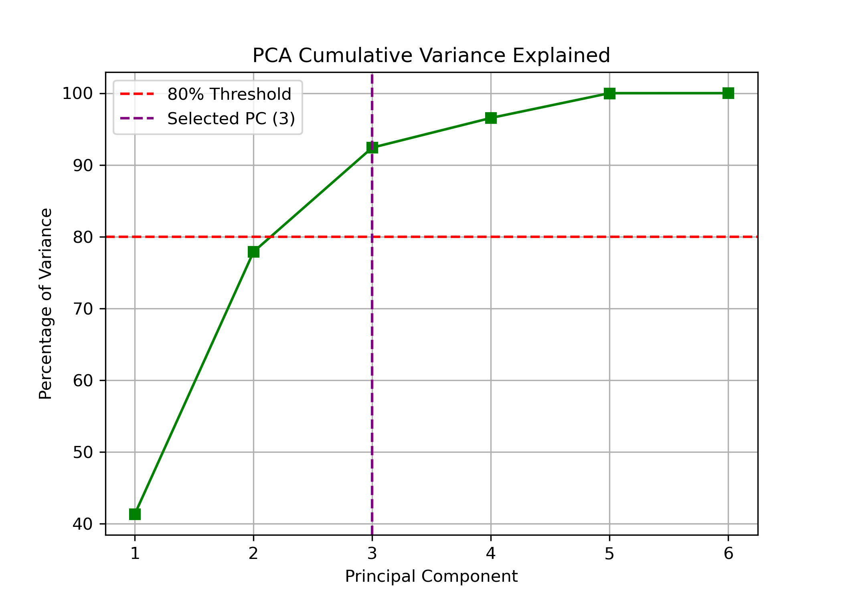
Results and Discussions
Total Variance Explained

Slide 14
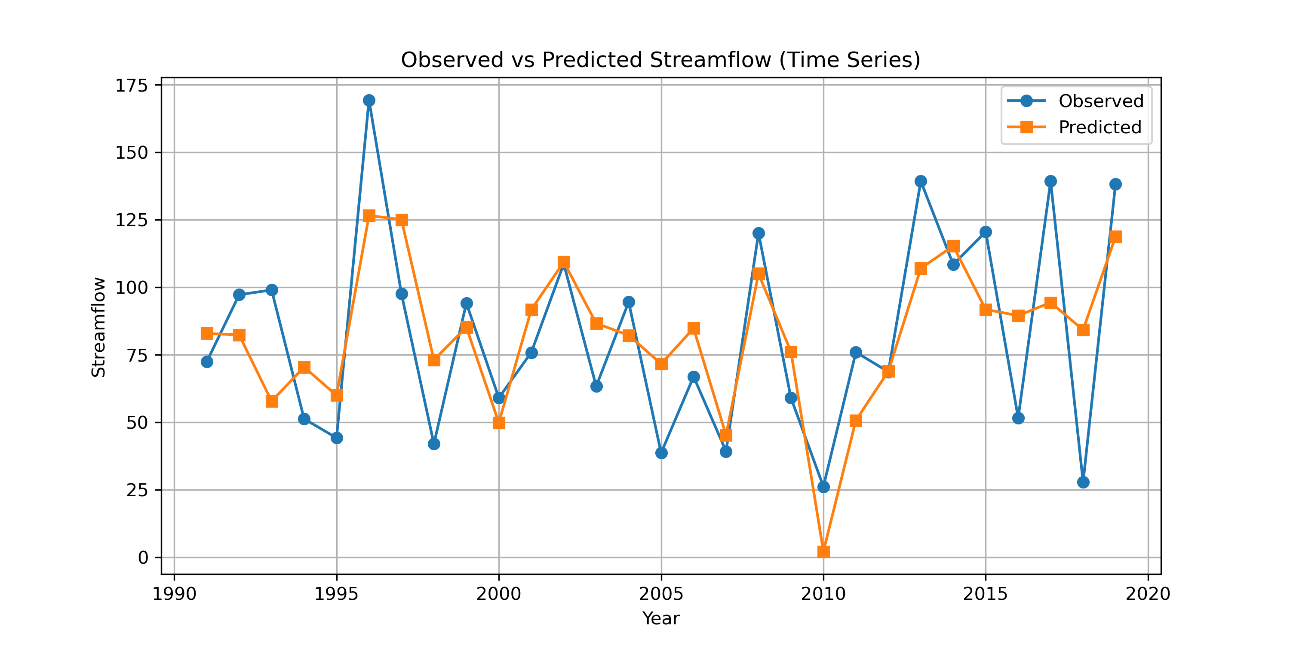
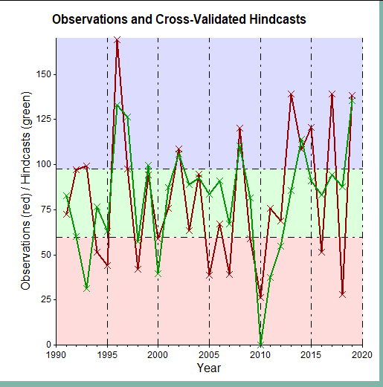
Results and Discussions
Observed Vs forecasted streamflow (PCR –left Vs MLR-right)

Slide 15
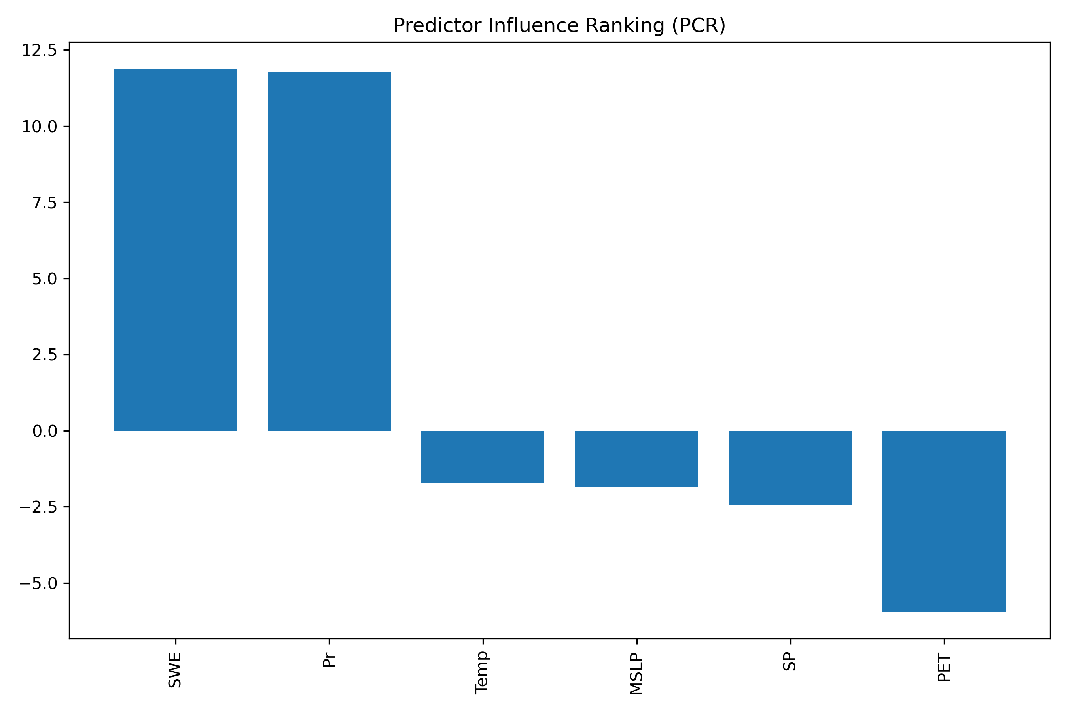
Results and Discussions
Predictors Influence Ranking -PCR

Slide 16
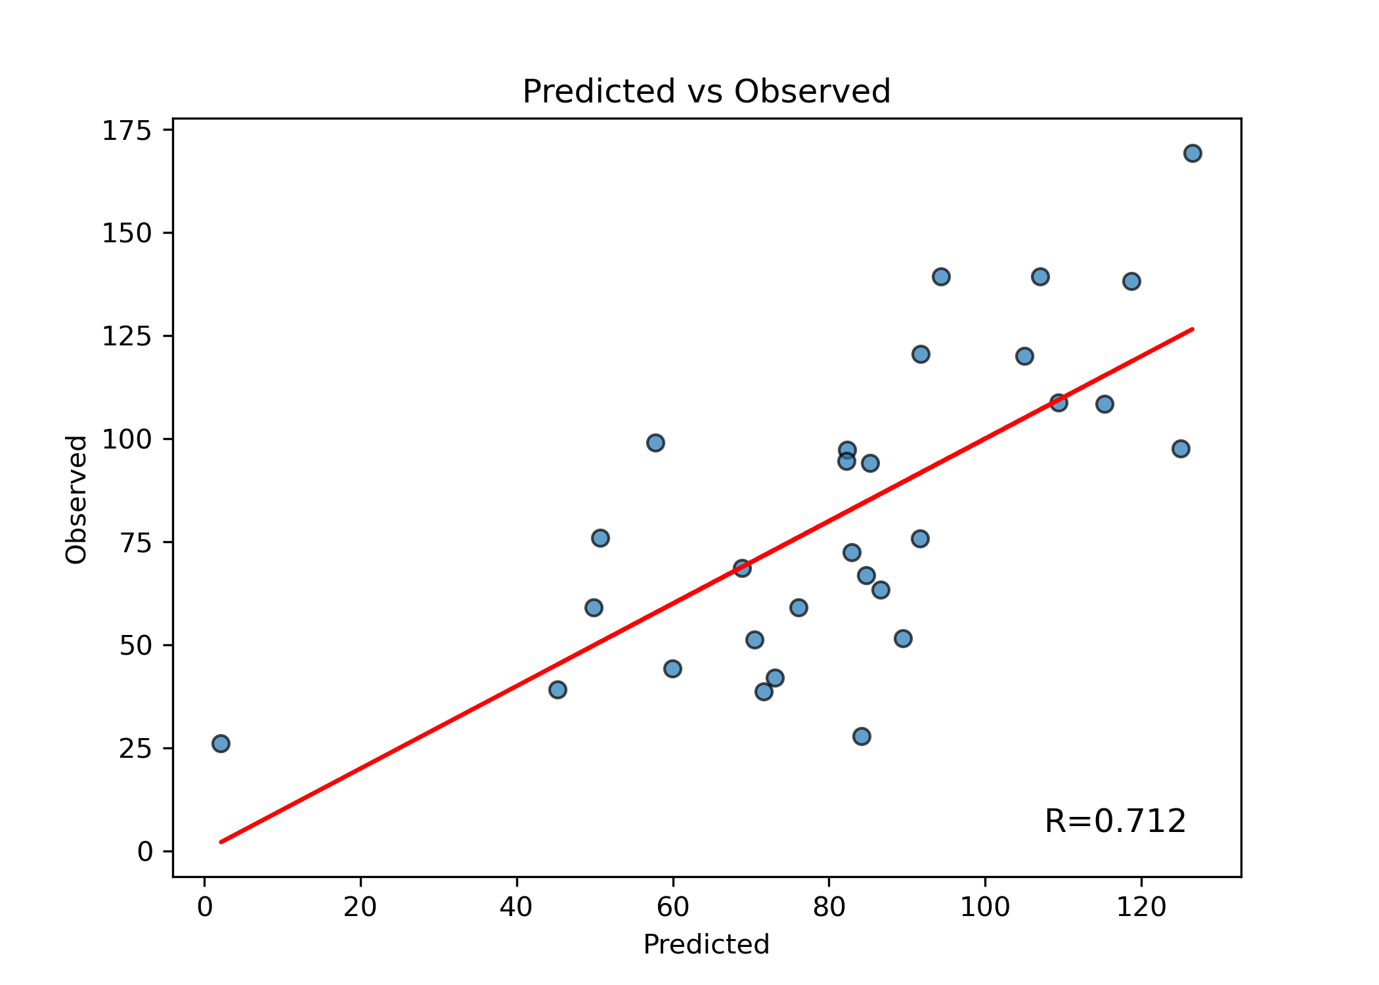
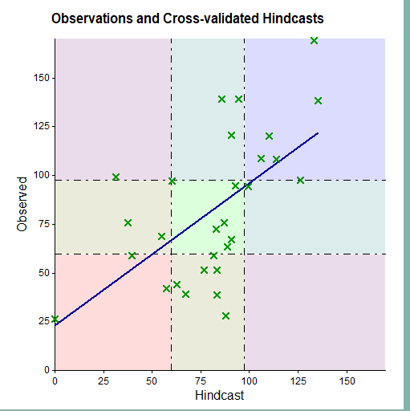
Results and Discussions
Scatter plots (PCR –left & MLR-right)

Slide 17
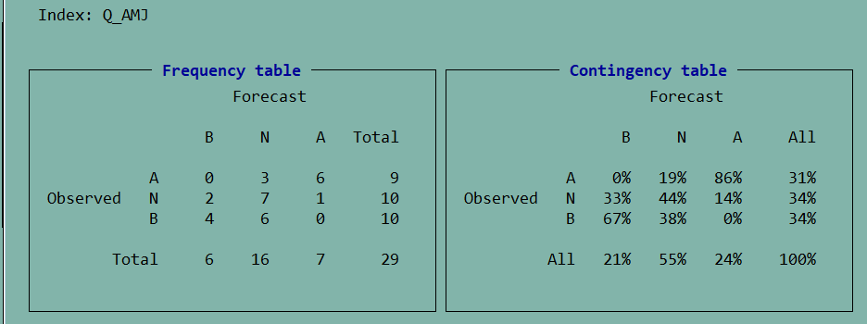

Contingency table

Slide 18
Results and discussion
Model | RMSE | MAE | Pearson_R | NSE | RPSS
PCR | 25.88 | 22.01 | 0.71 | 0.51 | 0.716
MLR | 30.72 | 25.59 | 0.5953 | 0.31
Regression Equation (PCR Model):
Q_AMJ = 82.361 + (-15.087 * PC1) + (-5.310 * PC2) + (8.455 * PC3)
Regression Equation (MLR Model):
Q_AMJ = 4095.052 -31.31T + 11.4 Pr + 0.35SWE + 10.76PET -135.58MSLP + 1.38SP
Model performance

Slide 19
Conclusions
Hindcasted Vs observed streamflow using PCR shows moderate correlation (R=0.712)
The PCR approach effectively overcame the challenge of multicollinearity and provided a more stable forecast than MLR methods.
For PCR, Snow Water Equivalent, precipitation and temperature are the most influential predictors.
PCR model significantly outperformed than MLR model

Slide 20
Thank you!
Questions?

