Slide 1
Development of a Pan-Tilt Gimbal Control System for Mechanical Video Stabilization and Vision Based Target Tracking.
Batch No. MRP 07
Project Members
SHARISH K A (RA2211038010017)
DIYANEZ KANDASAAMY J S (RA2211038010032)
ANIRUDH A(RA2211038010049)
Under the Guidance of
Dr R Senthilnathan M.E., Ph.D.

Slide 2
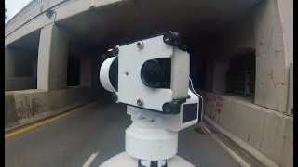
Background

Slide 3
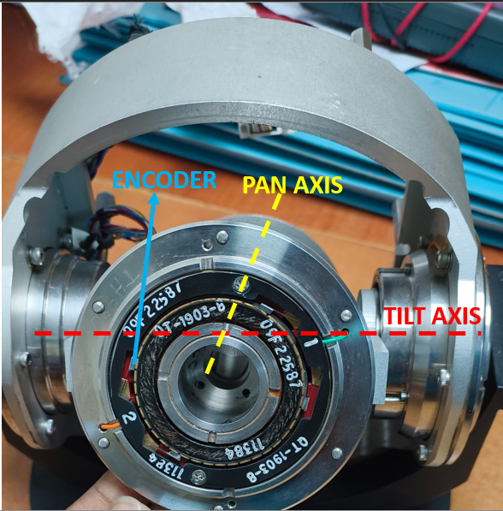
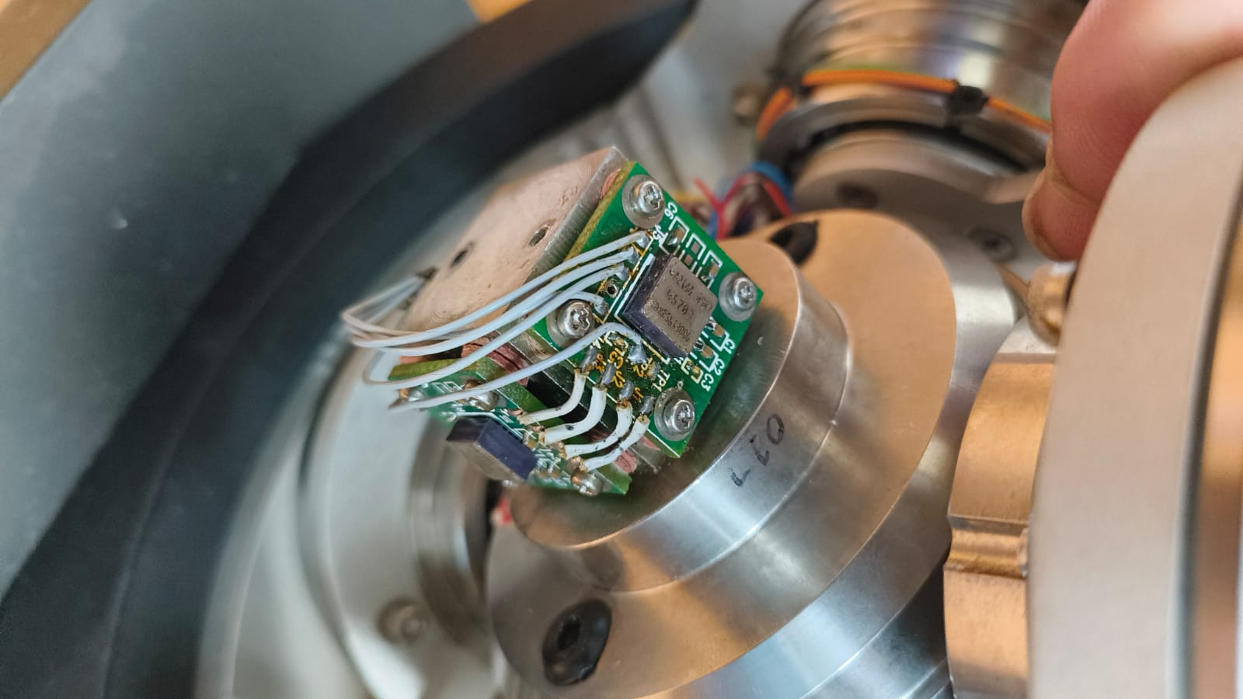
Project Objective
Integrate an existing pan tilt gimbal comprising onboard sensors and actuators to a FPGA based real-time controller.
To develop a pan-tilt gimbal control algorithm for mechanical stabilization, that reduces the effect disturbances, both internal and external, on the camera.
To develop an agile tracking system that enables the gimbal to lock onto the target specified by the user and follow it, maintaining minimum tracking error under dynamic conditions.
IMU
21MHP401L/403L - Major Project

Slide 4
APPLICATION CONTEXT
Operating Conditions: Adapted to outdoor settings subjected to non-harsh conditions and counteract to disturbances by maintaining reliable control for stable imagery.
Nature of Modalities: Only limited to land modalities. Limited bandwidth and low frequencies of undulations of road surface.
Nature of Targets: Designation through mouse clicks of target such as humans, motorcycles and cars.
Deployment Focus: Entire performance metrics such speed and accuracy of the system is governed by the existing mechanism, the actuators and sensors onboard.

Slide 5
System Block Diagram

Slide 6
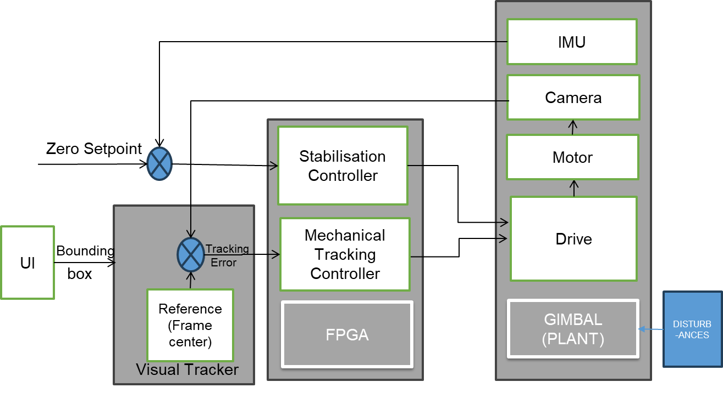

Slide 7
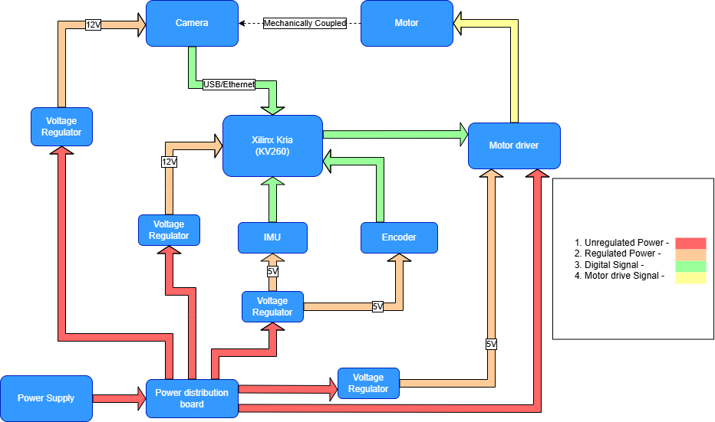
Hardware Block Diagram

Slide 8
METHODOLOGY
System Specification
Hardware integration
Sensor Data Acquisition
Algorithm Development
User Interface
Testing and Evaluation

Slide 9
Key Deliverables
Develop and evaluate control algorithm for mitigating both predictable and unpredictable external disturbances that affect camera stability
Engineer an algorithm that capable of providing stable imaging and precise tracking for dynamic targets on terrain.
Creating a experimental rig that could serve as a testbed for control algorithms as well as serve as a basis for future developments by allowing experimentation with differents software control strategies.
Delivering a modular control software, ensuring each module can be updated, replaced, or expanded independently—facilitating quick adaptation to new algorithms

Slide 10
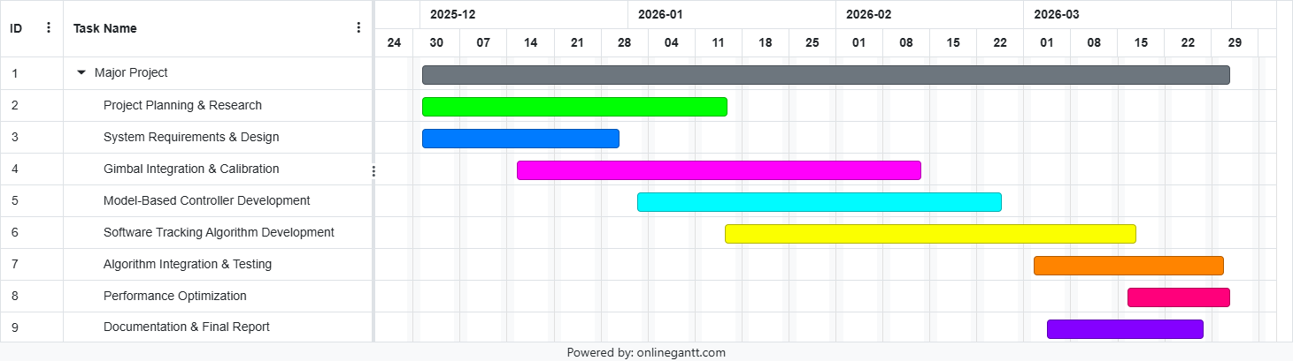
Gantt-Chart Timeline

Slide 11
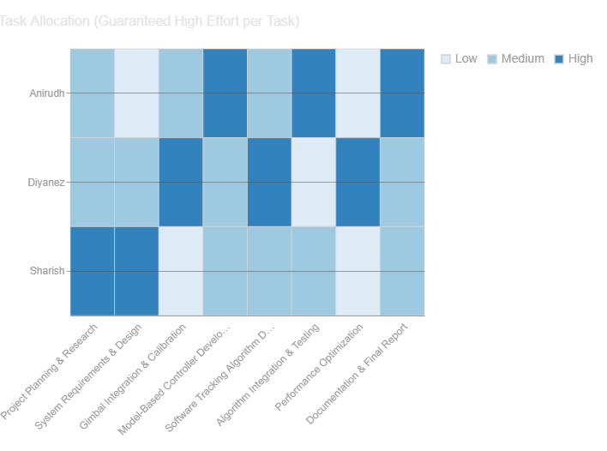
Work Breakdown Matrix

Slide 12
Thank You

