Slide 1
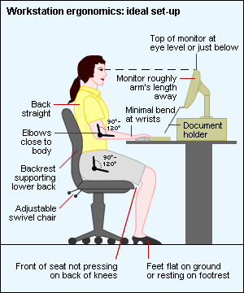

Slide 2
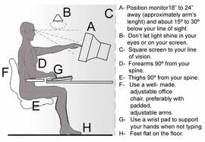

Slide 3
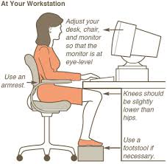

Slide 4
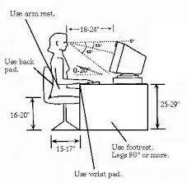

Slide 5
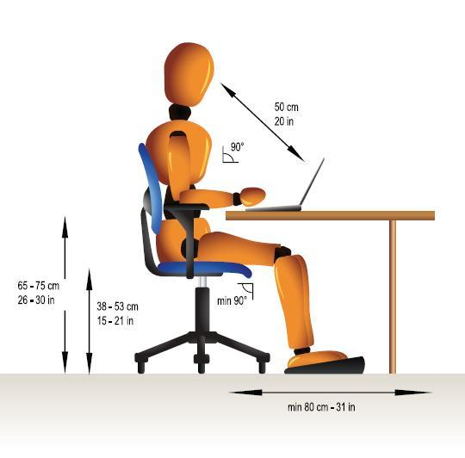

Slide 6
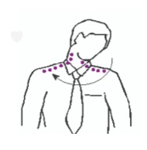
NECK ERGONOMIC EXCERCISES
HEAD ROLLS
Gently lower ear to shoulder
Hold for 10 secs
Repeat on other side
Do it gently
DO NOT jerk

Slide 7
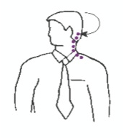
NECK ERGONOMIC EXCERCISES
HEAD TURNS
Turn head slowly
Hold for 10 seconds
Repeat on other side
Do this several times

Slide 8
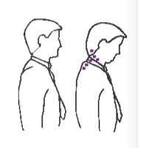
NECK ERGONOMIC EXCERCISES
CHIN TUCKS
Raise Head
Straighten Neck
Tuck Chin
Double chin
Hold for 10 secs
Repeat several times

Slide 9
NECK ERGONOMIC EXCERCISES
CHIN TUCKS
Raise Head
Straighten Neck
Tuck Chin
Double chin
Hold for 10 secs
Repeat several times

Slide 10
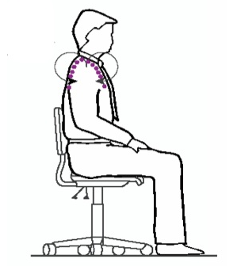
SHOULDER ERGONOMIC EXCERCISES
SHOULDER ROLLS
Circle forward several times
Circle backwards
Repeat 3-5 times

Slide 11
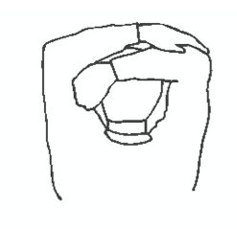
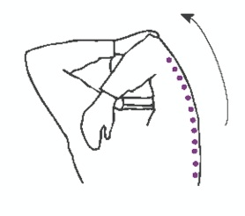
SHOULDER STRETCH EXCERCISES

Slide 12
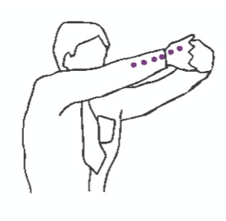
WRIST, HANDS & ARMS EXCERCISES
Interlace Fingers
Palm Outwards
Straighten arms in front
Hold for 10 secs
Repeat several times

Slide 13


GET ACTIVE AT WORK

Slide 14

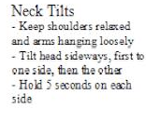
GET ACTIVE AT WORK

Slide 15
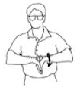
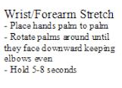
GET ACTIVE AT WORK

Slide 16
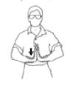
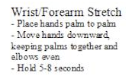
GET ACTIVE AT WORK

Slide 17
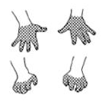
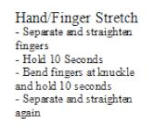
GET ACTIVE AT WORK

Slide 18
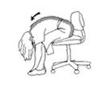
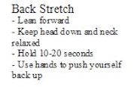
GET ACTIVE AT WORK

Slide 19
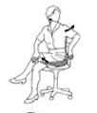
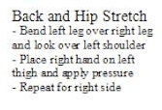
GET ACTIVE AT WORK

Slide 20
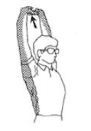
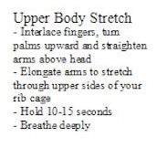
GET ACTIVE AT WORK

Slide 21
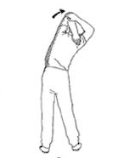
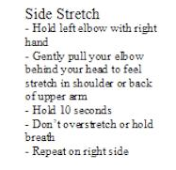
GET ACTIVE AT WORK

Slide 22
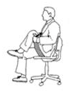
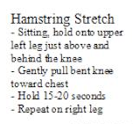
GET ACTIVE AT WORK

Slide 23
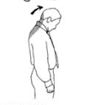
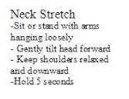
GET ACTIVE AT WORK

