Slide 1
Customer Segmentation Using Machine Learning
Presented by
A. Senthil Murugan
II MSc data analytics

Slide 2
Problem statement
In business, it is essential to tailor marketing strategies and offers to specific customers in order to enhance customer satisfaction, loyalty, and profitability. However, doing this effectively can be challenging due to the diverse characteristics and behaviors of the customer base. To address this issue, customer segmentation is employed, dividing a company's customers into distinct groups that share similar traits. This approach allows businesses to create more targeted and effective marketing strategies.

Slide 3
Introduction
Machine learning is the field of artificial intelligence that enables computers to learn from and make decisions based on data.
Instead of being explicitly programmed to perform specific tasks, machine learning algorithms use statistical techniques to identify patterns in data, allowing the system to improve its performance over time with experience.
Machine learning models can adapt to new data without human intervention, making them flexible for changing situations.
This project leverages K-Means clustering, an unsupervised machine learning algorithm, to analyze customer transaction data and segment customers into meaningful groups.

Slide 4
Objective
To Identify Customer Groups: Segment customers into distinct groups based on their purchasing behaviors, including recency, frequency, and monetary value.
To Enhance Targeted Marketing: Develop targeted marketing strategies tailored to each customer segment to improve engagement and conversion rates.
To Improve Customer Retention: Recognize high-value customers and design loyalty programs to enhance retention and increase customer lifetime value.
To Optimize Marketing Resources: Allocate marketing resources more efficiently by focusing efforts on the most profitable customer segments.
To Provide Business Insights: Generate actionable insights from customer data to inform strategic business decisions and improve overall marketing effectiveness.

Slide 5
Literature survey
Author Name | Algorithm | Description | Output
A. Jain, M. Murty, P. Flynn | K-means Clustering | Focuses on enhancements to the K-means algorithm, including improved initialization and centroid selection, to optimize clustering outcomes for customer segmentation. | Improved clustering accuracy and more meaningful customer segments.
J. Han, M. Kamber, J. Pei | DBSCAN (Density-Based Spatial Clustering of Applications with Noise) | Applies DBSCAN to customer segmentation, highlighting its ability to discover clusters of varying shapes and densities without needing to specify the number of clusters in advance. | Identification of customer segments with varying densities and irregular shapes.
R. A. Johnson, A. W. Scott | Self-Organizing Maps (SOM) | Explores the use of Self-Organizing Maps for customer segmentation, focusing on their ability to create visual representations of high-dimensional customer data. | Visual clustering of customers in a two-dimensional map, revealing distinct segments.
S. I. A. Ismail, H. Almasri | Agglomerative Clustering | Discusses the application of agglomerative hierarchical clustering for customer segmentation, emphasizing its use in identifying clusters based on customer similarity. | Hierarchical clustering results with dendrograms indicating customer groupings.
A. T. M. Nguyen, T. J. M. Hu | Principal Component Analysis (PCA) + Clustering | Combines PCA with various clustering algorithms (like K-means) to improve segmentation by reducing dimensionality before clustering customer data. | Enhanced cluster separation and reduced dimensionality leading to more interpretable segments.

Slide 6
Analysis and Algorithm
Understanding and segmenting customers is vital for effective marketing and retention.
This project employs RFM analysis, which evaluates Recency, Frequency, and Monetary metrics from transaction data to classify customers.
Recency is a measure of the time since a customer's last purchase
Frequency is a measure of the number of times a customer has made a purchase within a specific period.
Monetary is a measure of the total amount of money a customer has spent during a specified period.

Slide 7

These RFM scores enable targeted marketing.
The K-means elbow method refines segmentation, determining the optimal number of segments for efficient strategies.
K-means elbow method Algorithm steps:
Initialize: Randomly select K initial centroids.
Assign: Assign each data point to the nearest centroid based on Euclidean distance.
Update: Recalculate the centroids by taking the mean of all data points assigned to each centroid.
Repeat: Repeat the assignment and update steps until the centroids no longer change significantly or until a maximum number of iterations is reached.
Calculate WCSS: Compute the sum of squared distances between each data point and its assigned centroid for each K.
Plot Elbow Curve: Graph WCSS against the number of clusters K, showing a decreasing trend.

Slide 8
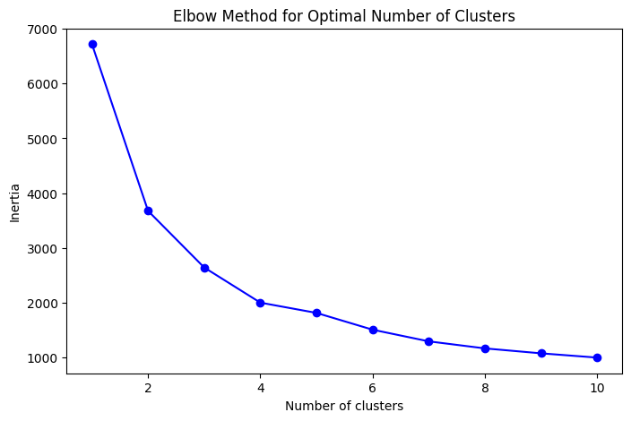
Identify Elbow Point: Find the point where the rate of decrease in WCSS slows, indicating the optimal K clusters.
Combined, RFM analysis and K-means elbow method offer crucial insights for data-driven marketing.
Conclusion: At K=4, where the "elbow" occurs, the optimal number of clusters for this dataset is 4. Beyond this point, adding more clusters does not significantly improve the clustering outcome, making K=4 the best balance between accuracy and complexity.

Slide 9
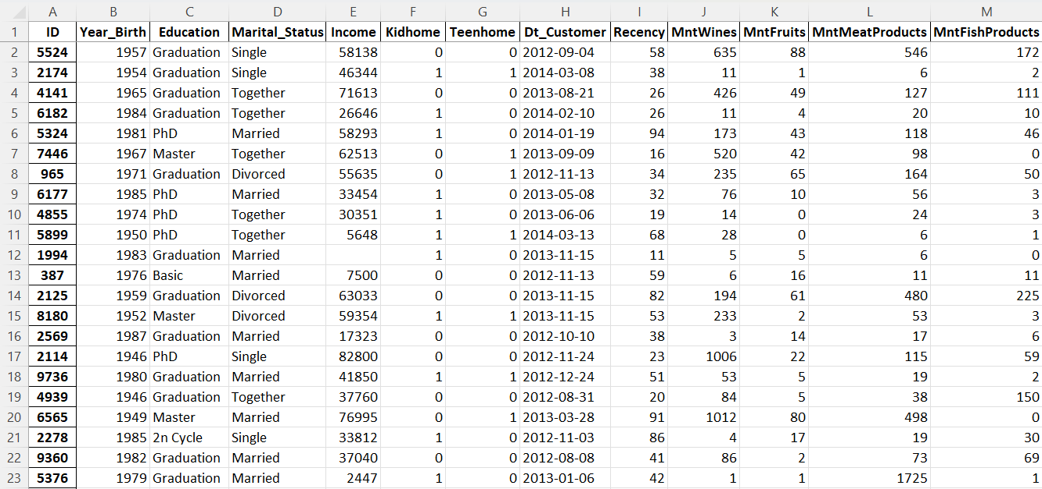
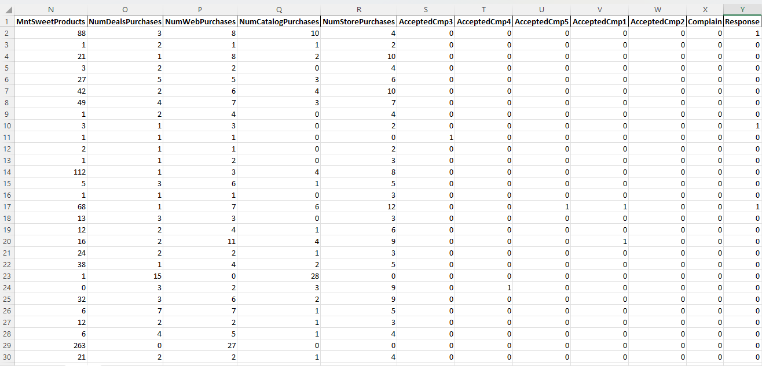
Dataset
Platform: Kaggle

Slide 10
Methodology
Data Loading & Inspection
Feature calculation
Exploratory Data Analysis (EDA)
Cluster Assignment
K-Means Clustering
RFM Analysis
Cluster Analysis
Visualization
Saving the Data

Slide 11
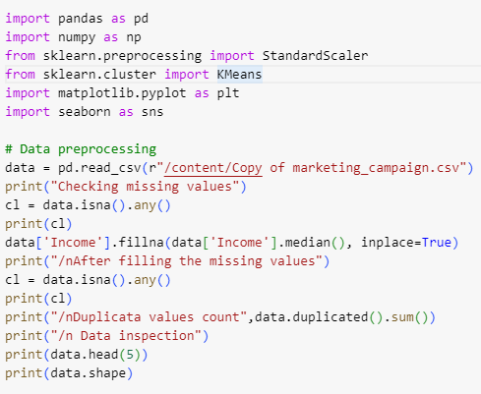
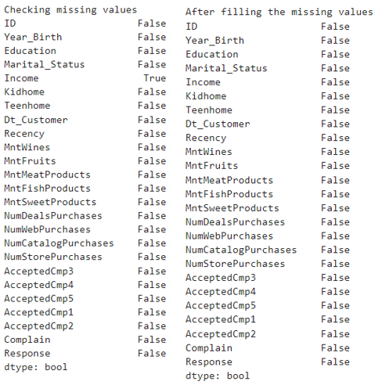
Implementation

Slide 12
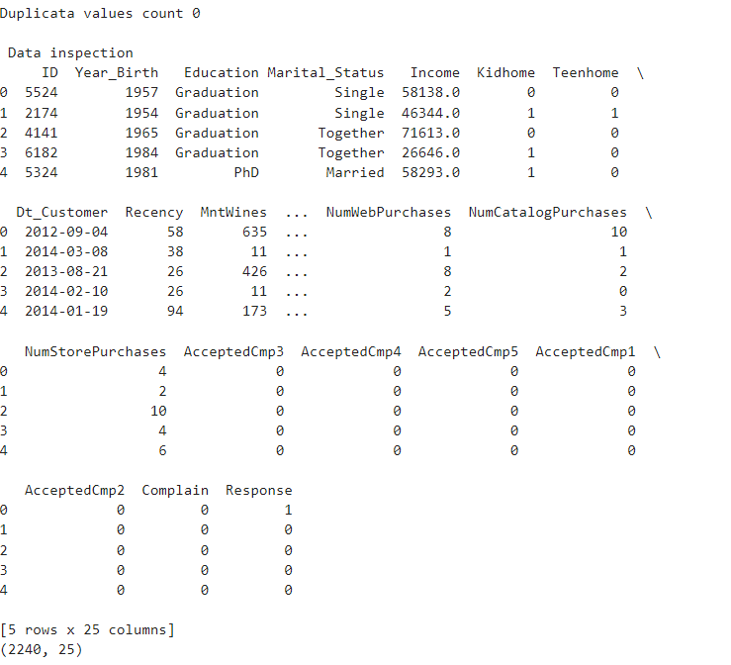

Slide 13
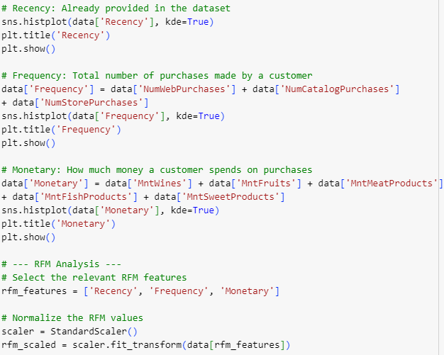
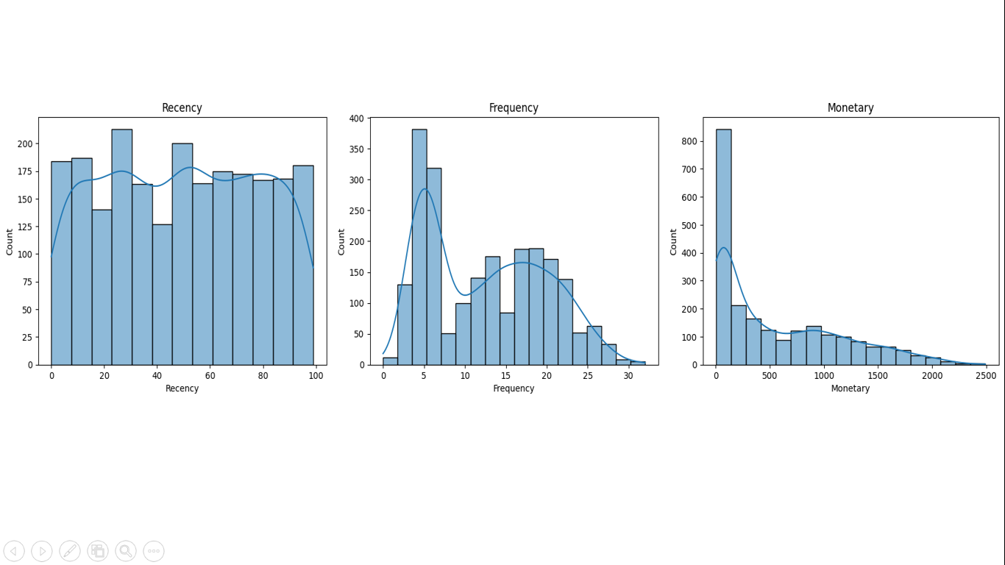

Slide 14
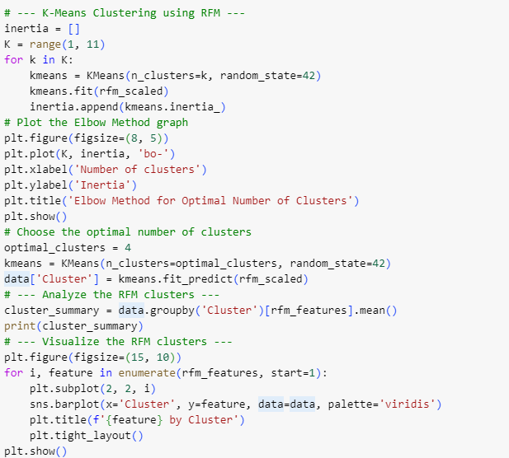
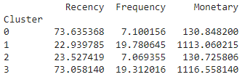

Slide 15
Visualizations

Slide 16
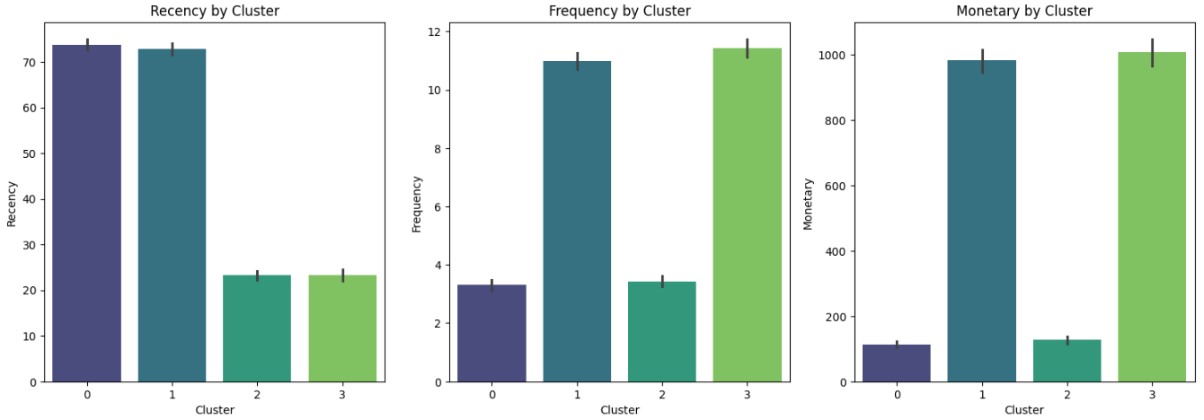
Bar Plots of RFM Features by Cluster
Insights:
Recency: Clusters with lower average recency show more recent engagement with customers. These customers are likely still active and can be nurtured further. Clusters with higher recency may indicate a need for re-engagement strategies, as these customers have not interacted recently.
Frequency: Clusters with a higher frequency of purchases are likely the most loyal and engaged customers. They should be a priority for retention strategies, such as loyalty programs or exclusive offers.
Monetary: Clusters with higher monetary values represent high-value customers. Retaining these customers is critical to revenue, and offering personalized experiences or high-end products could further solidify their loyalty.

Slide 17
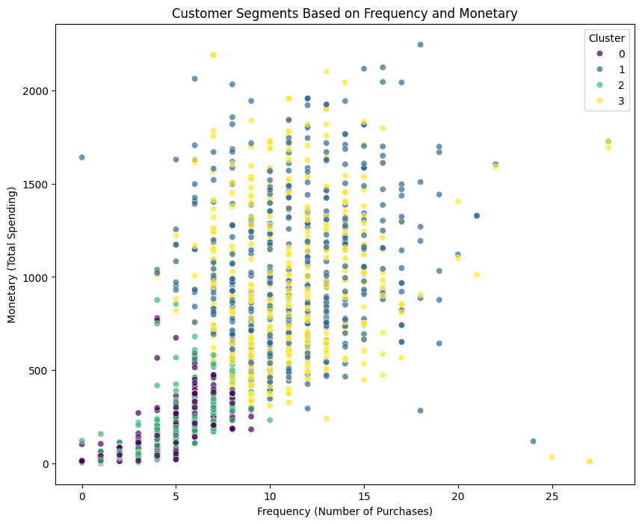
Scatter Plot of Frequency vs. Monetary
Insights:
Relationship between Frequency and Spending: The scatter plot shows that clusters with higher frequency generally tend to have higher monetary values. This indicates that frequent buyers also tend to spend more, suggesting a strong correlation between purchase frequency and customer value.
Cluster Outliers: Some clusters may show low frequency but high monetary values, which could represent high-value customers who make infrequent but large purchases. These customers may respond well to special, high-end promotions.

Slide 18
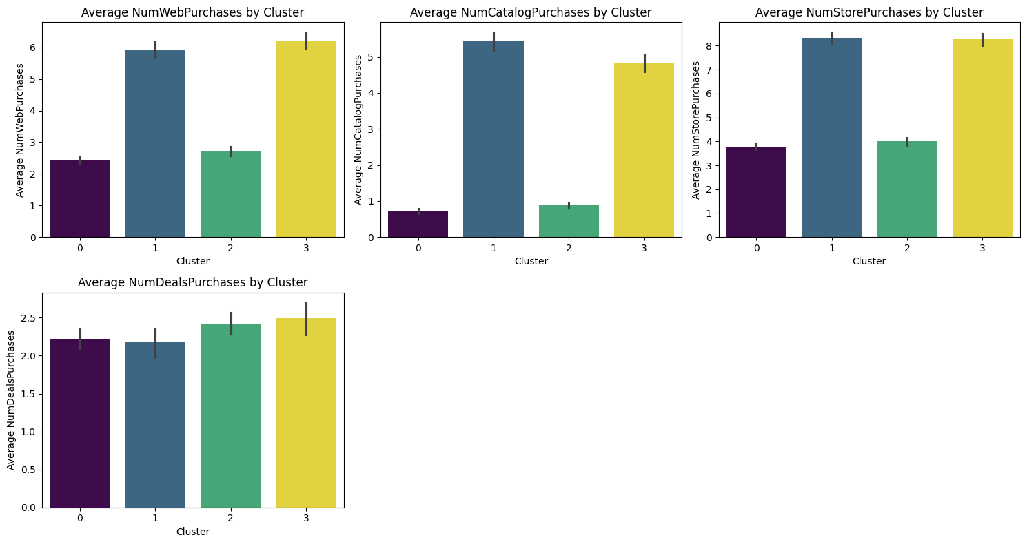
Bar Plots of Categorical Features by Cluster
Insights:
Web vs. Store Purchases: Some clusters show a strong preference for online shopping (e.g., NumWebPurchases) while others lean toward physical stores (NumStorePurchases). Clusters with higher NumCatalogPurchases indicate a continued interest in traditional channels, and marketing efforts could focus on these specific customer preferences.
Deals and Offers: Clusters with a higher number of NumDealsPurchases show that customers are more price-sensitive or deal-driven. Offering more promotions, discounts, or special offers to these clusters may increase engagement and spending.

Slide 19
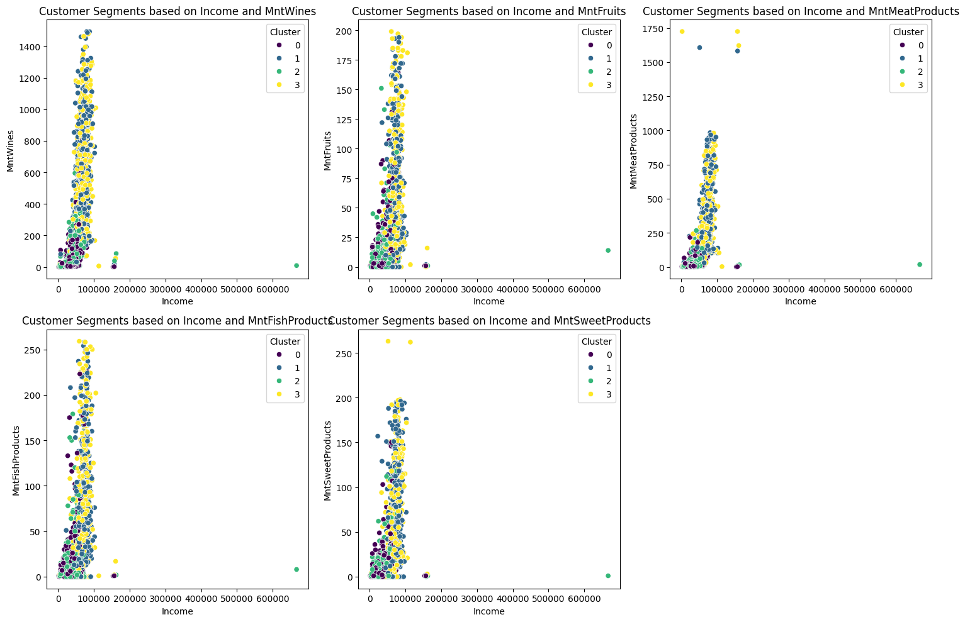
Scatter Plots of Income vs. Spending Categories
Insights:
Income and Product Category Preferences: Higher-income customers tend to spend more on premium categories such as MntWines and MntMeatProducts. Lower-income clusters may spend less overall but could be targeted with value-driven offers or bundles in categories like MntFruits and MntSweetProducts.
Cluster Differentiation by Spending Category: The scatter plots reveal that certain clusters are more inclined toward specific product categories. For example, one cluster may spend disproportionately more on MntFishProducts, while others favor MntWines.

Slide 20
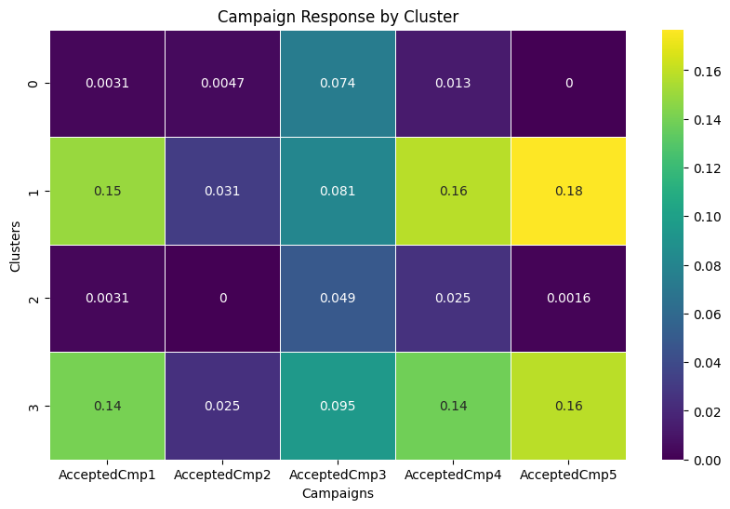
Heatmap of Campaign Response by Cluster
Insights:
Campaign Effectiveness by Cluster: The heatmap shows that some clusters have higher campaign acceptance rates than others. Clusters with consistently high responses to multiple campaigns are particularly valuable and should be targeted with ongoing marketing efforts. Conversely, clusters with low campaign response rates might require more personalized or different approaches to drive engagement.
Targeting Strategy: The heatmap helps prioritize which clusters to focus on for future campaigns based on their previous response rates, optimizing marketing budgets by focusing on segments that are more likely to convert.

Slide 21
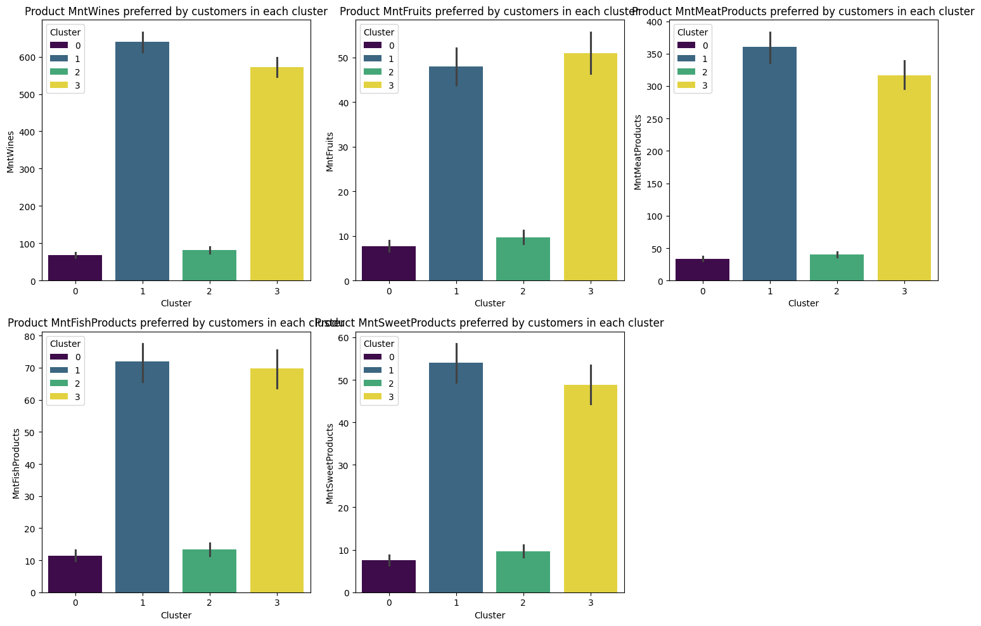
Bar Plots of Product Preferences by Cluster
Insights:
Product Preference Differences: The bar plots show clear distinctions in product category preferences across clusters. For instance, some clusters have high spending on MntWines, suggesting these customers may value premium or luxury products. Clusters with higher spending on MntMeatProducts could represent more value-conscious customers who prioritize practical purchases over indulgence.
Strategic Promotions: These insights can guide product-level marketing strategies. For example, clusters that show lower spending in certain categories could be targeted with cross-selling efforts or promotions to increase their average spend.

Slide 22
Cluster Characteristics and Analysis
1. Cluster Size: Number of customers in each cluster
Table presents the number of customers in each cluster, providing insights into the distribution and relative size of each customer segment identified through clustering analysis.
Cluster | Number of customers
0 | 637
1 | 481
2 | 637
3 | 485

Slide 23
2. Average RFM Scores: Mean values for each cluster, facilitating clear comparisons.
Table displays the average Recency, Frequency, and Monetary (RFM) scores for each customer cluster, allowing for a comparative analysis of customer engagement and value across different segments.
Cluster | Average Recency (days) | Average Frequency (purchases) | Average Monetary ($)
0 | 24 | 3 | 109
1 | 73 | 11 | 1,047
2 | 75 | 4 | 132
3 | 24 | 11 | 940

Slide 24
Descriptive Labels
Meaningful labels to each cluster based on their characteristics (e.g., "High Value," "At Risk")
Cluster 0: Represents low-value customers who purchase infrequently and have low monetary contributions. These customers are engaged recently but may require incentives to increase their frequency and spending.
Cluster 1: Includes high-value, loyal customers who have made multiple purchases but haven’t engaged recently. They should be prioritized for loyalty programs and exclusive offers to maintain their loyalty and re-engage them.

Slide 25
Cluster 2: Represents new or occasional customers who have made few purchases but show potential for growth. Targeted marketing efforts, such as personalized onboarding strategies, can help encourage more frequent purchases and increase their monetary contributions.
Cluster 3: Includes high-engagement customers who have a higher purchase frequency but may not have high monetary contributions. They require further analysis to determine how to boost their spending and improve overall profitability.

Slide 26
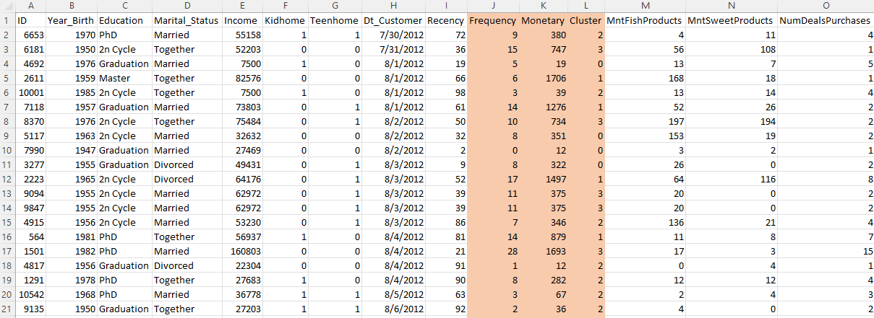
Saved the clustered data
Saved cluster file Screenshot shows a screenshot of the newly created clustered CSV file named 'cluster-file,' which includes the calculated Frequency and Monetary values, along with the cluster assignments for each customer

Slide 27
Thank you

