Slide 1
TYPES OF NETWORKS
S.KIRITHIK 8C

Slide 2
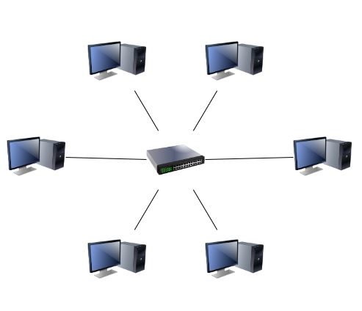
Local Area Network(LAN)
Xerox corporation worked in collaboration with DEC and Intel to create ethernet, which is the most pervasive LAN architecture used today.
Ethernet has involved and has seen significant improvements in regards to speed and efficiency.
Features of LAN : Resources/Application/File Sharing, Productivity, Communication, Management.
Advantages of LAN : Cost-effective, Flexible & Growth Oriented, Sharing Devices, Data Transfer, Security Local Area Network(LAN).

Slide 3
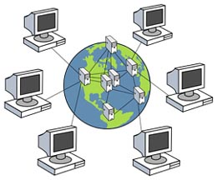
Wide Area Network(WAN)
Throughput refers to the amount of data transferred in a specified timeframe.
Transferring large blocks of data between users LAN WAN.

Slide 4
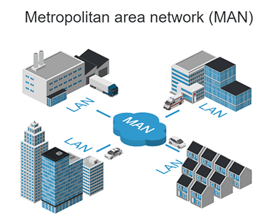
Metropolitan Area Network(MAN)
A MAN is larger than a LAN but smaller than or equal in size to a WAN.
MANs are typically owned and managed by single entity.
This could be an ISP or telecommunications company that sells its service to end-users in that metropolitan area .
For all intents and purposes, a MAN has the same characteristics as s WAN with distance constraints.

Slide 5
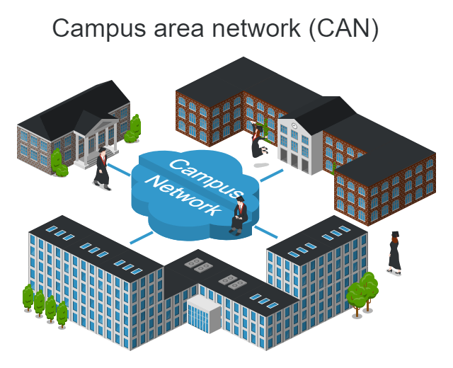
Campus Area Network(CAN)
A Campus Area Network is a computer network that spans a limited geographic area.
CANs connect multiple Local Area Network (LAN) within an educational or corporate campus. Most CANs connect to the Public Internet.
At colleges, universities and other educational institutions, CANs provide Internet access for students and faculty.

Slide 6
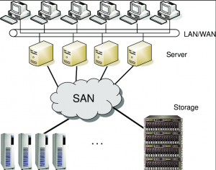
Storage Area Network(SAN)
SAN may be referred to as a subnetwork or special purpose network.
Its special purpose is to Allow users on a larger network to connect various data storage devices with clusters of data servers.

Slide 7
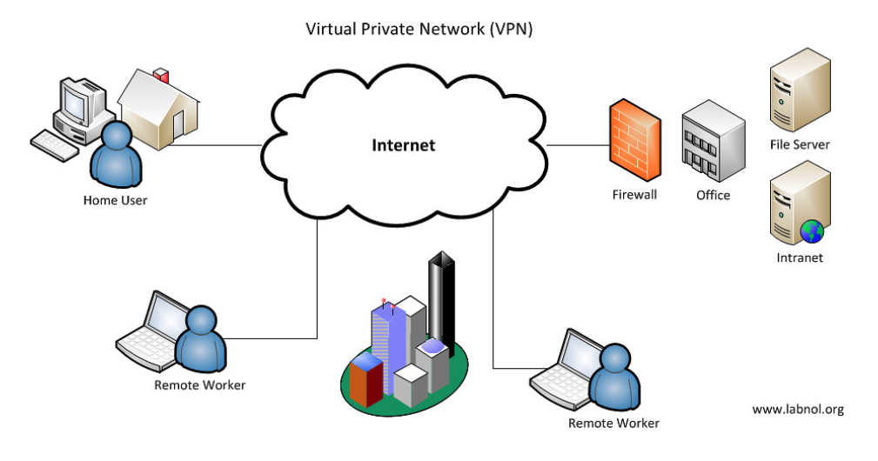
Virtual Private Network(VPN)
VPN is a private network that can access public networks remotely.
VPN uses encryption and security protocols to retain privacy while it accesses outside resources.
VPN enables an end user to create a virtual tunnel to a remote location.

Slide 8
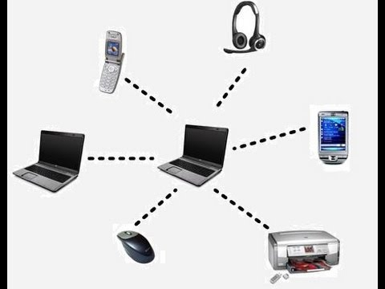
Personal Area Network(PAN)
PAN is a computer network used for data transmission amongst devices such as computers, telephones, tablets and personal digital assistants.
PANs can be used for communication amongst the personal devices themselves or for connecting higher level network and the internet where one “master” device takes up the role as internet router.

