Slide 1

Employee Attrition
Presented by: Senthil Kumar

Slide 2

what is Attrition and what determines it?
Attrition: It is basically the turnover rate of employees inside an organization.
This can happen for many reasons:
Employees looking for better opportunities.
A negative working environment.
Bad management
Sickness of an employee (or even death)
Excessive working hours

Slide 3
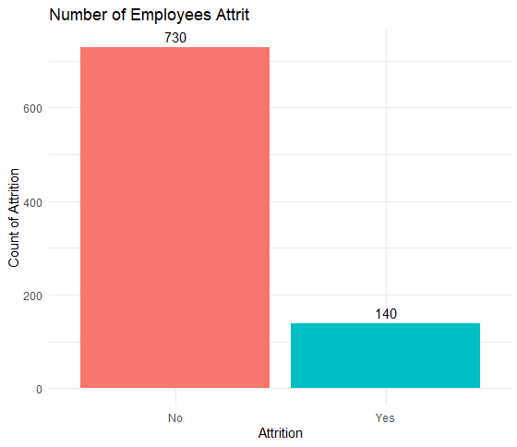
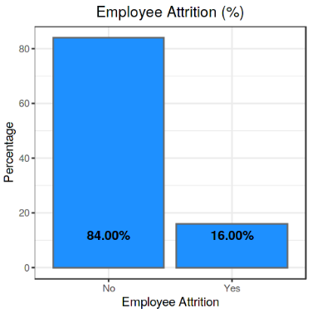

Summary of the employee attrition dataset
Dataset Structure: 870 observations (rows), 36 features (variables)
Label "Attrition" is the label in our dataset and we would like to find out why employees are leaving the organization!
Imbalanced dataset: 730 (84% of cases) employees did not leave the organization while 140 (16% of cases) did leave the organization making our dataset to be considered imbalanced since more people stay in the organization than they actually leave.
Distribution of our Labels: 84% of employees did not quit the organization while 16% did leave the organization. Knowing that we are dealing with an imbalanced dataset will help us determine what will be the best approach to implement our predictive model.

Slide 4
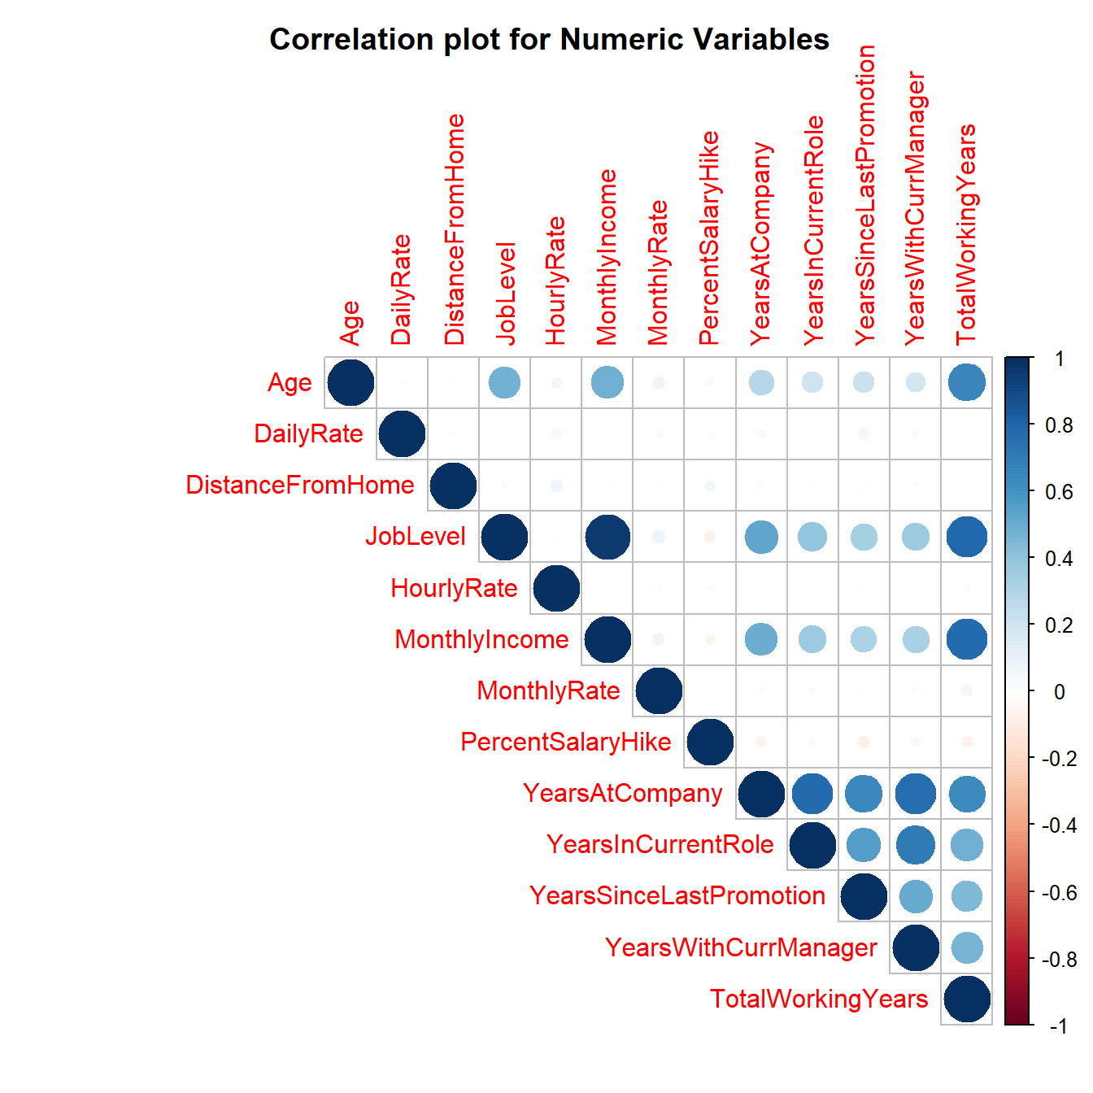
Correlation of the VARIABLES from employee attrition dataset
Before modelling, we need to find out the variables that could be important in predicting the outcome. Therefore we do some univariate and bivariate data analysis to discover insights and try to correlate the data.
Correlation Matrix Plot is used to predict correlation between numeric variables. Some of the correlated variables are:-
Age variable is correlated with TotalWorkingYears
TotalWorkingYears correlated with MonthlyIncome
YearsWithCurrManager also correlated with YearsAtCompany
YearsWithCurrManger correlated with YearsInCurrentRole
YearsInCurrentRole correlated with YearsAtCompany
From the correlation plot, we see that the predictor variables are less correlated to each other. The variables years at company, years in currentrole, years since last promotion, years with current manager, total working years each have negative correlation.

Slide 5
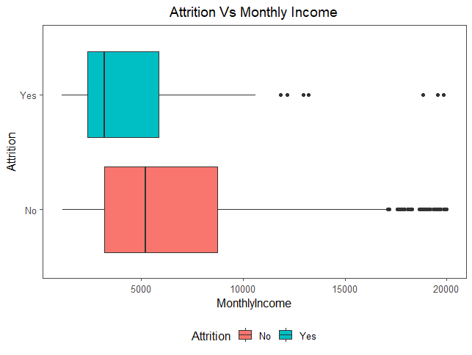
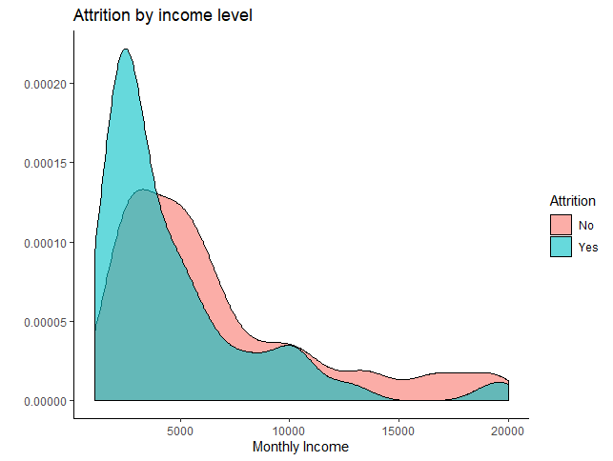
Attrition Vs Pay rates: Income levels for the attrition employees
The density plot clearly shows on a very high level that employees with lower monthly income of less than $5000 have higher attrition levels.
It is wise to draw a boxplot to understand the monthly income and how it affects the attrition rate, it depicts that those who have been paid less monthly income will turnover more.

Slide 6
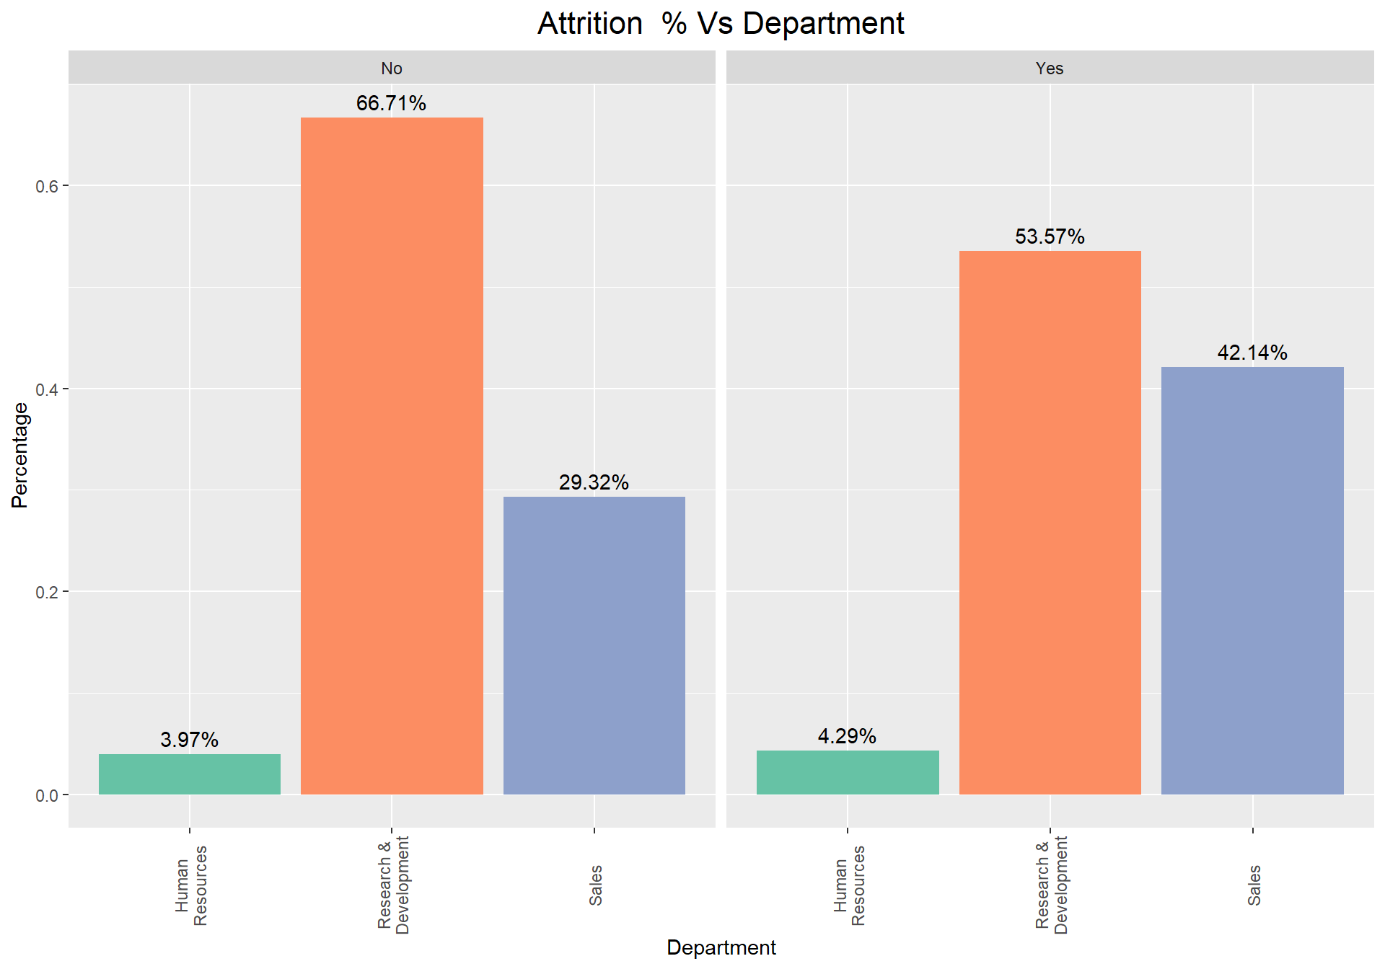
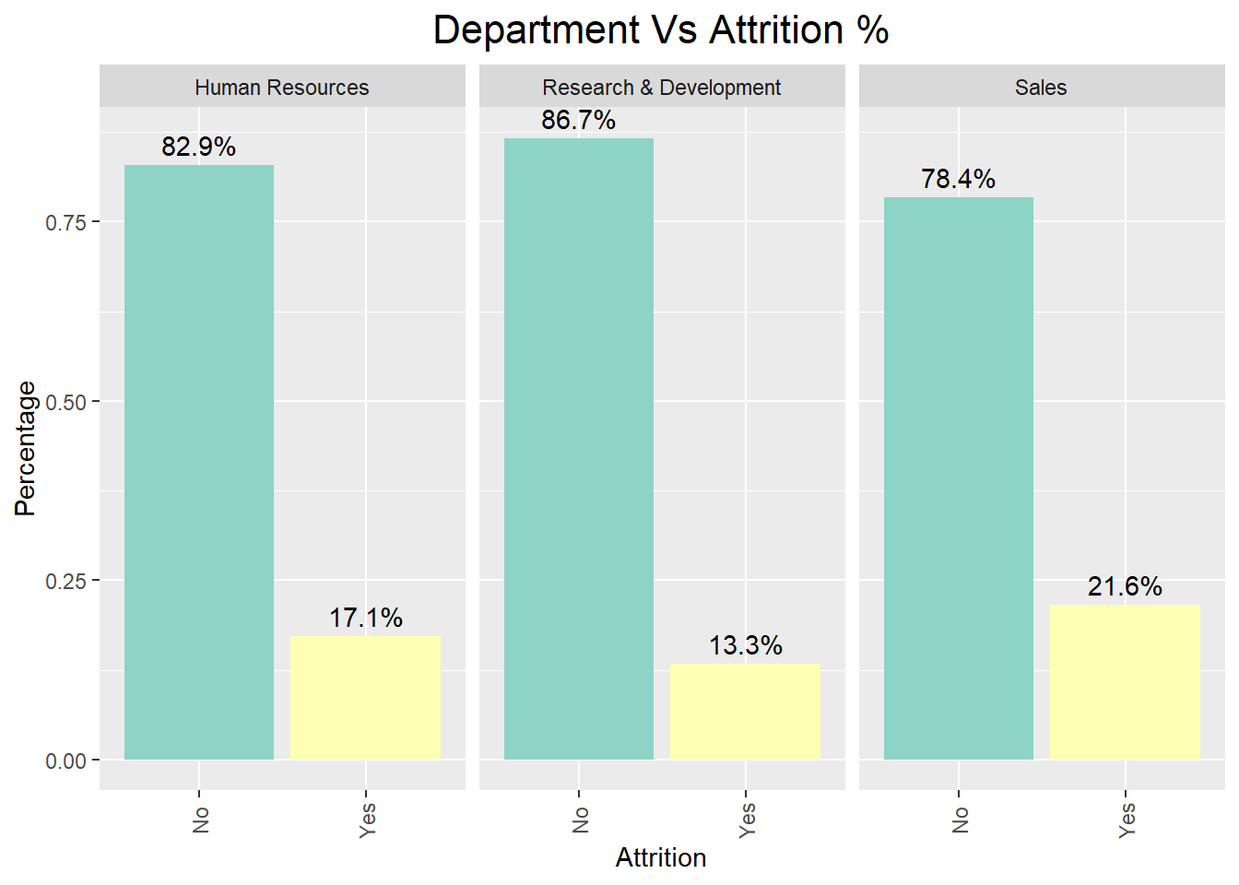
Attrition Vs Department: Percentage of people who are leaving from their departments
The amount of work and stress levels obviously depends on the department a person works in, this could be a good indicator of attrition levels.
On comparing departmentwise, we can conclude that HR has seen only a marginal high in turnover rates whereas the numbers are significant in sales department with attrition turnover rates of 42.1%.The attrition levels are not appreciable in R & D where 53.6% have recorded attrition.
Additional check for the attrition levels departmentwise: Sales has seen higher attrition levels (about 21.6%) followed by HR(17.1%).

Slide 7
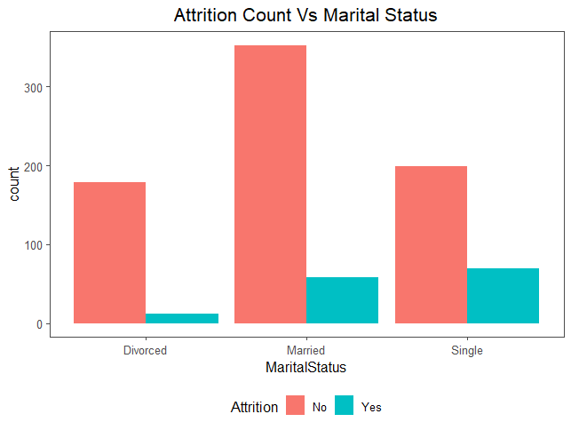
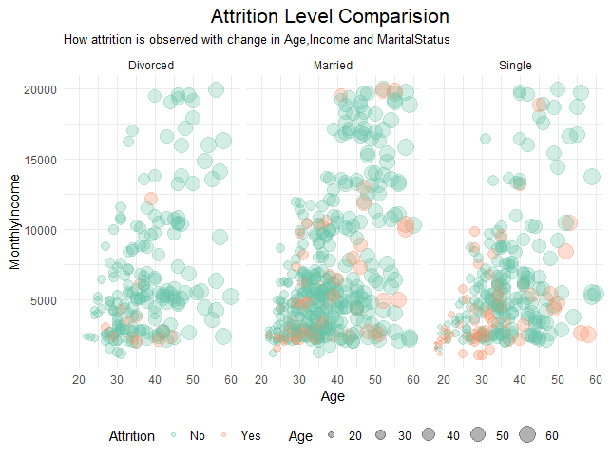
Attrition Vs Marital Status: whether there is a relationship between attrition levels and marital status?
From the plot, it is understood that irrespective of the marital status, there are large people who stay with the company and do not leave. Therefore, marital status is a weak predictor of attrition.
Attrition Vs Marital Status Vs age Vs monthly income: Including age and monthly income and then doing the analysis for the attrition employees:
The trend is linear for age and monthly income across the marital status.
It is observed that attrition is more pronounced with “single” people across the age groups.
Married people having lower salary attrit more whereas divorced people have not attrited much.

Slide 8
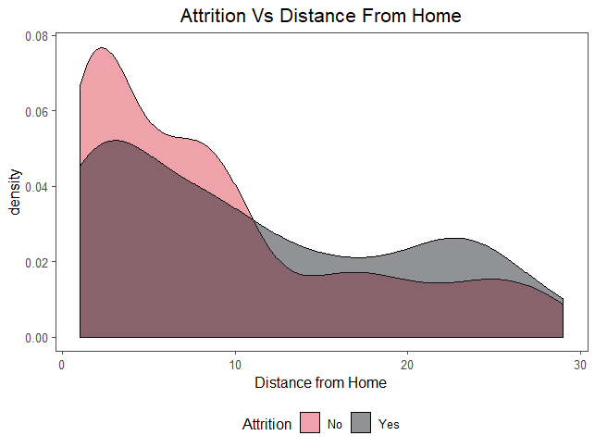
Attrition Vs Distance From Home
There is a higher number of people who reside near to offices and hence the attrition levels are lower for distance <10 .
With the increase in distance from home, the attrition curve overtakes the no attrition curve which is expected.

Slide 9
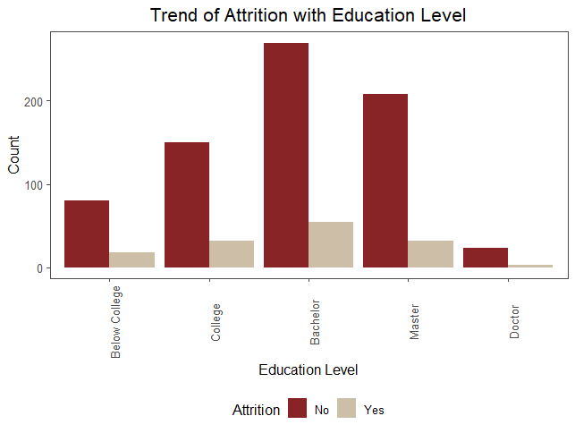
Attrition Vs Education
There are more people with a bachelors degree followed by masters degree. It is seen that the attrition levels are not pronounced across education levels, but the assumption is that people with higher education expect greater challenges to work on and if they don't find that this leads to lower satisfaction levels and consequently to attrition.

Slide 10
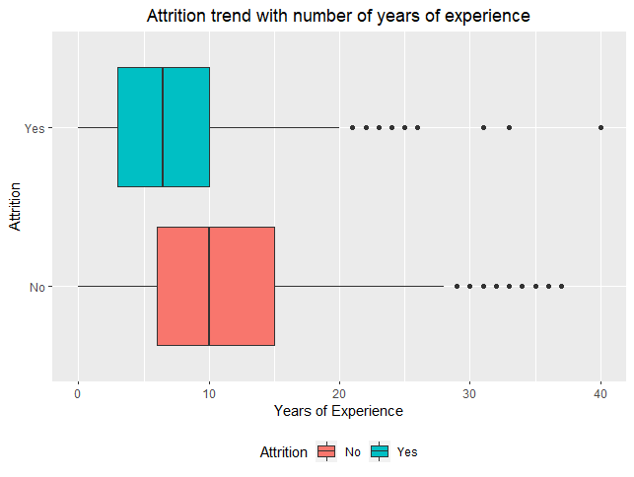
Attrition Vs Total Working Years
From the plot, it is seen that people having less than ~8 years of experience and have switched over to many companies have experienced a significant hike in the salary levels compared to those who stay in the company.

Slide 11
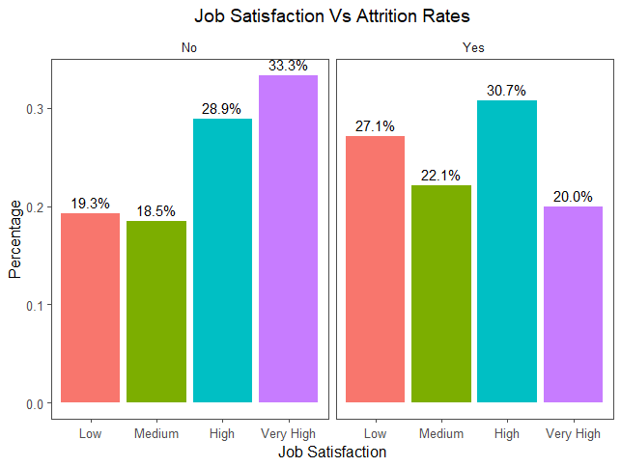
Attrition Vs Job Satisfaction
As expected, people with low satisfaction have left the company (27.1%) in large number.
What is surprising is, out of those who leave about 30.7% have experience high job satisfaction. Therefore, there should be some other factor which triggers their exit from the present company.
There is a visible trend in the category of people who do not leave whereas this is not so in the case of people who leave. The attrition group is most represented by people having high and very high job satisfaction.

Slide 12
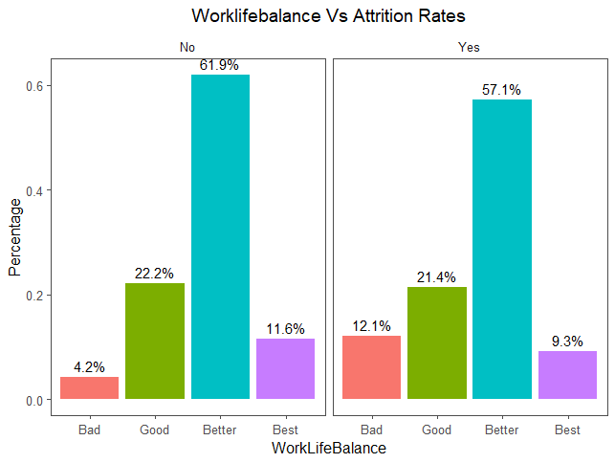
Attrition Vs Work life balance
As seen with the other categorical variables, here too we find that people having better work life balance leave the company whereas about 61.9% who have experienced better work life balance stay with the company.

Slide 13
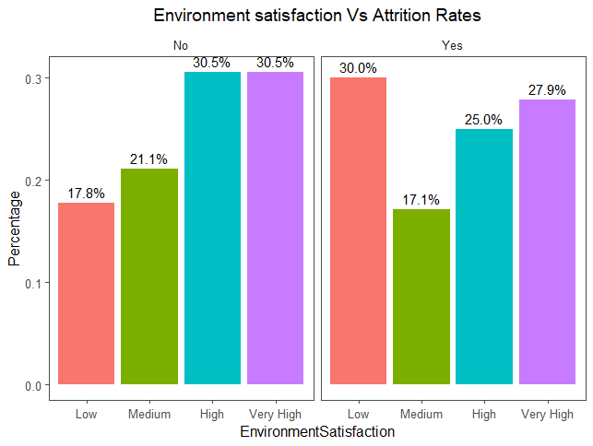
Attrition Vs Environment Satisfaction
Here we see that people having low environment satisfaction (30%) leave the company.

Slide 14
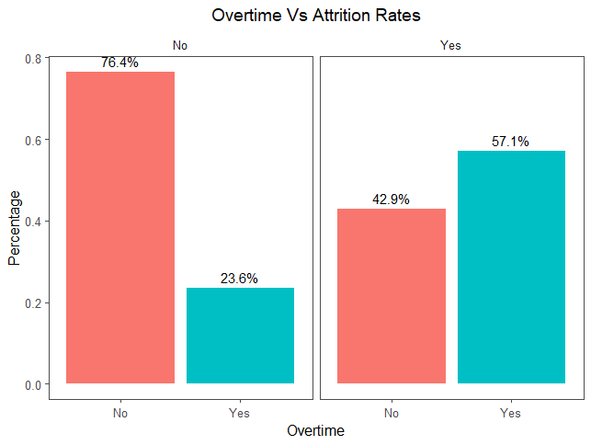
Attrition Vs OverTime
57.1% of those who experience attrition have worked overtime whereas 76.4% of those who have not experienced overtime have not left the company. Therefore overtime is a strong indicator of attrition.

Slide 15
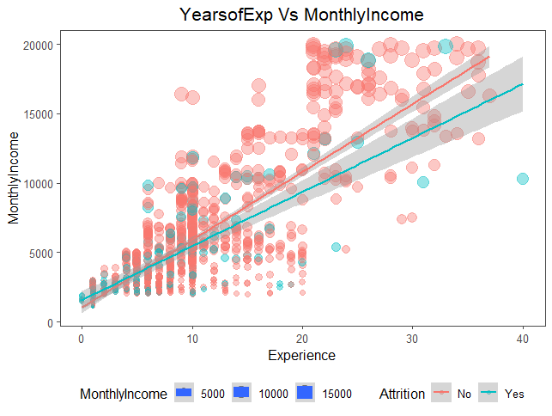
Attrition for years of experience vs monthly salary and their correlation
As expected, there exists a linear relationship between years of experience and monthly income as shown by the line.
There is a point in the graph, where the lines seems to intersect after which the no attrition line has higher monthly income compared to yes attrition line.
If a person stays in the company then how long he stays in the current role and there is a linear relation between the two predictors.

Slide 16
Feature Selection: Multicollinearity (VIF) & data preparation
Multicollinearity:-
It is the state of high correlation among independent variables. It occurs when a variable is derive from the other variable in the dataset.
It increases the variance of co-efficient estimates and make the estimates very sensitive to minor change in the model.
vif (variation inflation factor) function uses to predict the vif value. If vif value is greater than 10 then regression co-efficient are poorly estimated due to multicollinearity and if the vif value lies between 2 - 10 then it is highly correlated. I considered vif value as 2 for this dataset.
As all the variables seem to be of somewhat importance, we will keep all those predictors into the model for predicting attrition.
Data preparation:-
One-hot encoding converts it into n variables, while dummy encoding converts it into n-1 variables. If we have k categorical variables, each of which has n values. One hot encoding ends up with kn variables, while dummy encoding ends up with kn-k variables. Here for this case study dummy encoding method is preferred.
As part of data preparation, the class of variables were converted from numeric to factor, and then the categorical variables were converted to dummy variable encoding so that the variables can be used for fit in the model.

Slide 17
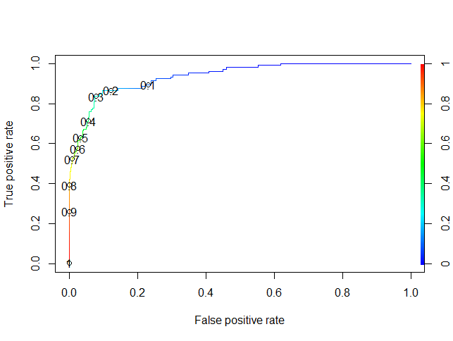
Logistic regression Model
Confusion Matrix | Attrition “No” | Attrition “Yes”
Predicted as Attrition “No” | 211 | 14
Predicted as Attrition “Yes” | 14 | 22
Metric | Value
Accuracy | 89.27%
Sensitivity | 93.78%
Specificity | 61.11%
Based on the Logistic Regression model, the variable which majorly affect the attrition are:-
Highly Significant: DistanceFromHome, EnvironmentSatisfaction (Low), JobInvolvement (High/Moderate), NumCompaniesWorked, OverTime (Yes), RelationshipSatisfaction (Low), WorkLifeBalance (Low), YearsWithCurrManager
Significant: Age, BusinessTravel (Frequently), JobSatisfaction (Low)
Moderately Significant: Education (Higher Education), MaritalStatus (Single), YearsSinceLastPromotion (High), StockOptionLevel(Less)
To conclude for the Logistic Regression model, the variable (or factors) which majorly affect the attrition (or turnover) are:
OverTime (Yes)
Business Travel
Environment Satisfaction (Low)
Job Involvement (High/Moderate)
Number of Companies Worked
Accuracy: Number of correctly classified observations/total
Sensitivity: Number of correctly identified successes/true number of successes
Specificity: Number of correctly identified failures/true number of failures
Relationship Satisfaction (Low)
Work Life Balance (Low)
Years With Current Manager
Stock Option Level(Low)

Slide 18
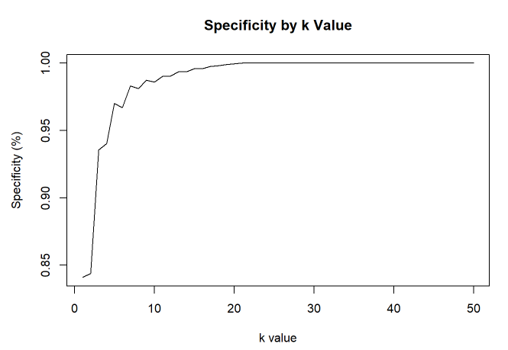
K-NN Model with cross validation after hyper parameter tuning
Confusion Matrix (for k=2) | Attrition “No” | Attrition “Yes”
Predicted as Attrition “No” | 181 | 38
Predicted as Attrition “Yes” | 34 | 8
Metric | Value
Accuracy | 72.41%
Sensitivity | 84.19%
Specificity | 17.39%
Conclusions from the k-NN model, which is using hyperparameter tuning and cross validation:-
With hyper parameter tuning it was found that with k=21 the mean specificity is 98.78% and mean accuracy is 84%.
It was observed as we increase the value of k, the model specificity goes to 0%, and this is obvious of the fact as the dataset is imbalanced and it will bias the prediction model towards the more common class (here is ‘NO’). From this k-NN model, there is also not much conclusive variable importance which majorly affects the attrition.
The model was tested for k=2, for optimal k-NN model metric results especially to have decent specificity.
Accuracy: Number of correctly classified observations/total
Sensitivity: Number of correctly identified successes/true number of successes
Specificity: Number of correctly identified failures/true number of failures

Slide 19
K-NN Model Leave One Out k-NN or Internal CV k-NN
Confusion Matrix (Leave One Out) | Attrition “No” | Attrition “Yes”
Predicted as Attrition “No” | 605 | 116
Predicted as Attrition “Yes” | 125 | 24
Metric | Value
Accuracy | 72.3%
Sensitivity | 82.88%
Specificity | 17.14%
Conclusions from the k-NN model, which is using leave one out method:-
For the leave one out k-NN model the specificity still remains low to 17.14%, and this is obvious of the fact as the dataset is imbalanced and it will bias the prediction model towards the more common class (here is ‘NO’).
Again, from leave one out k-NN model, there is also not much conclusive variable importance which majorly affects the attrition.
Accuracy: Number of correctly classified observations/total
Sensitivity: Number of correctly identified successes/true number of successes
Specificity: Number of correctly identified failures/true number of failures

Slide 20
Competition dataset for Classifying attrition
Classifying Attrition for the “Competition Set” from the “CaseStudy2CompSet No Attrition.csv” file:-
Logistic Regression model was chosen to classify attrition as it was found to have the best model statistical metrics as below, and it attained more than 60% sensitivity and specificity (60 each = 120 total) for the training and the validation set.
Metric | Value
Accuracy | 89.27%
Sensitivity | 93.78%
Specificity | 61.11%

Slide 21
Competition dataset for Predicting monthly income
Predicting Monthly income for the “Competition Set” from the “CaseStudy2CompSet No Salary.csv” file:-
Linear Regression model was chosen to predict monthly income for the attrition dataset.
The regression model had RMSE (Root Mean square error) of 1095.578 and it attained RMSE < $3000 for the training and the validation set.
Following variables were found to be significant in predicting the monthly income from the linear regression model:-
Total Working Years
Job Level
Job Role
Business Travel (Rarely)
Education (High)

Slide 22

Conclusion
Job roles most likely to leave
Sales Reps
Human Resources
Lab Techs
Top three factors leading to turnover
Years in Workforce
Monthly Income
Marital status

