Slide 1


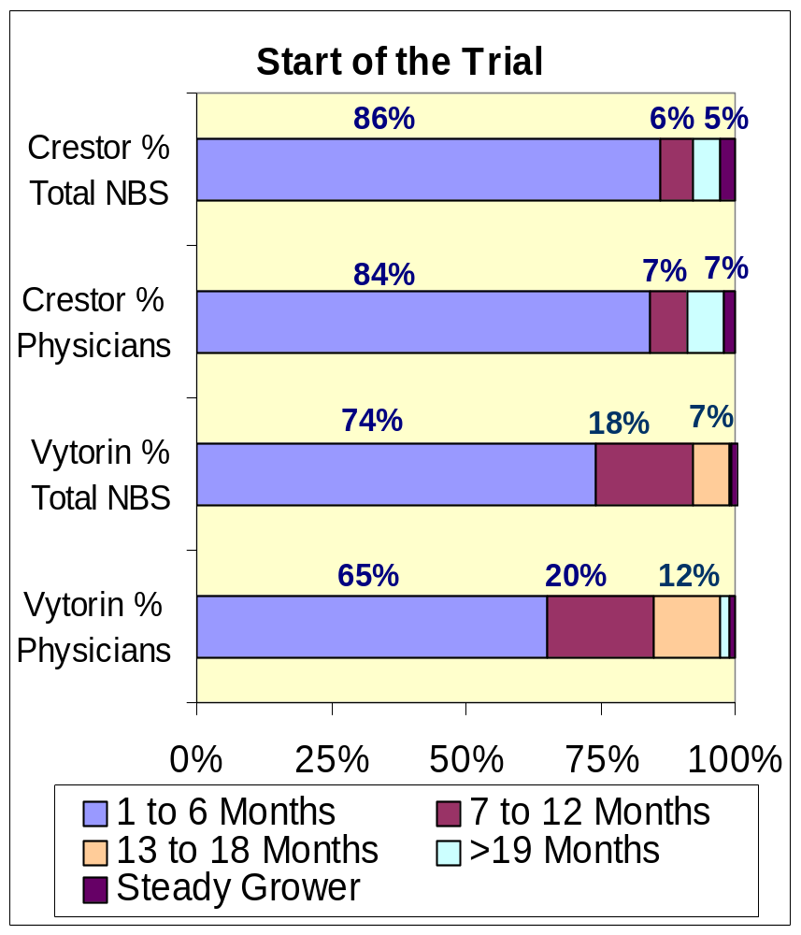
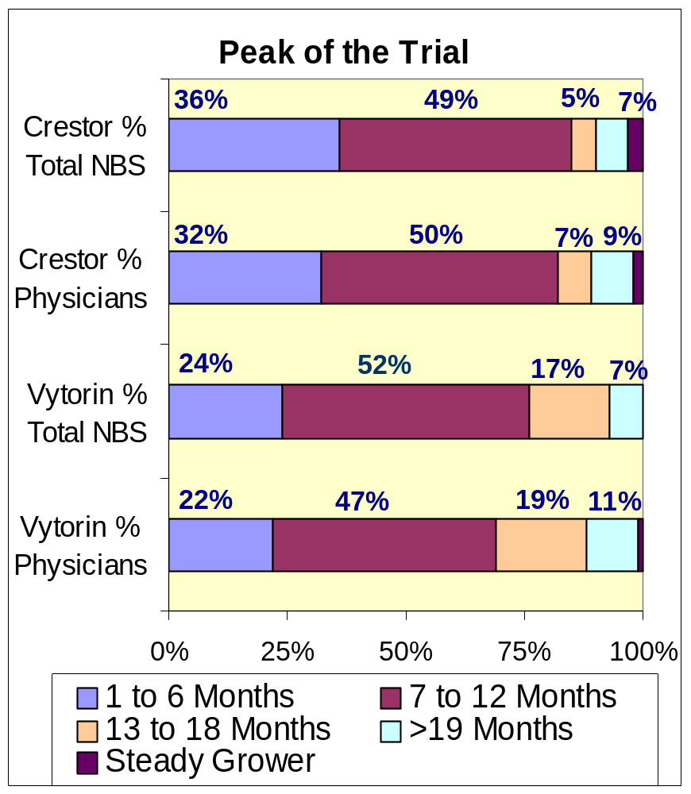
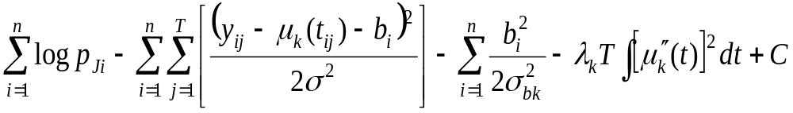
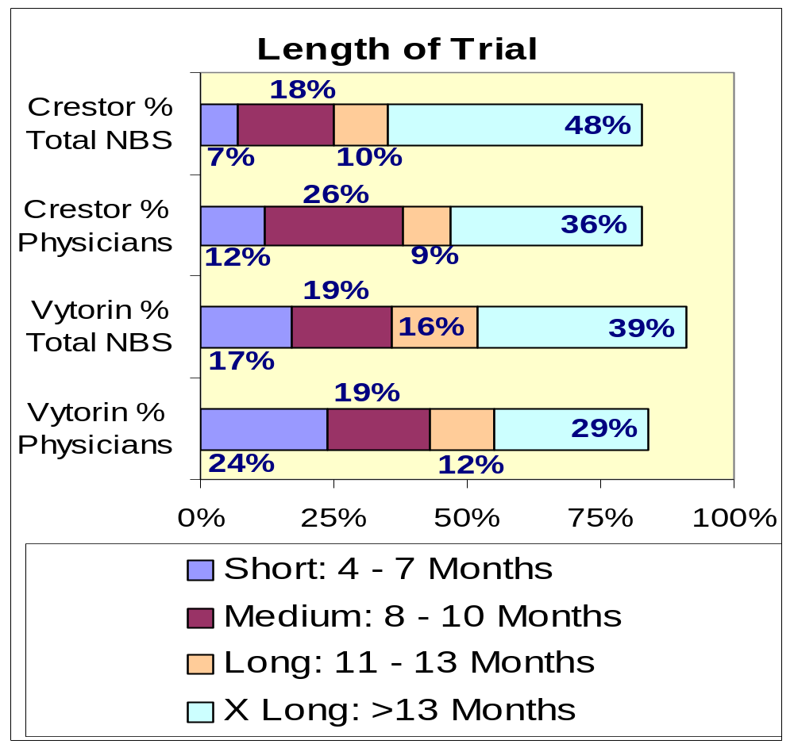
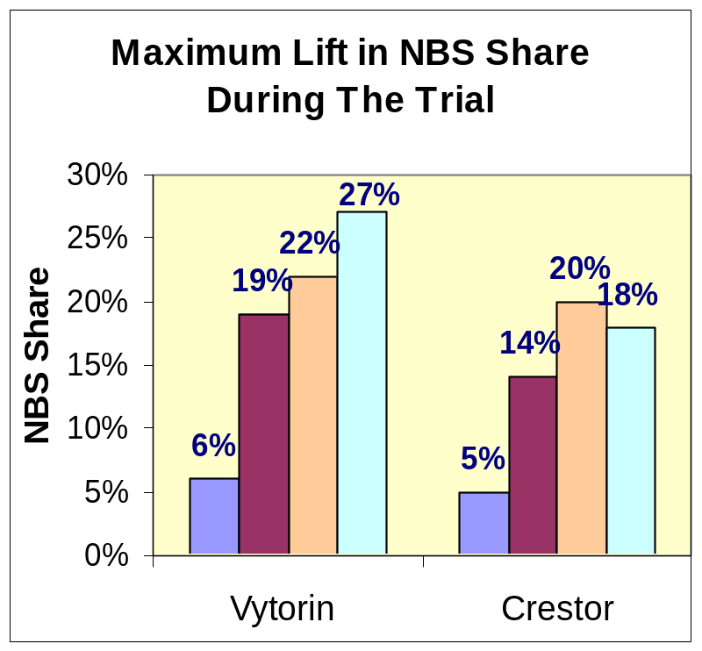
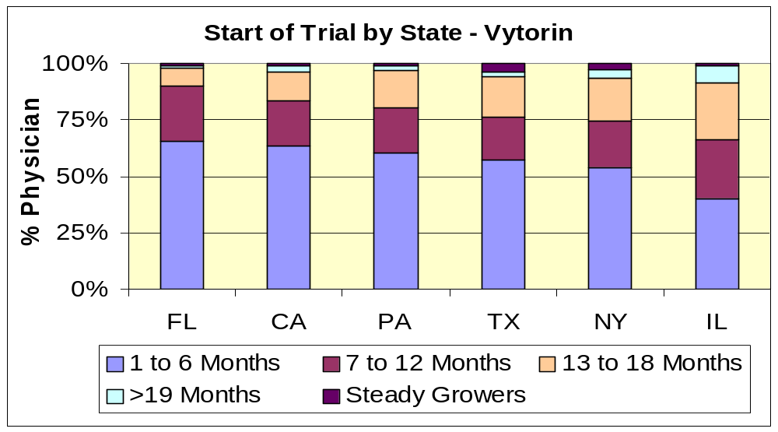
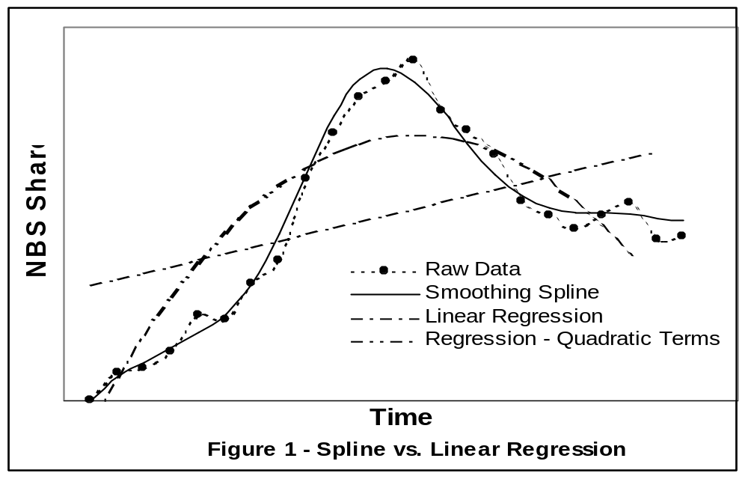
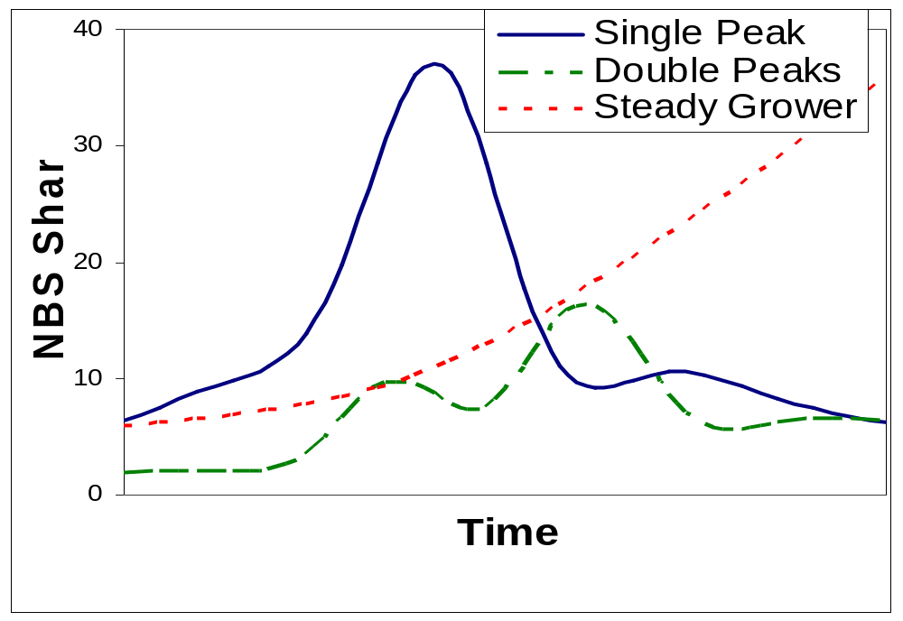
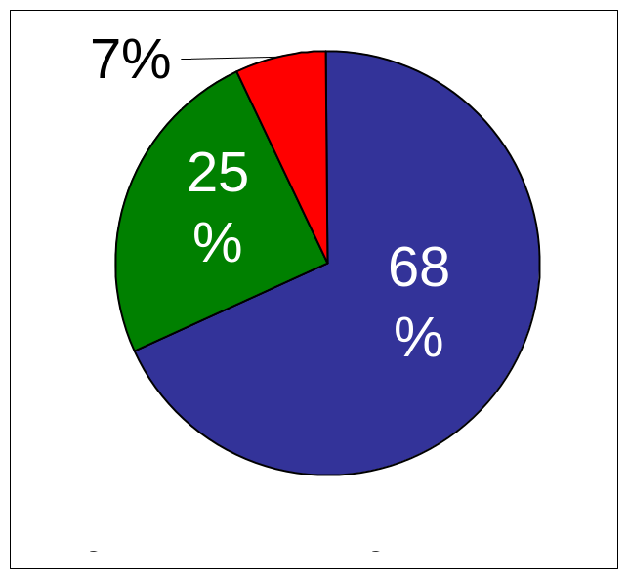
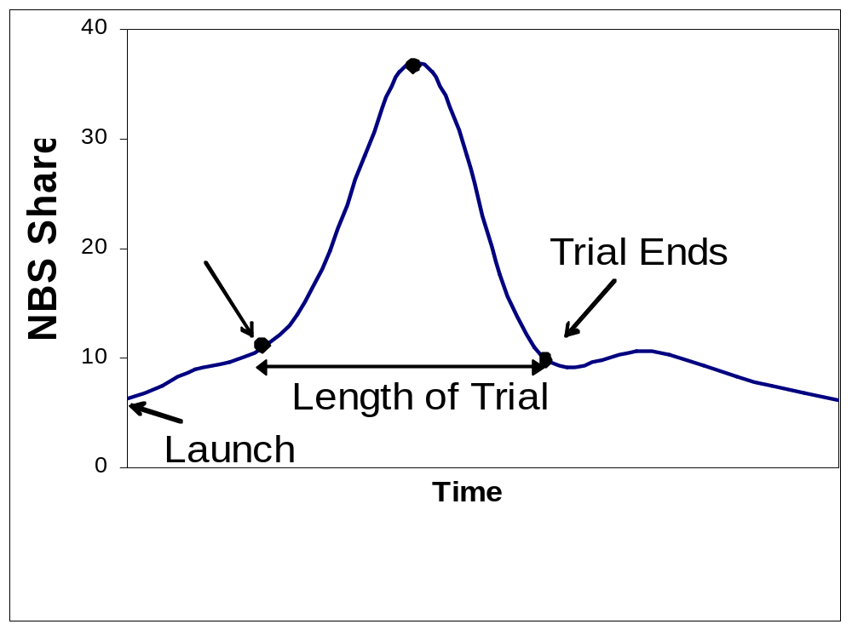
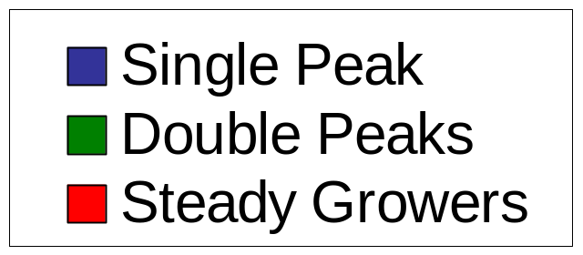
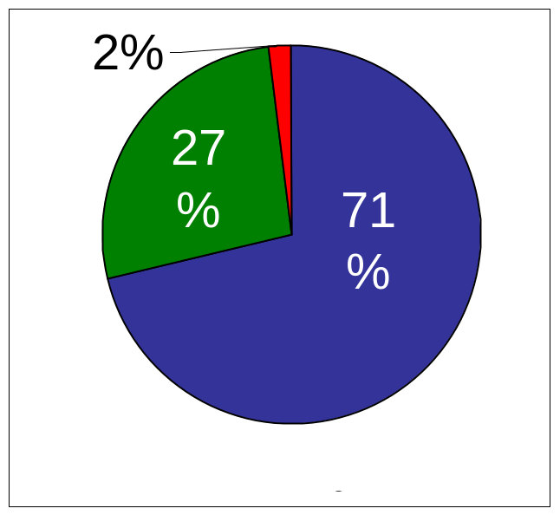
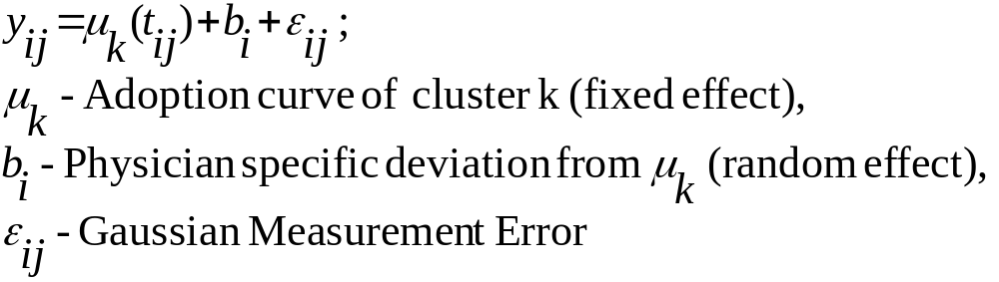
Uncovering Physicians’ Adoption Patterns of New Products
Senthil Murugan and Mark Rose
Dendrite International Inc.
Aim
To identify, understand and analyse various patterns in physician adoption curves.
Benefits
  Identification of key patterns in adoption of new products.
  Aids in customizing promotional strategies during product launch.
  Aids in selecting relevant targets over time and to manage sales resources optimally.
Model Specification (cont’d)
  Given K total clusters, cluster membership of physician ‘i’ is identified using mixture Gaussian distribution given below. That is, physician ‘i’ has probability pk to belong to cluster ‘k’ a priori.
  Model parameters are estimated by maximizing the penalized likelihood given below using a variation of Expectation Maximization (EM) algorithm [1].
  Final number of clusters is chosen using Bayesian Information Criteria (BIC) scores and the R² value distribution across the clusters.
Results – Trial Characteristics
Close to 85% - 90% of physicians start the trial within 1 year of product launch generating more than 90% of total product NBS in 2 years. Around 80% physicians reach the peak in 1 year.
The Longer the trial period, the higher the lift in NBS share during the trial.
Physicians in Florida and California adopted Vytorin sooner than those in Illinois.
Data Source, Products and Metrics
  Used Verispan’s Longitudinal Prescription Data (LPD).
  Adoption of Vytorin and Crestor, key products in cholesterol market, were analysed during the first 2 – 3 years of launch.
  A 3-month moving New Brand Start market share was used as the dependent variable to reflect the physician adoption pattern.
Results
Top prescribers generating 50% of total market NBS were analysed. About 30% of these physicians were dropped due to high noise or low NBS shares. There are 36 adoption segments (clusters) for Vytorin and 42 for Crestor.
Key Adoption Patterns
  There are three archetypal patterns - Single Peak, Double Peaks and Steady Grower [Fig. 2a].
  Almost all the physicians conduct brief “trials” with a large number of their patients after the product launch. This results in bell shaped peaks in NBS share [Fig. 2b]. While most conduct one trial (single peak), some conduct two trials (double peaks).
  The start period of the trials, peak share and length of trials are unique in each cluster. The peak mostly occurs around middle of the trial.
  Importantly, there is no definite relationship between volume deciles and trial start or length of trial(s). That is, decile 6 physicians are as likely as decile 10 physicians to adopt early.
Methodology
  A data driven mixed effect smoothing spline model based clustering (SSC) approach [1] is used to simultaneously:
    Cluster the physicians according to similarity in their adoption curves, and
    Build Predictive model for each cluster using smoothing spline regression approach.
  Smoothing spline regression models complex non-linear curves without prior specification (Fig.1)
Model Specification
  Given physician ‘i’ is in cluster ‘k’, the observed NBS share (yij) at time tij is specified as:
Conclusion
  Using a data driven mixed effect smoothing spline model based clustering approach, three key patterns in physician adoption are observed: single peak, double peaks and steady growers.
  Most physicians conduct brief “trials” before adoption. Promotional strategies should aim to increase the length of the trials of each physician to increase overall market share.
References
1. Ping Ma et.al., “ A data driven clustering method for time course gene expression data” Nucleic Acids Research, 2006, Vol.34, No.4 1261-1269.
Contact
Senthil Murugan – 908-443-3554
Mark Rose – 919-549-0270 x 4863

