Slide 1
Modeling response of multi-channel promotions: new methodologies for a new era
Mark Rose, Senthil Murugan, Ramesh Krishnan
PMSA 2008, April 27-30, Las Vegas, NV

Slide 2
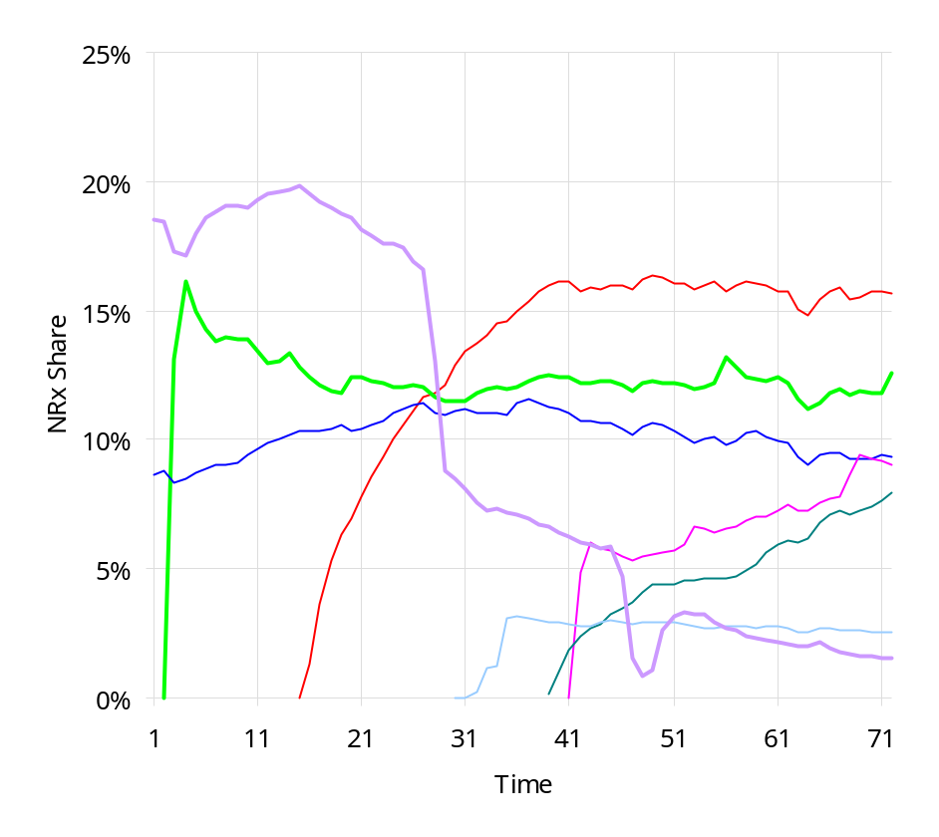
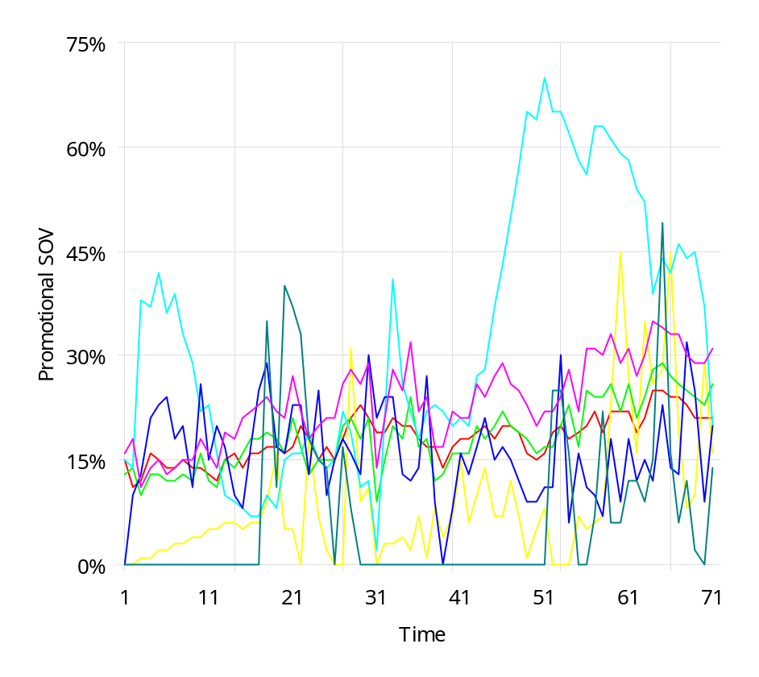
The market for product X is very crowded and competitive
The market characteristics leads to a lot of noise as well as capacity and access constraints.

Slide 3
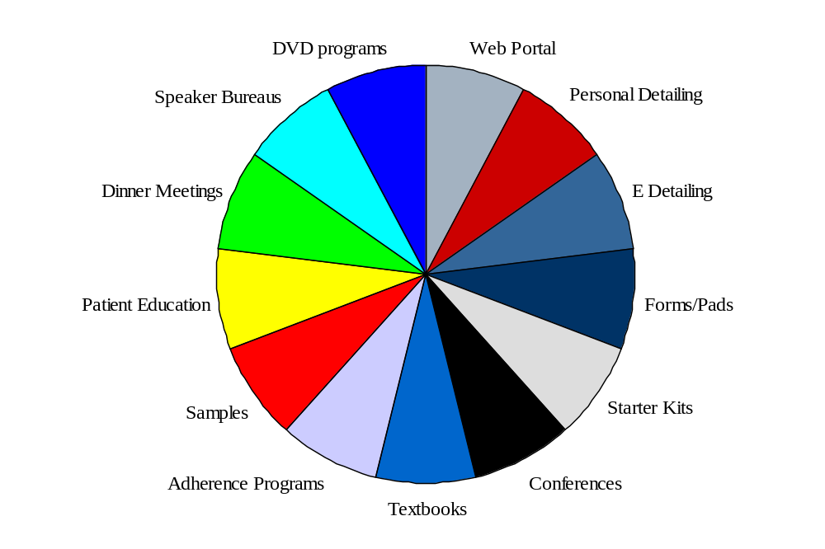
Accordingly, promotions in this market take on a variety of forms…

Slide 4
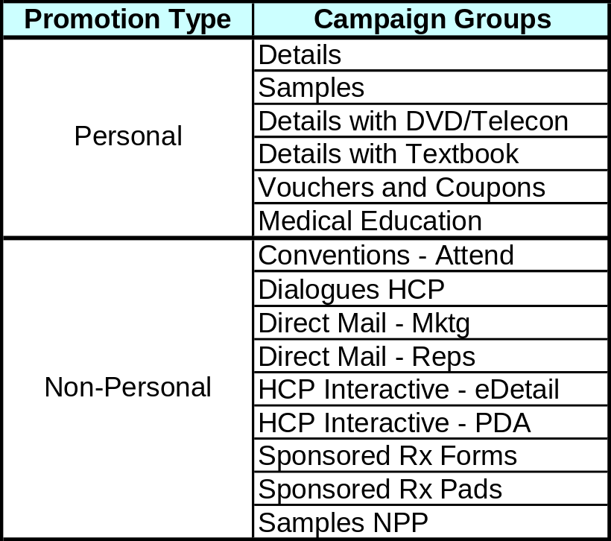
….that warrant several levels of aggregation.
Details with DVD
DVD Clinical
DVD CBT
DVD Drug Interactions
DVD Making the Diagnosis
DVD Nature
DVD NAV LIT-EBM
DVD Non-Adherance
DVD SM
Campaign groups were determined based on similarity of tactics and maximum possible physician counts

Slide 5
As always, but especially now, we wish to improve promotion effectiveness
Market and market share is mostly flat, and pipeline considerations mandate ever increasing returns on promotion investment.
More challenging reimbursement environment restrict patient choices.
So….
We decided to….
Forward looking rather than historic assessment of promotional investments.
Sharper focus on what promotions work, (why they work), and how they interact with one another.

Slide 6
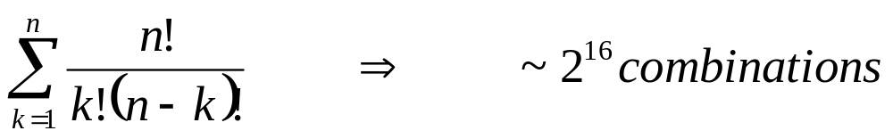
The effectiveness of a promotion tends to be correlated with that of other promotions
The more the promotions looked at, the greater this problem gets
Larger models (encompassing more promotions) tend to be more sensitive to specification errors
Interactions (essential here) add another layer of complexity
  Interaction terms increase exponentially in inputs
  Combinatorial expansions result in very sparse data

Slide 7
We looked at a number of approaches to address the above problem
Primary market research is quite flexible, but difficult to relate back to financial results
“Kitchen sink” regressions with linear and linearizable models are easy enough to run, but suffer from the curse of dimensionality, and lack of interpretability
Automated approaches, such as machine learning, or GAs are essentially more sophisticated versions of the above, and subject to (at least) the interpretability problem
These and other approaches were not practical enough for our needs

Slide 8
The magnitude and complexity of the data warranted a “human” look at the problem…
Investigate input distributions to assess feasibility of being able to estimate various coefficients
Intelligently group like tactics using tactic structure along with covariance structure
  This allows for a more simple model structure, where we estimate only those effects that are, in some sense, unique
  The simple structure also aids in model interpretability
  Modeling lag structures is also simplified by this structure (and underlying assumptions!)

Slide 9
…which led us to the path below
Linear Regression
Mizik and Jacobson Model *
Ridge Regression
Nonlinear Regressions
Simulations
* Natalie Mizik and Robert Jacobson, “Are Physicians “Easy Marks”? Quantifying the effects of Detailing and Sampling on New Prescriptions”, Management Science, Vol 50. No. 12, December 2004, pp.1704-1715

Slide 10
Models described…
NRx volume was chosen as response variable because:
  Adequate variation (more than NRx shares)
  More promotion-sensitive than TRxs
  Promotion response easily “dollarized”
Explain variation in Brand NRxs per Physician in terms of
  Promotion variables (including saturations and interactions)
  Competitive NRxs
  Time trend (accounts for impact of unique events/month)
  Sustained prescribing (lagged NRxs)
Separate models for Specialty/Segment

Slide 11
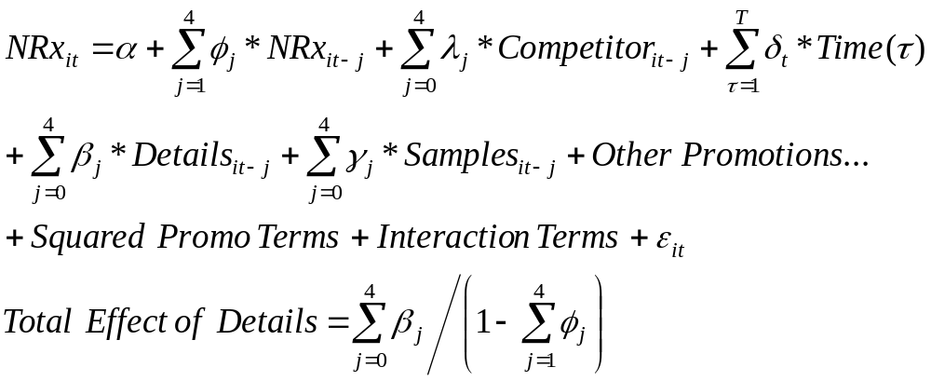
Linear Regression
Direct Effect
Issues:
Details and Samples were moderately correlated
High correlation among most lagged variables
Estimates were biased and many not significant

Slide 12
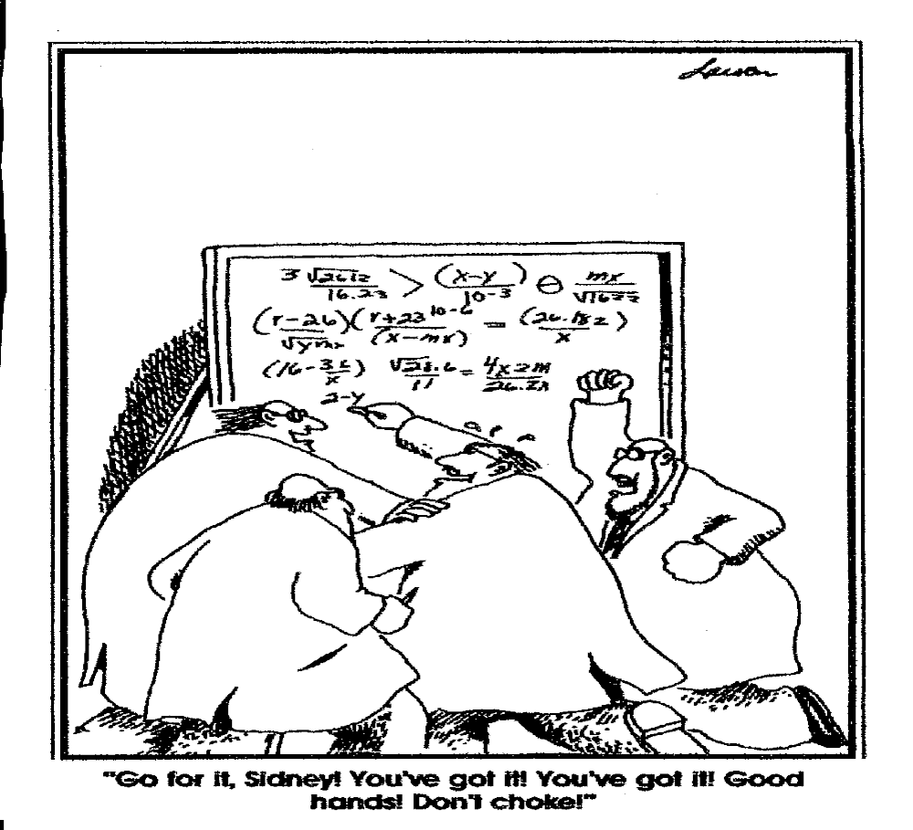

Slide 13
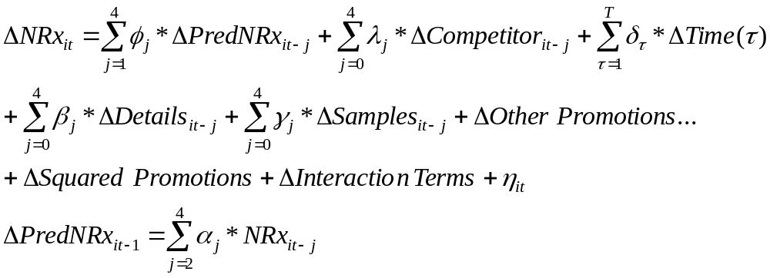
Mizik/Jacobson Model – State of the Art
Instrumental variable equation
Physician specific constants introduced to account for random variations with respect to each physician
Issues:
Carryover (lagged NRx variables) estimate was lower than in original Mizik due to weak Instrumental variables (not significant)
Promising model structure, but many promotions had sparse data

Slide 14
Ridge Regression
A “compromise” solution
Multi-collinearity reduced with ridge constant
  Constant k= 0.5 to 0.7 yielded stable estimates within this range
Confidence intervals were evaluated using a bootstrapping method because of (some) correlation among lagged variables
  Most parameter estimates were significant at the 90% level
Issues:
Ridge estimates are biased, but large number of observations helped to yield more robust estimates

Slide 15
Bootstrapping Method for Confidence Intervals
Simulated 500 new datasets using random sampling with replacement
Built ridge regression models on the bootstrapped data and stored the parameter estimates
  For individual and total effects
Using resulting distribution of parameter estimates, their confidence intervals (CI) were computed

Slide 16
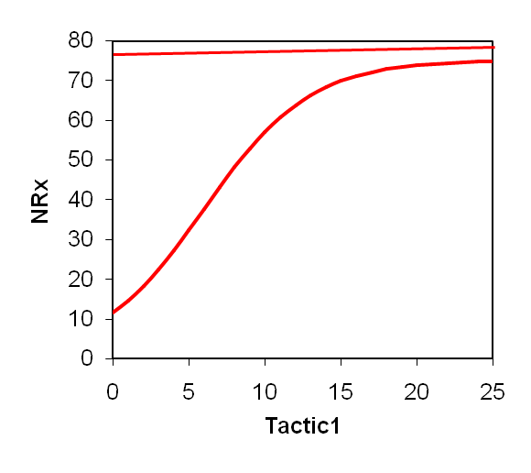
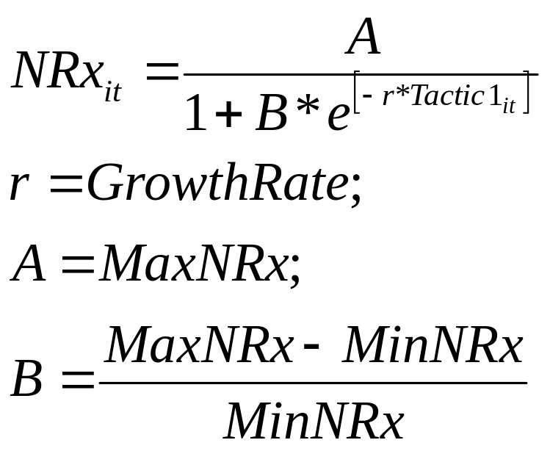
Testing for Saturation of Promotion
Included squared terms for select promotions
  b₁*Tactic1 + b₂*Tactic1²
Through calibration with logistic growth curves

Slide 17
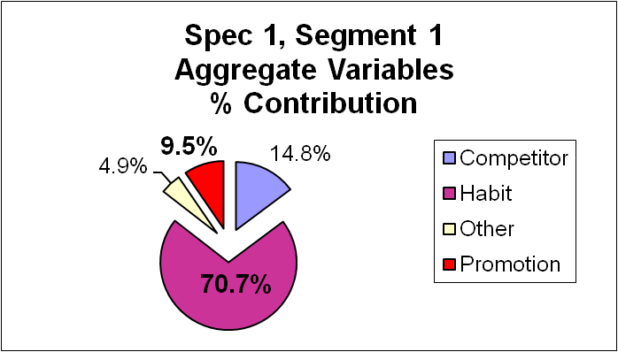
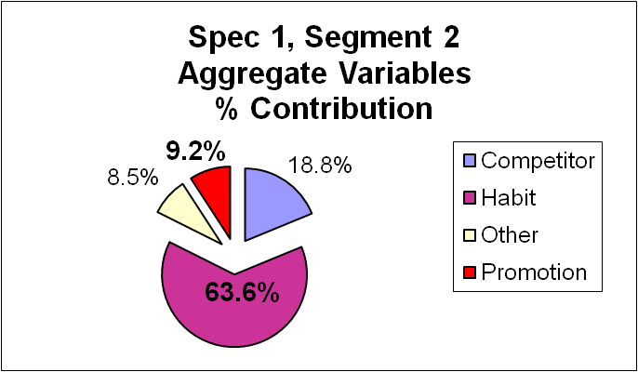
Promotion Impact is small, but detectable
Prescribing Habit (lagged NRxs) accounted for 60-70% of variation in NRxs – longer term trend
Promotion Impact accounted for ~10% of variation in NRxs…smaller, but statistically significant (p=0.05)

Slide 18
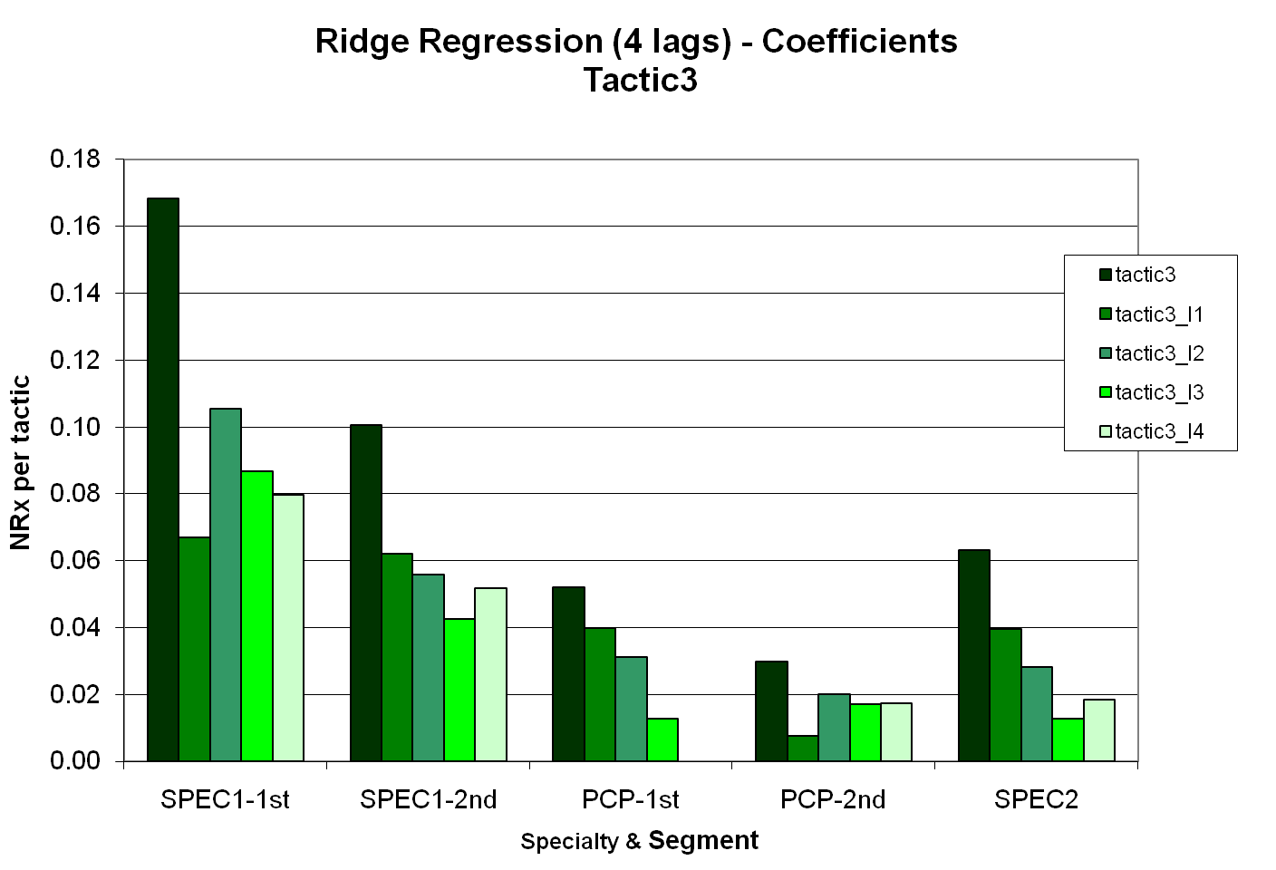
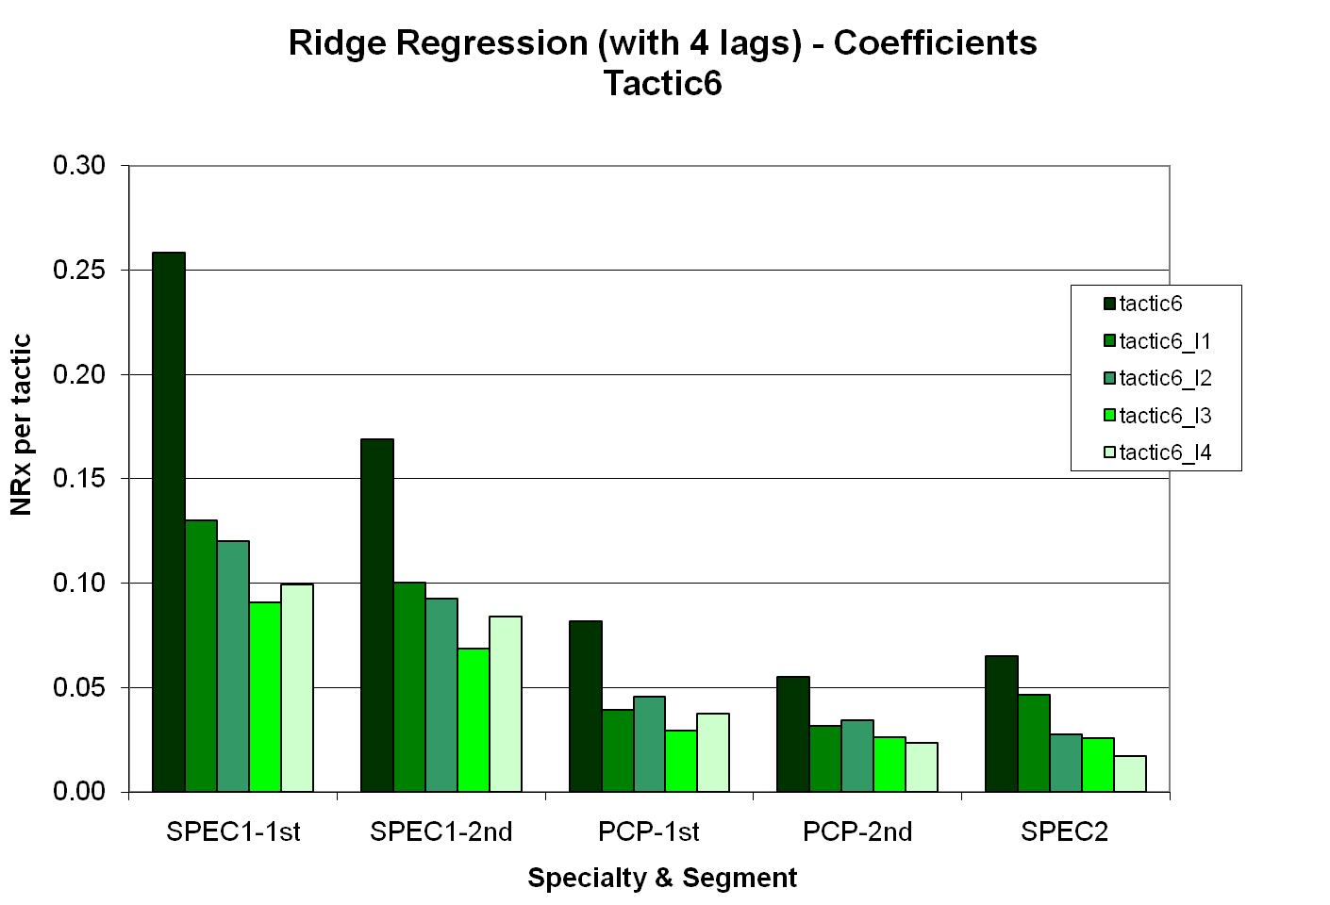
Promotional impact showed a decaying effect
Specialists have more impact than PCPs
Lags decay in similar pattern across specialty and segment

Slide 19
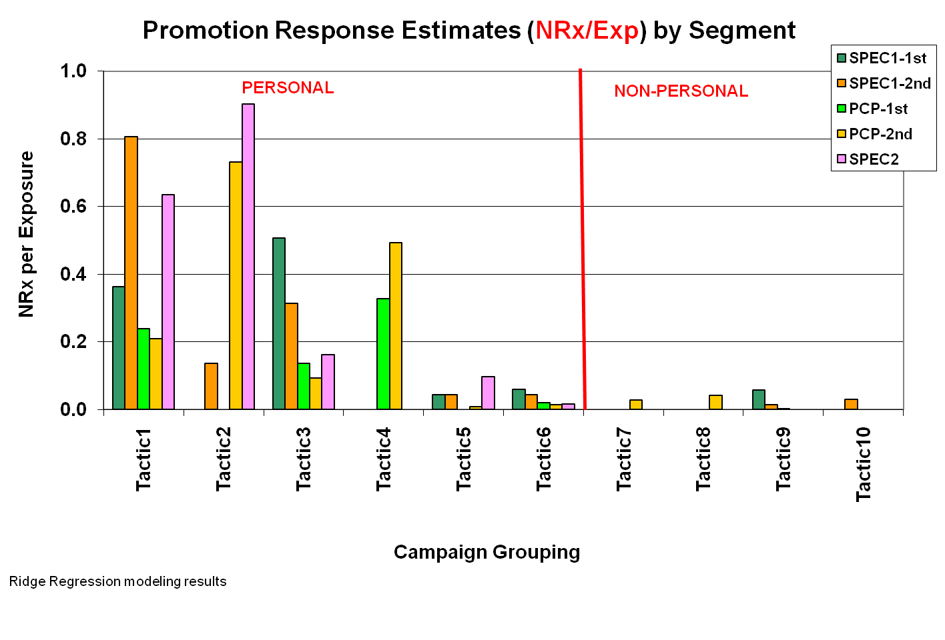
Personal promo was more notable per unit
Estimates = sum of current and lagged response coefficients
Impact varies by tactic and by specialty/segment

Slide 20
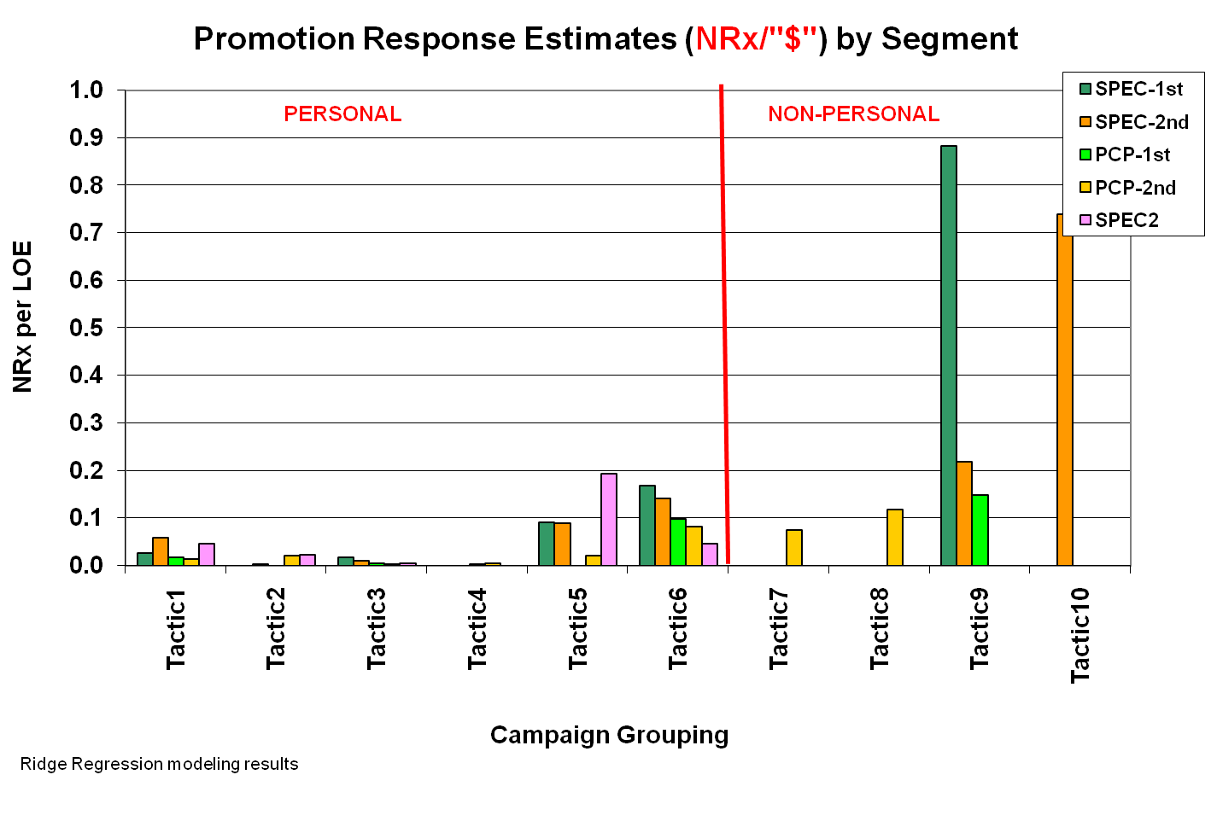
Select Non-Personal was more efficient per “$”
“$” = based on pseudo-dollarized costs
Distribution/Access costs are much lower for Non-Personal

Slide 21
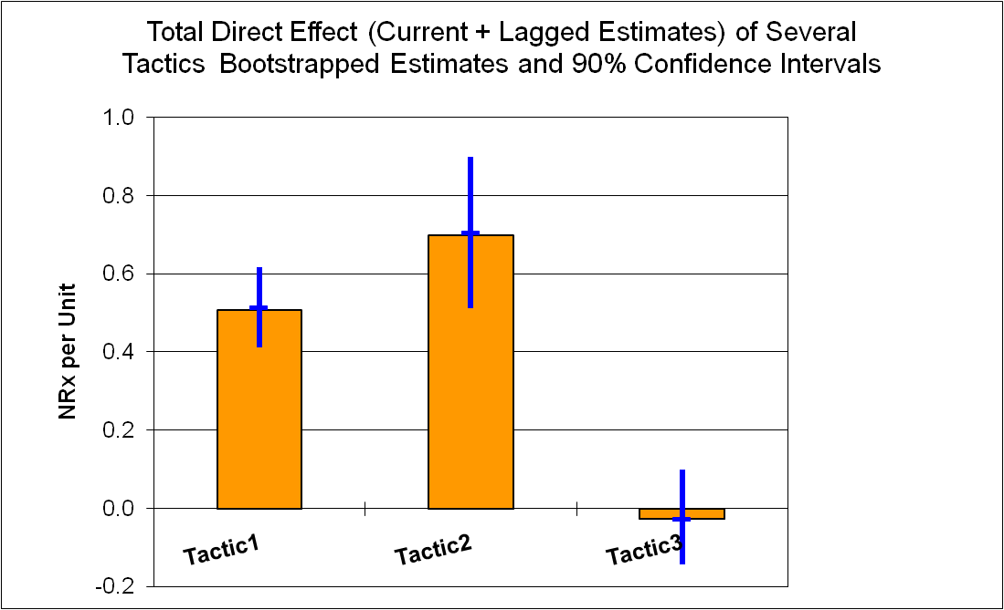
Bootstrapping of Confidence Intervals
Confidence intervals obtained by bootstrapping were wider than the CI obtained using ridge regression models on the original data

Slide 22
Promotion Saturation and Interaction: not observed
Saturation:
  by including squared as well as linear terms for select promotions
    a small positive but significant estimate, i.e., increasing returns, suggesting no saturation at the current promotion levels
  by modeling a logistic curve of NRx vs. Detailing
    saturations occurred only when current exposures were increased significantly (at 5-6 times current levels)
Interaction:
  Detailing + select other promotions
  The estimates were very, very small (1/100th of the direct effect)

Slide 23
Conclusions
  How should a brand manager use a model?
    Academic exercise (on the bookshelf)
    Weathervane (re-allocate directionally)
    Hammer (as a pronouncement of an oracle)
It depends on your point of view!!!
“A model is a stone in the shoe for better data!”
(Professor John Little, M.I.T., “Models and Managers, The Concept of a Decision Calculus”, Management Science, April 1970)

Slide 24
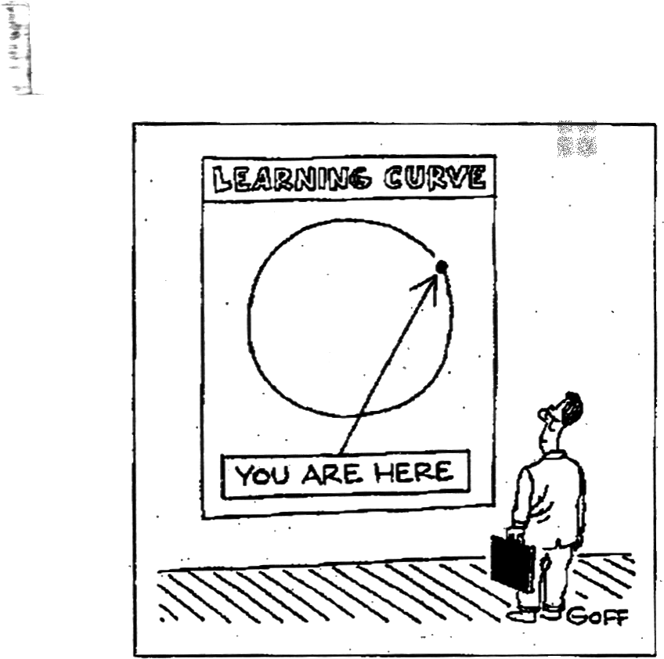
1980s – sparse Personal data
2008 – sparse Non-Personal data

Slide 25

PMSA 2008 Conference

Slide 26
Mark Rose
Manager, Pharmetrika LLC (formerly
Principal Scientist, Cegedim Dendrite)

Slide 27
Senthil Murugan
Senior Scientist, Cegedim Dendrite

Slide 28
Ramesh Krishnan, Ph.D.
Director , Marketing Science, Wyeth Labs

