Slide 1

Omnichannel Strategy & Execution - Launch Tumor
Part 1: Customer Relationship Strategy
Senthil Murugan

Slide 2
Part 1: Customer Relationship Strategy
Identify adoption patterns of targeted customers for new Tumor launch
Determine reach and frequency cadence
Covered Later
Part 2: Omnichannel Framework
Part3: Omnichannel Execution Plan

Slide 3
New Product Adoption patterns of Customers
Three distinct patterns of customer adoptions:
Single Peak (blue line): Majority of customers (68%) start their own trial of launch brand and continues this trial with more patients for some time then winds down and settles on a steady state.
Double peak (green line): About 25% of customers conduct two trials with new brand before their steady state.
Steady Growers (red line): Small number of customers (7%) steadily adapt the product over a long period of time.
Reference: “Uncovering Physician’s Adoption Patterns of New Products” PMSA 2007; Senthil Murugan and Mark Rose

Slide 4
Adoption Segments and Reach out Plan: New Launch Tumor with 10K Targets
10K targeted HCPs of a launch tumor are segmented per their historical trial patterns.
During (and closer to) trial periods a large amount of HCP support is provided through Omnichannel approach. – say, twice a week touchpoints
Up to few months before trial starts and during steady states the promotions are maintained at a low base level – say, twice a month touchpoints.
Such an approach allows us to focus on limited number of customers according to their trial pattern. This saves resources for Merck and minimizes customer contacts when not needed.

Slide 5
Adoption Segments and Cadence of Reach – Two Year Plan
Chart above shows two-year customer reach plan after tumor launch for each customer segment.

Slide 6
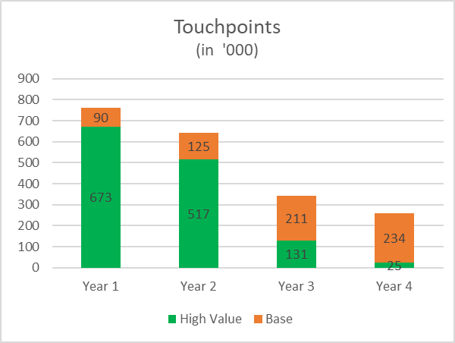
Adoption Segments and Cadence of Reach – Longer term view
Customers are considered as high value targets (Green) during their trial period and receive higher level of promotions and support.
At other times they receive base level of promotions ( Orange)
In Year 1 of launch there are more high value targets with more touch points. This gradually reduces to a low level by Year 4.
Volume and Frequency of customer contacts also reduces dynamically over time – saves resources and improves customer support.

Slide 7
Next Steps…
Develop Omnichannel Framework to reach customers during and outside their trial periods. (Part 2: Omnichannel Framework)
Develop granular channel / content Omnichannel execution plan (Part 3: Omnichannel Execution Plan)
A collaborative agile approach with multiple teams

