Slide 1
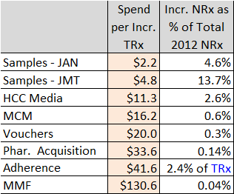
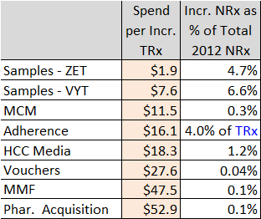
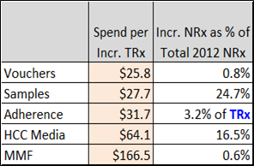
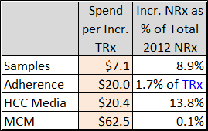
Promotion Type Impacts
Januvia / Janumet
Zetia, Vytorin (NO Liptruzet)
Dulera
Nasonex
(1) Samples are requested and received by prescribers for use by and benefit of patients. Samples provide the opportunity to gain experience with a product. The sample-related values shown here reflect the association between samples and new patient starts rescaled into TRx terms for comparability to other investment types; this applies to vouchers as well, which are treated as an alternative mechanism to provide samples to patients. (vs. samples left by Field personnel).

