Slide 1
Diabetes Investment Analysis:
Allocation Scenarios
Promotion Response Analytics
Commercial Analytics & Decision Sciences
April 2013

Slide 2
Objectives
Analysis Objective: For the diabetes product family, leverage advanced analysis to recommend a more optimal investment mix across promotion types to maximize incremental revenue.
  Use competitive insights, historical brand investments and performance, and promotion response curves by promotion type to create optimization scenarios.
Today’s Agenda:
  Introduce the overall optimization approach/process, key inputs to the process, and results of draft optimization scenarios run to-date.
  Solicit input from Marketing team to position Commercial Analytics to be able to refine the optimization process and scenarios based on expert input.
  This is meant to begin an ongoing conversation that may need to be continued over the next couple of weeks. There may be some iteration and deeper discussion needed.
  After any required iteration, the next step is to share results and recommendations with Rick Hartz and Graeme Bell.

Slide 3
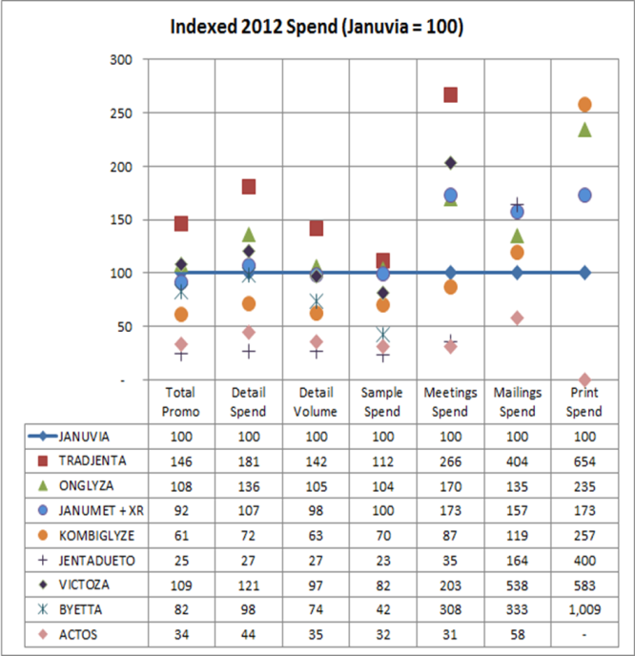
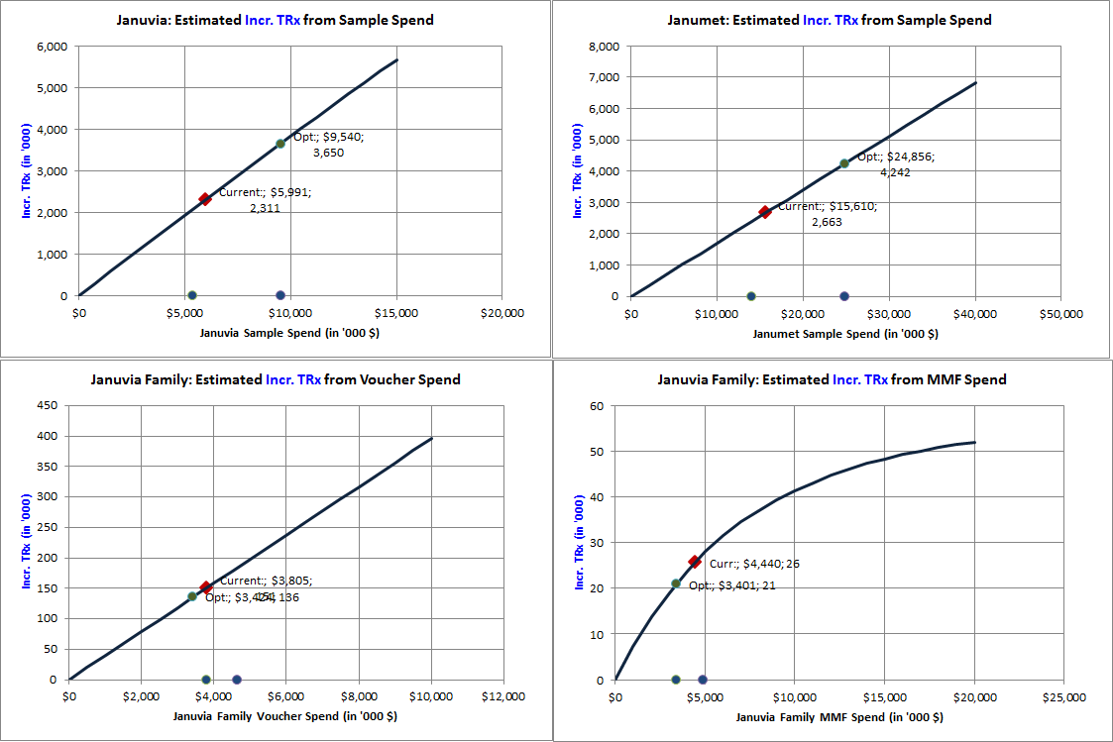
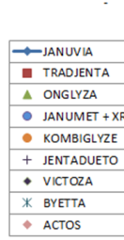
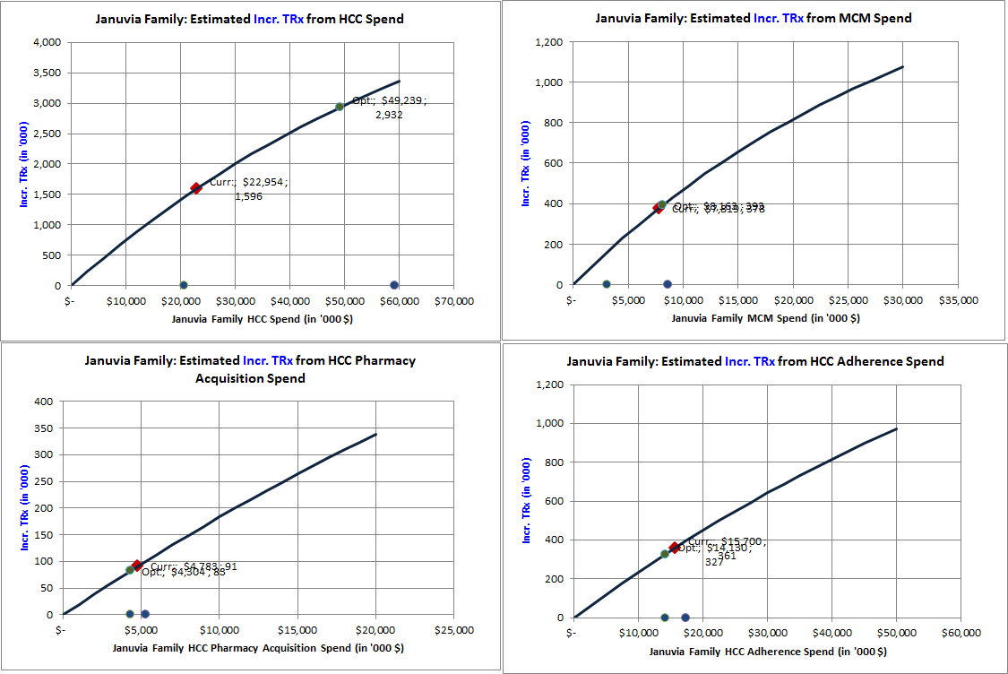
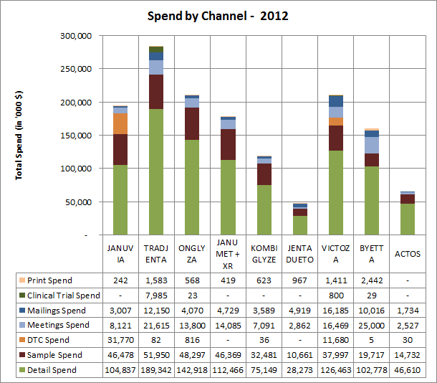
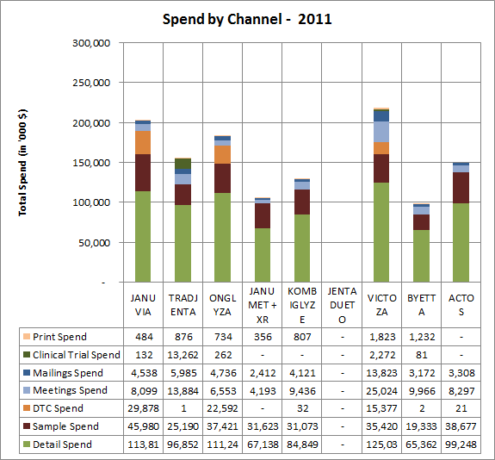
Overview of Multi-Faceted Approach
Influence product trend via recommendations based on competitive analysis and optimization.
Leverage competitive investment insights, historical brand investments and performance, and promotion response curves by promotion type to create optimization scenarios.
Competitive Analysis
Optimization from Promotion Response Curves
OPTIMIZE

Slide 4
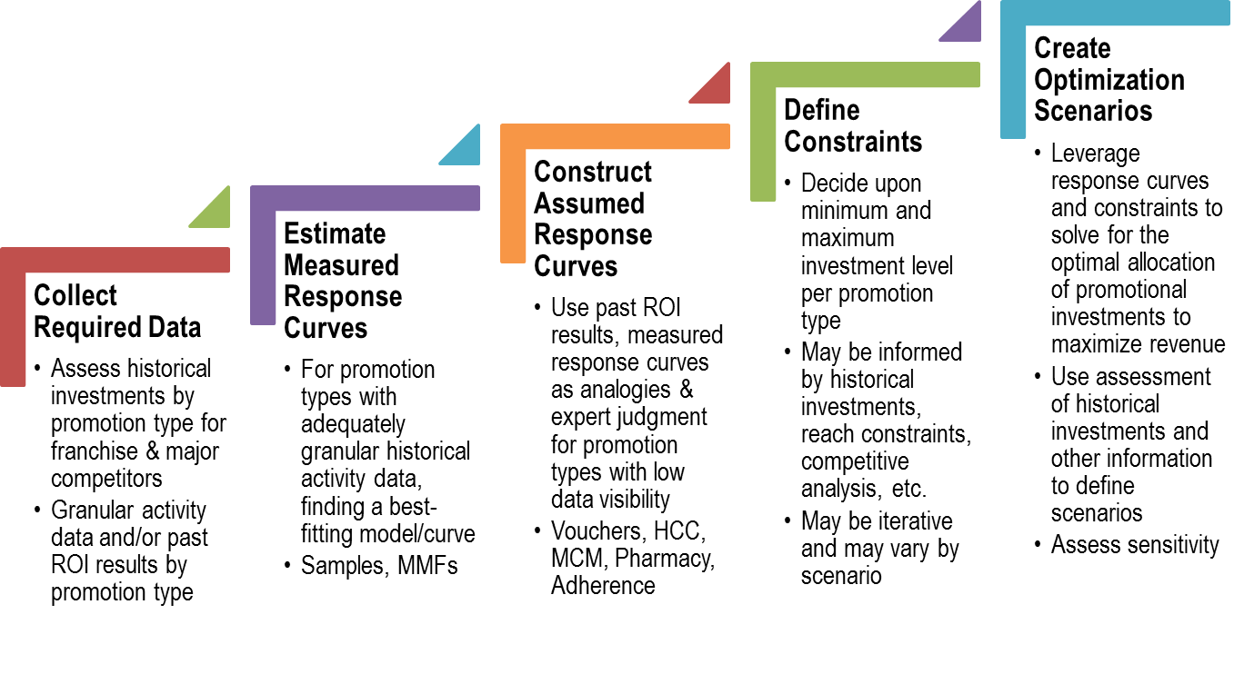
Optimization Process Steps
Marketing Collaboration Needed

Slide 5
Summary of Optimization Scenarios To-Date
Initial draft scenarios show expected incremental revenue contributions ranging from $139MM to $407MM. These are subject to change and refinement based on the Marketing input being solicited today/over the next several days.
Current expected revenue contribution of promotion is $742MM (based on after-tax three-year net present value per incremental new patient). It is likely that this can be improved by more optimal allocation of investments as these draft scenarios show:
Across these scenarios, optimization consistently results in increased investment in Samples and HCC media and in reductions in Adherence, Vouchers and Pharmacy programs. MMF and MCM recommendations vary between increasing and decreasing depending upon the scenario.
Scenario Description | Incremental Investment | Expected Increase in Incremental Revenue Contribution of Promotion
Base Case: Redistribution of current planned spend | $ -- | $139MM (19%)
Competitive: Allow total spend to increase to approximately match Tradjenta’s 2012 spend for Samples & Meetings | $10MM | $187MM (25%)
Historical: Set total spend similar to 2012-1Q (recent best NRx performance) | $36MM | $407MM (55%)

Slide 6
Assessment of Historical Investments
- Major Competitors Indexed vs. Franchise
- Franchise Investment and Rx Trends
- Franchise Best-Quarter Spends

Slide 7

Competitor Spend by Type – 2012 Index Chart
Indexed chart depicts spend by competitors across different promotion types with respect to Januvia® (whose index equals 100 for each promotion type)
This chart indexes the Januvia®’s spend in each promotion type to 100 and compares the competitors in terms of the normalized indexes.
Growing brands like Tradjenta have larger spends in most important promotion types, particularly the meetings.
Other major brands like Onglyza and Victoza have similar spends like Januvia® and/or Janumet® (+ XR).
For optimal spend allocation based on competitor spends:
  Januvia Sample spends are allowed to increase from current 2013 levels by 110% (Tradjenta Samples) to 140% (Tradjenta Details)
  Meetings (MMF) Spends varies between a minimum of 170% (Onglyza meetings) to a maximum of 270% (Tradjenta meetings)
Data Source: CSD audit
Chart is scaled to a maximum index value of 300. Data table shows some promotion types with much higher indices.
Notes:
Footnote what is in print and mailings, or add a bullet to clarify that DTC is not included here.

Slide 8
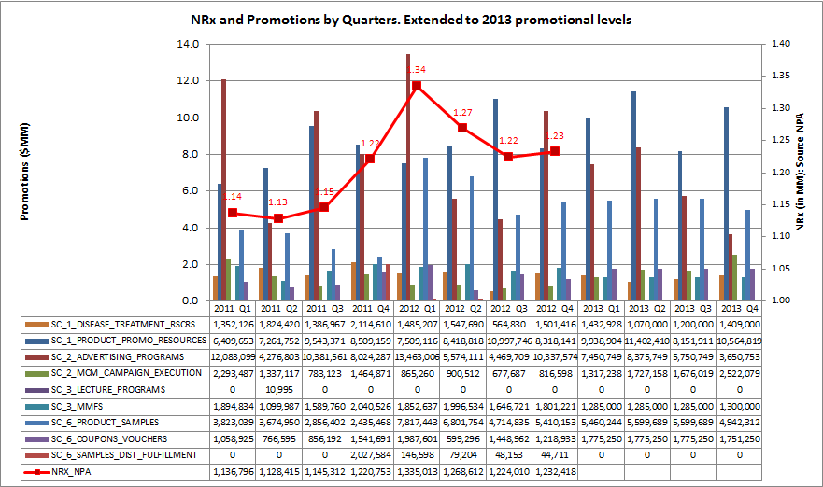
Januvia Family NRx and Historic Spend
Januvia® Family NRx grew between 2011-Q2 to 2012-Q1 then started dropping in 2012-Q2/Q3
2012-Q1 has the maximum spend and the maximum NRx as well.
Trends of Detail count, Sample spend, Coupon/Voucher spend, MMF spend and DTC Spend correlate well with Januvia® Family NRx trend. This may not represent causation.
Data Source: NPA audit

Slide 9
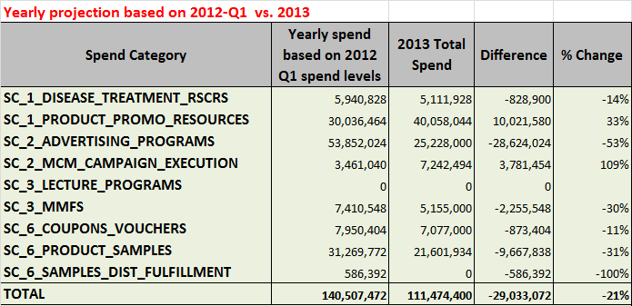
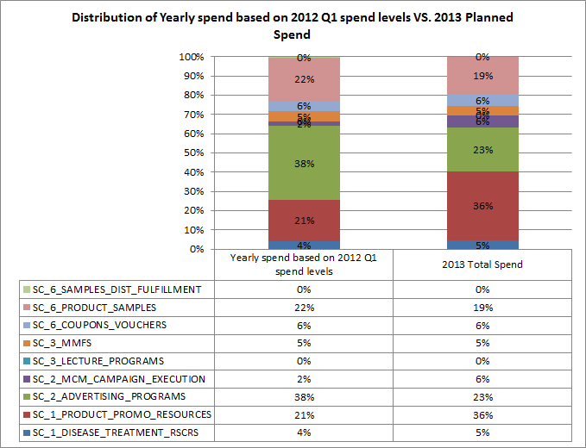
2013 Investment Plan vs. 2012 Q1 Investments
Comparing with best quarter (2012-Q1), there is a potential to increase 2013 spend by $29MM
2012-Q1 had best NRx. Projecting the spend in 2012-Q1 to full year level would result in $140 MM.
2013 planned spend of $111 MM is about 21% lower than the projected yearly spend based on 2012-Q1 spend.
Samples, DTC and Vouchers/Coupons are under-funded when compared to 2012-Q1 mix.
Promotion types considered for optimal allocation based on 2012-Q1 levels: Samples, Vouchers, MMF, MCM and HCC (advertising) programs. Spends are allowed to vary up to annualized 2012-Q1 level +10%.
Spend Data Source: Finance

Slide 10
Analyzed Promotion Types &
Promotion Response Curves

Slide 11
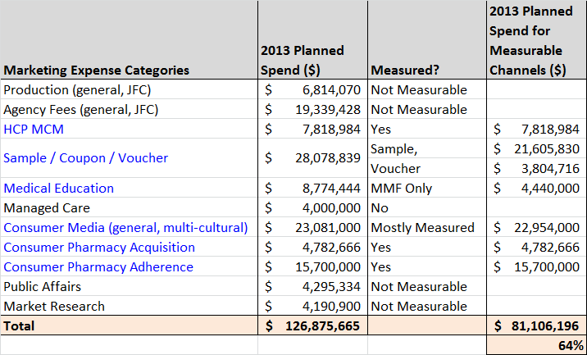
Measured Marketing Expense Categories
About 64% of the marketing expense categories that are measurable were accounted in the analysis
Measurable promotion types are MCM, Sample, Voucher, Medical Education (MMF only), Consumer Media (HCC), Pharmacy Acquisition and Adherence programs.
Measured promotion types account for about $81MM [64%] of the $127MM planned spend.
Data Source: Merck GMC
Notes:
Managed Care may be considered “Phase 2”...but understand what is in this expense category...

Slide 12
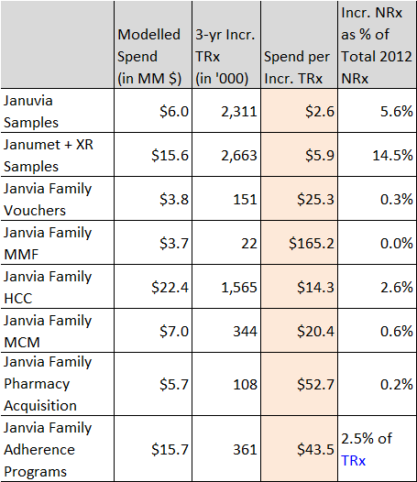
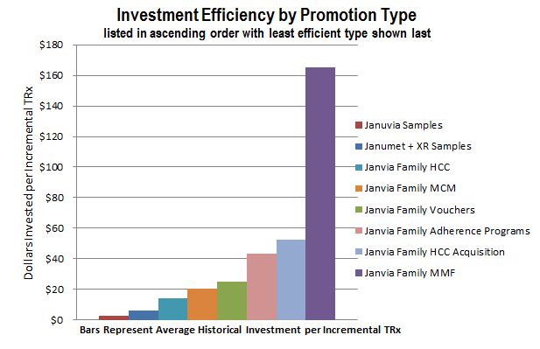
Impact Summary by Promotion Type
Spend for one Incremental TRx is lowest for samples* and highest for MMF. Optimal budget allocation for each promotion type is guided by this impact.
* Samples are requested and received by prescribers for use by and benefit of patients. Samples provide the opportunity to gain experience with a product. The sample-related values shown here reflect the association between samples and new patient starts rescaled into TRx terms for comparability to other investment types; this applies to vouchers as well, which are treated as an alternative mechanism to provide samples to patients. (vs. “samples” left by Field personnel).

Slide 13
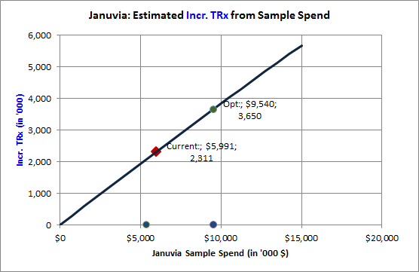
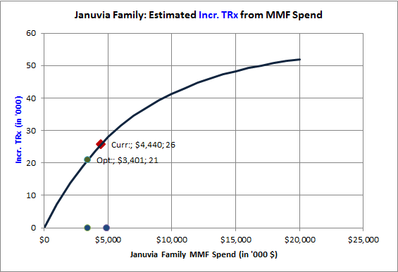
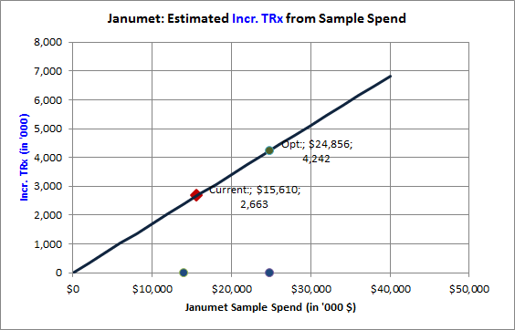
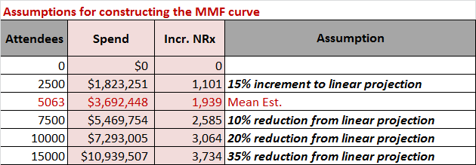
Measured Response Estimates & Curves: Samples & MMF
Sample curves were modeled from 2012 HCP level data. MMF curve was constructed to satisfy the diminishing returns assumptions and also to pass through the current modeled impact using 2012 HCP level attendee data.
Possible Optimal
Allocation
Measured
Impact
Currently
Planned Spend
Incremental TRxs are realized in 3 years. The spends are in pre-tax scale
* Samples are requested and received by prescribers for use by and benefit of patients. Samples provide the opportunity to gain experience with a product. The sample-related values shown here reflect the association between samples and new patient starts rescaled into TRx terms for comparability to other investment types; this applies to vouchers as well, which are treated as an alternative mechanism to provide samples to patients. (vs. “samples” left by Field personnel).

Slide 14
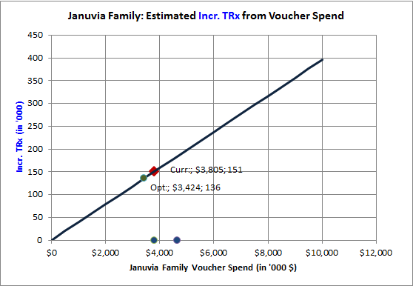
Assumed Response Curve by Proxy: Voucher Redemptions
Sample curves are used as a proxy to construct response curves for voucher redemptions. Impact from one redemption is assumed to be equivalent to the impact of 30 days of therapy of samples
Voucher redemptions here include both Field and Web programs.
Incremental TRxs are realized in 3 years. The spends are in pre-tax scale
* Samples are requested and received by prescribers for use by and benefit of patients. Samples provide the opportunity to gain experience with a product. The sample-related values shown here reflect the association between samples and new patient starts rescaled into TRx terms for comparability to other investment types; this applies to vouchers as well, which are treated as an alternative mechanism to provide samples to patients. (vs. “samples” left by Field personnel).

Slide 15
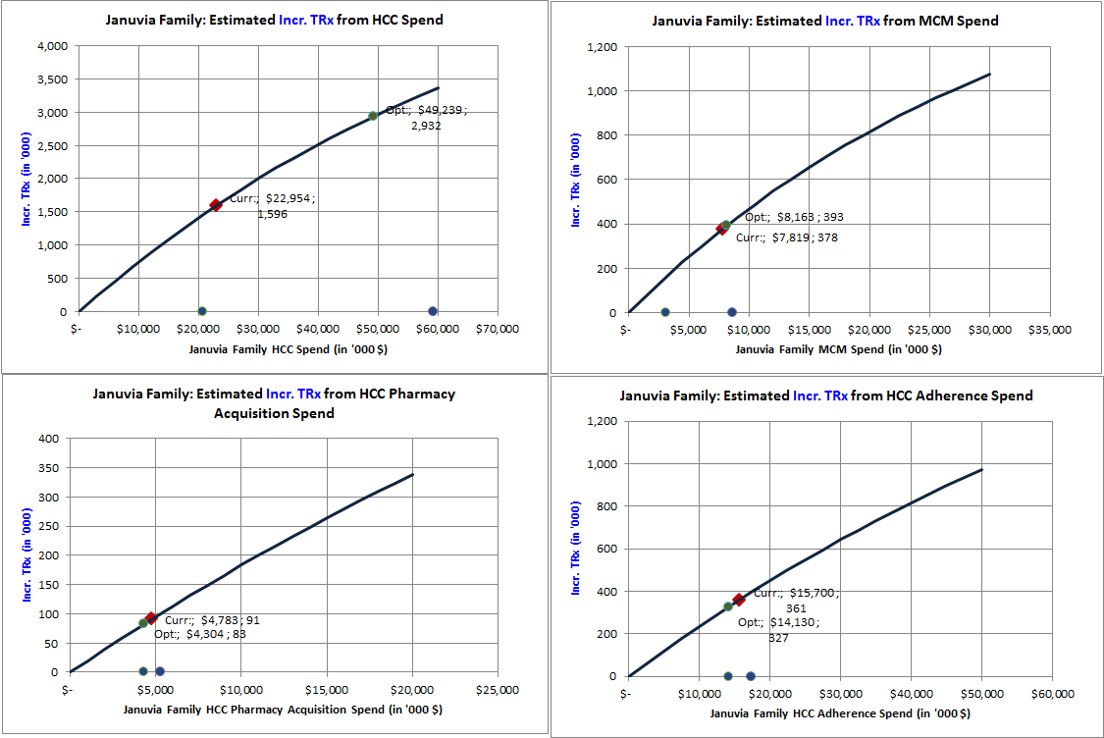
Assumed Response Curves using Aggregated Historic ROI’s: HCC, MCM, Acquisition and Adherence
Curves are calibrated using historic tactic ROIs and assumptions on maximum impact when spend increases infinitely.
Current: 2.6% of NRx
Assumed Max: 10% of NRx
Current: 0.6% of NRx
Assumed Max: 3% of NRx
Current: 0.2% of NRx
Assumed Max: 2% of NRx
Current: 2.5% of TRx
Assumed Max: 10% of TRx
Incremental TRxs are realized in 3 years. The spends are in pre-tax scale

Slide 16
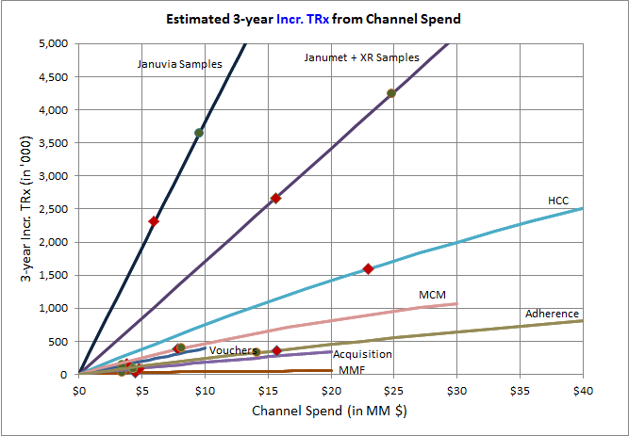
Combined Promotion Response Curves
High Impact: Samples, HCC programs.
Medium Impact: MCM, Vouchers and Adherence programs.
Low Impact: Pharmacy Acquisition programs and MMF
Red square points on each curve represents the impact at currently planned spend
Green circles illustrates the optimal allocation for each curve
In general, promotion types could be grouped into High, Medium and Low impact (in terms of incr. TRx per $ spent)
  High: Samples, HCC
  Medium: MCM, Vouchers, Adherence programs
  Low: Pharmacy Acquisition and MMF
Investments would be first prioritized for High Impact promotion types followed by medium and then low impact promotion types.
Minimum & maximum allocation constraints are specified for each promotion type.
Possible Optimal
Allocation
Currently
Planned Spend
Incremental TRxs are realized in 3 years. The spends are in pre-tax scale
* Samples are requested and received by prescribers for use by and benefit of patients. Samples provide the opportunity to gain experience with a product. The sample-related values shown here reflect the association between samples and new patient starts rescaled into TRx terms for comparability to other investment types; this applies to vouchers as well, which are treated as an alternative mechanism to provide samples to patients. (vs. “samples” left by Field personnel).

Slide 17
Optimal Allocation of Spend by Promotion Type:
Case Studies

Slide 18
Scenarios Considered for Budget Allocation
Three scenarios are considered for allocation: Redistribute (Base), Competitive Equivalent and Historical Best
Base Case
  Redistribute the current total spend of $81 MM to maximize the incremental revenue.
  Promotion types are allowed to vary their budgets by ±30% of current level.
Competitive
  Spends for Samples and Meetings are allowed to be similar to Tradjenta's 2012 levels.
  Increase current Januvia Sample spends by 110% (Tradjenta Samples) to 140% (Tradjenta Details).
  Increase current MMF spends by 170% (Onglyza MMF) to 270% (Tradjenta MMF).
  Total spend varies from current level ($81MM) to additional $ needed for samples and MMF ($91MM).
Historical Best (2012-Q1 levels)
  Total spend is similar to 2012-Q1 projected level ($117 MM).
    Promotion types considered: HCC, MCM, MMF, Vouchers & Samples
  Allowed maximum spends for the above promotion types are set to 110% of 2012-Q1 levels
    Other promotion types (Pharmacy Acquisition and Adherence) have allowed maximum of 110% of current levels.
  Allowed promotion type minimums are lesser of 90% of current level or 90% of 2012-Q1 levels

Slide 19
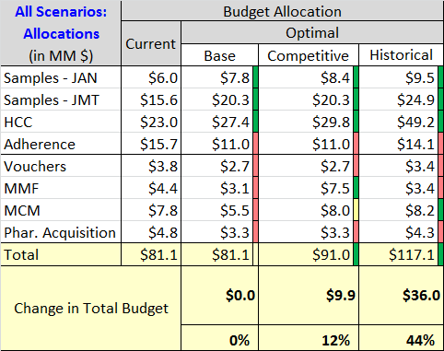
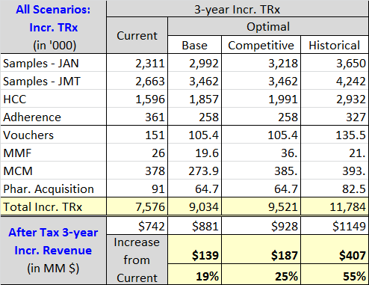

Optimal Allocation: All Scenarios
Increasing the budget from current $81MM to historical level of $117 MM increases the total incremental revenue by an estimated 55%.
Results
  Increasing the total budgets to $117 MM (Historical 2012-Q1 levels) and rebalancing across promotion types produces the maximum incremental revenues.
  In all scenarios, Sample and HCC allocations are increased due to their higher impact potential.
* Samples are requested and received by prescribers for use by and benefit of patients. Samples provide the opportunity to gain experience with a product. The sample-related values shown here reflect the association between samples and new patient starts rescaled into TRx terms for comparability to other investment types; this applies to vouchers as well, which are treated as an alternative mechanism to provide samples to patients. (vs. “samples” left by Field personnel).

Slide 20
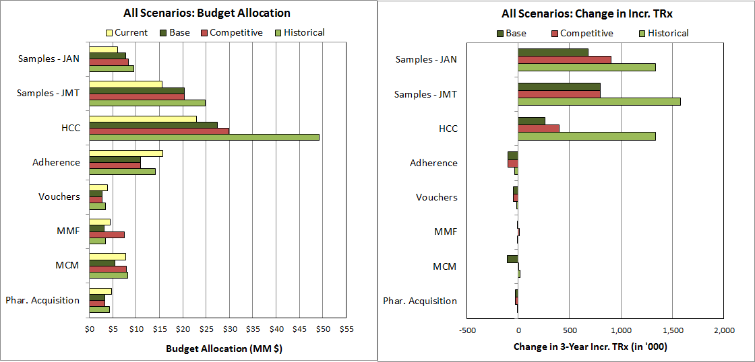
Optimal Allocation: All Scenarios
Increasing the budget from current $81MM to historical level of $117 MM increases the total incremental revenue by an estimated 55%.
Historical case performs the best. A combination of Competitive and Historical allocations could be considered.
* Samples are requested and received by prescribers for use by and benefit of patients. Samples provide the opportunity to gain experience with a product. The sample-related values shown here reflect the association between samples and new patient starts rescaled into TRx terms for comparability to other investment types; this applies to vouchers as well, which are treated as an alternative mechanism to provide samples to patients. (vs. “samples” left by Field personnel).

Slide 21
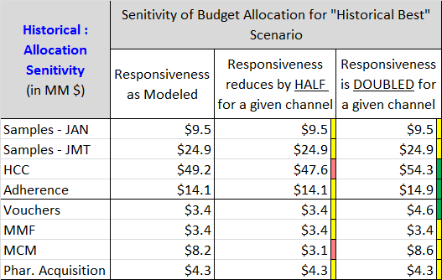
Allocation Sensitivity: Historical Best
Promotion types insensitive to large changes in responsiveness: Samples, Acquisition and MMF
MCM allocation decreases if responsiveness is reduced but not vice versa.
HCC and Vouchers would get larger allocations if responsiveness is doubled..
Sensitivity Analysis
  A wide variation in responsiveness is used to determine allocation sensitivity.
  Samples always gets maximum allowed allocation and is not so sensitive to changes in responsiveness.
  Acquisition programs and MMF gets minimum allowed allocation and are not sensitive to change in responsiveness.
  Allocation of funds between HCC, MCM, Vouchers and Adherence varies according to the variation in responsiveness.
    MCM allocation decreases if its responsiveness is reduced by half.
    HCC, Vouchers and Adherence allocation increases if their individual responsiveness are doubled

Slide 22
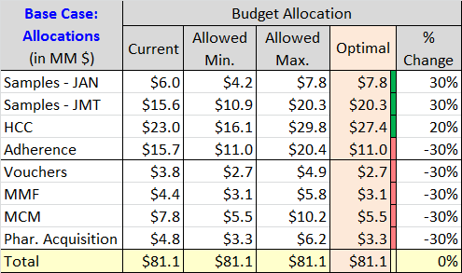
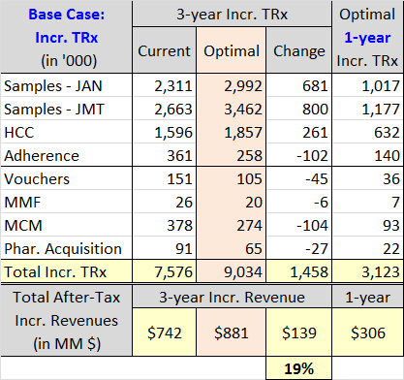
Optimal Allocation: Base Case
Samples and HCC programs get more allocation at the expense of other promotion type budgets. After-tax 3-year incremental revenues increases by an estimated $139 MM (19% increase)
Base Case Results
  Budgets for Samples and HCC are increased and budgets for all other promotion types are decreased
  By optimal redistribution of budgets, incremental revenue increases by an estimated 19%
* Samples are requested and received by prescribers for use by and benefit of patients. Samples provide the opportunity to gain experience with a product. The sample-related values shown here reflect the association between samples and new patient starts rescaled into TRx terms for comparability to other investment types; this applies to vouchers as well, which are treated as an alternative mechanism to provide samples to patients. (vs. “samples” left by Field personnel).

Slide 23
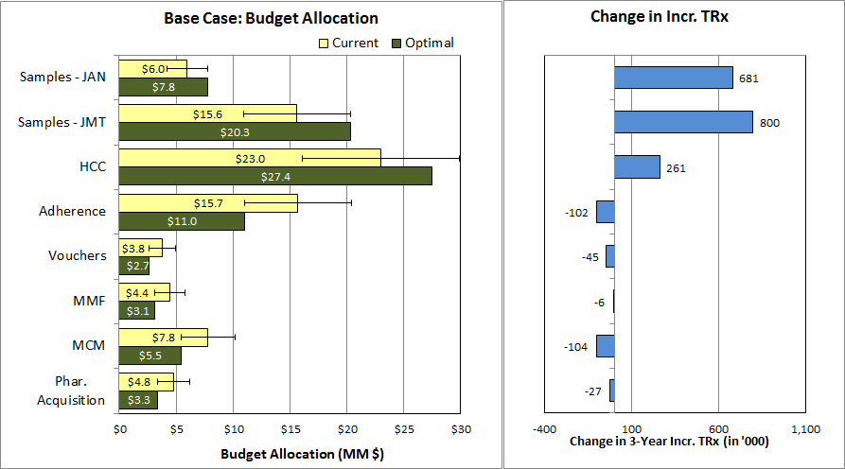
Optimal Allocation: Base Case
Samples and HCC programs gets more allocation at the expense of other promotion type budgets. After-tax 3-year incremental revenues increases by an estimated $139 MM (19% increase) when compared to the current allocation.
Total budget: $81.1 MM; 3-Year incr. revenue: $881 MM; 1-Year incr. revenue: $306 MM
* Samples are requested and received by prescribers for use by and benefit of patients. Samples provide the opportunity to gain experience with a product. The sample-related values shown here reflect the association between samples and new patient starts rescaled into TRx terms for comparability to other investment types; this applies to vouchers as well, which are treated as an alternative mechanism to provide samples to patients. (vs. “samples” left by Field personnel).

Slide 24
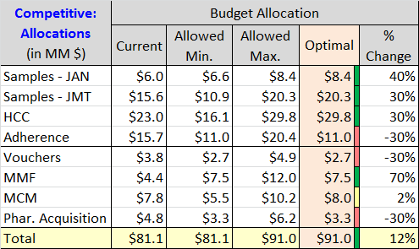
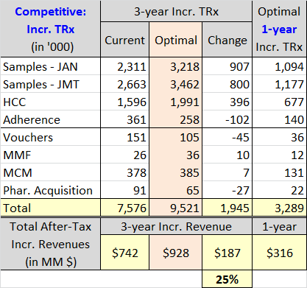
Optimal Allocation: Competitive
Samples, HCC and MMF gets more allocation. MCM allocation is similar to the current level. Other promotion type budgets are decreased. Total budget is increased by $10MM to $91MM. After-tax 3-year incremental revenues increases by an estimated $187 MM (25% increase)
Competitive Case Results
  Budgets for Samples, HCC and MMFs are increased. MCM is similar to current levels. All other promotion type budgets are decreased.
  Total spend is $91 MM.
  3-year Incremental revenue increases by an estimated $187MM (25% increase over current levels).
* Samples are requested and received by prescribers for use by and benefit of patients. Samples provide the opportunity to gain experience with a product. The sample-related values shown here reflect the association between samples and new patient starts rescaled into TRx terms for comparability to other investment types; this applies to vouchers as well, which are treated as an alternative mechanism to provide samples to patients. (vs. “samples” left by Field personnel).

Slide 25
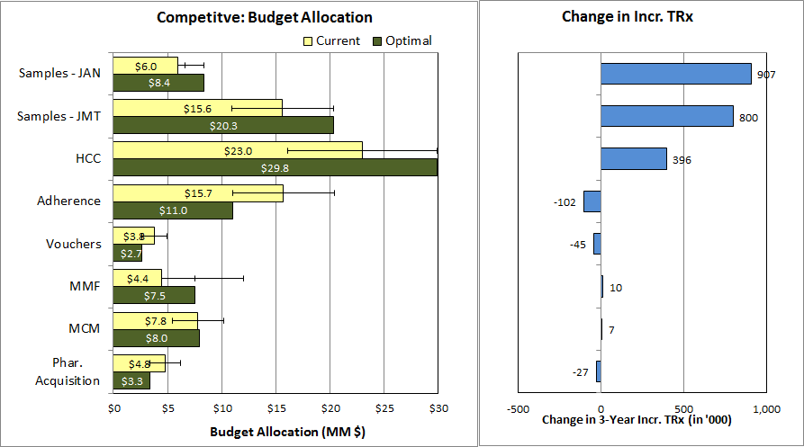
Optimal Allocation: Competitive
Samples, HCC and MMF gets more allocation. MCM allocation is similar to the current level. Other promotion type budgets are decreased. Total budget is increased by $10MM to $91MM. After-tax 3-year incremental revenues increases by an estimated $187 MM (25% increase)
Total budget: $91 MM; 3-Year incr. revenue: $928 MM; 1-Year incr. revenue: $398 MM
* Samples are requested and received by prescribers for use by and benefit of patients. Samples provide the opportunity to gain experience with a product. The sample-related values shown here reflect the association between samples and new patient starts rescaled into TRx terms for comparability to other investment types; this applies to vouchers as well, which are treated as an alternative mechanism to provide samples to patients. (vs. “samples” left by Field personnel).

Slide 26
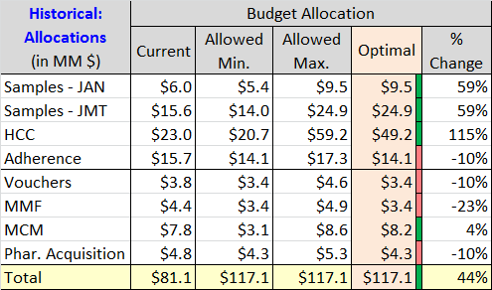
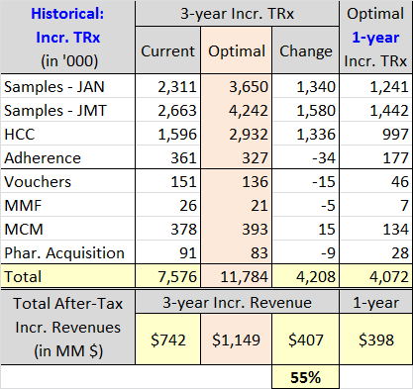
Optimal Allocation: Historical Best (2012-Q1)
Samples, HCC and MCM gets more allocation. Other promotion type budgets are decreased. Total budget is increased by $36MM to $117MM. After-tax 3-year incremental revenues increases by an estimated $407 MM (55% increase)
Historical Case Results
  Budgets for Samples, HCC and MCM are increased. All other promotion type budgets are decreased.
  Total spend is $117 MM.
  3-year Incremental revenue increases by an estimated $407MM (55% increase over current levels).
* Samples are requested and received by prescribers for use by and benefit of patients. Samples provide the opportunity to gain experience with a product. The sample-related values shown here reflect the association between samples and new patient starts rescaled into TRx terms for comparability to other investment types; this applies to vouchers as well, which are treated as an alternative mechanism to provide samples to patients. (vs. “samples” left by Field personnel).

Slide 27
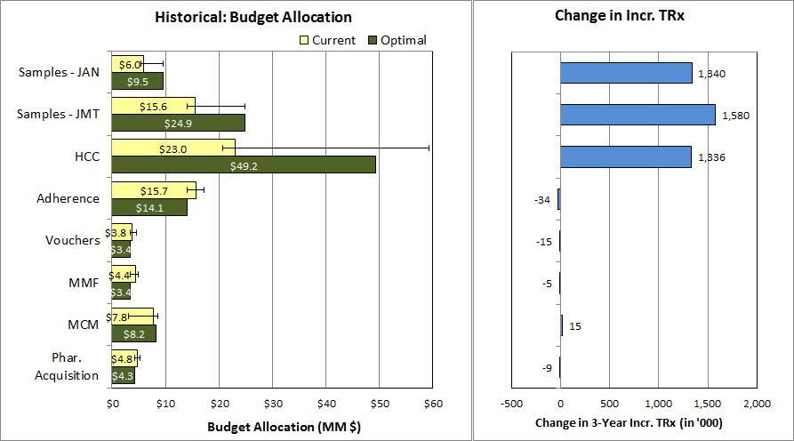
Optimal Allocation: Historical Best
Samples, HCC and MCM gets more allocation. Other promotion type budgets are decreased. Total budget is increased by $36MM to $117MM. After-tax 3-year incremental revenues increases by an estimated $407 MM (55% increase)
Total budget: $117 MM; 3-Year incr. revenue: $1,149 MM; 1-Year incr. revenue: $306 MM
* Samples are requested and received by prescribers for use by and benefit of patients. Samples provide the opportunity to gain experience with a product. The sample-related values shown here reflect the association between samples and new patient starts rescaled into TRx terms for comparability to other investment types; this applies to vouchers as well, which are treated as an alternative mechanism to provide samples to patients. (vs. “samples” left by Field personnel).

Slide 28
Next Steps
Identify Marketing team member(s) to collaborate with Commercial Analytics to review and, if necessary, refine key optimization process assumptions (e.g., minimum and maximum investment level constraints by promotion type) and scenarios characteristics.
Produce refined scenarios and review with Marketing leadership.
Share recommendations for key scenarios with Rick Hartz and Graeme Bell (by mid-May).

Slide 29
Appendix: Competitive and Historical Spends

Slide 30
Objectives and Approach
Objectives
  Allocate marketing promotional spends so as to maximize the incremental revenues
  Explore competitor spend levels and our historic spends for the allocation
  Understand brand team perspectives to further refine the analysis
Approach
  Identify promotion types for which promotion responses may be estimated
    In Scope: Samples, Vouchers, MMF, HCC Promotions, MCM, Pharmacy Acquisition, Adherence
  Build Promotional Response Curves to quantify the impact of various promotion types
    Use historic data and previously measured ROIs to build response curves
  Combine the promotion type responses and optimally allocate the spends to maximize the incremental revenues under scenarios such as:
    Base: Total budget is at current level. promotion type spends vary around their current levels.
    Competitive: Total budget and key (meetings & samples) promotion type spends are allowed to vary up to the competitor levels.
    Historical: Total budget and the promotion type spends are similar to 2012-Q1 levels (historically best)

Slide 31
Januvia Family NRx and Historic Spend
Januvia® Family NRx grew between 2011-Q2 to 2012-Q1 then started dropping in 2012-Q2/Q3
2012-Q1 has the maximum spend and the maximum NRx as well.
Data Source: NPA audit

Slide 32
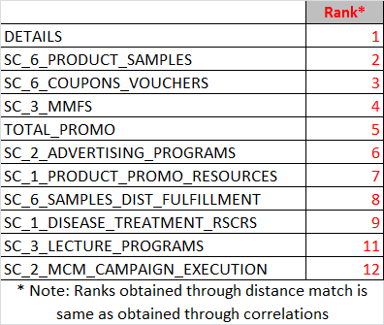
Matching trends between Spend Category and NRx
Spend on samples, voucher/coupons, MMF and DTC correlates with NRx Trend. Detail count also correlates well.
Trends of Detail count, Sample spend, Coupon/Voucher spend, MMF spend and DTC Spend correlate well with Januvia® Family NRx trend. This may not represent causation.
Part of product promotional resources spend is for materials in support of Sales Force detailing, however this spend does not seem to correlate well with NRx trend.
Spend Data Source: Merck

Slide 33
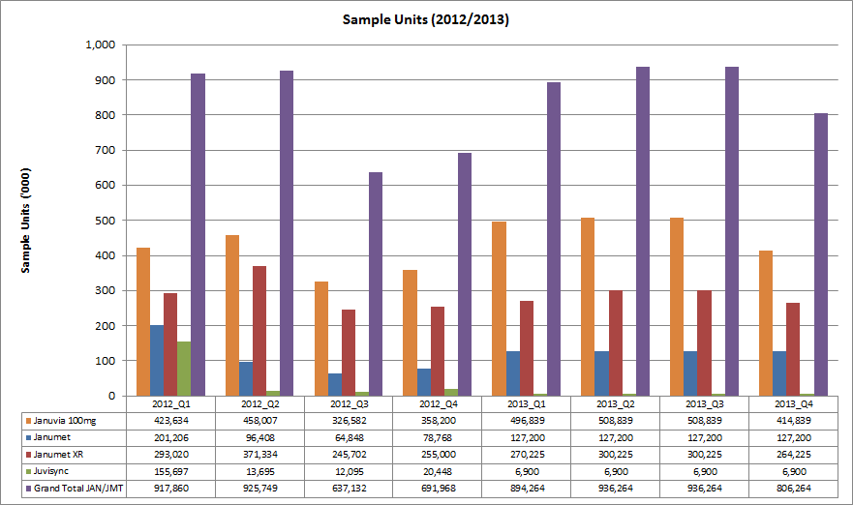
Trends in Sample Units
Janumet ® sample units fell drastically from 2012-Q2 to 2012-Q4.
Janumet ® Samples decreased substantially from 2012-Q2 to 2012-Q4. The next slide shows trends in sample units vs. NRx share.
Data Source: Marketing / Forecast (internal)

Slide 34
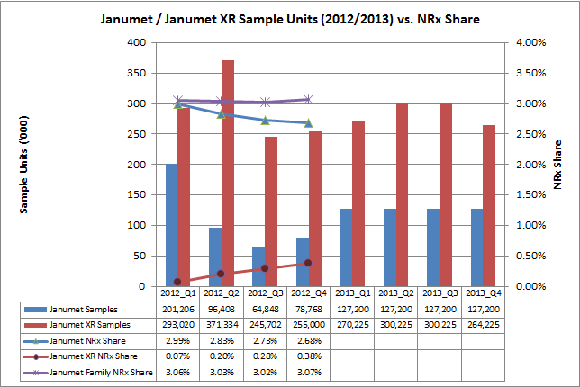
Janumet® Family Trends in Sample Units vs. NRx Share
Janumet ® sample units fell drastically from 2012-Q2 to 2012-Q4. Janumet ® Family NRx Share is flat in 2012.
Janumet ® Samples decreased substantially from 2012-Q2 to 2012-Q4. From the above chart, it appears that the fall in Janumet ® NRx share is compensated by increase in Janumet XR® NRx share.
Open question: Would it be possible to decrease the fall in Janumet® trend by increasing Janumet® samples but still retain the Janumet XR® sampling levels?
Data Source: Marketing / Forecast (internal)

Slide 35
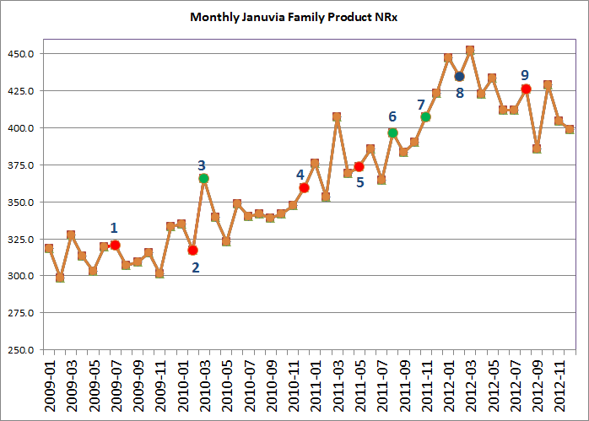
Events Chart
Various Market Events and Januvia Family NRx Trend
Onglyza launch [Jul-09]
Victoza launch [Feb-10]
Avandia off market FDA communication [Mar-10]
Kombiglyze launch [Dec-10]
Tradgenta launch [May-11]
Actos warning, Januvia promotion changes [Aug-11]
Juvisunc launch [Nov-11]
Janumet XR® launch, Jentaduetto launch, Bydureon launch [Feb-12]
Actos off patent [Aug-12]
Data Source: NPA audit

Slide 36
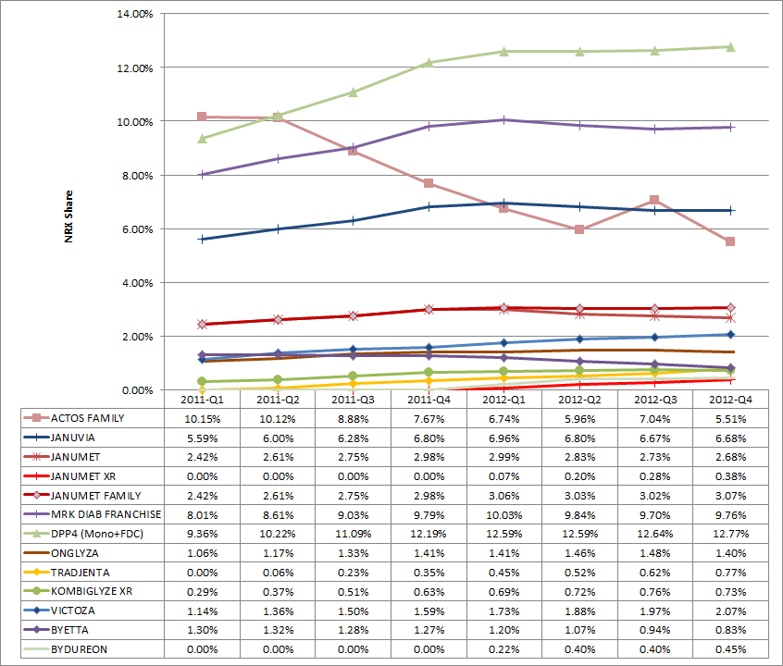
Quarterly NRx Share Chart
Tradjenta and Victoza are growing in 2012. All others are flat or decreasing in 2012.
DPP4 and GLP-1 Brands are growing in 2011
Most DPP4 brands are flat in 2012
Tradgenta (DPP4) and Victoza (GLP-1) are growing in 2012
  What do they do differently?
Janumet ® Family is flat in 2012.
  Janumet® keeps falling (due to drastic fall in samples?)
  Janumet XR ® grows slowly
Actos has a steep fall even in 2012-Q2 when Januvia® falls as well.
  Loss of business from Actos may not be the only reason for Januvia®’s fall.
Data Source: NPA audit

Slide 37
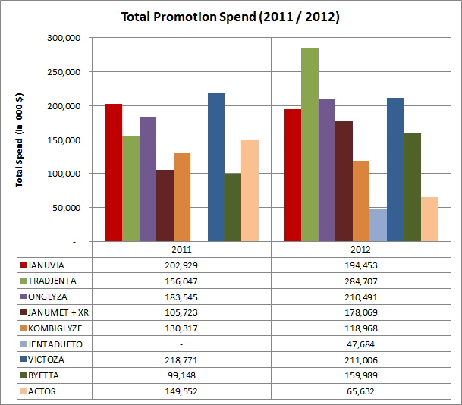
CSD Total Promotions Spend
In 2012, Tradjenta increased its total spend by a large margin. Onglyza and Victoza has similar spend like Januvia®. Janumet ® (+ XR) spend increase in 2012 is largely due to the spend associated with Janumet XR®.
Data Source is CSD. promotion types measured by CSD are: Details, Samples, DTC (TV), Meetings, Mailings, Clinical Trials and Print.
Due to the nature of data collection (small panels), these spends are approximate and directional.
Januvia® 2011 and 2012 spends are similar.
Spend on Janumet® + XR increased in 2012. Large portion of this may be for Janumet XR®.
Tradjenta has increased its 2012 spend by a large amount. Onglyza also increased marginally in 2012.
Victoza has more or less same spend as Januvia®. Byetta’s spend increased in 2012.
JentaDueto was launched in 2012 and has noticeable spend.
Data Source: CSD audit

Slide 38
CSD Spend by Promotion Type - 2011
Details are a bigger component of overall promotion spends captured by CSD. Januvia®’s Sample spend is comparable to other major brands .
Details are the bigger component of the total spend.
Tredjenta launched in May-2011, probably that is why its spend seems lower overall.
Relatively Januvia®’s sample spend is comparable to other products.
Kombiglyze has higher spend than Janumet® in 2011 (Janumet XR® not launched yet).
Details are more or less similar for Januvia®, Tradjenta, Onglyza and Victoza.
DTC here captures only TV (i.e., does not give a complete picture).
JentaDueto was not launched in 2011.
Data Source: CSD audit

Slide 39
CSD Spend by Promotion Type - 2012
In 2012, Tradjenta leads the market in terms of details and samples. Januvia® and Janumet® (+ XR) lags behind Tradjenta, Onglyza and Victoza. Janumet® (+ XR) leads in DPP-4 Combo market.
Tradjenta has a large spend in details and samples when compared to Januvia®.
Onglyza also has a larger detail spend.
Janumet XR® launched in early 2012.
In DPP-4 Combo class, Janumet® (+ XR) has a relatively larger overall spend. A large portion of the spend probably goes to Janumet XR®.
In terms of details. Januvia® and Janumet® lags behind Tradjenta, Onglyza and Victoza.
There is a potential for increasing samples for Januvia® and Janumet®.
  Competitors have larger presence in terms of samples.
Competitors have a significantly larger spend in meetings than Januvia® and Janumet® (+ XR).
Data Source: CSD audit

Slide 40
CSD Spend by Promotion Type – 2012 Index Chart
Indexed chart depicts spend by competitors across different promotion types with respect to Januvia® (whose index equals 100 for each promotion type)
This chart indexes the Januvia®’s spend in each promotion type to 100 and compares the competitors in terms of the normalized indexes.
Growing brands like Tradjenta has larger spends in most important promotion types, particularly the meetings.
Other major brands like Onglyza and Victoza have similar spends like Januvia® and/or Janumet® (+ XR).
Chart is scaled to a maximum index value of 300. Data table shows some promotion types with much higher indices.
Data Source: CSD audit

Slide 41
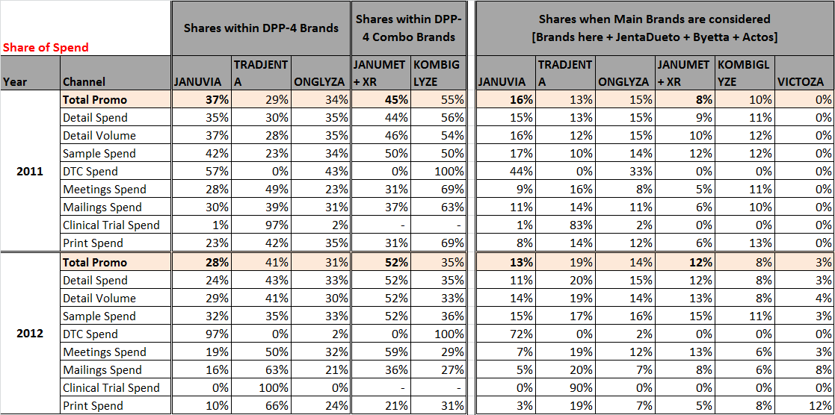

Share of Spend – 2011 vs. 2012
For most promotion types, Share of Spend for Januvia® and Janumet® (+ XR) in 2012 has decreased compared to 2011.
Data Source: CSD audit

Slide 42
Appendix: Allocation Analysis

Slide 43
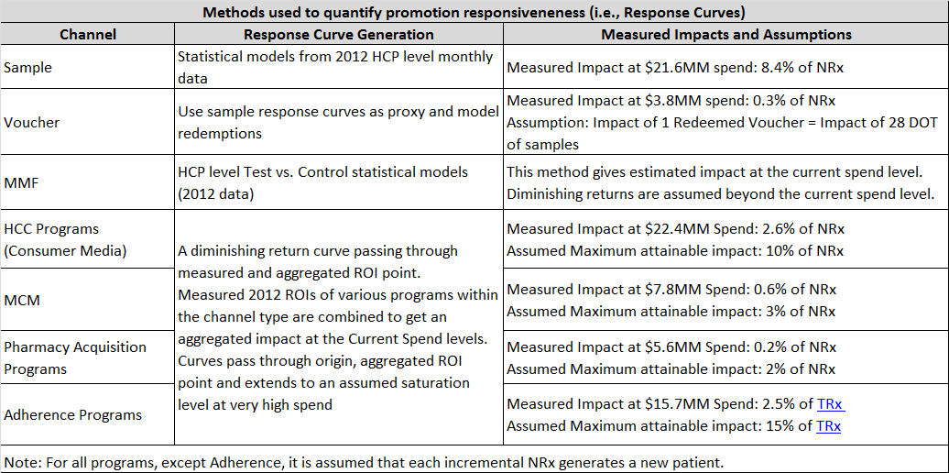
Promotion Response Computation: Methods and Assumptions
Various techniques are used to compute promotional response curves based on granularity of available data for modeling and the measured ROIs of various programs within a given promotion type. Accuracies are generally higher around the historic spend levels.
MMF, HCC, MCM, Acquisition and Adherence programs have measured ROI at the current spend levels (i.e., point estimates). For each of these promotion types, an appropriate diminishing return curve is computed from this ROI and assumed saturation point.
Notes:
Split last column into multiple columns (Measured Spend Level, NRx Contribution, Assumption Notes, Confidence Level)

Slide 44
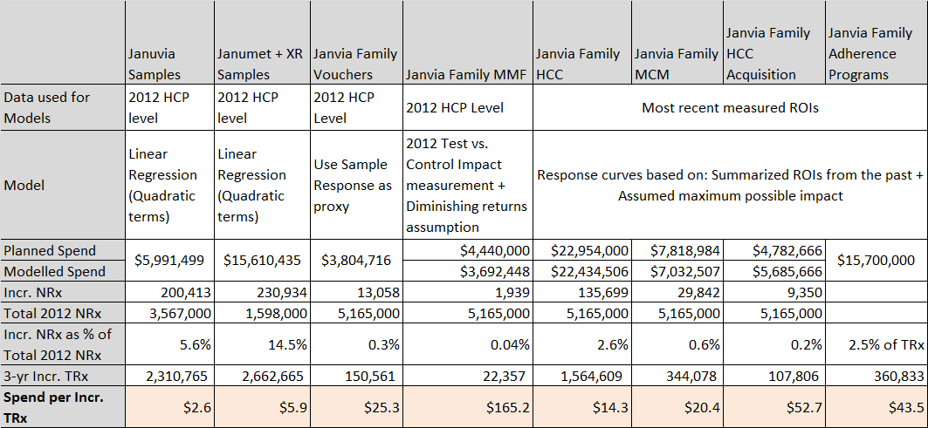
Promotion Response Models and Impact Summary
Spend for one Incremental TRx is lowest for samples and highest for MMF. Optimal budget allocation for each promotion type is guided by this impact.
Above stated spends may have to be verified, particularly for MMF.
* Samples are requested and received by prescribers for use by and benefit of patients. Samples provide the opportunity to gain experience with a product. The sample-related values shown here reflect the association between samples and new patient starts rescaled into TRx terms for comparability to other investment types; this applies to vouchers as well, which are treated as an alternative mechanism to provide samples to patients. (vs. “samples” left by Field personnel).
Notes:
Think about the base of Total 2012 NRx and how to express JAN vs. JMT/XR contribution

Slide 45
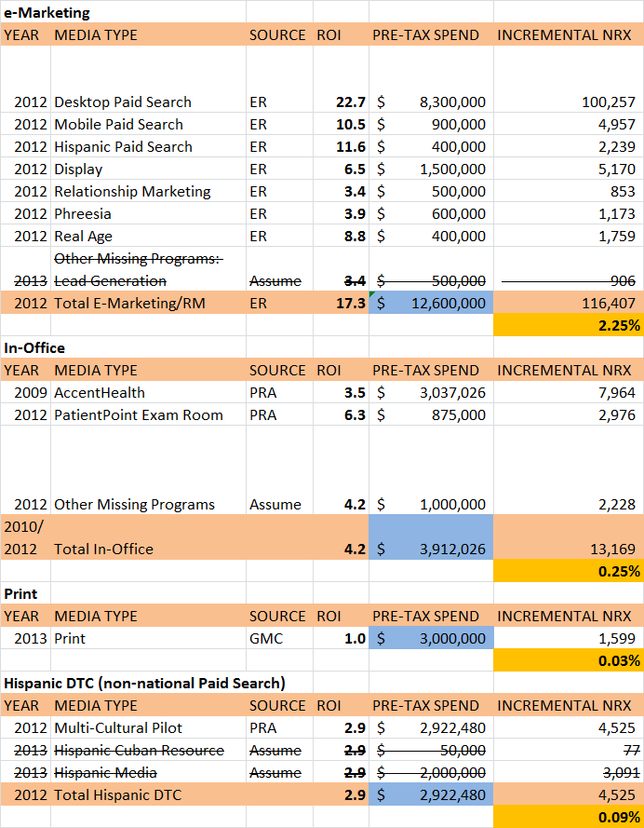
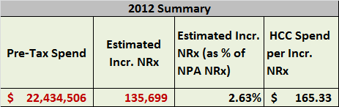
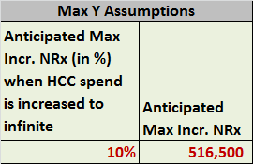

HCC Programs
Tactic ROIs are collected from various sources and summarized to get total HCC Spend and its impact. Summarized impact and a possible maximum of 10% impact in NRx from this promotion type are used to compute response curves.
A maximum of 10% impact in NRx is assumed to be attainable through this promotion type (i.e., when spends are drastically increased)

Slide 46
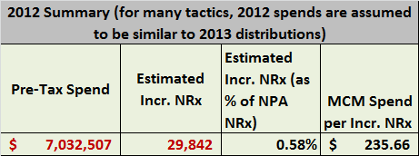
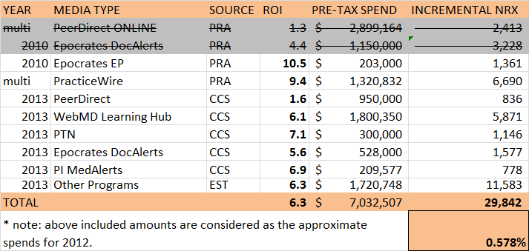
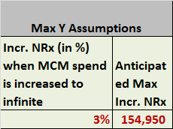

MCM Programs
Tactic ROIs are collected from various sources and summarized to get total MCM Spend and its impact. Summarized impact and a possible maximum of 3% impact in NRx from this promotion type are used to compute response curves.
A maximum of 3% impact in NRx is assumed to be attainable through this promotion type (i.e., when spends are drastically increased)

Slide 47
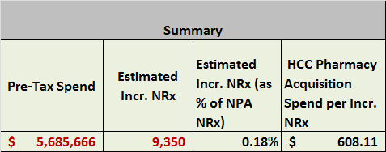
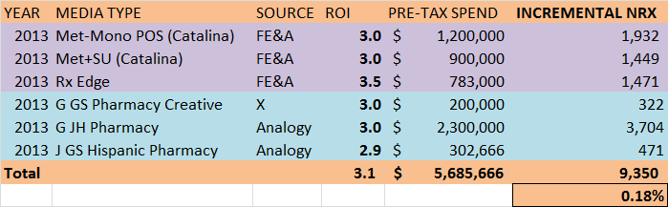


Pharmacy Acquisition Programs
Tactic ROIs are collected from various sources and summarized to get total Acquisition Spend and its impact. Summarized impact and a possible maximum of 2% impact in NRx from this promotion type are used to compute response curves.
A maximum of 2% impact in NRx is assumed to be attainable through this promotion type (i.e., when spends are drastically increased)

Slide 48



Adherence Programs
Tactic ROIs are collected from various sources and summarized to get total Adherence program Spend and its impact. Summarized impact and a possible maximum of 15% impact in TRx from this promotion type are used to compute response curves.
For Adherence programs, ROIs are calculated using Incr. TRx as the measurement scale.
A maximum of 15% impact in TRx is assumed to be attainable through this promotion type (i.e., when spends are drastically increased)

Slide 49




Promotion Response Curves: HCC, MCM, Acquisition and Adherence Programs
Response curves that are built using summarized ROIs are shown below

Slide 50


MMF Programs
Tactic ROIs are measured using 2012 HCP level attendee data through Test vs. Control statistical models. For the spends beyond the 2012 program spend, diminishing returns assumptions are made.

Slide 51
Observations, Next Steps & Timing
Januvia® product family promotion may be under-funded vs. competitors in important promotion types.
  In 2012, Tradjenta had larger spends in most important promotion types. If this continues in 2013, it may disadvantage the Januvia® product family.
  Janumet® may benefit from additional product samples for the segment of customers who prefer this vs. the Janumat XR® formulation.
This competitive analysis was undertaken as a first step to developing recommendations to positively influence the Januvia® product family trend in 2013.
The next step is to develop promotion response curves for each major category of promotion (proposed categories to include are listed below) and to optimize the promotion budget based on these curves (illustrated on next slide).
  HCP MCM
  Sample/Voucher
  Medical Education
  Managed Care
  Consumer Media (general, multi-cultural)
  Consumer Pharmacy Acquisition
  Consumer Pharmacy Adherence
  Target completion date for first-pass promotion response curves and budget optimization: mid-April

Slide 52
Marketing Expense Categories vs. Measurable Items
Marketing Expense Categories
Measurable Items
Production (general, JFC)
Agency Fees (general, JFC)
HCP MCM
Sample/Coupon/Voucher
Medical Education (1/2)
Managed Care
Consumer Media (general, multi-cultural)
Consumer Pharmacy Acquisition
Consumer Pharmacy Adherence
Public Affairs
Market Research
Details – HCP-level analysis
Samples – HCP-level analysis
Vouchers – extrapolation from samples analysis
MMF – HCP-level analysis (T/C)
MCM - consolidation of program ROI results
Consumer Media – national model results (3%-5% contribution) vs. consolidation of program ROI results (ER)
Consumer Pharmacy Acquisition – consolidation of program ROI results (Ennis)
Consumer Pharmacy Adherence – consolidation of program ROI results (Ennis)
Notes:
Consumer Promotion (Burgopak creative dev)
Consumer JFC Promotion
HCP MCM has ER expenses

Slide 53
Promotion Expense Categories: Marketing vs. Finance
Finance
Marketing
Multi-Channel Campaign Execution | Y
Disease/Treatment Resources | Y
Product Promotional Resources | Y
Lecture Programs | Y
Merck Medical Forums | Y
Coupons & Vouchers | Y
Product Samples | Y
Samples Distribution & Fulfillment | Y
Public Affairs/External Relations | N
Payer/Policy Resources | N
Congress & Exhibits | N
Health Care Consumer (HCC) Programs | N
Speaker Preparation Forums | N
Outcomes Research | N
Pricing and Reimbursement Support | N
Launch Meetings | N
Sales Team Support and Logistics | N
Advisory Boards | N
Competetive Intelligence | N
Expert Input Forums | N
Market Research Activities | N
Network Strategy (CoP) | N
Promotional Material Depreciation | N
Charitable Contributions | N
Grants | N
Production (general, JFC)
Agency Fees (general, JFC)
HCP MCM
Sample/Coupon/Voucher
Medical Education
Managed Care (agency, prod, media)
Consumer Media (general, multi-cultural)
Consumer JFC Promotion
Consumer Pharmacy Acquisition
Public Affairs
Market Research
Notes:
Consumer media includes Burgopak dev.

