Slide 1
Diabetes Investment Analysis:
Allocation Scenarios
Promotion Response Analytics
Commercial Analytics & Decision Sciences
April 2013

Slide 2
Objectives
Analysis Objective: For the diabetes product family, leverage advanced analysis to recommend a more optimal investment mix across promotion types to maximize incremental revenue.
  Use competitive insights, historical brand investments and performance, and promotion response curves by promotion type to create optimization scenarios.
Today’s Agenda:
  Introduce the overall optimization approach/process, key inputs to the process, and results of draft optimization scenarios run to-date.
  Solicit input from Marketing team to position Commercial Analytics to be able to refine the optimization process and scenarios based on expert input.
  This is meant to begin an ongoing conversation that may need to be continued over the next couple of weeks. There may be some iteration and deeper discussion needed.
  After any required iteration, the next step is to share results and recommendations with Rick Hartz and Graeme Bell.

Slide 3
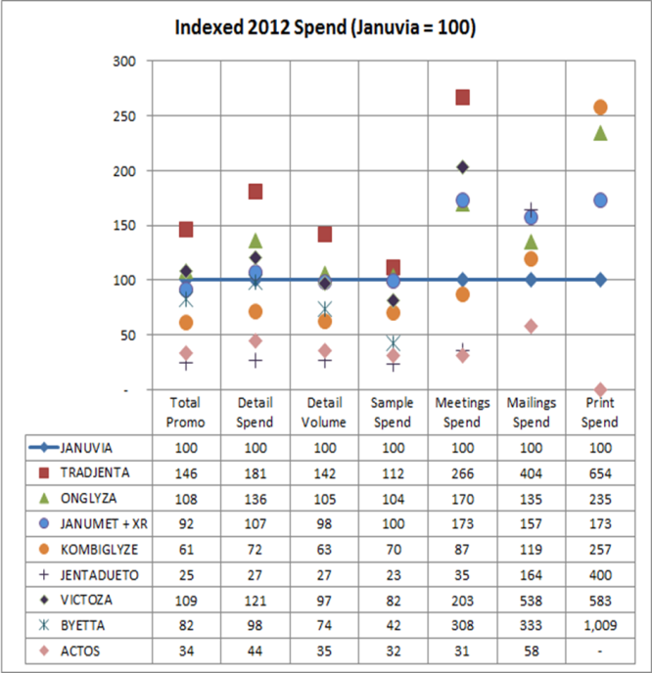
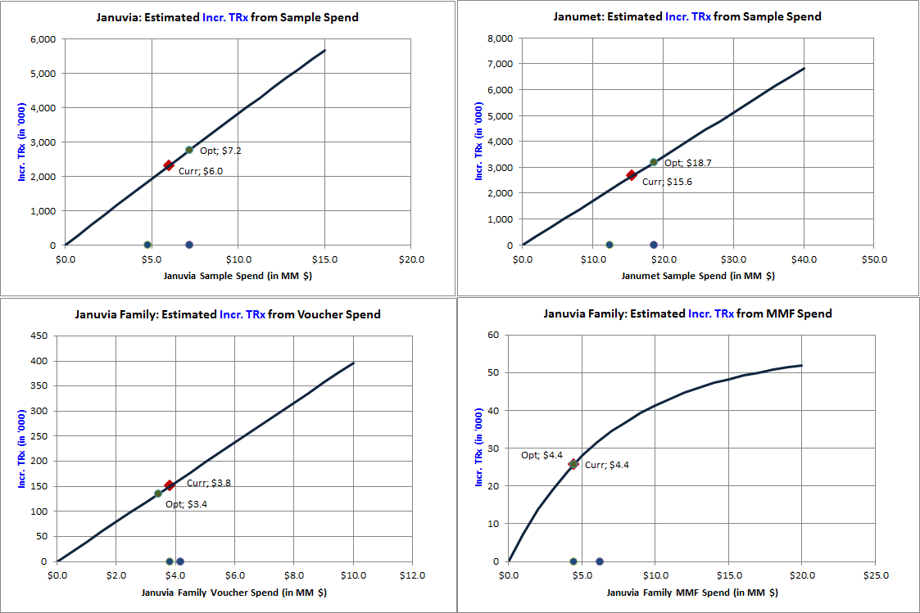
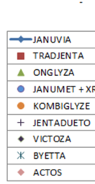
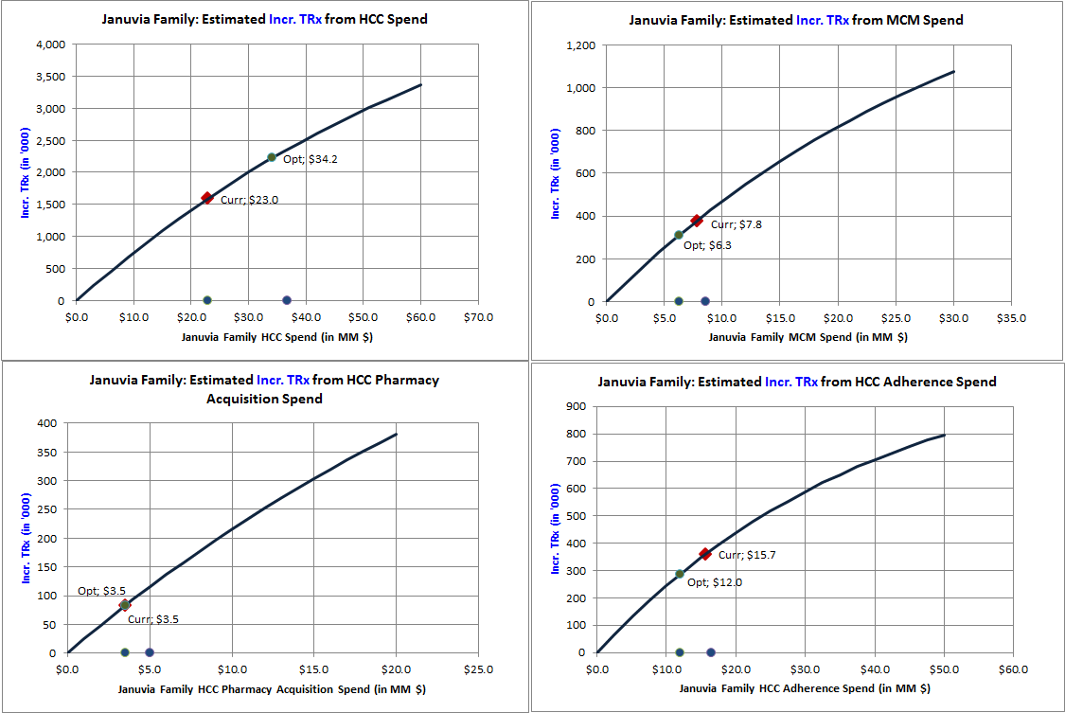
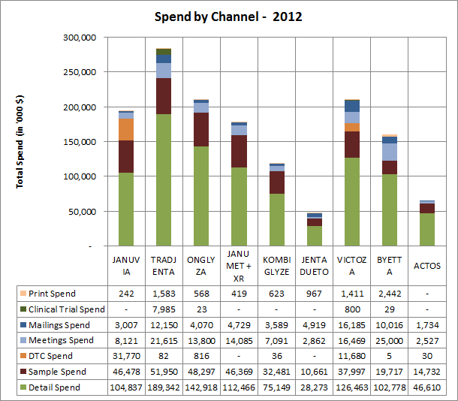
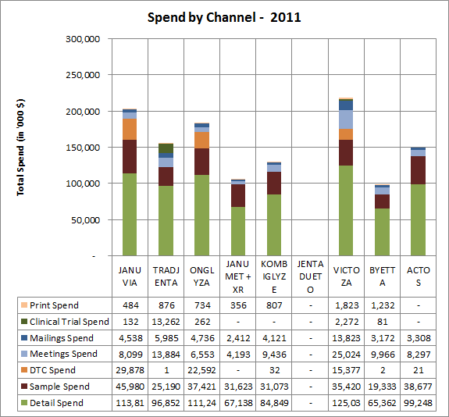
Overview of Multi-Faceted Approach
Influence product trend via recommendations based on competitive analysis and optimization.
Leverage competitive investment insights, historical brand investments and performance, and promotion response curves by promotion type to create optimization scenarios.
Competitive Analysis
Optimization from Promotion Response Curves
OPTIMIZE

Slide 4
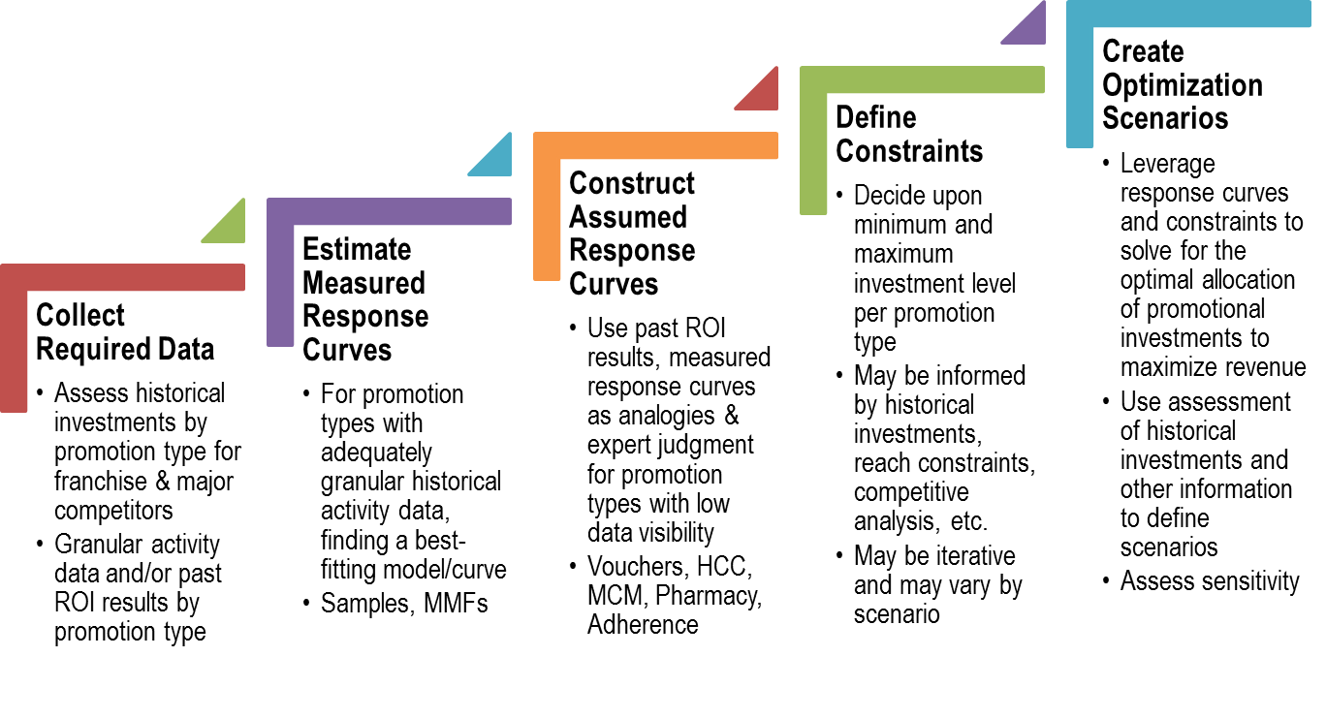
Optimization Process Steps
Marketing Collaboration Needed

Slide 5
Executive Summary: Recommendation & Rationale
Recommendation: During the next 12 months, invest an incremental $10MM and reallocate the current¹ Januvia® product family promotion budget for an expected contribution of approximately $130MM of incremental revenue (based on 3-year after-tax NPV and Standard Scenario +/- 20%)².
  Sources of incremental revenue contribution
    72% ($93MM) of the expected incremental revenue contribution is due to reallocation of the current budget.
    28% ($37MM) is due to the incremental $10MM investment assuming that this is optimally allocated.
  Incremental revenue contribution by year if changes/additions implemented as of 1 July 2013
Rationale: Commercial Analytics conducted extensive analysis of revenue contributions and ROI of historical Januvia® product family promotion to construct promotion response curves for major promotion types. These were leveraged to recommend reallocation using an optimization algorithm.
  Assessment of the competitive landscape, historical brand performance comparing promotion investment to product volume, and integration of expert input from Marketing were considered to define upper and lower constraints on promotion investments by type.
  All optimization scenarios suggest that there is considerable opportunity to effectively reallocate existing investments and to increase investment in key promotion types with low risk of saturation.
Year 1 | Year 2 | Year 3 +
$44MM | $50MM | $36MM
(1) Assumes that the Januvia® product family promotion budget is approximately $125.5MM during the 12 months starting in July 2013. If allocated similarly to 2S2013 plans, the total 3-year NPV contribution would be $741MM.
(2) The optimization scenario leveraged to generate these estimates allows investment in each existing promotion type to vary up to 20% in either direction vs. current plans. Other scenarios with different constraints yield different estimates of the potential impact of incremental investment and reallocation.

Slide 6
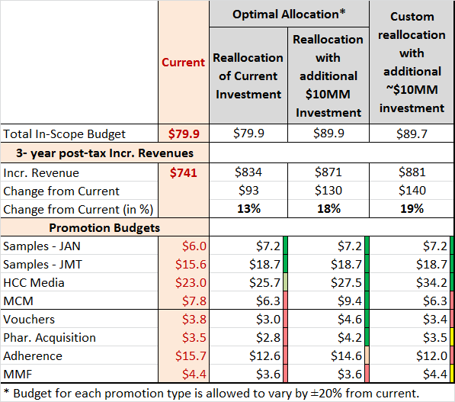

Executive Summary: Current vs. Optimal Allocations
Optimization consistently results in increased investment in Samples and HCC media, and reductions in Adherence. Vouchers, Pharmacy Acquisition, MMF and MCM recommendations vary between increasing, no change and decreasing.
1
2
2
2
(1) Out of scope expenses include: Production and Agency fees, Coupons, Managed Care, Public Affairs, Market Research.
(2) HCC Media, MCM and Vouchers exhibit promotion sensitivity in the middle of the observed range across studied promotion types for the Januvia® product family. An analysis of the sensitivity of the recommended allocations to bias in promotion responsiveness assumptions suggests increased investment in MCM and Vouchers if promotion sensitivity is substantially higher than historical levels. See Slide 12 for allocation sensitivity analysis.
Notes:
The first data row in this table should have “Total In-Scope Budget” in the first column.
Include callout box for HCC Media – Custom Reallocation only – that lower response may be in play.

Slide 7
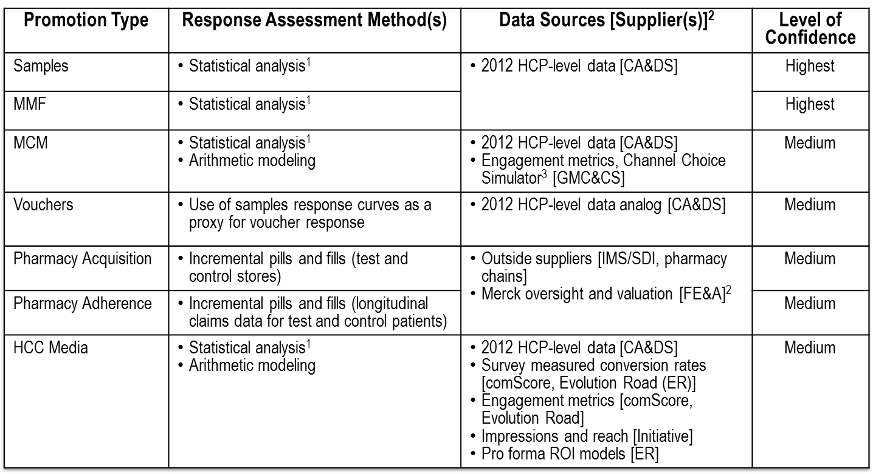
Executive Summary: Confidence in Promo. Response
The resource allocations suggested by the optimization model depend upon promotion response curves. The level of confidence associated with these varies by promotion type and should be considered when making investment decisions.
(1) Statistical analysis of in-market data studying the association between the promotion and NRx volume (as a proxy for new patient starts). Leverages multivariate models to control for potential confounding influences while isolating the effect of the promotion. May include use of a prospectively held out control group or retrospectively matched comparison group.
(2) All financial valuation carried out in accordance with Financial Evaluation & Analysis models.
(3) Pro forma ROI modeling tool created/maintained by CA&DS and used by GMC&CS Promotion and MCM managers.
Notes:
Need to complete this...

Slide 8
Assessment of Historical Investments
- Major Competitors Indexed vs. Franchise
- Franchise Investment and Rx Trends
- Franchise Best-Quarter Spends

Slide 9
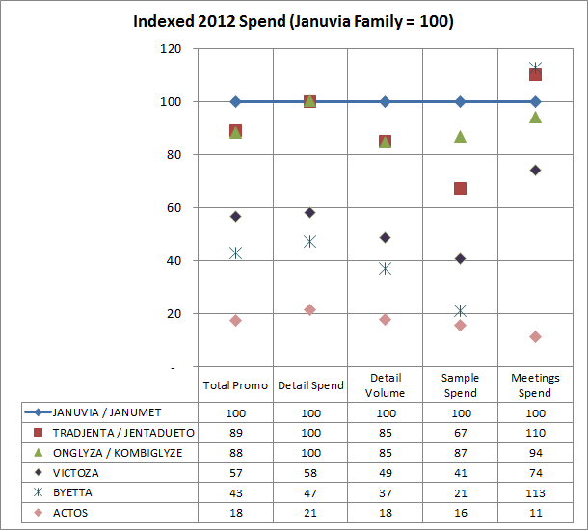
Competitor Spend by Type – 2012 Index Chart
Indexed chart depicts spend by competitors across different promotion types with respect to Januvia Family (whose index equals 100 for each promotion type)
This chart indexes the Januvia Family’s spend in each promotion type to 100 and compares the competitors in terms of the normalized indexes.
Growing brands like Tradjenta Family have large spends in meetings.
When Tradgenta / Jentaduetto and Onglyza / Kombiglyze are considered together, a possible increase in Januvia / Janumet (IR + XR) samples may be helpful.
Data Source: CSD audit
Notes:
Footnote what is in print and mailings, or add a bullet to clarify that DTC is not included here.

Slide 10
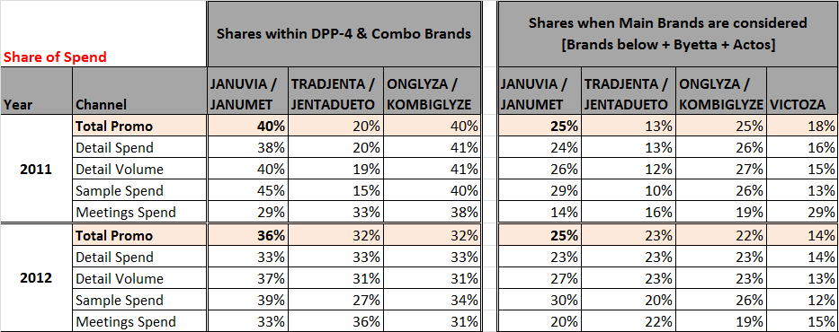
Competitor Spend by Type – Share of Voice
Januvia / Janumet (IR + XR) share of voice among most of the listed channels are slightly lower in 2012, when compared to 2011. Sample spend has reduced by 6%.
Data Source: CSD audit
Notes:
Footnote what is in print and mailings, or add a bullet to clarify that DTC is not included here.

Slide 11
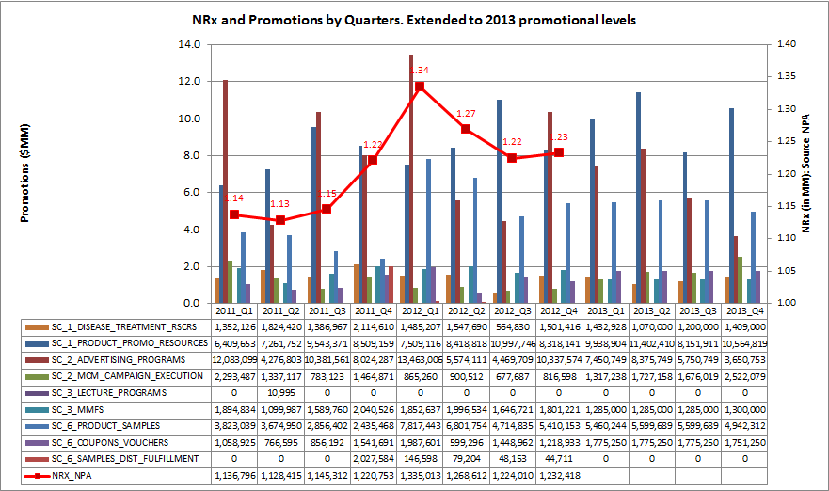
Januvia Family NRx and Historic Spend
Januvia® Family NRx grew between 2011-Q2 to 2012-Q1 then started dropping in 2012-Q2/Q3
2012-Q1 has the maximum spend (with some upfront spends) and the maximum NRx as well.
2011-S2 is the growth period. This period is further considered for historical comparison of spends.
Trends of Detail count, Sample spend, Coupon/Voucher spend, MMF spend and DTC Spend correlate well with Januvia® Family NRx trend. This may not represent causation.
Data Source: NPA audit

Slide 12
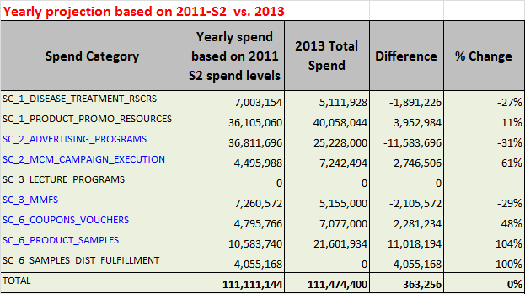
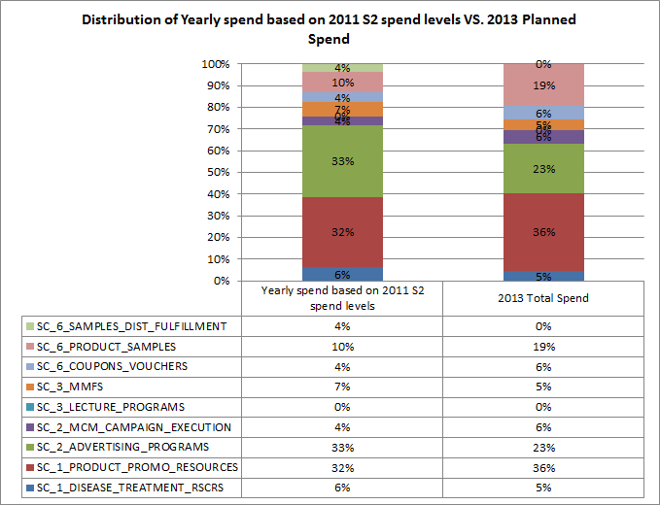
2013 Investment Plan vs. 2011 S2 Investments
Comparing with 2011 growth period (2011-S2), there is a potential to increase 2013 spend by $10 MM when considering samples, vouchers, HCC, MCM and MMF programs.
2011-S2 was the recent growth period in terms of NRx. Projecting the spend in 2011-S2 to full year level would result in approximately same 2013 budget level. Items in blue are considered for allocation purposes.
DTC and MMFs are under funded and MCM is over funded when compared to 2011-S2 mix.
In terms of sample days of therapy, Januvia and Janumet IR samples are under funded in 2013. In 2011, Janumet XR was not launched.
Considering equivalent sample days of therapy and the spends for other promotion types like DTC, MMF, Vouchers and MCM, an additional ~$10MM spend may be needed to match the 2011-S2 activities (calculations not shown here).
Spend Data Source: Finance

Slide 13
Analyzed Promotion Types &
Promotion Response Curves

Slide 14
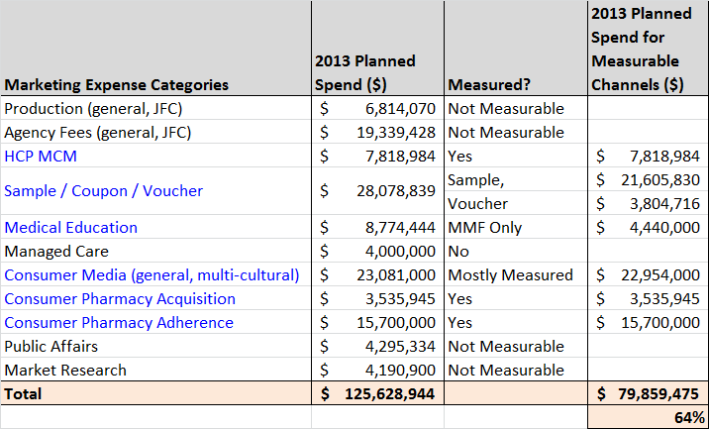
Measured Marketing Expense Categories
About 64% of the marketing expense categories that are measurable were accounted in the analysis
Measurable promotion types are MCM, Sample, Voucher, Medical Education (MMF only), Consumer Media (HCC), Pharmacy Acquisition and Adherence programs.
Measured promotion types account for about $80MM [64%] of the $125MM planned spend.
Marketing spends were initially obtained from GMC team. Some line items like acquisition programs were updated with later versions got from marketing team.
Data Source: Merck GMC
Notes:
Managed Care may be considered “Phase 2”...but understand what is in this expense category...

Slide 15
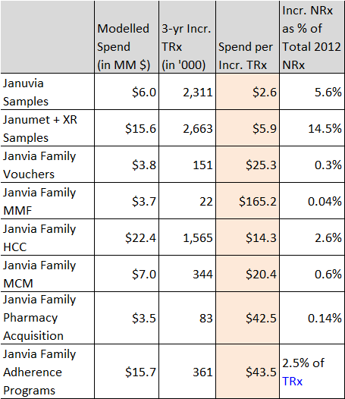
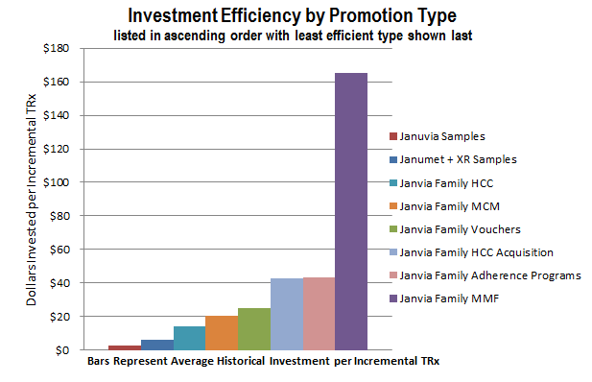
Impact Summary by Promotion Type
Spend for one Incremental TRx is lowest for samples* and highest for MMF. Optimal budget allocation for each promotion type is guided by this impact.
* Samples are requested and received by prescribers for use by and benefit of patients. Samples provide the opportunity to gain experience with a product. The sample-related values shown here reflect the association between samples and new patient starts rescaled into TRx terms for comparability to other investment types; this applies to vouchers as well, which are treated as an alternative mechanism to provide samples to patients. (vs. “samples” left by Field personnel).

Slide 16
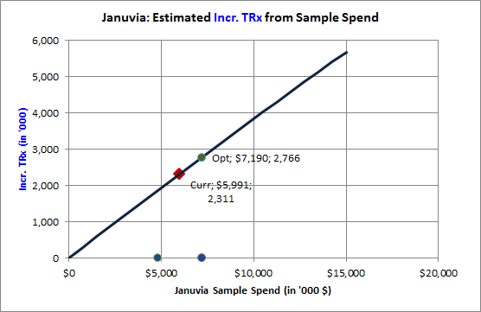
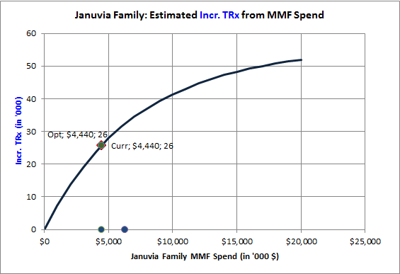
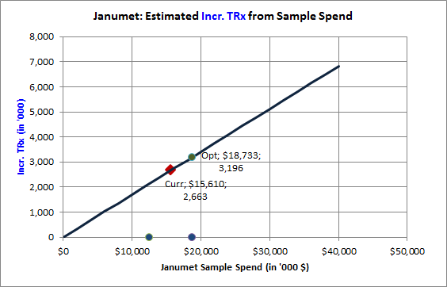
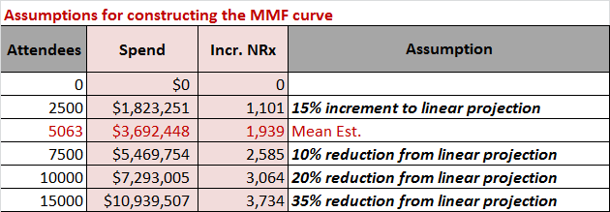
Measured Response Estimates & Curves: Samples & MMF
Sample curves were modeled from 2012 HCP level data. MMF curve was constructed to satisfy the diminishing returns assumptions and also to pass through the current modeled impact using 2012 HCP level attendee data.
Possible Optimal
Allocation
Measured
Impact
Currently
Planned Spend
Incremental TRxs are realized in 3 years. The spends are in pre-tax scale
* Samples are requested and received by prescribers for use by and benefit of patients. Samples provide the opportunity to gain experience with a product. The sample-related values shown here reflect the association between samples and new patient starts rescaled into TRx terms for comparability to other investment types; this applies to vouchers as well, which are treated as an alternative mechanism to provide samples to patients. (vs. “samples” left by Field personnel).

Slide 17
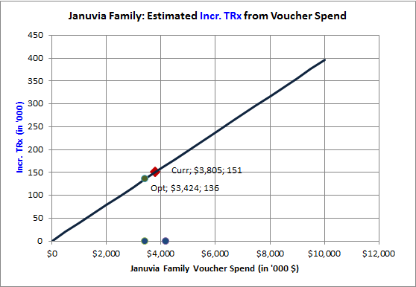
Assumed Response Curve by Proxy: Voucher Redemptions
Sample curves are used as a proxy to construct response curves for voucher redemptions. Impact from one redemption is assumed to be equivalent to the impact of 30 days of therapy of samples
Voucher redemptions here include both Field and Web programs.
Incremental TRxs are realized in 3 years. The spends are in pre-tax scale
* Samples are requested and received by prescribers for use by and benefit of patients. Samples provide the opportunity to gain experience with a product. The sample-related values shown here reflect the association between samples and new patient starts rescaled into TRx terms for comparability to other investment types; this applies to vouchers as well, which are treated as an alternative mechanism to provide samples to patients. (vs. “samples” left by Field personnel).

Slide 18
Assumed Response Curves using Aggregated Historic ROI’s: HCC, MCM, Acquisition and Adherence
Curves are calibrated using historic tactic ROIs and assumptions on maximum impact when spend increases infinitely.
Current: 2.6% of NRx
Assumed Max: 10% of NRx
Current: 0.6% of NRx
Assumed Max: 3% of NRx
Current: 0.14% of NRx
Assumed Max: 1.5% of NRx
Current: 2.5% of TRx
Assumed Max: 7.5% of TRx
Incremental TRxs are realized in 3 years. The spends are in pre-tax scale

Slide 19
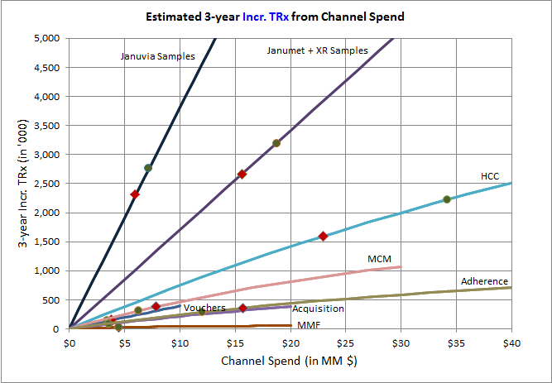
Combined Promotion Response Curves
High Impact: Samples, HCC programs.
Medium Impact: MCM, Vouchers and Adherence programs.
Low Impact: Pharmacy Acquisition programs and MMF
Red square points on each curve represents the impact at currently planned spend
Green circles illustrates the optimal allocation for each curve
In general, promotion types could be grouped into High, Medium and Low impact (in terms of incr. TRx per $ spent)
  High: Samples, HCC
  Medium: MCM, Vouchers,
  Low: Pharmacy Acquisition, Adherence programs and MMF
Investments would be first prioritized for High Impact promotion types followed by medium and then low impact promotion types.
Minimum & maximum allocation constraints are specified for each promotion type.
Possible Optimal
Allocation
Currently
Planned Spend
Incremental TRxs are realized in 3 years. The spends are in pre-tax scale
* Samples are requested and received by prescribers for use by and benefit of patients. Samples provide the opportunity to gain experience with a product. The sample-related values shown here reflect the association between samples and new patient starts rescaled into TRx terms for comparability to other investment types; this applies to vouchers as well, which are treated as an alternative mechanism to provide samples to patients. (vs. “samples” left by Field personnel).

Slide 20
Optimal Allocation of Spend by Promotion Type:
Case Studies

Slide 21
Scenarios Considered for Budget Allocation
Scenarios considered for allocation: Standard +or-20%, Standard +or-30% and Custom
Two Standard Scenarios
  Total budgets change in the increment of $5MM (from $-15MM to $+15MM).
  Standard ±20%: Promotion types are allowed to vary their budgets by ±20% of current level.
  Standard ±30%: Promotion types are allowed to vary their budgets by ±30% of current level.
Custom Scenario
  Total spend is similar to 2012-S2 (Jul-2011 to Dec-2011) projected level of about $90 MM.
    Projection for samples considers Days of Therapy of samples in supply as Janumet XR was not launched in 2011..
  Allowed minimum and maximum budgets are based on balance between inputs from brand team, comparison to historic growth period (2011-S2) and some considerations to competitor spends.
    Samples: + or – 20% from current.
    Vouchers: + or – 10% from current.
    HCC: Current spend of ~$23MM to $36.8MM (2011-S2 equivalent)
    MCM: -20% to +10% of current.
    Acquisition: Current spend of ~$3.5MM to $5.0MM
    Adherence: $12MM to $16.5MM
    MMF: Current spend of ~$4.4MM to $6.3MM (2011-S2 equivalent)

Slide 22
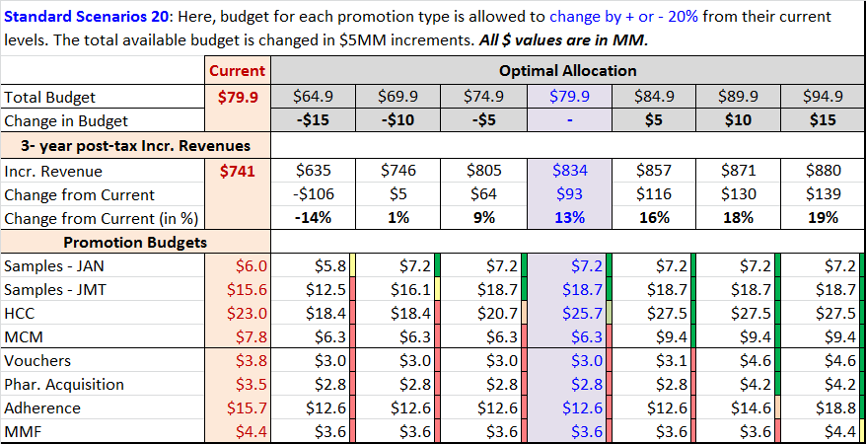
Optimal Allocation: Standard Scenario ±20%
By increasing the total budget by $10MM and allowing a ±20% budget change for each of the promotion type, the optimal reallocation results in an increase of $130MM in 3-year incremental revenue.
Current $80MM investment results in $741MM 3-year incr. revenue. About 34% could be realized in the first year.
  Reallocation of $80MM may yield an additional $93 MM incr. revenue.
Optimal allocation with $90MM spend may increase incr. revenue by $130 MM.
* Samples are requested and received by prescribers for use by and benefit of patients. Samples provide the opportunity to gain experience with a product. The sample-related values shown here reflect the association between samples and new patient starts rescaled into TRx terms for comparability to other investment types; this applies to vouchers as well, which are treated as an alternative mechanism to provide samples to patients. (vs. “samples” left by Field personnel).

Slide 23
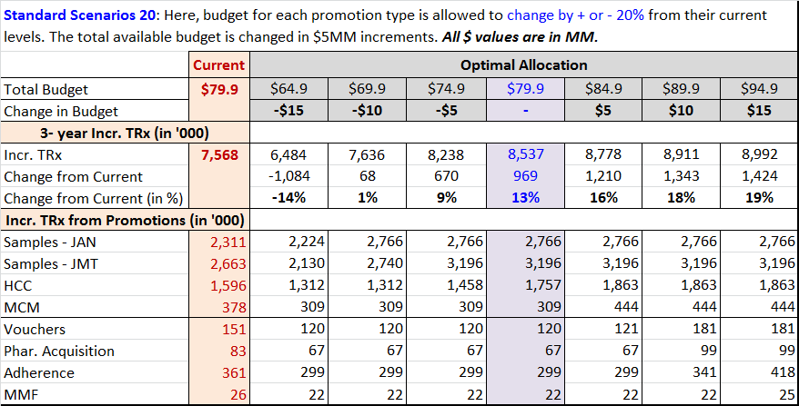
Optimal Allocation: Standard Scenario ±20% (Incr. TRx)
By increasing the total budget by $10MM and allowing a ±20% budget change for each of the promotion type, the optimal reallocation results in 18% increase in 3-year incremental TRx.
Current $80MM investment results in 7.5MM 3-year incr. TRx. About 34% could be realized in the first year.
  Reallocation of $80MM may yield an additional 13% incr. TRx.
Optimal allocation with $90MM spend may increase incr. TRx by 18%.
* Samples are requested and received by prescribers for use by and benefit of patients. Samples provide the opportunity to gain experience with a product. The sample-related values shown here reflect the association between samples and new patient starts rescaled into TRx terms for comparability to other investment types; this applies to vouchers as well, which are treated as an alternative mechanism to provide samples to patients. (vs. “samples” left by Field personnel).

Slide 24
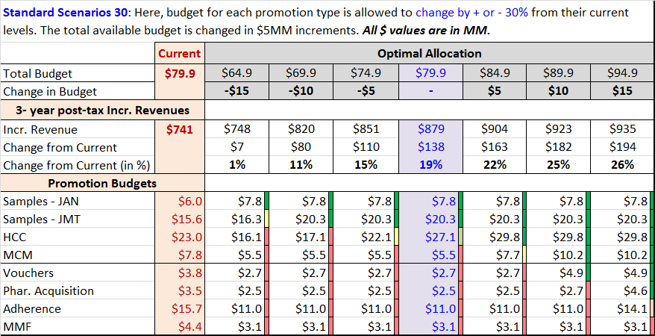
Optimal Allocation: Standard Scenario ±30%
By increasing the total budget by $10MM and allowing a ±30% budget change for each of the promotion type, the optimal reallocation results in an increase of $182MM in 3-year incremental revenue.
Current $80MM investment results in $741MM 3-year incr. revenue. About 34% could be realized in the first year.
  Reallocation of $80MM may yield an additional $138 MM incr. revenue.
Optimal allocation with $90MM spend may increase incr. revenue by $182 MM.
* Samples are requested and received by prescribers for use by and benefit of patients. Samples provide the opportunity to gain experience with a product. The sample-related values shown here reflect the association between samples and new patient starts rescaled into TRx terms for comparability to other investment types; this applies to vouchers as well, which are treated as an alternative mechanism to provide samples to patients. (vs. “samples” left by Field personnel).

Slide 25

Optimal Allocation: Standard Scenario ±30% (Incr. TRx)
By increasing the total budget by $10MM and allowing a ±30% budget change for each of the promotion type, the optimal reallocation results in 25% increase in 3-year incremental TRx.
Current $80MM investment results in 7.5MM 3-year incr. TRx. About 34% could be realized in the first year.
  Reallocation of $80MM may yield an additional 19% incr. TRx.
Optimal allocation with $90MM spend may increase incr. TRx by 25%.
* Samples are requested and received by prescribers for use by and benefit of patients. Samples provide the opportunity to gain experience with a product. The sample-related values shown here reflect the association between samples and new patient starts rescaled into TRx terms for comparability to other investment types; this applies to vouchers as well, which are treated as an alternative mechanism to provide samples to patients. (vs. “samples” left by Field personnel).

Slide 26
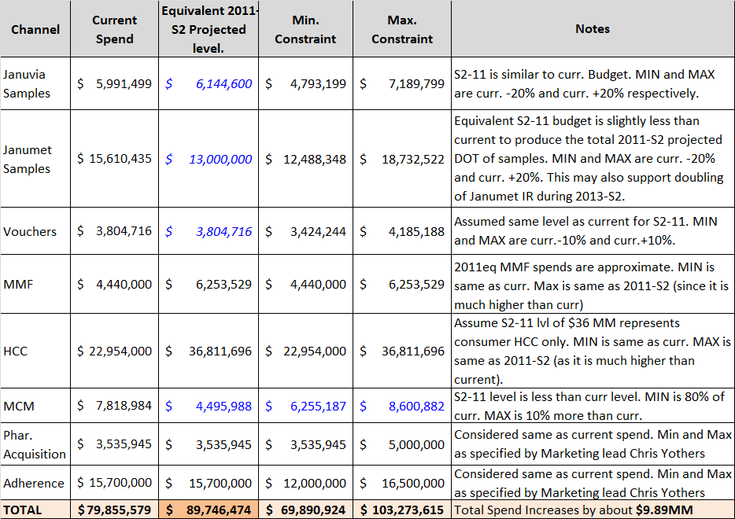
Optimal Allocation: Custom Case
Custom Case is built based on inputs from brand team. Budgets are also compared to the investments during historic growth period (2011-S2). Some consideration to competitor spends are also incorporated (ex: samples).
Custom Case: Allowed minimum and maximum budgets are based on balance between inputs from brand team, comparison to historic growth period (2011-S2) and some considerations to competitor spends.
  Based on 2011-S2 projection, an additional spend of about $10MM may be required to maintain the right level of promotions (for samples, days of therapy is considered for comparison to 2011-S2).

Slide 27
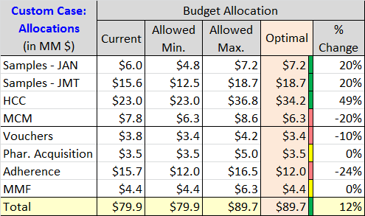
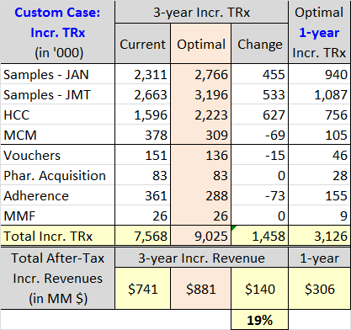
Optimal Allocation: Custom Case
Samples and HCC programs get more allocation at the expense of other promotion type budgets. Acquisition and MMF retains their current budget. After-tax 3-year incremental revenues increases by an estimated $140 MM (19% increase)
Custom Case Results
  Total budget is up by $10MM. Budgets for Samples and HCC are increased. Acquisition and MMF budgets remains at current level. Budgets for all other promotion types are reduced.
  By optimal redistribution of budgets, incremental revenue increases by 19% to $881MM.
* Samples are requested and received by prescribers for use by and benefit of patients. Samples provide the opportunity to gain experience with a product. The sample-related values shown here reflect the association between samples and new patient starts rescaled into TRx terms for comparability to other investment types; this applies to vouchers as well, which are treated as an alternative mechanism to provide samples to patients. (vs. “samples” left by Field personnel).

Slide 28
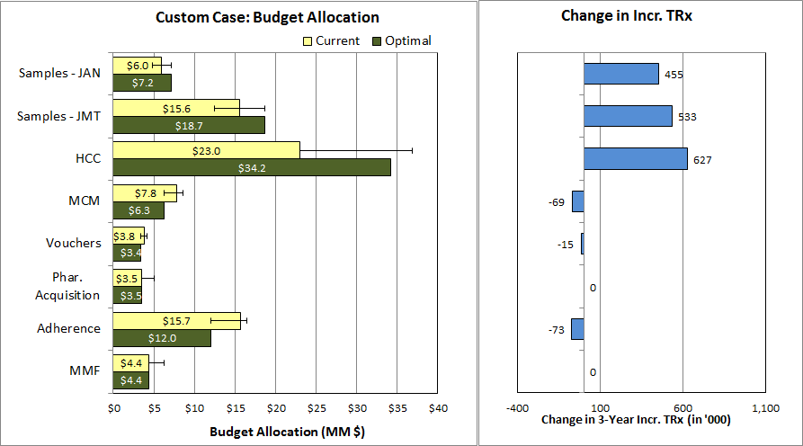
Optimal Allocation: Custom Case
Samples and HCC programs gets more allocation . Acquisition and MMF remains same. Other promotion type budgets are reduced. After-tax 3-year incremental revenues increases by an estimated $140 MM (19% increase) when compared to the current allocation.
Total budget: $89.7 MM; 3-Year incr. revenue: $881 MM; 1-Year incr. revenue: $306 MM
* Samples are requested and received by prescribers for use by and benefit of patients. Samples provide the opportunity to gain experience with a product. The sample-related values shown here reflect the association between samples and new patient starts rescaled into TRx terms for comparability to other investment types; this applies to vouchers as well, which are treated as an alternative mechanism to provide samples to patients. (vs. “samples” left by Field personnel).

Slide 29
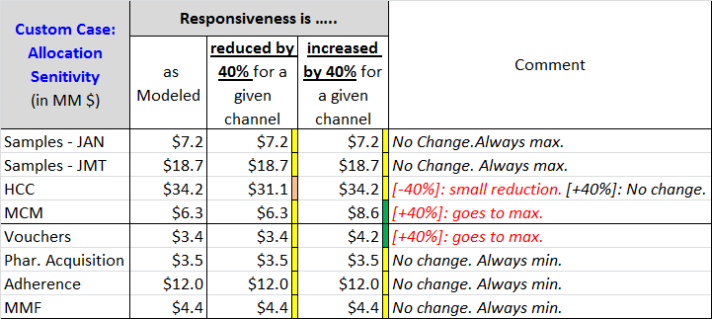
Allocation Sensitivity: Custom Case
Promotion types insensitive to large changes in responsiveness: Samples, Acquisition, Adherence and MMF
MCM, Voucher allocation increases if responsiveness is increased by 40% or more
HCC has a small reduction if responsiveness is reduced by 40% or more
Sensitivity Analysis
  A wide variation in responsiveness is used to determine allocation sensitivity.
  Samples always gets maximum allowed allocation and is not sensitive to changes in responsiveness.
  Acquisition, Adherence and MMF gets minimum allowed allocation and are not sensitive to change in responsiveness.
  Allocation of funds between HCC, MCM, and Vouchers vary according to the variation in responsiveness.
    MCM and Voucher allocation increases if their responsiveness is increased by 40% or more.
    HCC allocation decreases a little if their individual responsiveness is decreased by 40% or more.
NOTE: Same exact allocations as above are obtained when responsiveness is reduced by HALF or DOUBLED

Slide 30
Next Steps
Identify Marketing team member(s) to collaborate with Commercial Analytics to review and, if necessary, refine key optimization process assumptions (e.g., minimum and maximum investment level constraints by promotion type) and scenarios characteristics.
Produce refined scenarios and review with Marketing leadership.
Share recommendations for key scenarios with Rick Hartz and Graeme Bell (by mid-May).

Slide 31
Appendix: Competitive and Historical Spends

Slide 32
Objectives and Approach
Objectives
  Allocate marketing promotional spends so as to maximize the incremental revenues
  Explore competitor spend levels and our historic spends for the allocation
  Understand brand team perspectives to further refine the analysis
Approach
  Identify promotion types for which promotion responses may be estimated
    In Scope: Samples, Vouchers, MMF, HCC Promotions, MCM, Pharmacy Acquisition, Adherence
  Build Promotional Response Curves to quantify the impact of various promotion types
    Use historic data and previously measured ROIs to build response curves
  Combine the promotion type responses and optimally allocate the spends to maximize the incremental revenues under scenarios such as:
    Base: Total budget is at current level. promotion type spends vary around their current levels.
    Competitive: Total budget and key (meetings & samples) promotion type spends are allowed to vary up to the competitor levels.
    Historical: Total budget and the promotion type spends are similar to 2012-Q1 levels (historically best)

Slide 33
Januvia Family NRx and Historic Spend
Januvia® Family NRx grew between 2011-Q2 to 2012-Q1 then started dropping in 2012-Q2/Q3
2012-Q1 has the maximum spend and the maximum NRx as well.
Data Source: NPA audit

Slide 34
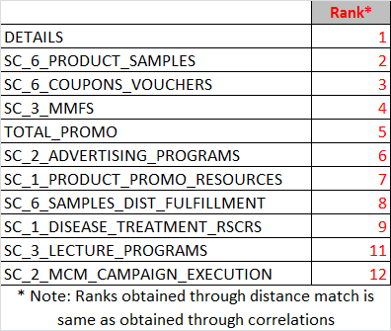
Matching trends between Spend Category and NRx
Spend on samples, voucher/coupons, MMF and DTC correlates with NRx Trend. Detail count also correlates well.
Trends of Detail count, Sample spend, Coupon/Voucher spend, MMF spend and DTC Spend correlate well with Januvia® Family NRx trend. This may not represent causation.
Part of product promotional resources spend is for materials in support of Sales Force detailing, however this spend does not seem to correlate well with NRx trend.
Spend Data Source: Merck

Slide 35
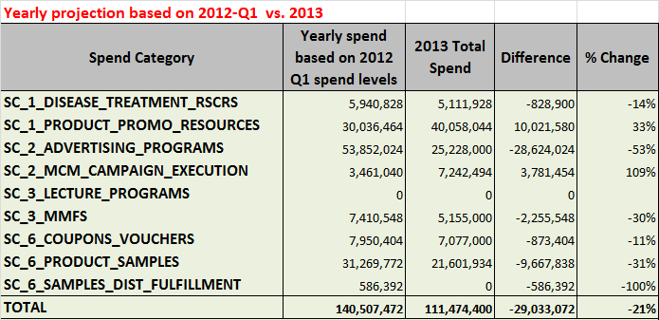
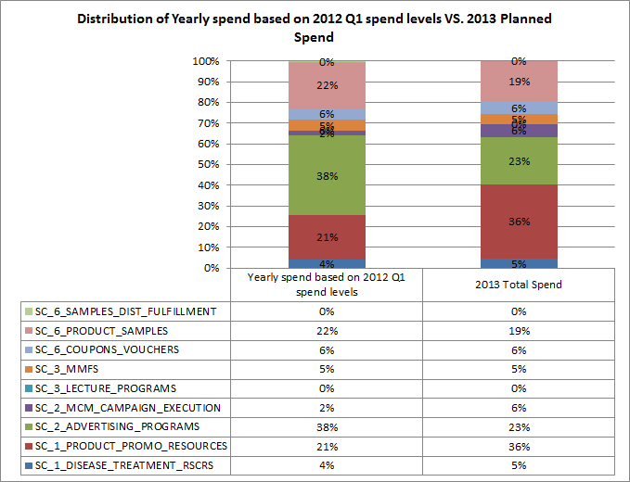
2013 Investment Plan vs. 2012 Q1 Investments
Comparing with best quarter (2012-Q1), there is a potential to increase 2013 spend by $29MM
2012-Q1 had best NRx. Projecting the spend in 2012-Q1 to full year level would result in $140 MM.
2013 planned spend of $111 MM is about 21% lower than the projected yearly spend based on 2012-Q1 spend.
Samples, DTC and Vouchers/Coupons are under-funded when compared to 2012-Q1 mix.
Promotion types considered for optimal allocation based on 2012-Q1 levels: Samples, Vouchers, MMF, MCM and HCC (advertising) programs. Spends are allowed to vary up to annualized 2012-Q1 level +10%.
Spend Data Source: Finance

Slide 36
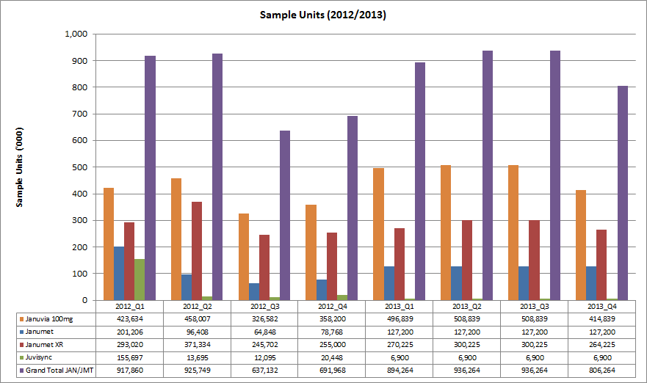
Trends in Sample Units
Janumet ® sample units fell drastically from 2012-Q2 to 2012-Q4.
Janumet ® Samples decreased substantially from 2012-Q2 to 2012-Q4. The next slide shows trends in sample units vs. NRx share.
Data Source: Marketing / Forecast (internal)

Slide 37
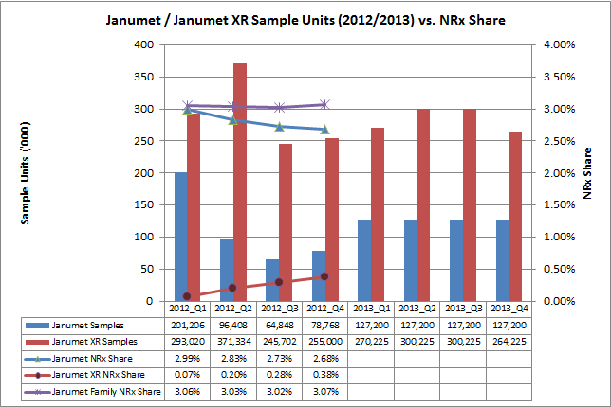
Janumet® Family Trends in Sample Units vs. NRx Share
Janumet ® sample units fell drastically from 2012-Q2 to 2012-Q4. Janumet ® Family NRx Share is flat in 2012.
Janumet ® Samples decreased substantially from 2012-Q2 to 2012-Q4. From the above chart, it appears that the fall in Janumet ® NRx share is compensated by increase in Janumet XR® NRx share.
Open question: Would it be possible to decrease the fall in Janumet® trend by increasing Janumet® samples but still retain the Janumet XR® sampling levels?
Data Source: Marketing / Forecast (internal)

Slide 38
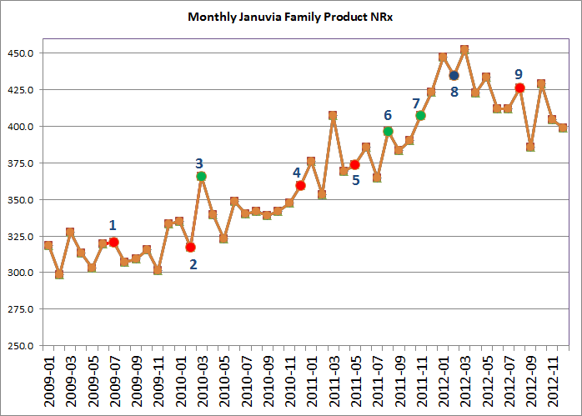
Events Chart
Various Market Events and Januvia Family NRx Trend
Onglyza launch [Jul-09]
Victoza launch [Feb-10]
Avandia off market FDA communication [Mar-10]
Kombiglyze launch [Dec-10]
Tradgenta launch [May-11]
Actos warning, Januvia promotion changes [Aug-11]
Juvisunc launch [Nov-11]
Janumet XR® launch, Jentaduetto launch, Bydureon launch [Feb-12]
Actos off patent [Aug-12]
Data Source: NPA audit

Slide 39
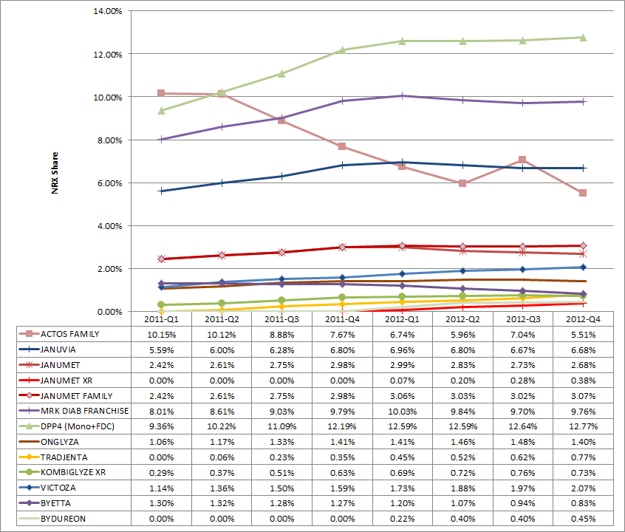
Quarterly NRx Share Chart
Tradjenta and Victoza are growing in 2012. All others are flat or decreasing in 2012.
DPP4 and GLP-1 Brands are growing in 2011
Most DPP4 brands are flat in 2012
Tradgenta (DPP4) and Victoza (GLP-1) are growing in 2012
  What do they do differently?
Janumet ® Family is flat in 2012.
  Janumet® keeps falling (due to drastic fall in samples?)
  Janumet XR ® grows slowly
Actos has a steep fall even in 2012-Q2 when Januvia® falls as well.
  Loss of business from Actos may not be the only reason for Januvia®’s fall.
Data Source: NPA audit

Slide 40
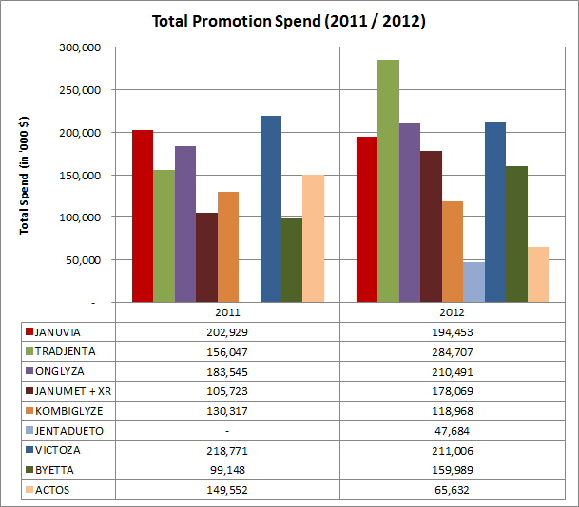
CSD Total Promotions Spend
In 2012, Tradjenta increased its total spend by a large margin. Onglyza and Victoza has similar spend like Januvia®. Janumet ® (+ XR) spend increase in 2012 is largely due to the spend associated with Janumet XR®.
Data Source is CSD. promotion types measured by CSD are: Details, Samples, DTC (TV), Meetings, Mailings, Clinical Trials and Print.
Due to the nature of data collection (small panels), these spends are approximate and directional.
Januvia® 2011 and 2012 spends are similar.
Spend on Janumet® + XR increased in 2012. Large portion of this may be for Janumet XR®.
Tradjenta has increased its 2012 spend by a large amount. Onglyza also increased marginally in 2012.
Victoza has more or less same spend as Januvia®. Byetta’s spend increased in 2012.
JentaDueto was launched in 2012 and has noticeable spend.
Data Source: CSD audit

Slide 41
CSD Spend by Promotion Type - 2011
Details are a bigger component of overall promotion spends captured by CSD. Januvia®’s Sample spend is comparable to other major brands .
Details are the bigger component of the total spend.
Tredjenta launched in May-2011, probably that is why its spend seems lower overall.
Relatively Januvia®’s sample spend is comparable to other products.
Kombiglyze has higher spend than Janumet® in 2011 (Janumet XR® not launched yet).
Details are more or less similar for Januvia®, Tradjenta, Onglyza and Victoza.
DTC here captures only TV (i.e., does not give a complete picture).
JentaDueto was not launched in 2011.
Data Source: CSD audit

Slide 42
CSD Spend by Promotion Type - 2012
In 2012, Tradjenta leads the market in terms of details and samples. Januvia® and Janumet® (+ XR) lags behind Tradjenta, Onglyza and Victoza. Janumet® (+ XR) leads in DPP-4 Combo market.
Tradjenta has a large spend in details and samples when compared to Januvia®.
Onglyza also has a larger detail spend.
Janumet XR® launched in early 2012.
In DPP-4 Combo class, Janumet® (+ XR) has a relatively larger overall spend. A large portion of the spend probably goes to Janumet XR®.
In terms of details. Januvia® and Janumet® lags behind Tradjenta, Onglyza and Victoza.
There is a potential for increasing samples for Januvia® and Janumet®.
  Competitors have larger presence in terms of samples.
Competitors have a significantly larger spend in meetings than Januvia® and Janumet® (+ XR).
Data Source: CSD audit

Slide 43

CSD Spend by Promotion Type – 2012 Index Chart
Indexed chart depicts spend by competitors across different promotion types with respect to Januvia® (whose index equals 100 for each promotion type)
This chart indexes the Januvia®’s spend in each promotion type to 100 and compares the competitors in terms of the normalized indexes.
Growing brands like Tradjenta has larger spends in most important promotion types, particularly the meetings.
Other major brands like Onglyza and Victoza have similar spends like Januvia® and/or Janumet® (+ XR).
Chart is scaled to a maximum index value of 300. Data table shows some promotion types with much higher indices.
Data Source: CSD audit

Slide 44
Competitor Spend by Type – 2012 Index Chart
Indexed chart depicts spend by competitors across different promotion types with respect to Januvia® (whose index equals 100 for each promotion type)
This chart indexes the Januvia®’s spend in each promotion type to 100 and compares the competitors in terms of the normalized indexes.
Growing brands like Tradjenta have larger spends in most important promotion types, particularly the meetings.
Other major brands like Onglyza and Victoza have similar spends like Januvia® and/or Janumet® (+ XR).
For optimal spend allocation based on competitor spends:
  Januvia Sample spends are allowed to increase from current 2013 levels by 110% (Tradjenta Samples) to 140% (Tradjenta Details)
  Meetings (MMF) Spends varies between a minimum of 170% (Onglyza meetings) to a maximum of 270% (Tradjenta meetings)
Data Source: CSD audit
Chart is scaled to a maximum index value of 300. Data table shows some promotion types with much higher indices.
Notes:
Footnote what is in print and mailings, or add a bullet to clarify that DTC is not included here.

Slide 45
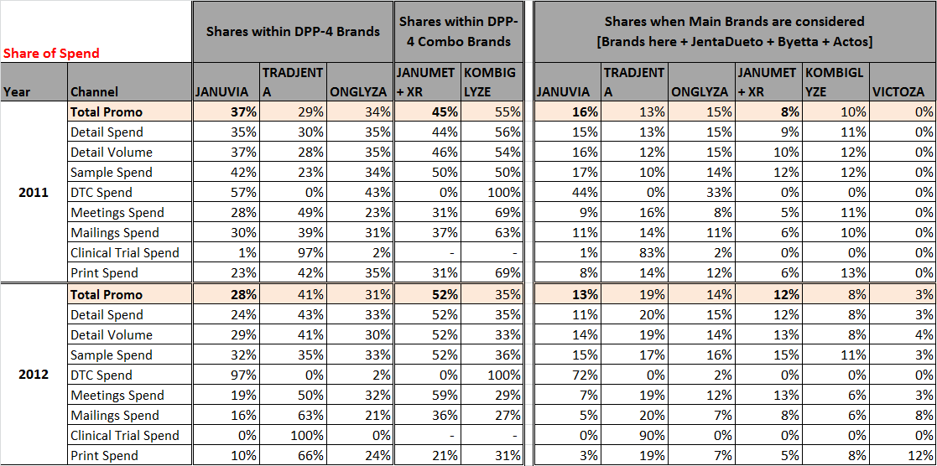

Share of Spend – 2011 vs. 2012
For most promotion types, Share of Spend for Januvia® and Janumet® (+ XR) in 2012 has decreased compared to 2011.
Data Source: CSD audit

Slide 46
Appendix: Allocation Analysis

Slide 47
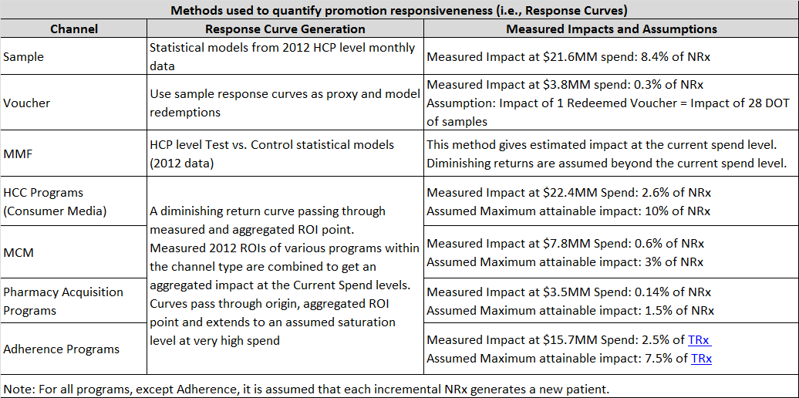
Promotion Response Computation: Methods and Assumptions
Various techniques are used to compute promotional response curves based on granularity of available data for modeling and the measured ROIs of various programs within a given promotion type. Accuracies are generally higher around the historic spend levels.
MMF, HCC, MCM, Acquisition and Adherence programs have measured ROI at the current spend levels (i.e., point estimates). For each of these promotion types, an appropriate diminishing return curve is computed from this ROI and assumed saturation point.
Notes:
Split last column into multiple columns (Measured Spend Level, NRx Contribution, Assumption Notes, Confidence Level)

Slide 48
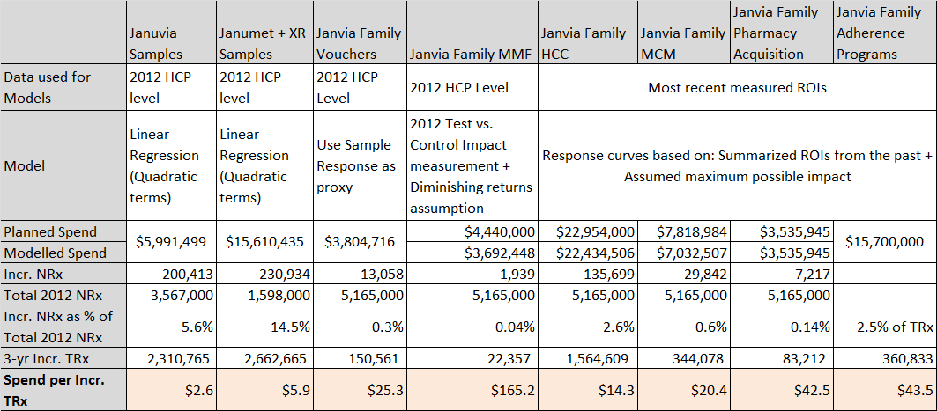
Promotion Response Models and Impact Summary
Spend for one Incremental TRx is lowest for samples and highest for MMF. Optimal budget allocation for each promotion type is guided by this impact.
* Samples are requested and received by prescribers for use by and benefit of patients. Samples provide the opportunity to gain experience with a product. The sample-related values shown here reflect the association between samples and new patient starts rescaled into TRx terms for comparability to other investment types; this applies to vouchers as well, which are treated as an alternative mechanism to provide samples to patients. (vs. “samples” left by Field personnel).
Notes:
Think about the base of Total 2012 NRx and how to express JAN vs. JMT/XR contribution

Slide 49
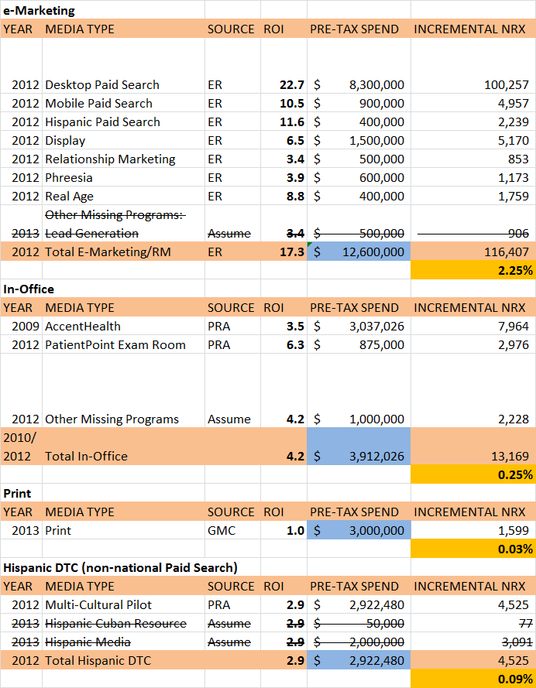
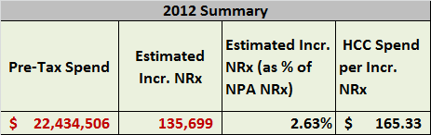
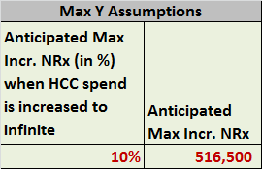

HCC Programs
Tactic ROIs are collected from various sources and summarized to get total HCC Spend and its impact. Summarized impact and a possible maximum of 10% impact in NRx from this promotion type are used to compute response curves.
A maximum of 10% impact in NRx is assumed to be attainable through this promotion type (i.e., when spends are drastically increased)

Slide 50
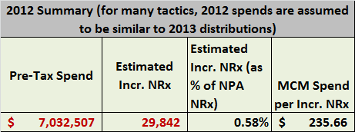
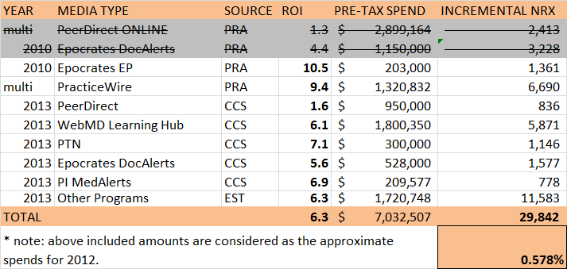
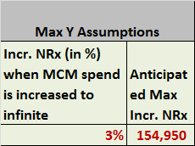

MCM Programs
Tactic ROIs are collected from various sources and summarized to get total MCM Spend and its impact. Summarized impact and a possible maximum of 3% impact in NRx from this promotion type are used to compute response curves.
A maximum of 3% impact in NRx is assumed to be attainable through this promotion type (i.e., when spends are drastically increased)

Slide 51
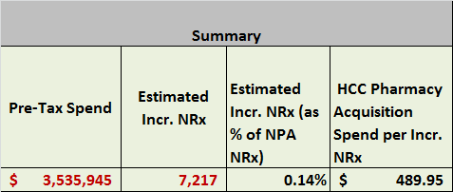
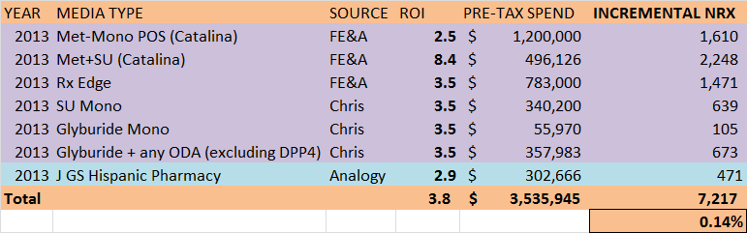


Pharmacy Acquisition Programs
Tactic ROIs are collected from various sources and summarized to get total Acquisition Spend and its impact. Summarized impact and a possible maximum of 1.5% impact in NRx from this promotion type are used to compute response curves.
A maximum of 1.5% impact in NRx is assumed to be attainable through this promotion type (i.e., when spends are drastically increased)

Slide 52



Adherence Programs
Tactic ROIs are collected from various sources and summarized to get total Adherence program Spend and its impact. Summarized impact and a possible maximum of 7.5% impact in TRx from this promotion type are used to compute response curves.
For Adherence programs, ROIs are calculated using Incr. TRx as the measurement scale.
A maximum of 7.5% impact in TRx is assumed to be attainable through this promotion type (i.e., when spends are drastically increased)

Slide 53
Promotion Response Curves: HCC, MCM, Acquisition and Adherence Programs
Response curves that are built using summarized ROIs are shown below

Slide 54


MMF Programs
Tactic ROIs are measured using 2012 HCP level attendee data through Test vs. Control statistical models. For the spends beyond the 2012 program spend, diminishing returns assumptions are made.

Slide 55
Observations, Next Steps & Timing
Januvia® product family promotion may be under-funded vs. competitors in important promotion types.
  In 2012, Tradjenta had larger spends in most important promotion types. If this continues in 2013, it may disadvantage the Januvia® product family.
  Janumet® may benefit from additional product samples for the segment of customers who prefer this vs. the Janumat XR® formulation.
This competitive analysis was undertaken as a first step to developing recommendations to positively influence the Januvia® product family trend in 2013.
The next step is to develop promotion response curves for each major category of promotion (proposed categories to include are listed below) and to optimize the promotion budget based on these curves (illustrated on next slide).
  HCP MCM
  Sample/Voucher
  Medical Education
  Managed Care
  Consumer Media (general, multi-cultural)
  Consumer Pharmacy Acquisition
  Consumer Pharmacy Adherence
  Target completion date for first-pass promotion response curves and budget optimization: mid-April

Slide 56
Marketing Expense Categories vs. Measurable Items
Marketing Expense Categories
Measurable Items
Production (general, JFC)
Agency Fees (general, JFC)
HCP MCM
Sample/Coupon/Voucher
Medical Education (1/2)
Managed Care
Consumer Media (general, multi-cultural)
Consumer Pharmacy Acquisition
Consumer Pharmacy Adherence
Public Affairs
Market Research
Details – HCP-level analysis
Samples – HCP-level analysis
Vouchers – extrapolation from samples analysis
MMF – HCP-level analysis (T/C)
MCM - consolidation of program ROI results
Consumer Media – national model results (3%-5% contribution) vs. consolidation of program ROI results (ER)
Consumer Pharmacy Acquisition – consolidation of program ROI results (Ennis)
Consumer Pharmacy Adherence – consolidation of program ROI results (Ennis)
Notes:
Consumer Promotion (Burgopak creative dev)
Consumer JFC Promotion
HCP MCM has ER expenses

Slide 57
Promotion Expense Categories: Marketing vs. Finance
Finance
Marketing
Multi-Channel Campaign Execution | Y
Disease/Treatment Resources | Y
Product Promotional Resources | Y
Lecture Programs | Y
Merck Medical Forums | Y
Coupons & Vouchers | Y
Product Samples | Y
Samples Distribution & Fulfillment | Y
Public Affairs/External Relations | N
Payer/Policy Resources | N
Congress & Exhibits | N
Health Care Consumer (HCC) Programs | N
Speaker Preparation Forums | N
Outcomes Research | N
Pricing and Reimbursement Support | N
Launch Meetings | N
Sales Team Support and Logistics | N
Advisory Boards | N
Competetive Intelligence | N
Expert Input Forums | N
Market Research Activities | N
Network Strategy (CoP) | N
Promotional Material Depreciation | N
Charitable Contributions | N
Grants | N
Production (general, JFC)
Agency Fees (general, JFC)
HCP MCM
Sample/Coupon/Voucher
Medical Education
Managed Care (agency, prod, media)
Consumer Media (general, multi-cultural)
Consumer JFC Promotion
Consumer Pharmacy Acquisition
Public Affairs
Market Research
Notes:
Consumer media includes Burgopak dev.

Slide 58
Optimal Allocation of Spend by Promotion Type:
OLD Case Studies

Slide 59
Summary of Optimization Scenarios To-Date
Initial draft scenarios show expected incremental revenue contributions ranging from $139MM to $407MM. These are subject to change and refinement based on the Marketing input being solicited today/over the next several days.
Current expected revenue contribution of promotion is $742MM (based on after-tax three-year net present value per incremental new patient). It is likely that this can be improved by more optimal allocation of investments as these draft scenarios show:
Across these scenarios, optimization consistently results in increased investment in Samples and HCC media and in reductions in Adherence, Vouchers and Pharmacy programs. MMF and MCM recommendations vary between increasing and decreasing depending upon the scenario.
Scenario Description | Incremental Investment | Expected Increase in Incremental Revenue Contribution of Promotion
Base Case: Redistribution of current planned spend | $ -- | $139MM (19%)
Competitive: Allow total spend to increase to approximately match Tradjenta’s 2012 spend for Samples & Meetings | $10MM | $187MM (25%)
Historical: Set total spend similar to 2012-1Q (recent best NRx performance) | $36MM | $407MM (55%)

Slide 60
Scenarios Considered for Budget Allocation
Three scenarios are considered for allocation: Redistribute (Base), Competitive Equivalent and Historical Best
Base Case
  Redistribute the current total spend of $81 MM to maximize the incremental revenue.
  Promotion types are allowed to vary their budgets by ±30% of current level.
Competitive
  Spends for Samples and Meetings are allowed to be similar to Tradjenta's 2012 levels.
  Increase current Januvia Sample spends by 110% (Tradjenta Samples) to 140% (Tradjenta Details).
  Increase current MMF spends by 170% (Onglyza MMF) to 270% (Tradjenta MMF).
  Total spend varies from current level ($81MM) to additional $ needed for samples and MMF ($91MM).
Historical Best (2012-Q1 levels)
  Total spend is similar to 2012-Q1 projected level ($117 MM).
    Promotion types considered: HCC, MCM, MMF, Vouchers & Samples
  Allowed maximum spends for the above promotion types are set to 110% of 2012-Q1 levels
    Other promotion types (Pharmacy Acquisition and Adherence) have allowed maximum of 110% of current levels.
  Allowed promotion type minimums are lesser of 90% of current level or 90% of 2012-Q1 levels

Slide 61


Optimal Allocation: All Scenarios
Increasing the budget from current $81MM to historical level of $117 MM increases the total incremental revenue by an estimated 55%.
Results
  Increasing the total budgets to $117 MM (Historical 2012-Q1 levels) and rebalancing across promotion types produces the maximum incremental revenues.
  In all scenarios, Sample and HCC allocations are increased due to their higher impact potential.
* Samples are requested and received by prescribers for use by and benefit of patients. Samples provide the opportunity to gain experience with a product. The sample-related values shown here reflect the association between samples and new patient starts rescaled into TRx terms for comparability to other investment types; this applies to vouchers as well, which are treated as an alternative mechanism to provide samples to patients. (vs. “samples” left by Field personnel).

Slide 62

Optimal Allocation: All Scenarios
Increasing the budget from current $81MM to historical level of $117 MM increases the total incremental revenue by an estimated 55%.
Historical case performs the best. A combination of Competitive and Historical allocations could be considered.
* Samples are requested and received by prescribers for use by and benefit of patients. Samples provide the opportunity to gain experience with a product. The sample-related values shown here reflect the association between samples and new patient starts rescaled into TRx terms for comparability to other investment types; this applies to vouchers as well, which are treated as an alternative mechanism to provide samples to patients. (vs. “samples” left by Field personnel).

Slide 63

Allocation Sensitivity: Historical Best
Promotion types insensitive to large changes in responsiveness: Samples, Acquisition and MMF
MCM allocation decreases if responsiveness is reduced but not vice versa.
HCC and Vouchers would get larger allocations if responsiveness is doubled..
Sensitivity Analysis
  A wide variation in responsiveness is used to determine allocation sensitivity.
  Samples always gets maximum allowed allocation and is not so sensitive to changes in responsiveness.
  Acquisition programs and MMF gets minimum allowed allocation and are not sensitive to change in responsiveness.
  Allocation of funds between HCC, MCM, Vouchers and Adherence varies according to the variation in responsiveness.
    MCM allocation decreases if its responsiveness is reduced by half.
    HCC, Vouchers and Adherence allocation increases if their individual responsiveness are doubled

Slide 64


Optimal Allocation: Base Case
Samples and HCC programs get more allocation at the expense of other promotion type budgets. After-tax 3-year incremental revenues increases by an estimated $139 MM (19% increase)
Base Case Results
  Budgets for Samples and HCC are increased and budgets for all other promotion types are decreased
  By optimal redistribution of budgets, incremental revenue increases by an estimated 19%
* Samples are requested and received by prescribers for use by and benefit of patients. Samples provide the opportunity to gain experience with a product. The sample-related values shown here reflect the association between samples and new patient starts rescaled into TRx terms for comparability to other investment types; this applies to vouchers as well, which are treated as an alternative mechanism to provide samples to patients. (vs. “samples” left by Field personnel).

Slide 65

Optimal Allocation: Base Case
Samples and HCC programs gets more allocation at the expense of other promotion type budgets. After-tax 3-year incremental revenues increases by an estimated $139 MM (19% increase) when compared to the current allocation.
Total budget: $81.1 MM; 3-Year incr. revenue: $881 MM; 1-Year incr. revenue: $306 MM
* Samples are requested and received by prescribers for use by and benefit of patients. Samples provide the opportunity to gain experience with a product. The sample-related values shown here reflect the association between samples and new patient starts rescaled into TRx terms for comparability to other investment types; this applies to vouchers as well, which are treated as an alternative mechanism to provide samples to patients. (vs. “samples” left by Field personnel).

Slide 66


Optimal Allocation: Competitive
Samples, HCC and MMF gets more allocation. MCM allocation is similar to the current level. Other promotion type budgets are decreased. Total budget is increased by $10MM to $91MM. After-tax 3-year incremental revenues increases by an estimated $187 MM (25% increase)
Competitive Case Results
  Budgets for Samples, HCC and MMFs are increased. MCM is similar to current levels. All other promotion type budgets are decreased.
  Total spend is $91 MM.
  3-year Incremental revenue increases by an estimated $187MM (25% increase over current levels).
* Samples are requested and received by prescribers for use by and benefit of patients. Samples provide the opportunity to gain experience with a product. The sample-related values shown here reflect the association between samples and new patient starts rescaled into TRx terms for comparability to other investment types; this applies to vouchers as well, which are treated as an alternative mechanism to provide samples to patients. (vs. “samples” left by Field personnel).

Slide 67

Optimal Allocation: Competitive
Samples, HCC and MMF gets more allocation. MCM allocation is similar to the current level. Other promotion type budgets are decreased. Total budget is increased by $10MM to $91MM. After-tax 3-year incremental revenues increases by an estimated $187 MM (25% increase)
Total budget: $91 MM; 3-Year incr. revenue: $928 MM; 1-Year incr. revenue: $398 MM
* Samples are requested and received by prescribers for use by and benefit of patients. Samples provide the opportunity to gain experience with a product. The sample-related values shown here reflect the association between samples and new patient starts rescaled into TRx terms for comparability to other investment types; this applies to vouchers as well, which are treated as an alternative mechanism to provide samples to patients. (vs. “samples” left by Field personnel).

Slide 68


Optimal Allocation: Historical Best (2012-Q1)
Samples, HCC and MCM gets more allocation. Other promotion type budgets are decreased. Total budget is increased by $36MM to $117MM. After-tax 3-year incremental revenues increases by an estimated $407 MM (55% increase)
Historical Case Results
  Budgets for Samples, HCC and MCM are increased. All other promotion type budgets are decreased.
  Total spend is $117 MM.
  3-year Incremental revenue increases by an estimated $407MM (55% increase over current levels).
* Samples are requested and received by prescribers for use by and benefit of patients. Samples provide the opportunity to gain experience with a product. The sample-related values shown here reflect the association between samples and new patient starts rescaled into TRx terms for comparability to other investment types; this applies to vouchers as well, which are treated as an alternative mechanism to provide samples to patients. (vs. “samples” left by Field personnel).

Slide 69

Optimal Allocation: Historical Best
Samples, HCC and MCM gets more allocation. Other promotion type budgets are decreased. Total budget is increased by $36MM to $117MM. After-tax 3-year incremental revenues increases by an estimated $407 MM (55% increase)
Total budget: $117 MM; 3-Year incr. revenue: $1,149 MM; 1-Year incr. revenue: $306 MM
* Samples are requested and received by prescribers for use by and benefit of patients. Samples provide the opportunity to gain experience with a product. The sample-related values shown here reflect the association between samples and new patient starts rescaled into TRx terms for comparability to other investment types; this applies to vouchers as well, which are treated as an alternative mechanism to provide samples to patients. (vs. “samples” left by Field personnel).

Slide 70
Next Steps
Identify Marketing team member(s) to collaborate with Commercial Analytics to review and, if necessary, refine key optimization process assumptions (e.g., minimum and maximum investment level constraints by promotion type) and scenarios characteristics.
Produce refined scenarios and review with Marketing leadership.
Share recommendations for key scenarios with Rick Hartz and Graeme Bell (by mid-May).

