Slide 1
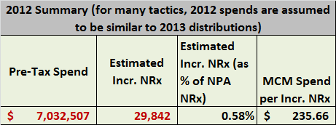
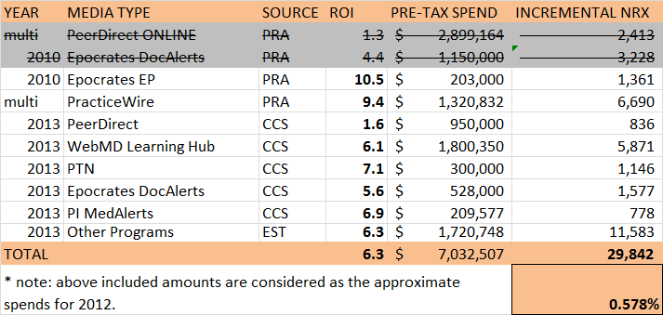
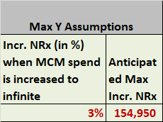

MCM Programs
Tactic ROIs are collected from various sources and summarized to get total MCM Spend and its impact. Summarized impact and a possible maximum of 3% impact in NRx from this promotion type are used to compute response curves.
A maximum of 3% impact in NRx is assumed to be attainable through this promotion type (i.e., when spends are drastically increased)
Source Descriptors:
PRA – Measurement done by Promotional Response Analysis team
CCS – Channel Choice Simulator (proforma ROI)
EST – Estimated to be same as mean of all impacts (TOTAL row)

Slide 2
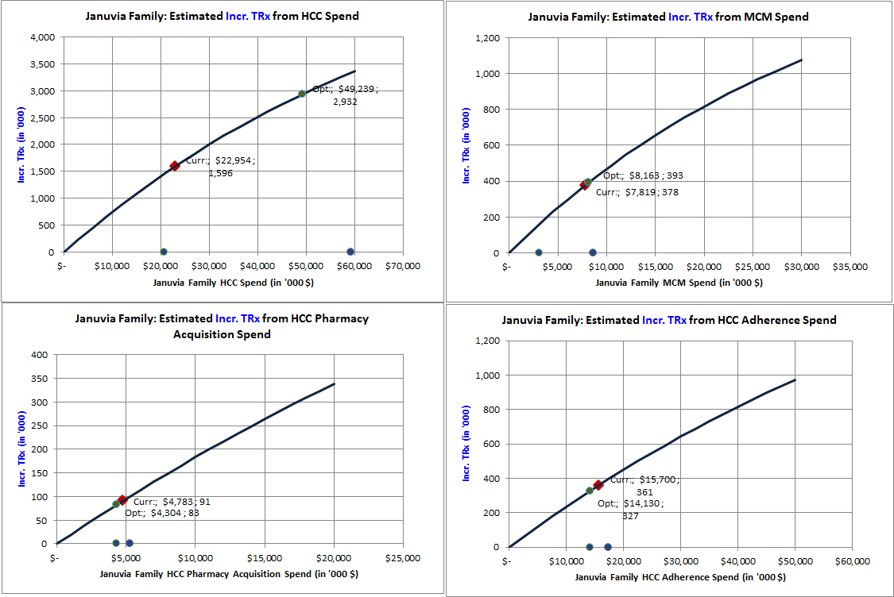
Assumed Response Curves using Aggregated Historic ROI’s: HCC, MCM, Acquisition and Adherence
Curves are calibrated using historic tactic ROIs and assumptions on maximum impact when spend increases infinitely.
Current: 2.6% of NRx
Assumed Max: 10% of NRx
Current: 0.6% of NRx
Assumed Max: 3% of NRx
Current: 0.2% of NRx
Assumed Max: 2% of NRx
Current: 2.5% of TRx
Assumed Max: 10% of TRx
Incremental TRxs are realized in 3 years. The spends are in pre-tax scale

